Slide 1
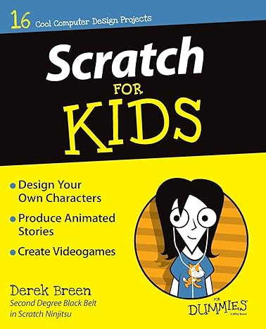
Scratch for Kids
Subtitle

