Slide 1
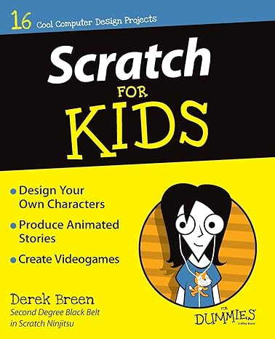


Scratch for Kids
15 Interactive Projects
Author: Derek Breen

Slide 2
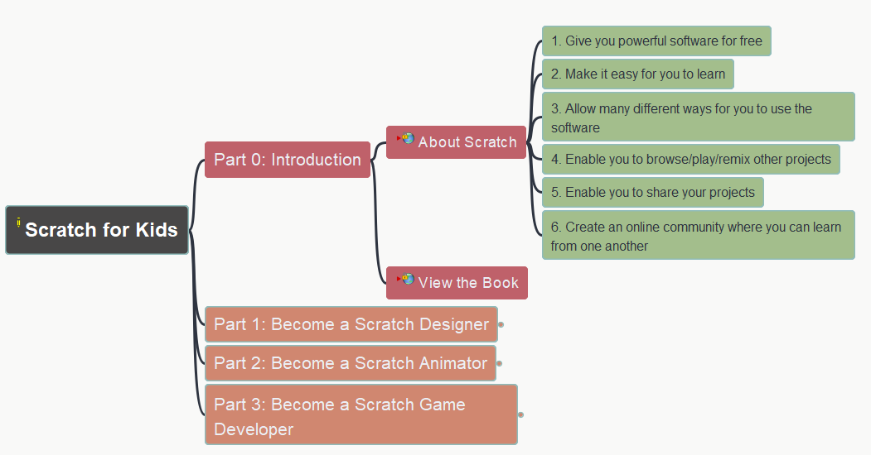
Scratch for Kids
000
Opening and Introduction

Slide 3
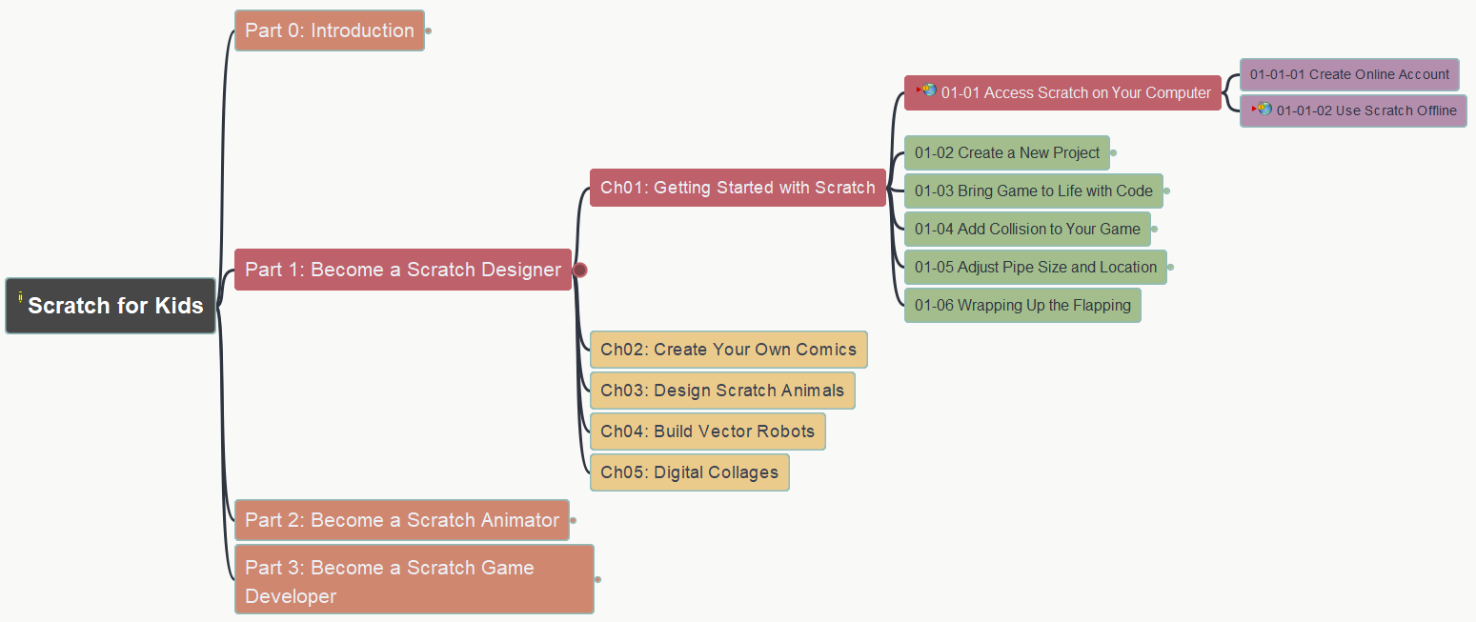
Scratch for Kids – Part 1
001
Become a Scratch Designer
Chapter 1: Getting Started with Scratch
(1) Access Scratch on Your Computer

Slide 4
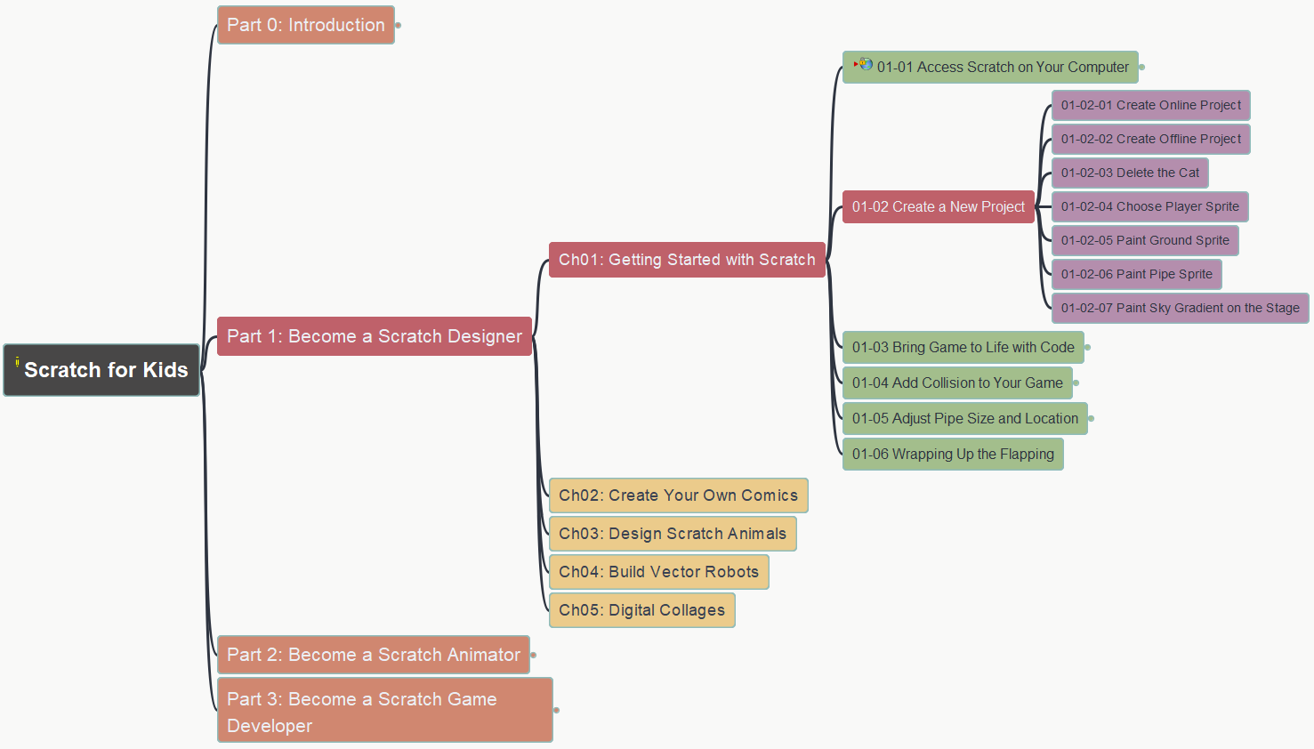
Scratch for Kids – Part 1
002
Become a Scratch Designer
Chapter 1: Getting Started with Scratch
(2) Create a New Project

