Slide 1

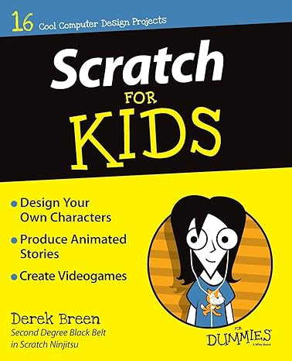

Slide 2

Scratch for Kids
15 Interactive Projects
Author: Derek Breen

Slide 3
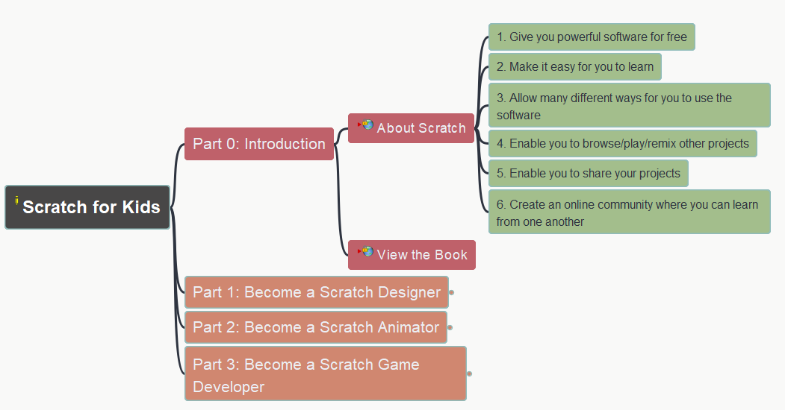
Scratch for Kids
000
Opening and Introduction
https://github.com/yasenstar/learn_scratch

Slide 4
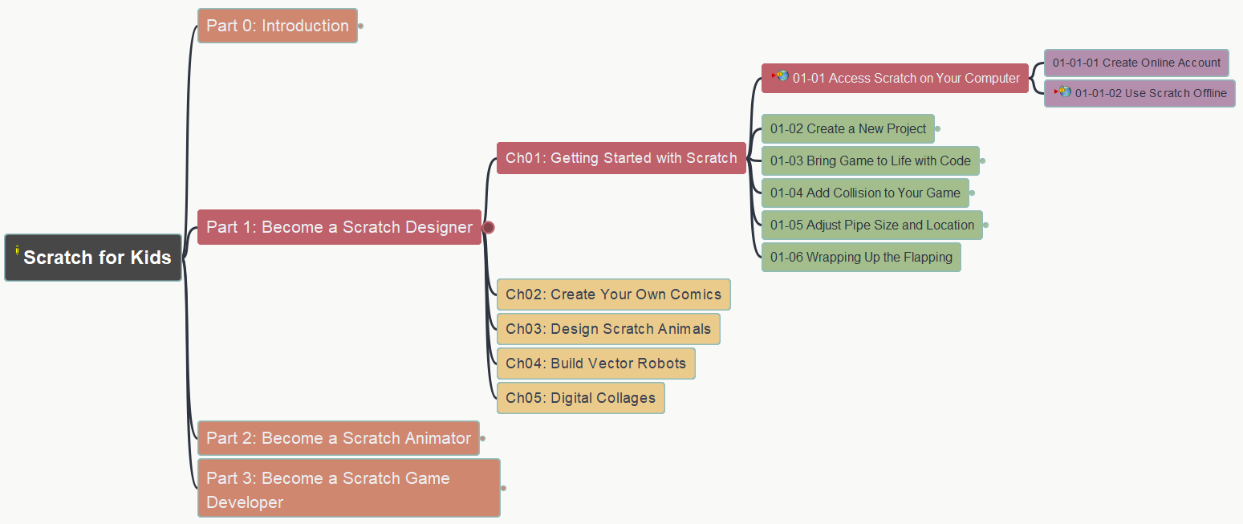
Scratch for Kids – Part 1
001
Become a Scratch Designer
Chapter 1: Getting Started with Scratch
(1) Access Scratch on Your Computer
https://github.com/yasenstar/learn_scratch

Slide 5

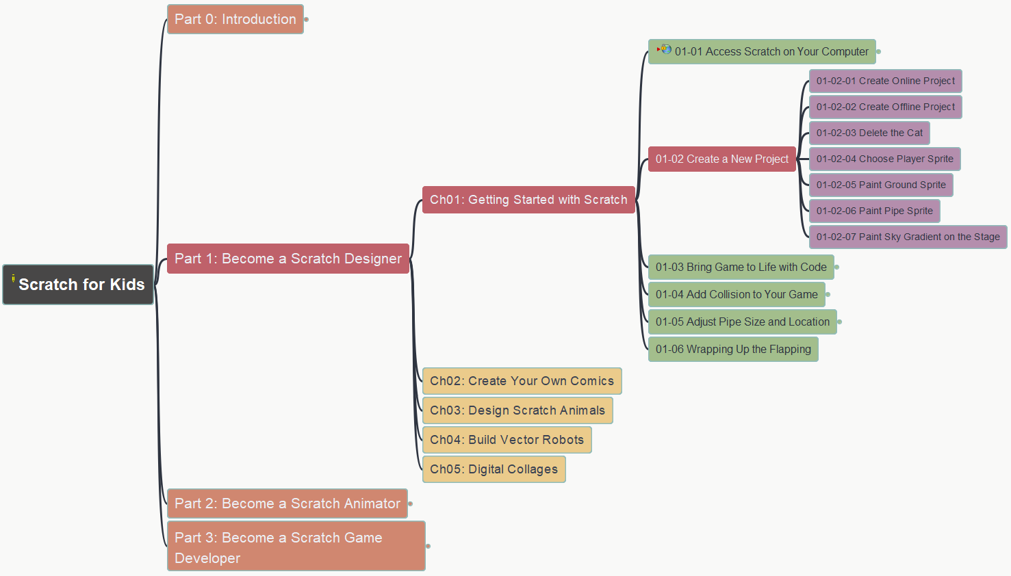
Scratch for Kids – Part 1
002
Become a Scratch Designer
Chapter 1: Getting Started with Scratch
(2) Create a New Project – Flapping Bat
https://github.com/yasenstar/learn_scratch

Slide 6
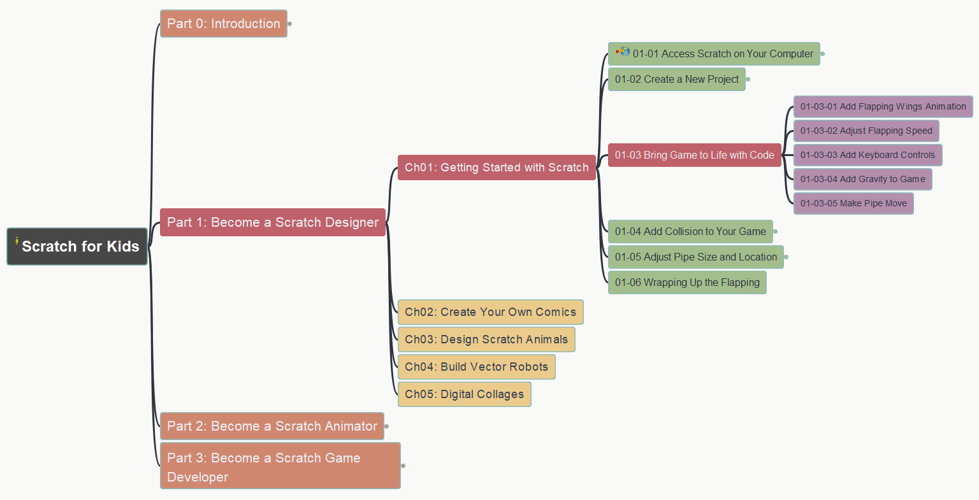
Scratch for Kids – Part 1
003
Become a Scratch Designer
Chapter 1: Getting Started with Scratch
(3) Bring Game to Life with Code
https://github.com/yasenstar/learn_scratch

Slide 7
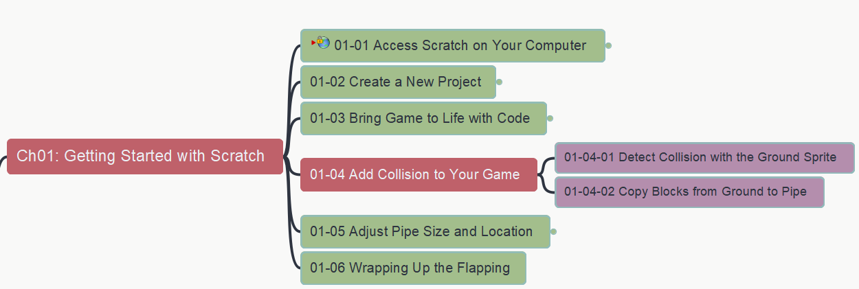
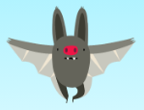
Scratch for Kids – Part 1
004
Become a Scratch Designer
Chapter 1: Getting Started with Scratch
(4) Add Collision to Your Game
https://github.com/yasenstar/learn_scratch

Slide 8
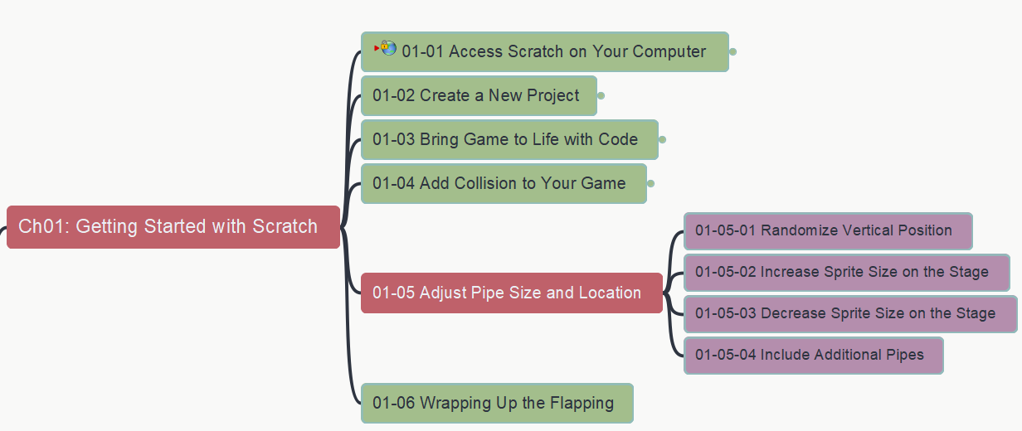
Scratch for Kids – Part 1
005
Become a Scratch Designer
Chapter 1: Getting Started with Scratch
(5) Adjust Pipe Size and Location
https://github.com/yasenstar/learn_scratch

Slide 9
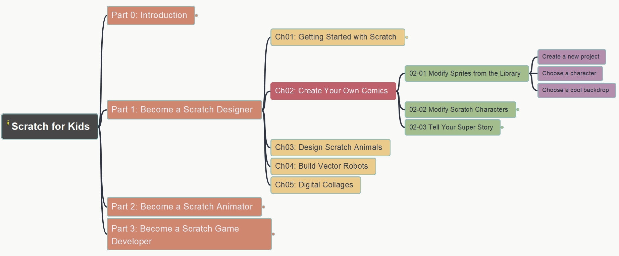
Scratch for Kids
006
Part 1: Become a Scratch Designer
Chapter 2: Create Your Own Comics
(1) Modify Sprites from the Library
https://github.com/yasenstar/learn_scratch

Slide 10
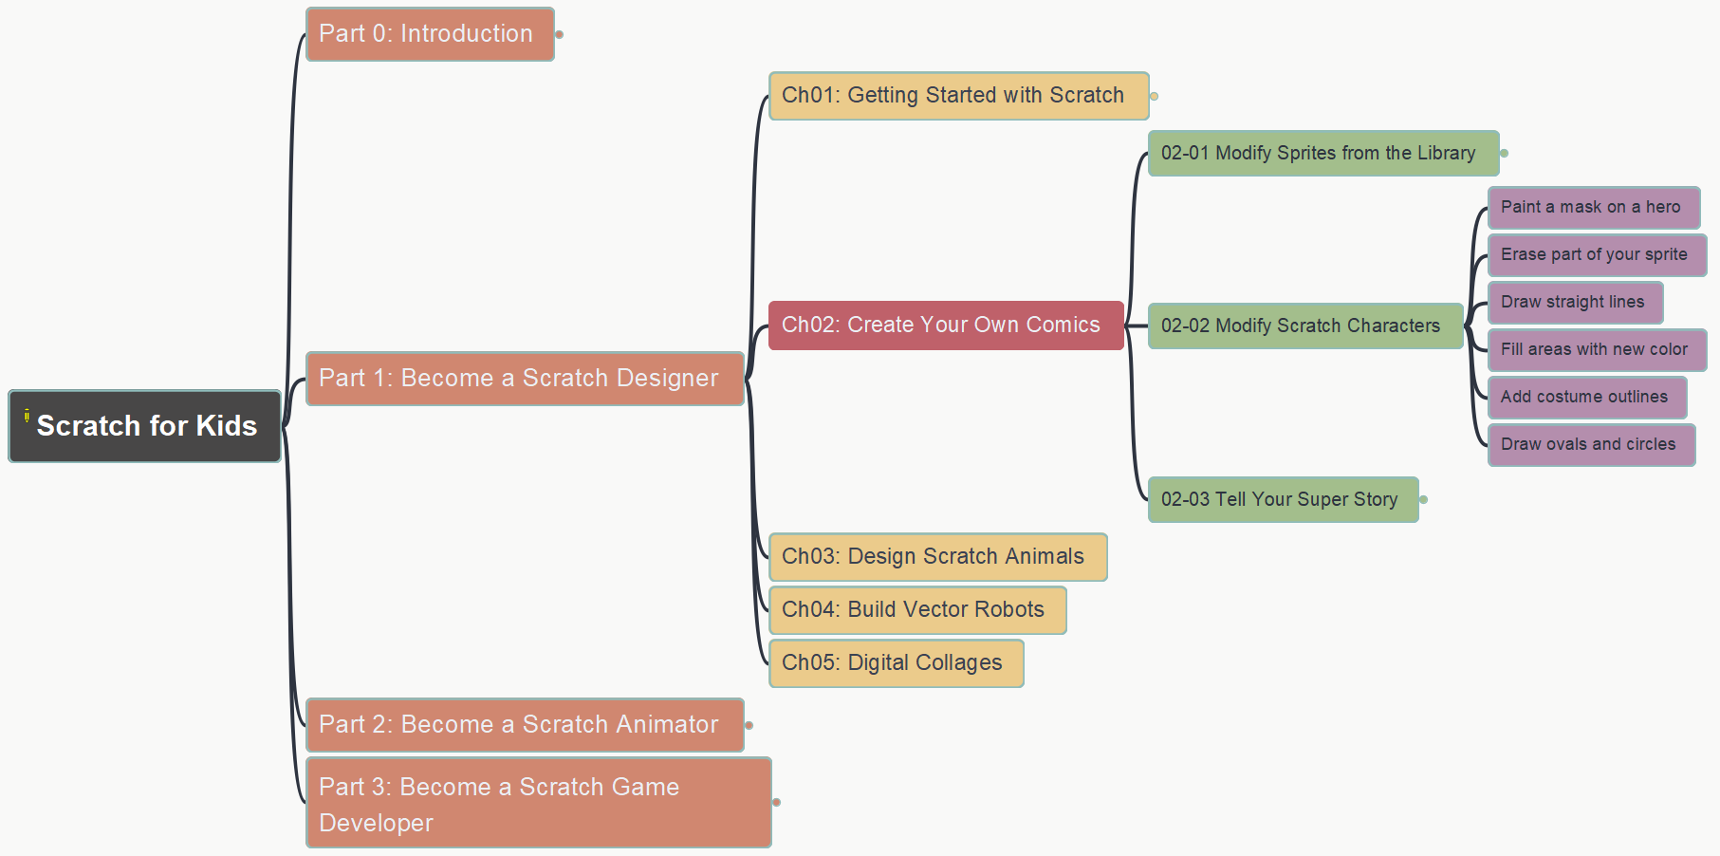
Scratch for Kids
007
Part 1: Become a Scratch Designer
Chapter 2: Create Your Own Comics
(2) Modify Scratch Characters
https://github.com/yasenstar/learn_scratch

Slide 11
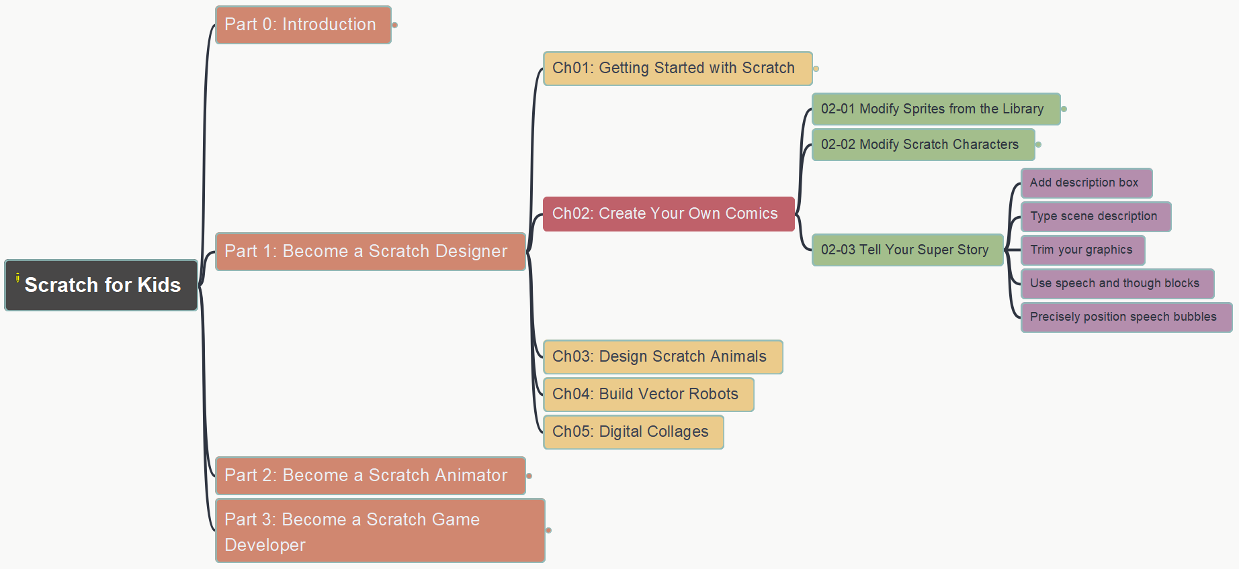
Scratch for Kids
008
Part 1: Become a Scratch Designer
Chapter 2: Create Your Own Comics
(3) Tell Your Super Story
https://github.com/yasenstar/learn_scratch

Slide 12
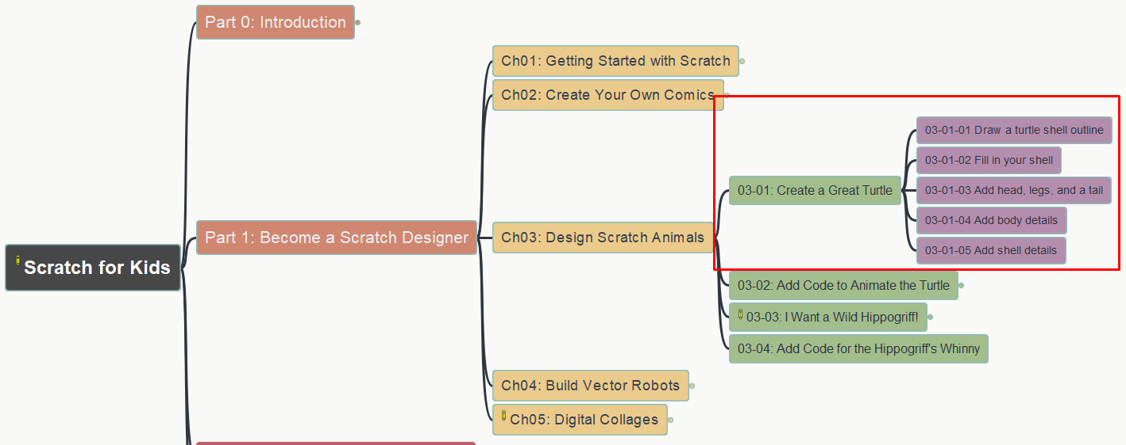
Scratch for Kids
009
Part 1: Become a Scratch Designer
Chapter 3: Design Scratch Animals
(1) Create a Great Turtle
https://github.com/yasenstar/learn_scratch

Slide 13
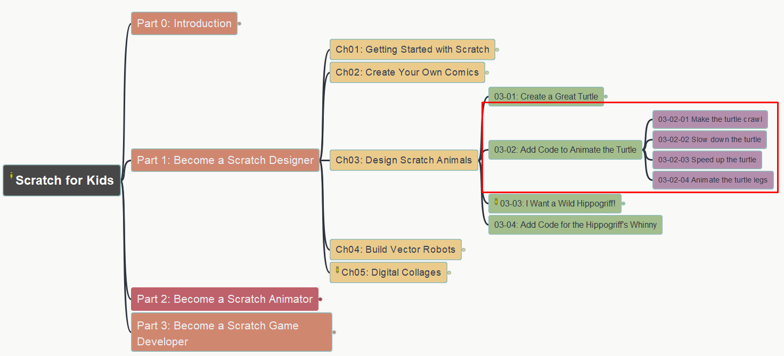
Scratch for Kids
010
Part 1: Become a Scratch Designer
Chapter 3: Design Scratch Animals
(2) Add Code to Animate the Turtle
https://github.com/yasenstar/learn_scratch

Slide 14
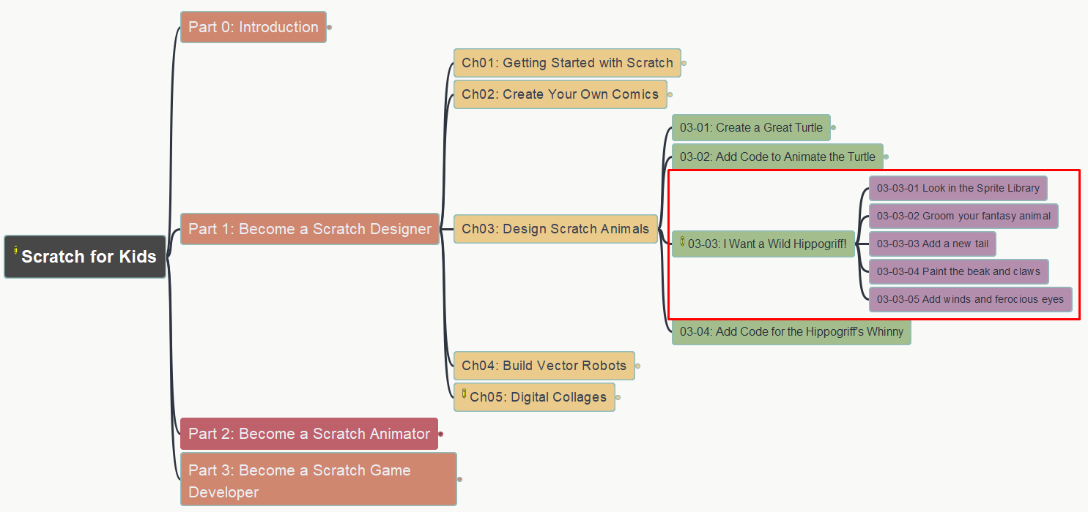
Scratch for Kids
011
Part 1: Become a Scratch Designer
Chapter 3: Design Scratch Animals
(3) I Want a Wild Hippogriff!
https://github.com/yasenstar/learn_scratch

Slide 15
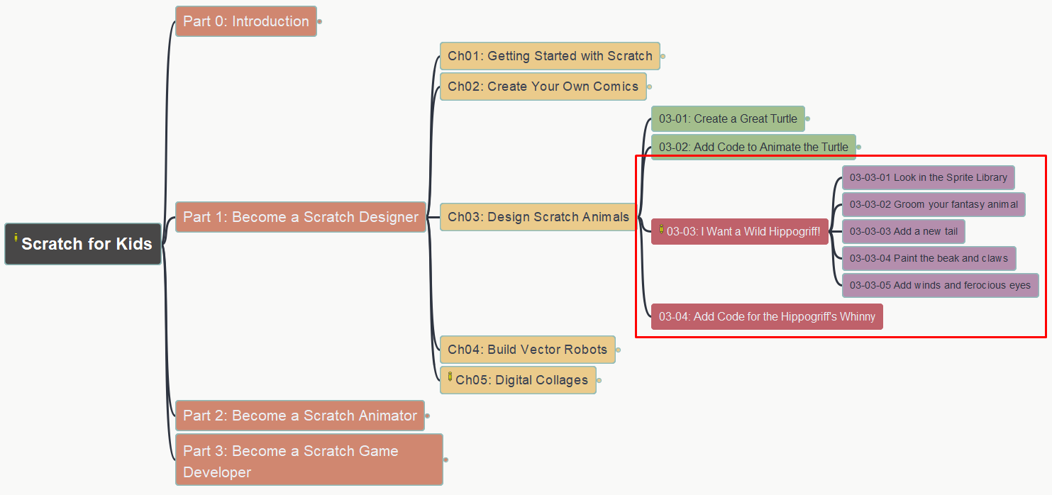
Scratch for Kids
012
Part 1: Become a Scratch Designer
Chapter 3: Design Scratch Animals
(4) Adding Code for the Hippogriff’s Whinny
https://github.com/yasenstar/learn_scratch

Slide 16
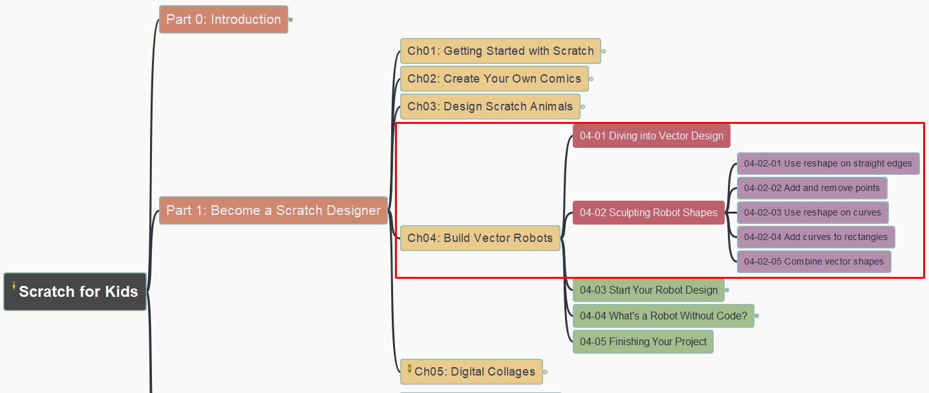
Scratch for Kids
013
Part 1: Become a Scratch Designer
Chapter 4: Build Vector Robots
Diving into Vector Design
Sculpting Robot Shapes
https://github.com/yasenstar/learn_scratch

Slide 17
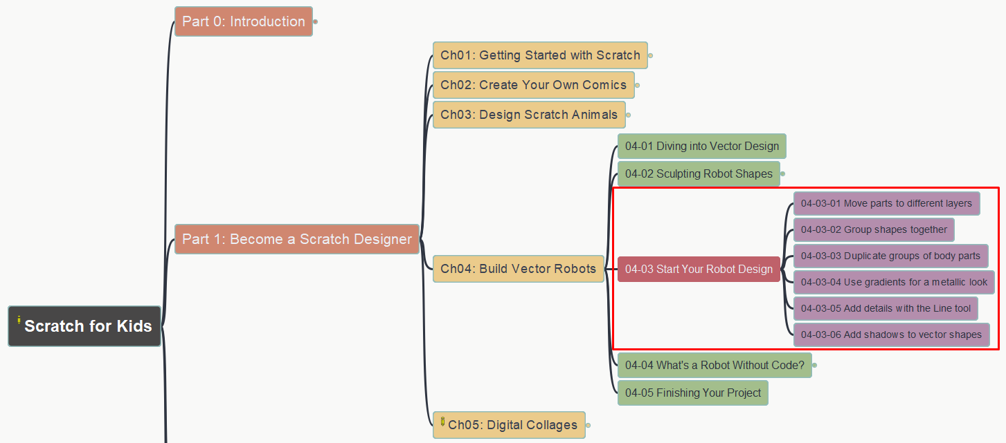
Scratch for Kids
014
Part 1: Become a Scratch Designer
Chapter 4: Build Vector Robots
(3) Start Your Robot Design
https://github.com/yasenstar/learn_scratch

Slide 18
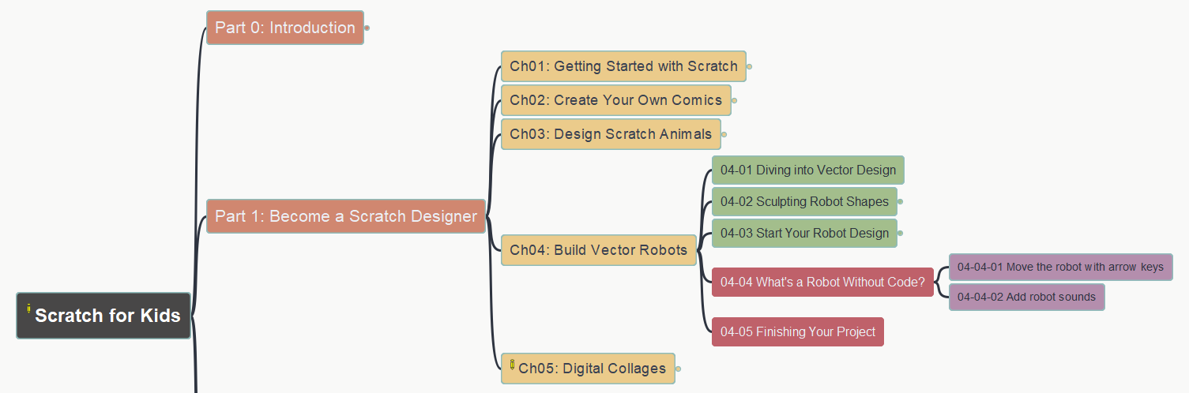
Scratch for Kids
015
Part 1: Become a Scratch Designer
Chapter 4: Build Vector Robots
(4) Adding Code to Robot
https://github.com/yasenstar/learn_scratch

