Slide 1
RDF 1.2 Primer
(W3C Group Draft Note)

Slide 2

Contents
Introduction
Why Use RDF?
RDF Data Model
RDF Vocabularies
Writing RDF Graphs
Semantics of RDF Graphs
RDF Data
This primer is designed to provide the reader with the basic knowledge required to effectively use RDF.
It introduces the basic concepts of RDF and shows concrete examples of the use of RDF
RDF 1.2 Document Suite:
A document describing the basic concepts underlying RDF, as well as abstract syntax ("RDF Concepts and Abstract Syntax") [RDF12-CONCEPTS]
A document describing the formal model-theoretic semantics of RDF ("RDF Semantics") [RDF12-SEMANTICS]
Specifications of serialization formats for RDF:
Turtle [RDF12-TURTLE] and TriG [RDF12-TRIG]
JSON-LD [JSON-LD11] (JSON based)
RDFa [RDFA-PRIMER] (for HTML embedding)
N-Triples [RDF12-N-TRIPLES] and N-Quads [RDF12-N-QUADS] (line-based exchange formats)
RDF/XML [RDF12-XML] (the original 2004 syntax, updated for RDF 1.2)
A document describing RDF Schema [RDF12-SCHEMA], which provides a data-modeling vocabulary for RDF data.

Slide 3
RDF-star Working Group - Publications
Name | File |  | Name | File
SPARQL 1.2 Query Language | https://www.w3.org/TR/sparql12-query/ |  | RDF 1.2 TriG | https://www.w3.org/TR/rdf12-trig/
RDF 1.2 Semantics | https://www.w3.org/TR/rdf12-semantics/ |  | SPARQL 1.2 Entailment Regimes | https://www.w3.org/TR/sparql12-entailment/
RDF 1.2 Concepts and Abstract Syntax | https://www.w3.org/TR/rdf12-concepts/ |  | SPARQL 1.2 Federated Quary | https://www.w3.org/TR/sparql12-federated-query/
RDF 1.2 XML Syntax | https://www.w3.org/TR/rdf12-xml/ |  | SPARQL 1.2 Graph Store Protocol | https://www.w3.org/TR/sparql12-graph-store-protocol/
RDF 1.2 Schema | https://www.w3.org/TR/rdf12-schema/ |  | SPARQL 1.2 Protocol | https://www.w3.org/TR/sparql12-protocol/
RDF 1.2 N-Quads | https://www.w3.org/TR/rdf12-n-quads/ |  | SPARQL 1.2 Query Results CSV and TSV Formats | https://www.w3.org/TR/sparql12-results-csv-tsv/
RDF 1.2 Turtle | https://www.w3.org/TR/rdf12-turtle/ |  | SPARQL 1.2 Query Results JSON Format | https://www.w3.org/TR/sparql12-results-json/
SPARQL 1.2 Update | https://www.w3.org/TR/sparql12-update/ |  | SPARQL 1.2 Service Description | https://www.w3.org/TR/sparql12-service-description/
SPARQL 1.2 Query Results XML Format | https://www.w3.org/TR/sparql12-results-xml/ |  | RDF 1.2 Primer (this one) | https://www.w3.org/TR/rdf12-primer/
RDF 1.2 N-Triples | https://www.w3.org/TR/rdf12-n-triples/

Slide 4
Introduction of RDF
The Resource Description Framework (RDF) is a framework for expressing information about resources.
Resources can be anything, including documents, people, physical objects, and abstract concepts.
RDF is intended for situations in which information on the web needs to be processed by applications, rather than being only displayed to people.
In particular, RDF can be used to publish and interlink data on the web. A person or an automated process can then follow such links and aggregate data about these various things. Such use of RDF are often qualified as Linked Data
Any IRI or literal denotes something in the world (the “universe of discourse”), these things are called resources.
https://w3c.github.io/rdf-primer/spec/#bib-linked-data

Slide 5
Why Use RDF?
Adding machine-readable information to Web pages using, e.g., the popular schema.org vocabulary, enabling them to be displayed in an enhanced format on search engines or to be processed automatically by third-party applications
Enriching a dataset by linking it to third-party datasets. E.g., a dataset about paintings could be enriched by linking them to the corresponding artists in Wikidata, therefore giving access to a wide range of information about them and related resources.
Interlinking API feeds, making sure that clients can easily discover how to access more information.
Using the datasets currently published as Linked Data, e.g., building aggregations of data around specific topics.
Building distributed social networks by interlinking RDF descriptions of people across multiple Web sites
Providing a standards-compliant way for exchanging data between databases.
Interlinking various datasets within an organization, enabling cross-dataset queries to be performed using SPARQL.
https://schema.org/
https://www.wikidata.org/
https://w3c.github.io/rdf-primer/spec/#bib-linked-data
https://w3c.github.io/rdf-primer/spec/#bib-sparql12-concepts

Slide 6
RDF Data Model
RDF Data Model
Triples
IRIs
Literals
Blank Nodes
Triple Terms
Multiple Graphs

Slide 7
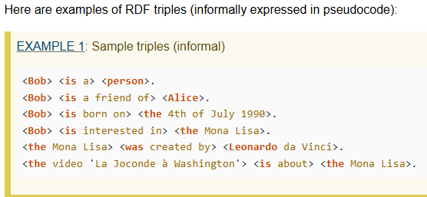
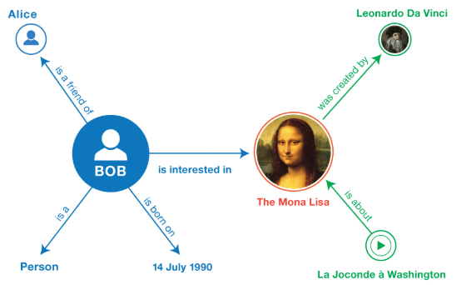
RDF Data Model - Triples
RDF allows us to make statements about resources, in following structure: <subject> <predicate> <object>
An RDF statement represses a relationship between two resources.
The subject and the object represent the two resources being related; the predicate represents the nature of their relationship.
The relationship is phrased in a directional way (from subject to object) and is called in RDF a property.
Because RDF statements consist of three elements they are called triples.
The same resource is often referenced in multiple triples.
The ability to have the same resource be in the subject position of one triple and the object position of another makes it possible to find connections between triples.
A set of triples is called a graph. Graphs consist of nodes and arcs.
SPARQL can be used to query data from a graph.
Four kinds of RDF term that occur in triples: IRIs, literals, blank nodes, and triple terms.

Slide 8
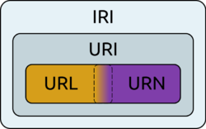
RDF Data Model – RDF Term - IRIs
https://w3c.github.io/rdf-primer/spec/#bib-rfc3987
IRI – Internationalized Resource Identifier (RFC 3987)
An IRI identifies a resource.
The URLs (Uniform Resource Locator) that provide use as Web addresses are one form of IRI.
Other forms of IRI provide an identifier for a resource without implying its location or how to access it.
The notion of IRI is a generalization of URI (Uniform Resource Identifier), allowing non-ASCII characters to be used in the IRI character string.
IRI can appear in all three positions of a triple.
IRIs are global identifiers, so other people can re-use the IRI to identify the same thing.
RDF is agnostic about what the IRI represents. However, IRIs may be given meaning by particular vocabularies or conventions.

Slide 9
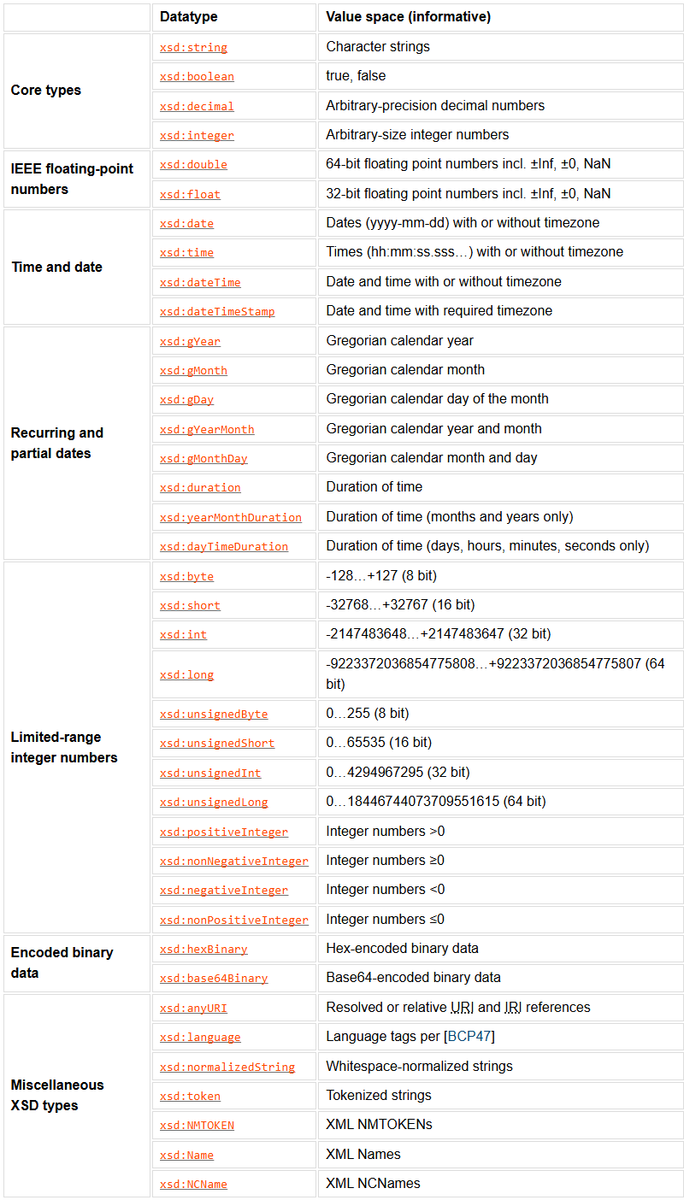
RDF Data Model – RDF Term - Literals
Literals are basic values that are not IRIs.
Literals are associated with a datatype enabling such values to be parsed and interpreted correctly.
String literals can optionally be associated with a language tag
Literals may only appear in the object position of a triple.
The RDF Concepts document provides a (non-exhaustive) list of datatypes defined by XML Schema
https://www.w3.org/TR/rdf12-concepts/#section-Datatypes

Slide 10
RDF Data Model – RDF Term – Blank Nodes
IRIs and literals together provide the basic material for writing down RDF statements.
In addition, it is sometimes handy to be able to talk about resources without bothering to use a global identifier.
https://www.w3.org/TR/rdf12-concepts/#section-Datatypes

