Slide 1

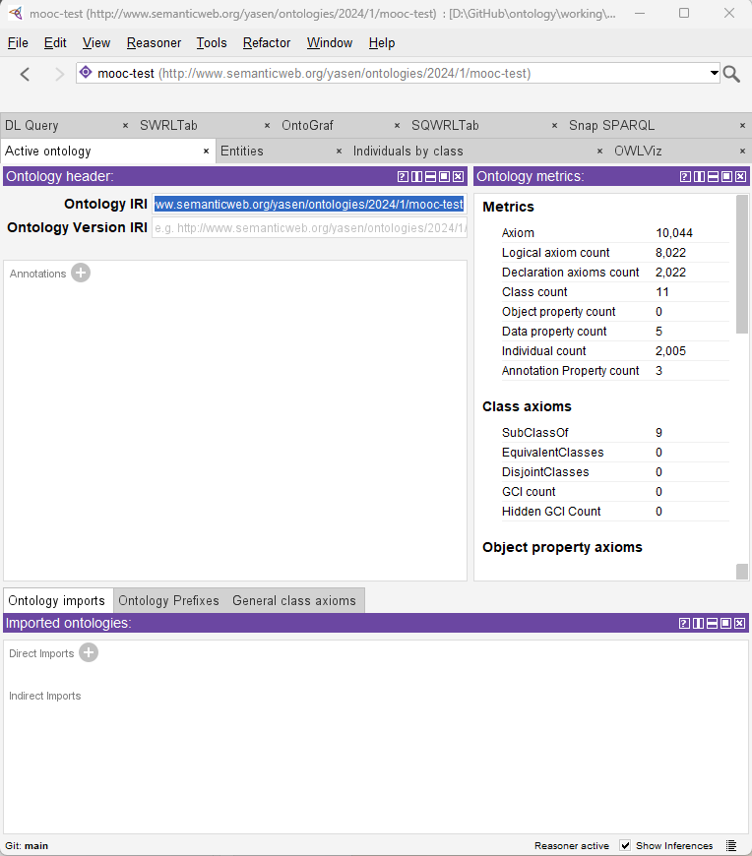
Using Protégé – the ontology editor
001 – Opening and Introduction
Xiaoqi Zhao
https://github.com/yasenstar/ontology/tree/main/use_protege

Slide 2
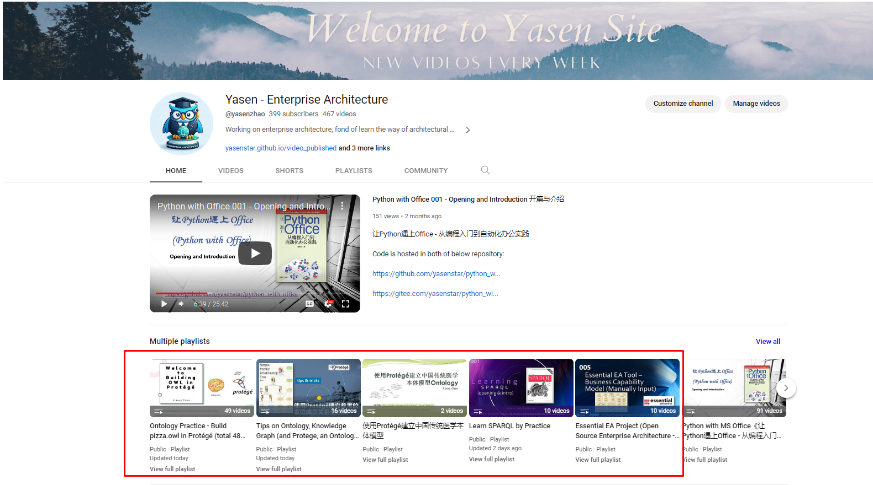
Ontology Related Videos in my Channel
https://www.youtube.com/channel/UCTshmTJGpJunOz23vCEhzWg

Slide 3
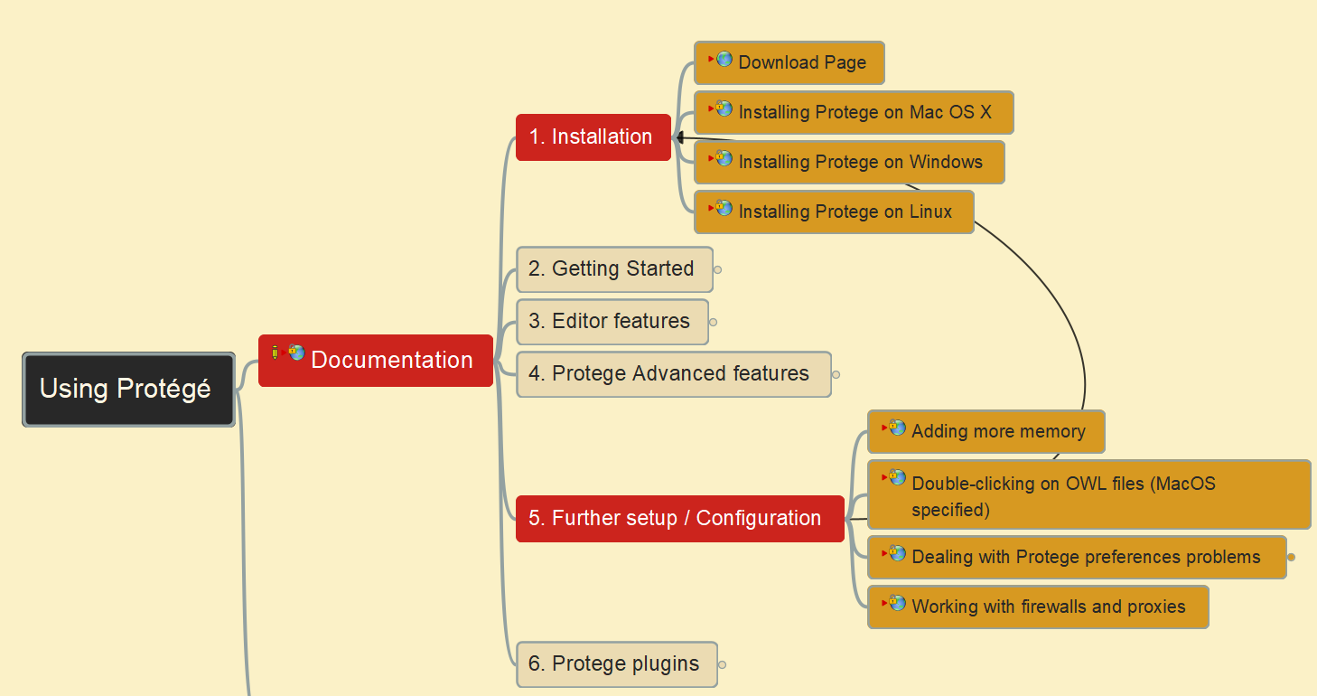
Using Protégé – the ontology editor
002 – Protégé Download, Installation and Configuration
Xiaoqi Zhao
https://github.com/yasenstar/ontology/tree/main/use_protege

Slide 4
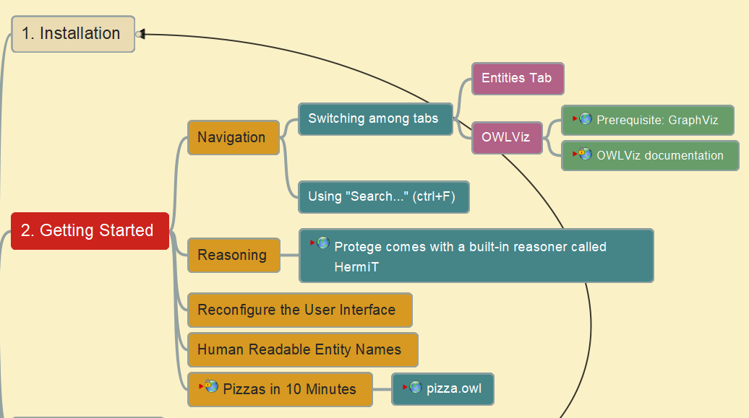
Using Protégé – the ontology editor
003 – Protégé – Getting Started with pizza.owl
Xiaoqi Zhao
https://github.com/yasenstar/ontology/tree/main/use_protege

Slide 5
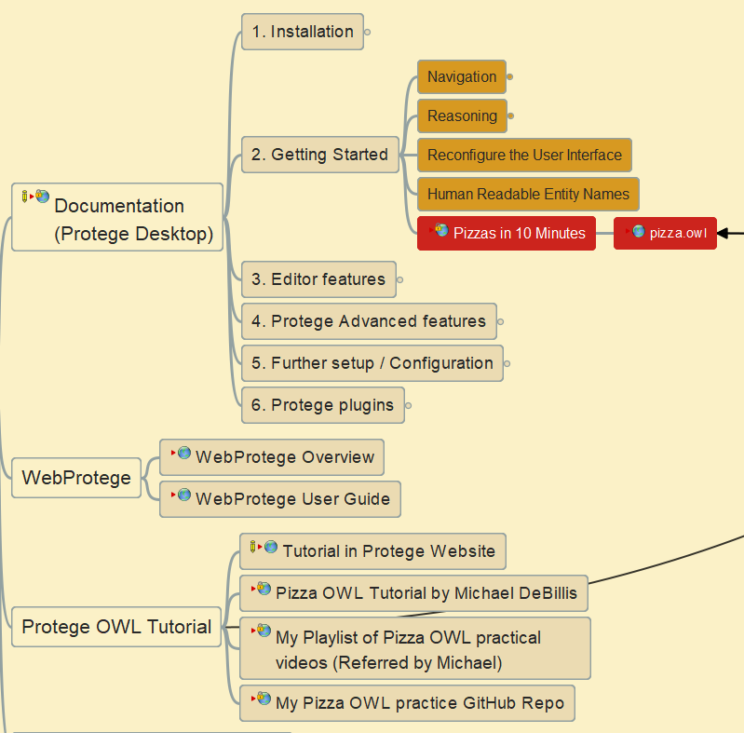
Using Protégé – the ontology editor
004 – Building pizza ontology in 10 minutes
Xiaoqi Zhao
https://github.com/yasenstar/ontology/tree/main/use_protege

Slide 6
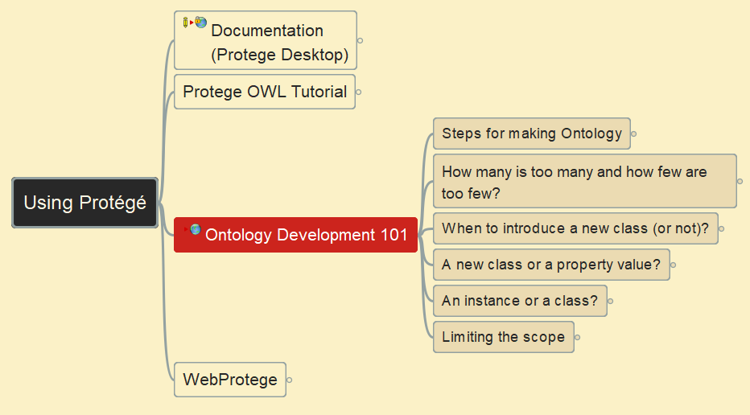
Using Protégé – the ontology editor
005 – Ontology Development 101 – Steps for Making Ontology
Xiaoqi Zhao
https://github.com/yasenstar/ontology/tree/main/use_protege

Slide 7
Using Protégé – the ontology editor
006 – Ontology Development 101 – Key Questions
Xiaoqi Zhao
https://github.com/yasenstar/ontology/tree/main/use_protege

