Slide 1

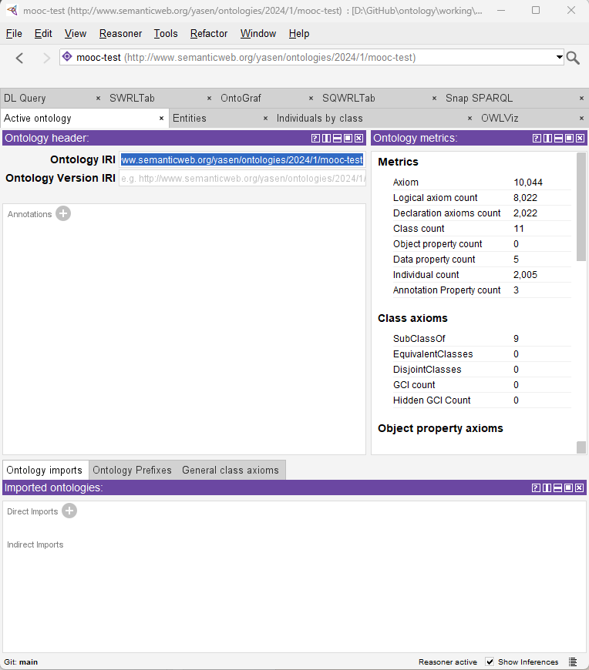
Using Protégé – the ontology editor
001 – Opening and Introduction
Xiaoqi Zhao
https://github.com/yasenstar/ontology/tree/main/use_protege

Slide 2
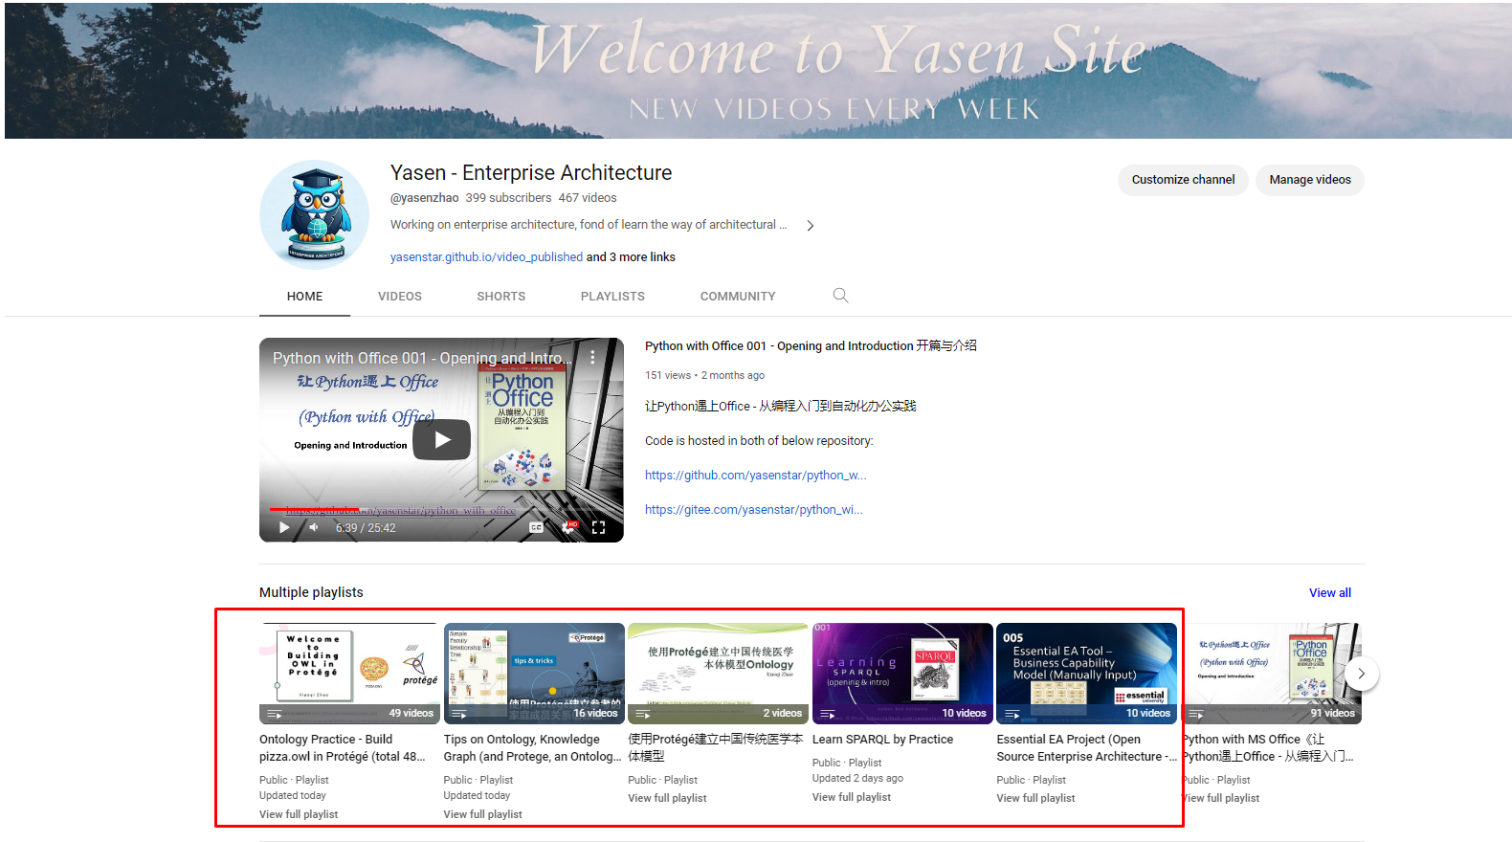
Ontology Related Videos in my Channel
https://www.youtube.com/channel/UCTshmTJGpJunOz23vCEhzWg

Slide 3
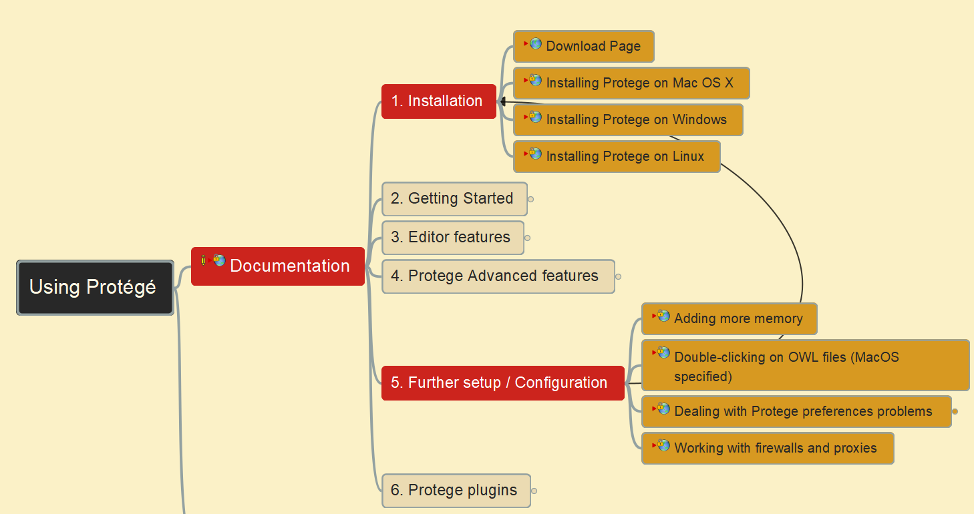
Using Protégé – the ontology editor
002 – Protégé Download, Installation and Configuration
Xiaoqi Zhao
https://github.com/yasenstar/ontology/tree/main/use_protege

Slide 4
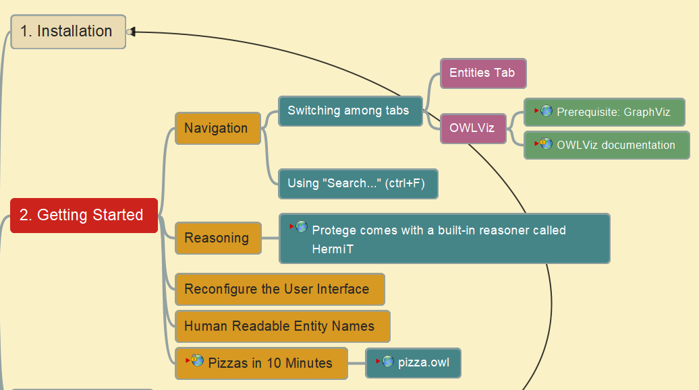
Using Protégé – the ontology editor
003 – Protégé – Getting Started with pizza.owl
Xiaoqi Zhao
https://github.com/yasenstar/ontology/tree/main/use_protege

Slide 5
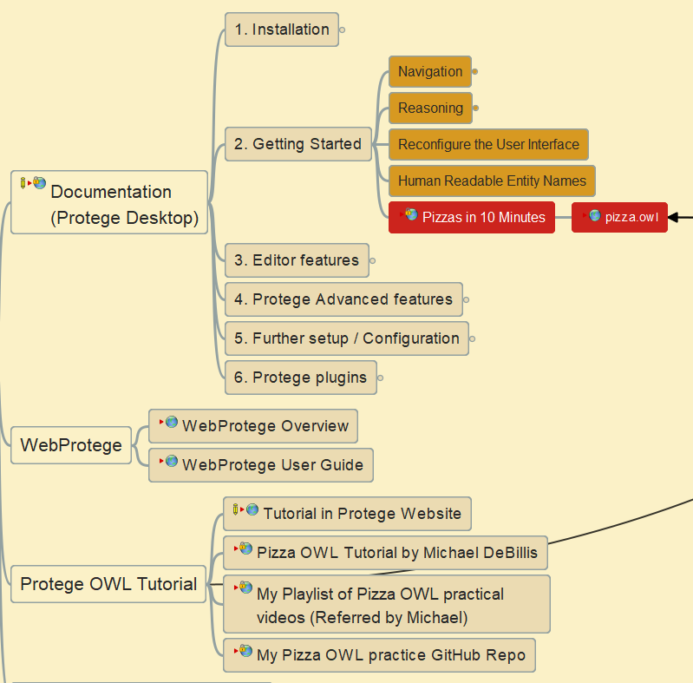
Using Protégé – the ontology editor
004 – Building pizza ontology in 10 minutes
Xiaoqi Zhao
https://github.com/yasenstar/ontology/tree/main/use_protege

Slide 6
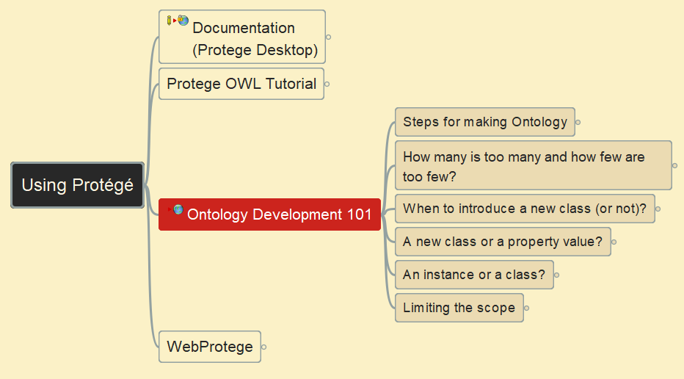
Using Protégé – the ontology editor
005 – Ontology Development 101 – Steps for Making Ontology
Xiaoqi Zhao
https://github.com/yasenstar/ontology/tree/main/use_protege

Slide 7
Using Protégé – the ontology editor
006 – Ontology Development 101 – Key Questions
Xiaoqi Zhao
https://github.com/yasenstar/ontology/tree/main/use_protege

Slide 8
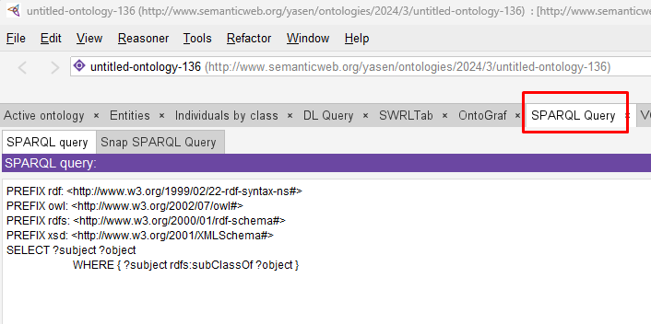

Using Protégé – the ontology editor
007 – How to get Inferred Result from SPARQL
Xiaoqi Zhao
https://github.com/yasenstar/ontology/tree/main/use_protege

Slide 9
Contents
Problem
When you have classes / axioms in Ontology (edited in Protégé) which are inferred base on the Reasoner (e.g. Pellet), those contents are not shown in the SPARQL query result
Reason
The inferred contents are not actually in your knowledge base
How to make them visible in the SPARQL query?
3 button steps in SWRLTab

Slide 10
