Slide 1

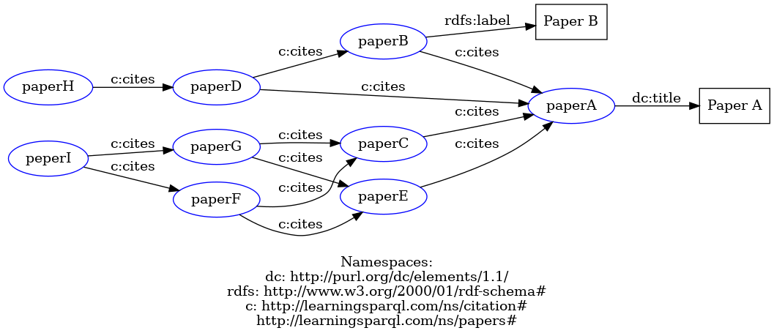

Use “RDF Grapher” to Visualize Your Ontology
Date: 2024/09/29

Slide 2
Contents
Introduction on RDF Grapher
Parameters in the Service: rdf, from, to
Demo in https://www.ldf.fi/service/rdf-grapher web page directly
Demo in Postman
Choose GET or POST?

Slide 3


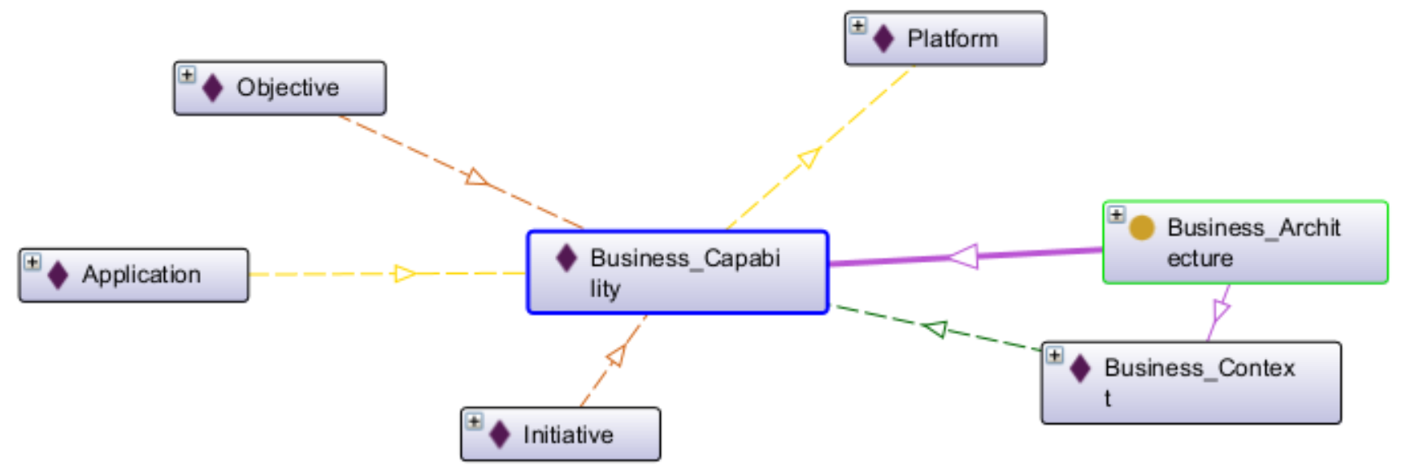
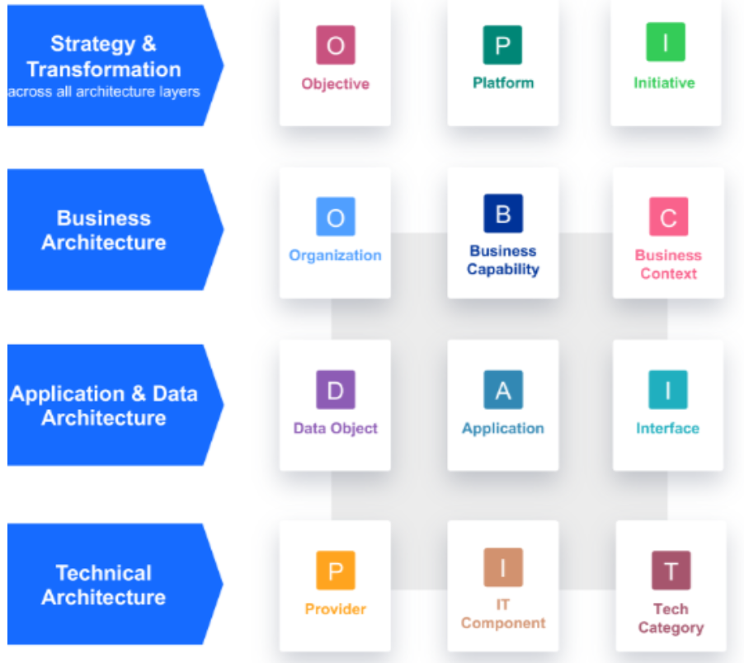

Ontology View of LeanIX Meta-Model V4

Slide 4

Overcoming nervousness
Confidence-building strategies

Slide 5
Engaging the audience
Make eye contact with your audience to create a sense of intimacy and involvement
Weave relatable stories into your presentation using narratives that make your message memorable and impactful
Encourage questions and provide thoughtful responses to enhance audience participation
Use live polls or surveys to gather audience opinions, promoting engagement and making sure the audience feel involved

Slide 6

Selecting visual aids
Enhancing your presentation

Slide 7
Effective delivery techniques
This is a powerful tool in public speaking. It involves varying pitch, tone, and volume to convey emotion, emphasize points, and maintain interest.
Pitch variation
Tone inflection
Volume control
Effective body language enhances your message, making it more impactful and memorable.
Meaningful eye contact
Purposeful gestures
Maintain good posture
Control your expressions

Slide 8
Navigating Q&A sessions
Know your material in advance
Anticipate common questions
Rehearse your responses
Maintaining composure during the Q&A session is essential for projecting confidence and authority. Consider the following tips for staying composed:
Stay calm
Actively listen
Pause and reflect
Maintain eye contact

Slide 9

Speaking impact
Your ability to communicate effectively will leave a lasting impact on your audience
Effectively communicating involves not only delivering a message but also resonating with the experiences, values, and emotions of those listening

Slide 10
Dynamic delivery
Learn to infuse energy into your delivery to leave a lasting impression
One of the goals of effective communication is to motivate your audience
Metric | Measurement | Target | Actual
Audience attendance | # of attendees | 150 | 120
Engagement duration | Minutes | 60 | 75
Q&A interaction | # of questions | 10 | 15
Positive feedback | Percentage (%) | 90 | 95
Rate of information retention | Percentage (%) | 80 | 85

Slide 11
Final tips & takeaways
Consistent rehearsal
Strengthen your familiarity
Refine delivery style
Pacing, tone, and emphasis
Timing and transitions
Aim for seamless, professional delivery
Practice audience
Enlist colleagues to listen & provide feedback
Seek feedback
Reflect on performance
Explore new techniques
Set personal goals
Iterate and adapt

Slide 12
Speaking engagement metrics
Impact factor | Measurement | Target | Achieved
Audience interaction | Percentage (%) | 85 | 88
Knowledge retention | Percentage (%) | 75 | 80
Post-presentation surveys | Average rating | 4.2 | 4.5
Referral rate | Percentage (%) | 10 | 12
Collaboration opportunities | # of opportunities | 8 | 10

Slide 13

Thank you
Brita Tamm
502-555-0152
brita@firstupconsultants.com
www.firstupconsultants.com

