Slide 1


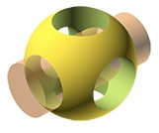
OpenSCAD
GitHub Repository: https://github.com/yasenstar/openscad
OpenSCAD Website: https://openscad.org/
Video List in YouTube: https://www.youtube.com/playlist?list=PL6DEHvciXKeUwcYw7k4wKWhW1cbE_omAg
Learn and Practice on 3d Modeling

Slide 2
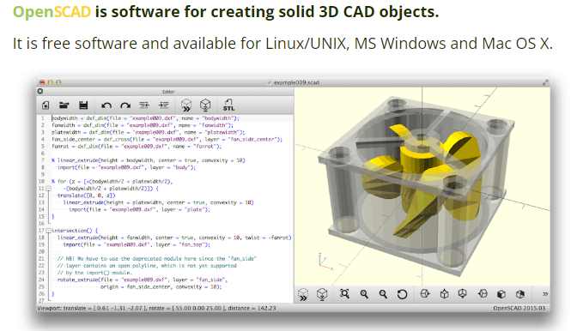
OpenSCAD Modeling Practice
Installation and Configure the Tool

Slide 3
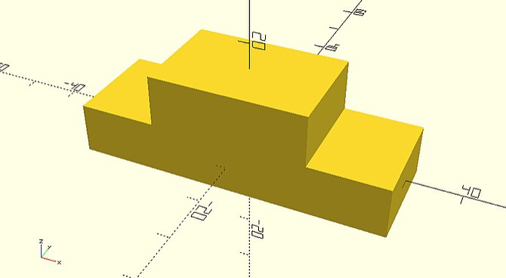
OpenSCAD Modeling Practice
OpenSCAD Tutorial/Chapter 1 (part 1)

Slide 4
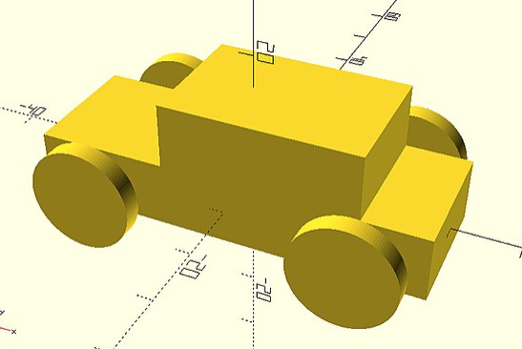
OpenSCAD Modeling Practice
OpenSCAD Tutorial/Chapter 1 (part 2)

Slide 5
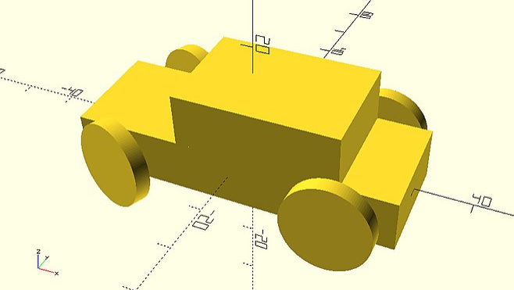
OpenSCAD Modeling Practice
OpenSCAD Tutorial/Chapter 2 (part 1 – Scaling Parts)

Slide 6
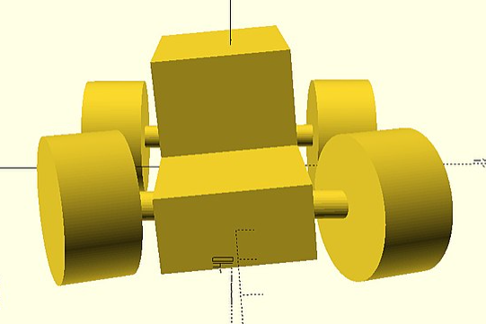
OpenSCAD Modeling Practice
OpenSCAD Tutorial/Chapter 2 (part 2 – Parameterizing)

Slide 7
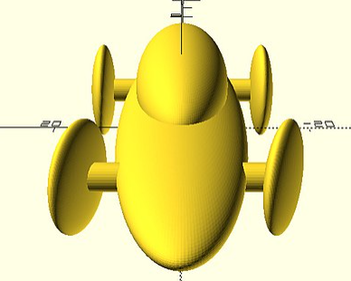
OpenSCAD Modeling Practice
OpenSCAD Tutorial/Chapter 3 (part 1 – Sphere & Resizing)

Slide 8
OpenSCAD Modeling Practice
OpenSCAD Tutorial/Chapter 3 (part 2 – Combining Objects)
Union
Difference
Intersection

Slide 9
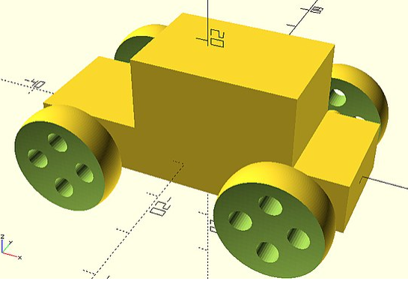
OpenSCAD Modeling Practice
OpenSCAD Tutorial/Chapter 3 (part 3 – Update Car Model)

Slide 10
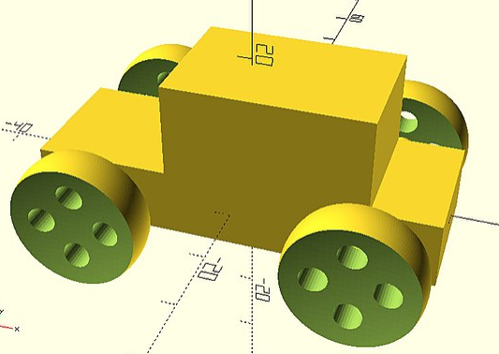
OpenSCAD Modeling Practice
OpenSCAD Tutorial/Chapter 4 (part 1 – Defining Modules)
Module_Name(parameter=defaultvalue,…) {block}

Slide 11
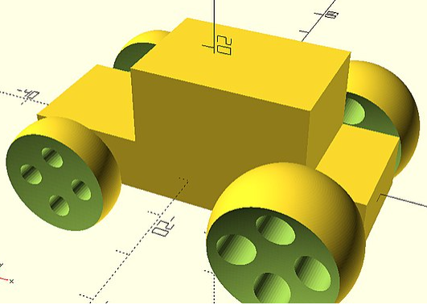
OpenSCAD Modeling Practice
OpenSCAD Tutorial/Chapter 4 (part 2 – Parameterizing Modules)

Slide 12
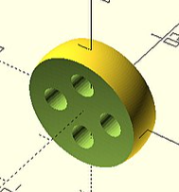
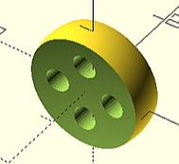
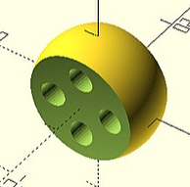
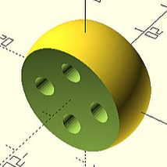
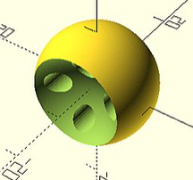
OpenSCAD Modeling Practice
OpenSCAD Tutorial/Chapter 4 (part 3 – Default Values in Modules)

Slide 13
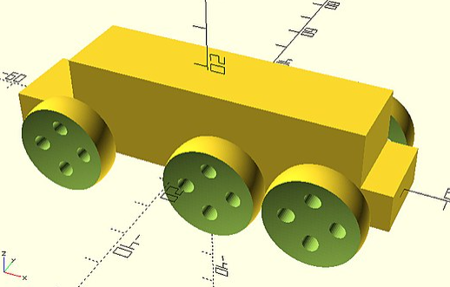
OpenSCAD Modeling Practice
OpenSCAD Tutorial/Chapter 4 (part 4 – Separating Model into Modules)

Slide 14
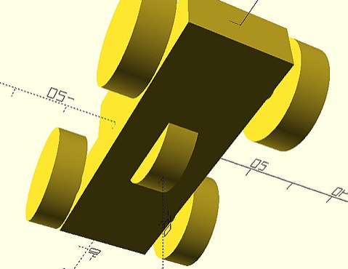
OpenSCAD Modeling Practice
OpenSCAD Tutorial/Chapter 5 (part 1 – Modules as Separate Scripts)

Slide 15
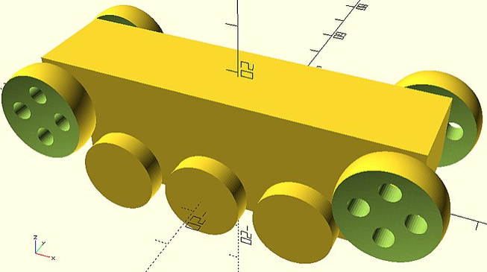
OpenSCAD Modeling Practice
OpenSCAD Tutorial/Chapter 5 (part 2 – Script with Multiple Modules)

Slide 16
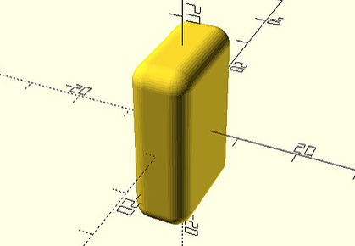
OpenSCAD Modeling Practice
OpenSCAD Tutorial/Chapter 5 (part 3 – Use MCAD Library)

Slide 17
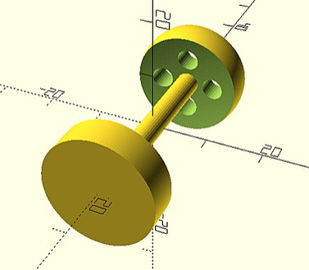
OpenSCAD Modeling Practice
OpenSCAD Tutorial/Chapter 5 (part 4 – More Parameterizable Modules)

Slide 18
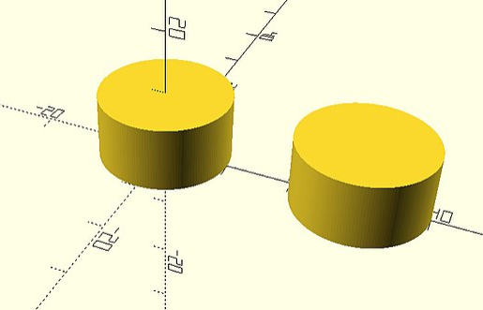
OpenSCAD Modeling Practice
OpenSCAD Tutorial/Chapter 6 (part 1 – OpenSCAD Variables)

Slide 19
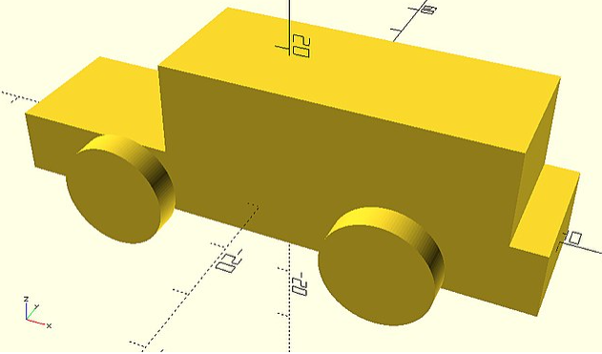
OpenSCAD Modeling Practice
OpenSCAD Tutorial/Chapter 6 (part 2 – Conditional Variables)

Slide 20
OpenSCAD Modeling Practice
OpenSCAD Tutorial/Chapter 6 (part 3 – More Conditional Variable Assigement)

Slide 21
OpenSCAD Modeling Practice
OpenSCAD Tutorial/Chapter 6 (part 4 – Conditional Creation – If Statement)

Slide 22
OpenSCAD Modeling Practice
OpenSCAD Tutorial/Chapter 6 (part 5 – Update Car Model by Variables Usage)

Slide 23
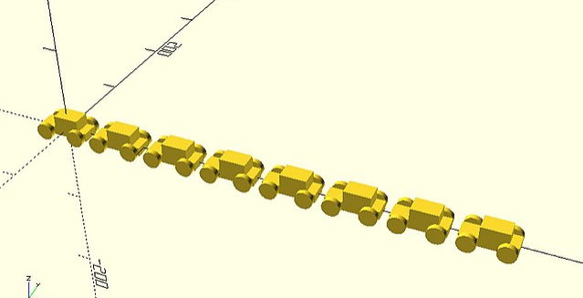
OpenSCAD Modeling Practice
OpenSCAD Tutorial/Chapter 7 (part 1 – For loops)

Slide 24
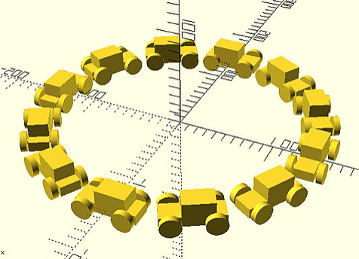
OpenSCAD Modeling Practice
OpenSCAD Tutorial/Chapter 7 (part 2 – More Complex Patterns – Car Circle)

Slide 25
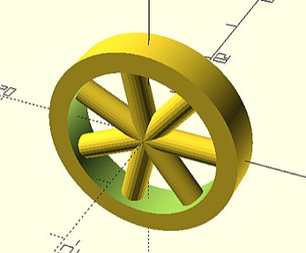
OpenSCAD Modeling Practice
OpenSCAD Tutorial/Chapter 7 (part 2 – More Complex Patterns – Spoked_Wheel)

Slide 26
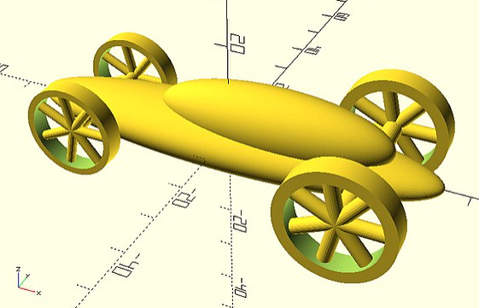
OpenSCAD Modeling Practice
OpenSCAD Tutorial/Chapter 7 (part 2 – More Complex Patterns – Car with Spoked_Wheels)

Slide 27
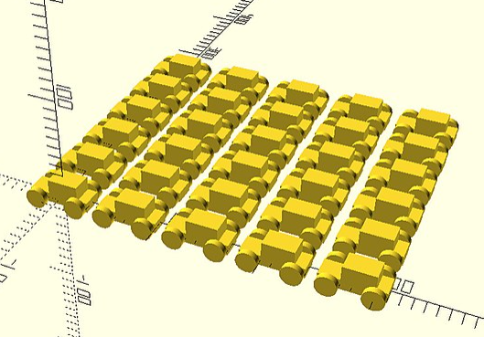
OpenSCAD Modeling Practice
OpenSCAD Tutorial/Chapter 7 (part 3 – Nested For Loops)

Slide 28
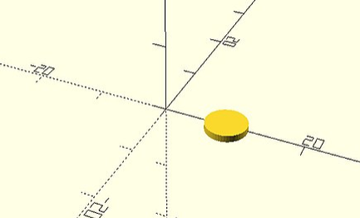
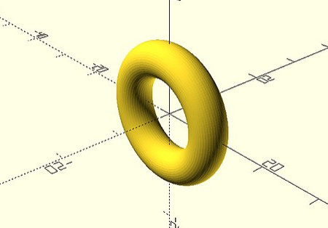
OpenSCAD Modeling Practice
OpenSCAD Tutorial/Chapter 8 (part 1 – Rotationally Extruding 3D Objects from 2D Objects)

Slide 29
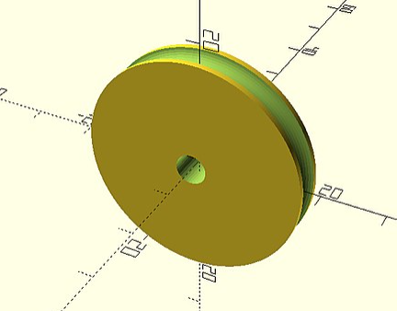
OpenSCAD Modeling Practice
OpenSCAD Tutorial/Chapter 8 (part 2 – Rotationally Extruding on Wheel)

Slide 30
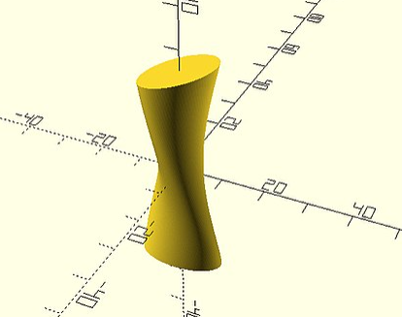
OpenSCAD Modeling Practice
OpenSCAD Tutorial/Chapter 8 (part 3 – Linearly Extruding 3D objects from 2D objects)

Slide 31
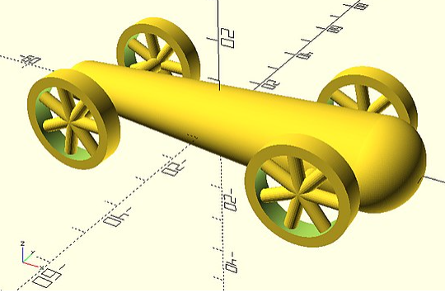
OpenSCAD Modeling Practice
OpenSCAD Tutorial/Chapter 8 (part 4 – Car with Rounded Body from 2D Extruding)

Slide 32
OpenSCAD Modeling Practice
OpenSCAD Tutorial/Chapter 9 (part 1 – Math Calculations)

Slide 33
OpenSCAD Modeling Practice
OpenSCAD Tutorial/Chapter 9 (part 2 – Polygon 2D Object)

Slide 34
OpenSCAD Modeling Practice
OpenSCAD Tutorial/Chapter 9 (part 3 – Racing Car Body)

Slide 35
OpenSCAD Modeling Practice
OpenSCAD Tutorial/Chapter 9 (part 4 – Create “Heart”)

Slide 36
OpenSCAD Modeling Practice
OpenSCAD Tutorial/Chapter 9 (part 5 – Aerodynamic Spoiler for Racing Car)

