Slide 1
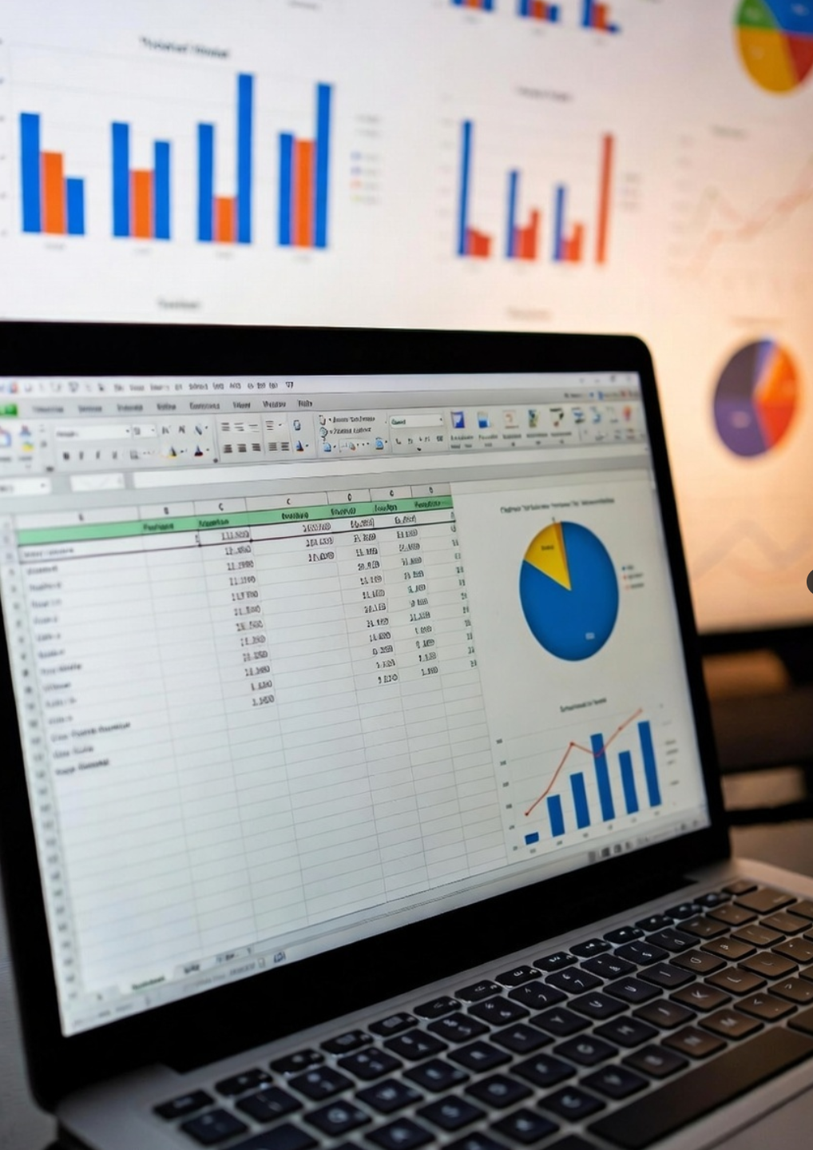
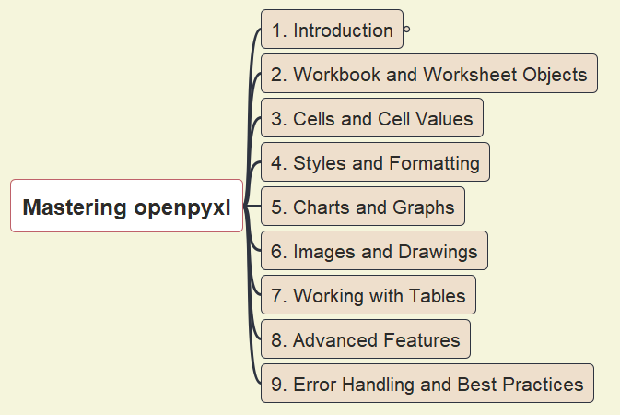
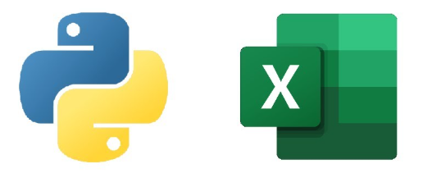
Mastering Python’s openpyxl
- Opening & Introduction
001

Slide 2
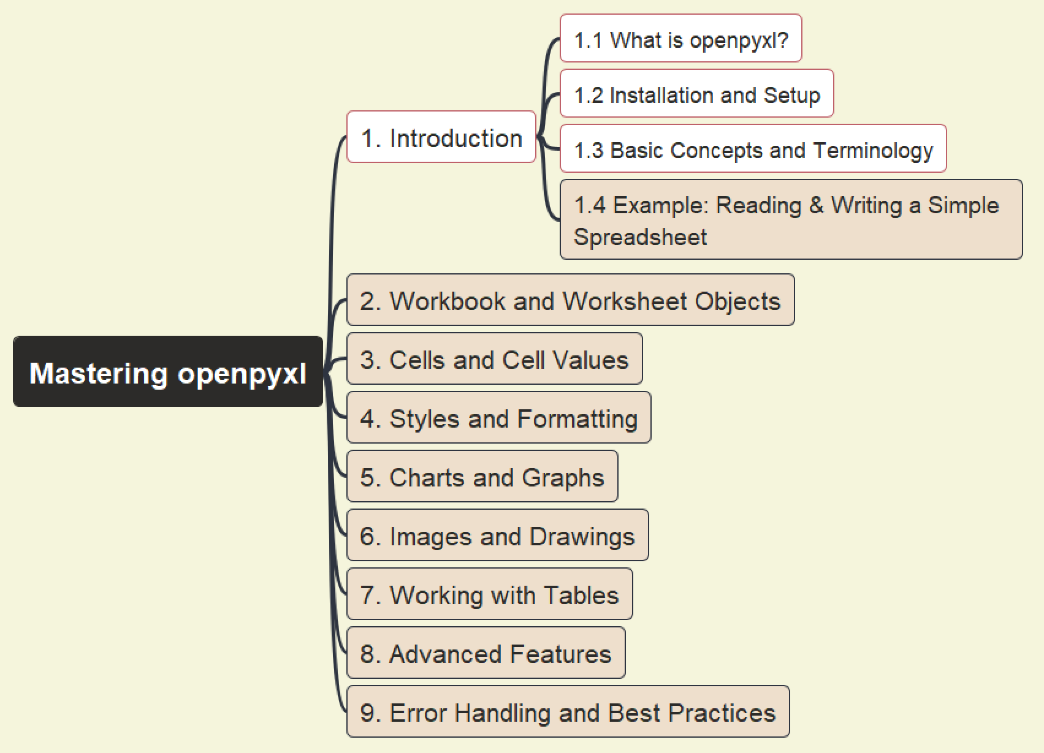
Mastering openpyxl
002
1. Introduction – About openpyxl

Slide 3
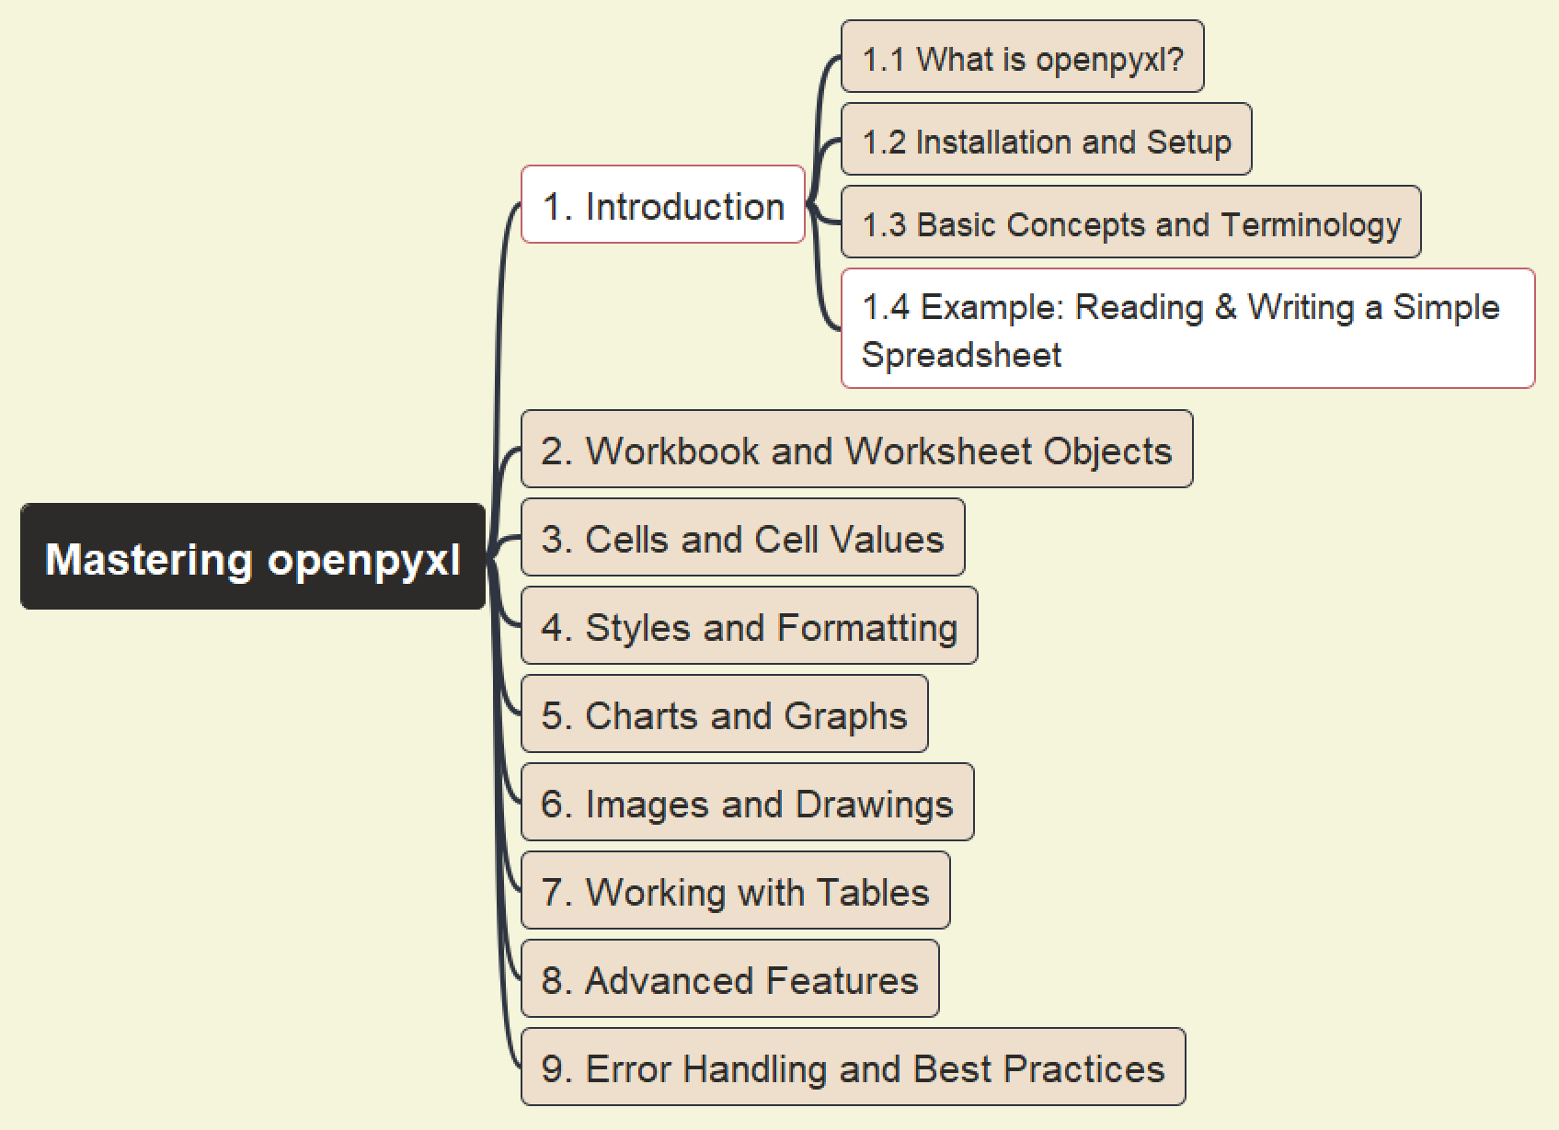
Mastering openpyxl
003
1. Introduction – First Sample

Slide 4


