Slide 1

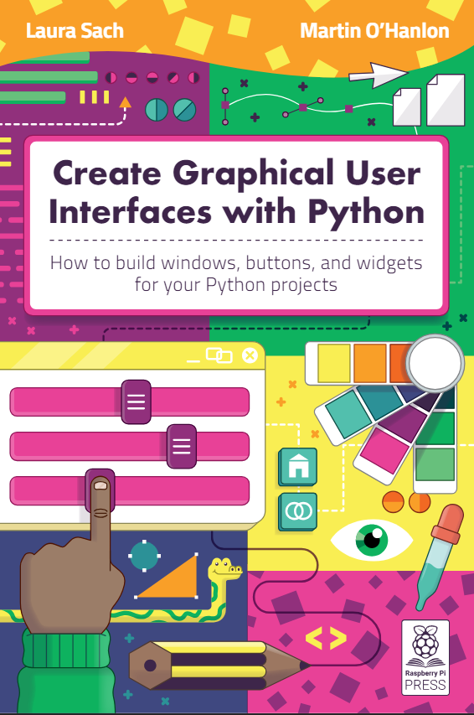
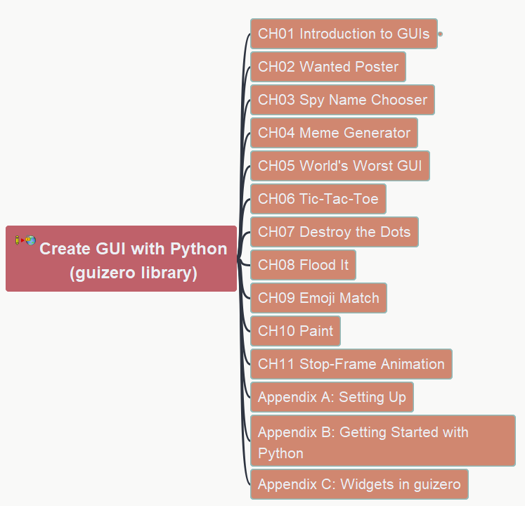

Create GUI with Python
001 Opening and Introduction
https://github.com/yasenstar/python/tree/master/GUI_Python

Slide 2
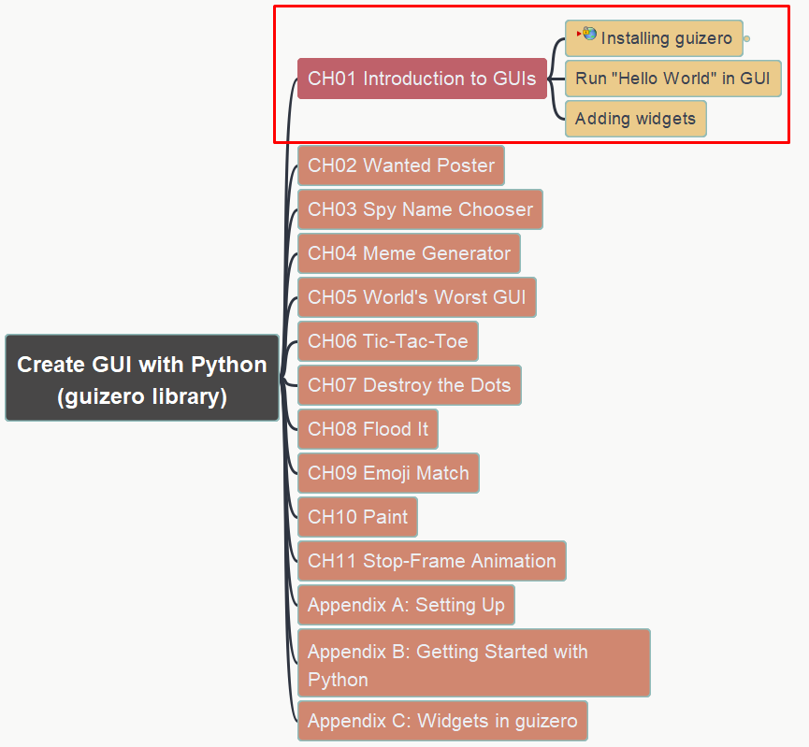
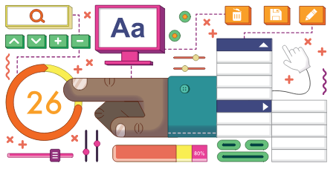
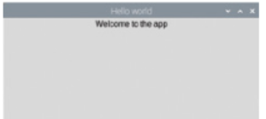
Create GUI with Python 001 Ch01 Hello World in GUI
https://github.com/yasenstar/python/tree/master/GUI_Python

