Slide 1

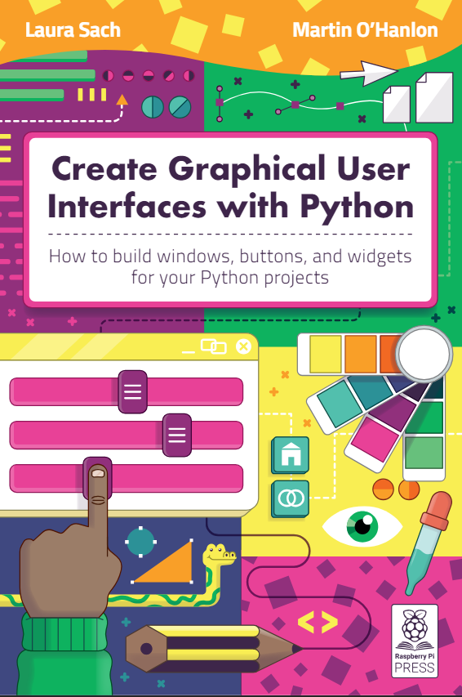
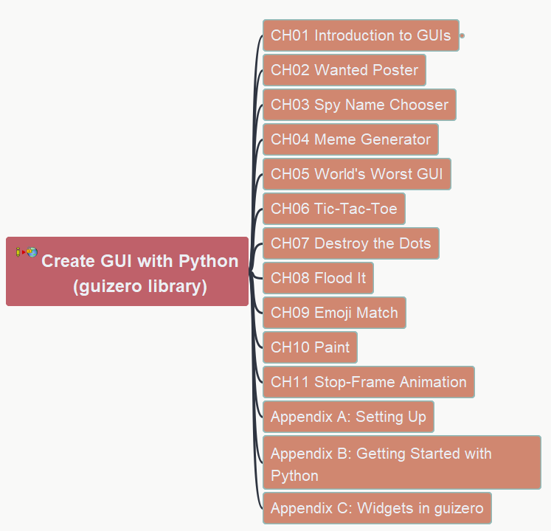

Create GUI with Python
001 Opening and Introduction
https://github.com/yasenstar/python/tree/master/GUI_Python

Slide 2
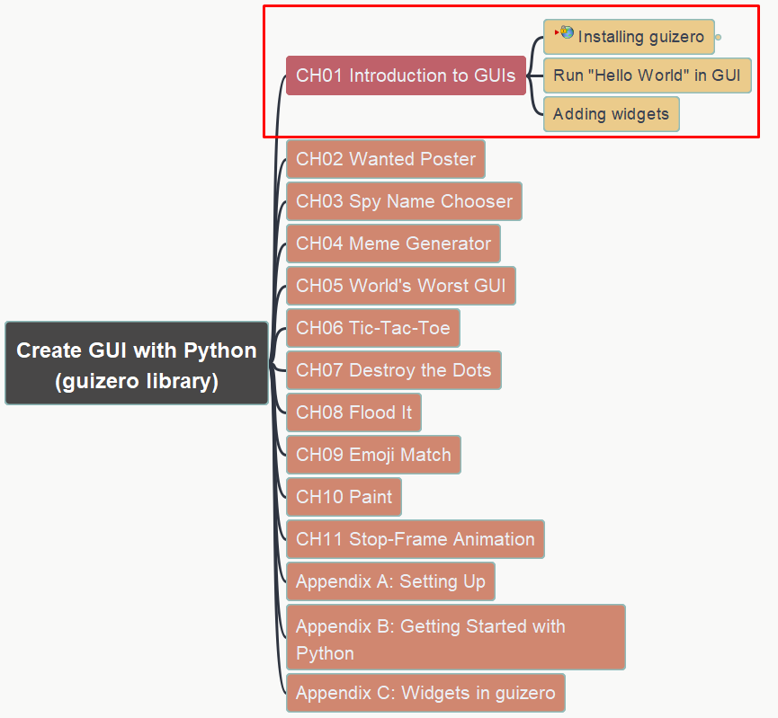
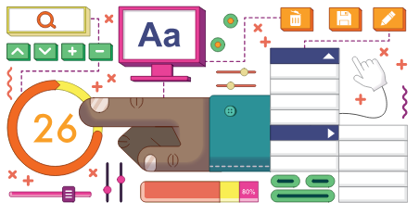
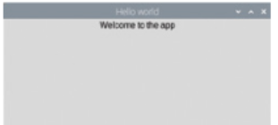
Create GUI with Python 002 Ch01 Hello World in GUI
https://github.com/yasenstar/python/tree/master/GUI_Python

Slide 3
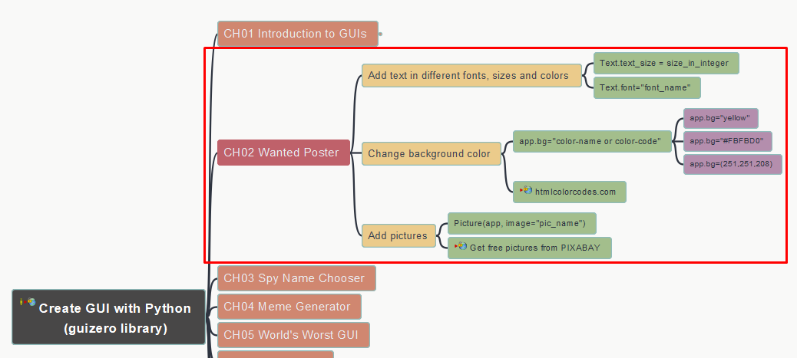
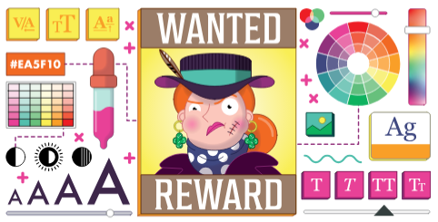
Create GUI with Python 003 Ch02 Wanted Poster
https://github.com/yasenstar/python/tree/master/GUI_Python

Slide 4
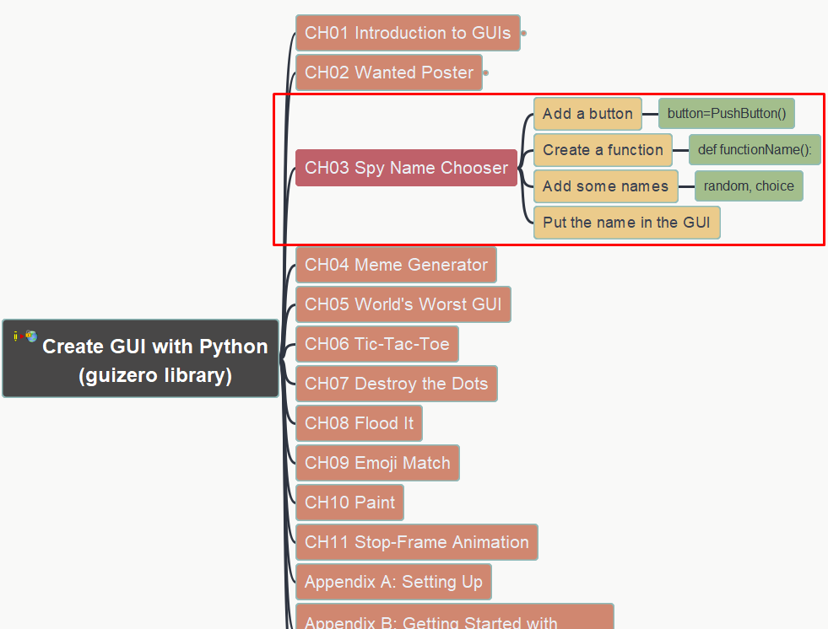
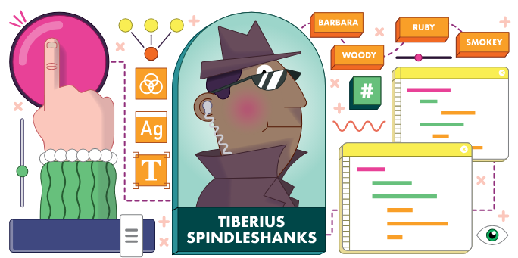
Create GUI with Python 004 Ch03 Spy Name Chooser
https://github.com/yasenstar/python/tree/master/GUI_Python

Slide 5
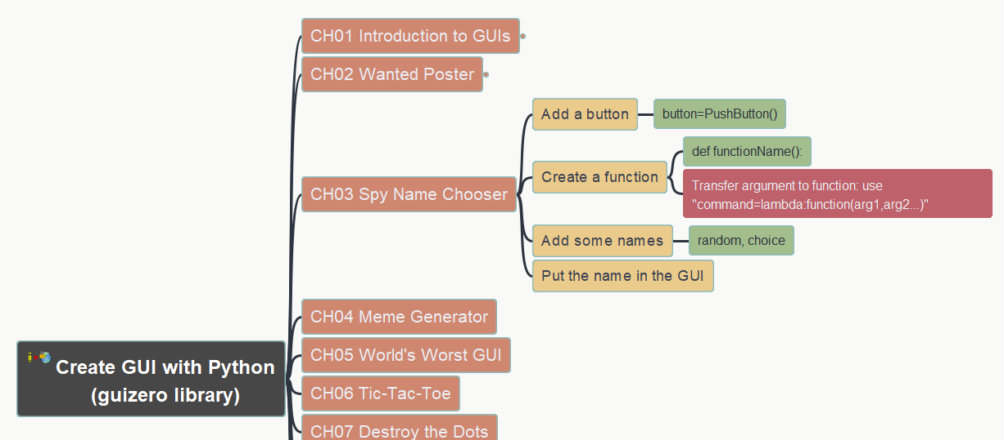
Create GUI with Python 005 Ch03 Spy Name Chooser Addition 1: use Lambda to transfer argument to function
https://github.com/yasenstar/python/tree/master/GUI_Python

Slide 6
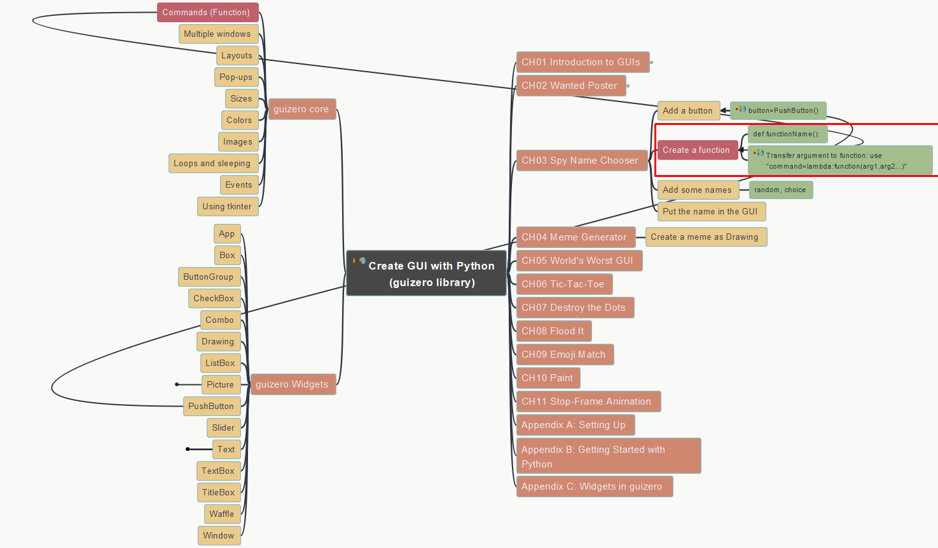
Create GUI with Python 006 Ch03 Spy Name Chooser Addition 2: More Investigation on “Commands”
https://github.com/yasenstar/python/tree/master/GUI_Python

Slide 7
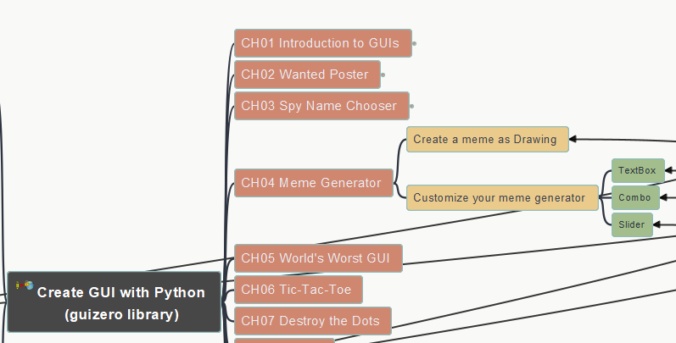
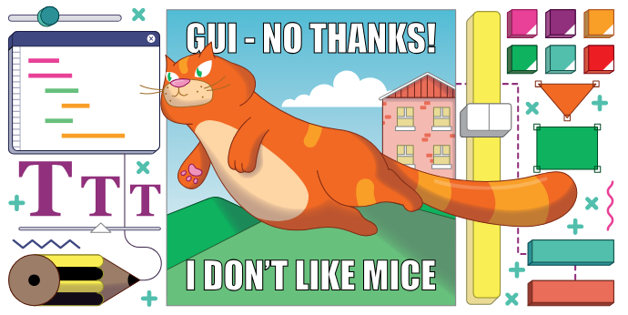
Create GUI with Python 007 Ch04 Meme Generator
https://github.com/yasenstar/python/tree/master/GUI_Python

Slide 8
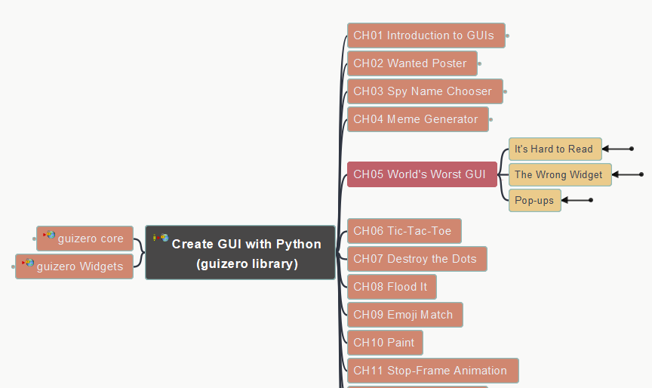
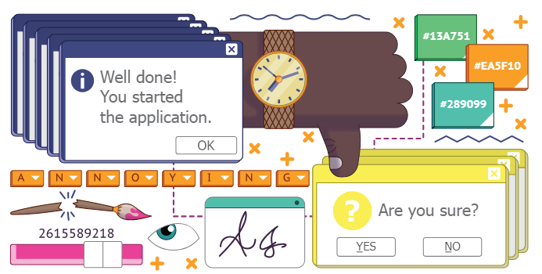
Create GUI with Python 008 Ch05 World’s Worst GUI
https://github.com/yasenstar/python/tree/master/GUI_Python

Slide 9
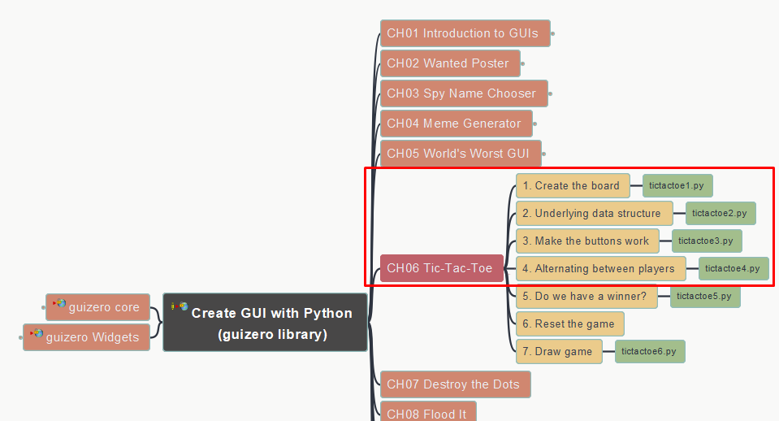
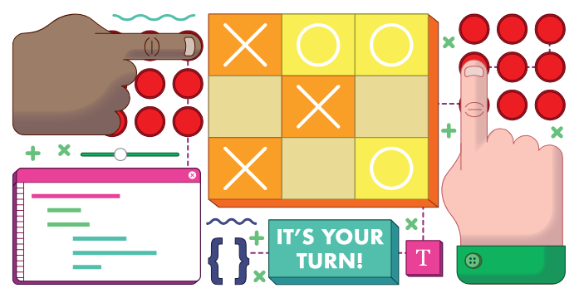
Create GUI with Python 009 Ch06 Tic-Tac-Toe (part 1)
https://github.com/yasenstar/python/tree/master/GUI_Python

Slide 10
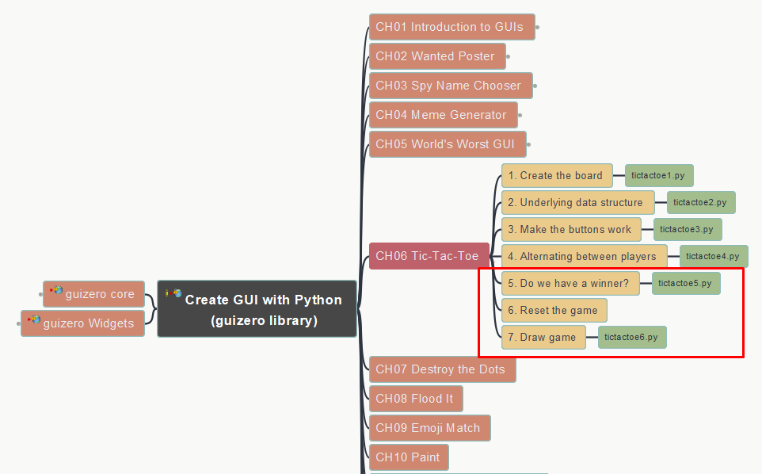
Create GUI with Python 010 Ch06 Tic-Tac-Toe (part 2)
https://github.com/yasenstar/python/tree/master/GUI_Python

Slide 11
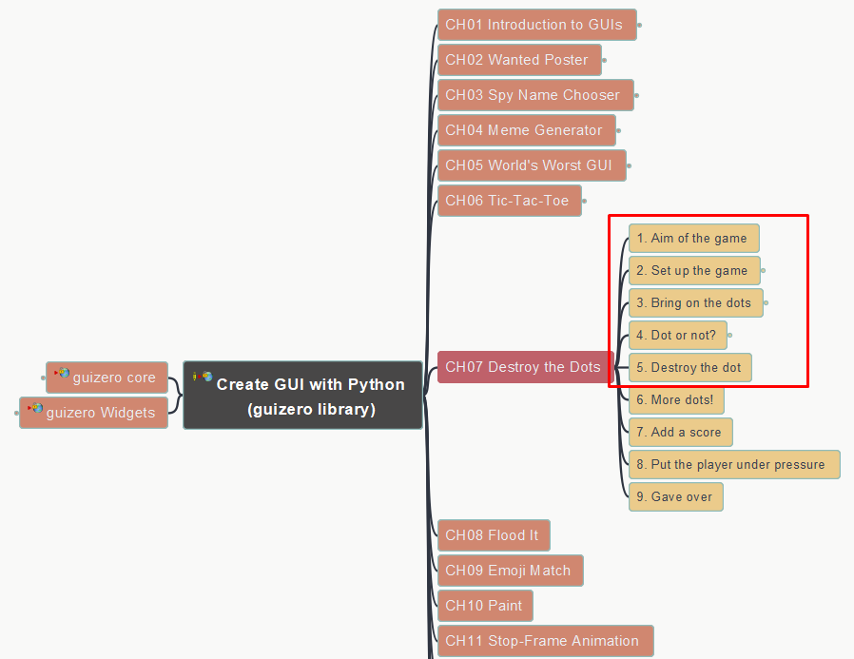
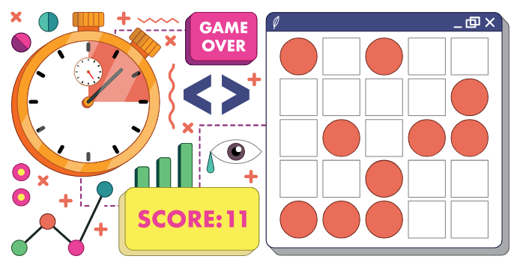
Create GUI with Python 011 Ch07 Destroy the Dots (part 1)
https://github.com/yasenstar/python/tree/master/GUI_Python

Slide 12
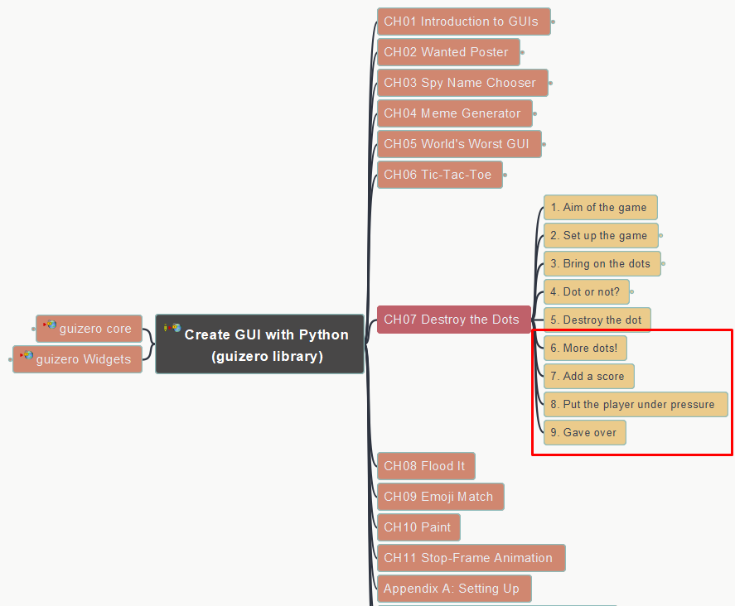
Create GUI with Python 012 Ch07 Destroy the Dots (part 2)
https://github.com/yasenstar/python/tree/master/GUI_Python

Slide 13
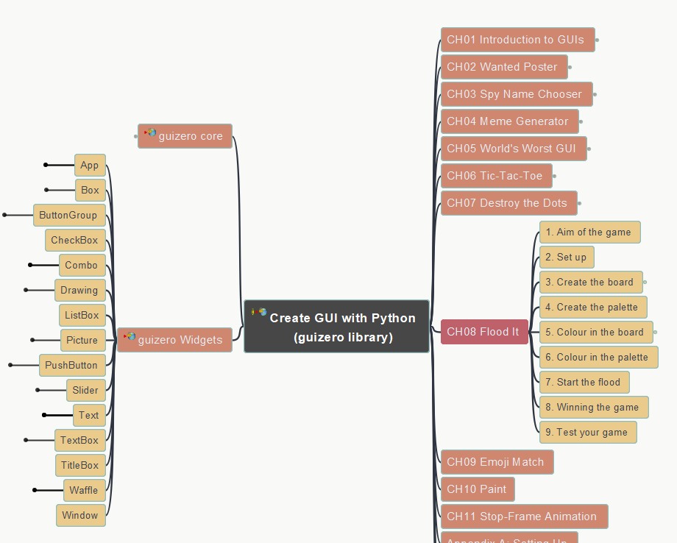
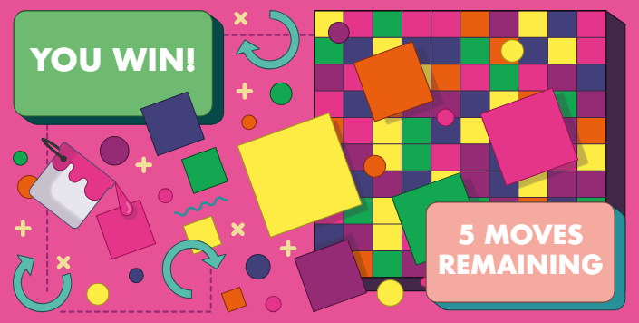
Create GUI with Python 013 Ch08 Flood It (part 1)
https://github.com/yasenstar/python/tree/master/GUI_Python

Slide 14
Create GUI with Python 014 Ch08 Flood It (part 2)
https://github.com/yasenstar/python/tree/master/GUI_Python

Slide 15
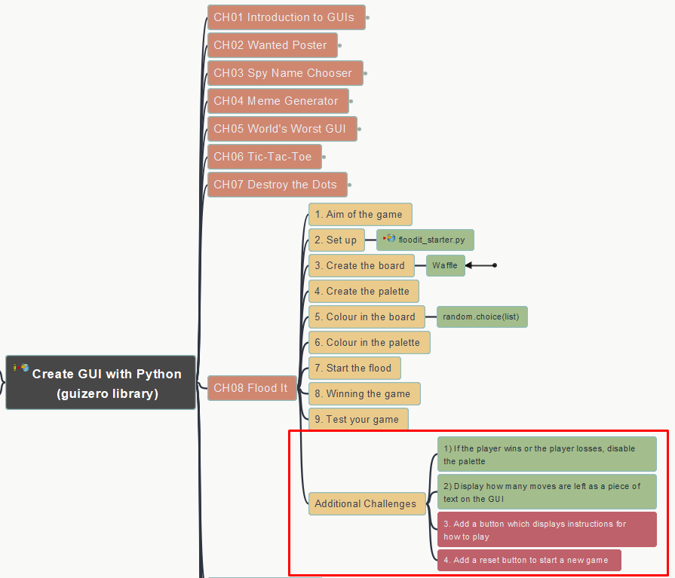
Create GUI with Python 015 Ch08 Flood It (add-on)
https://github.com/yasenstar/python/tree/master/GUI_Python

Slide 16
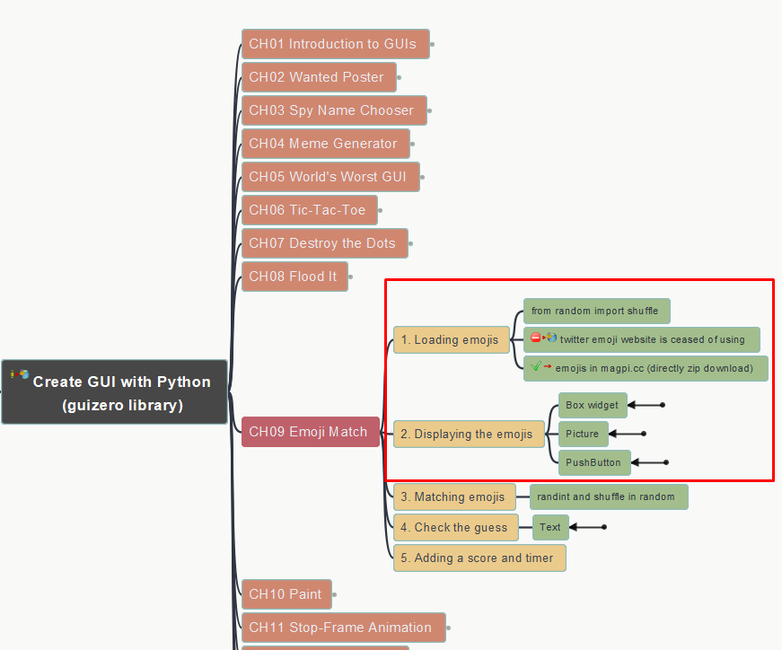
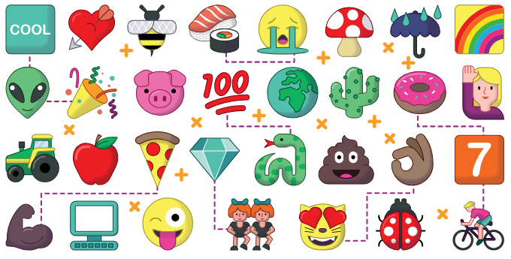
Create GUI with Python 016 Ch09 Emoji Match (part 1)
https://github.com/yasenstar/python/tree/master/GUI_Python

Slide 17
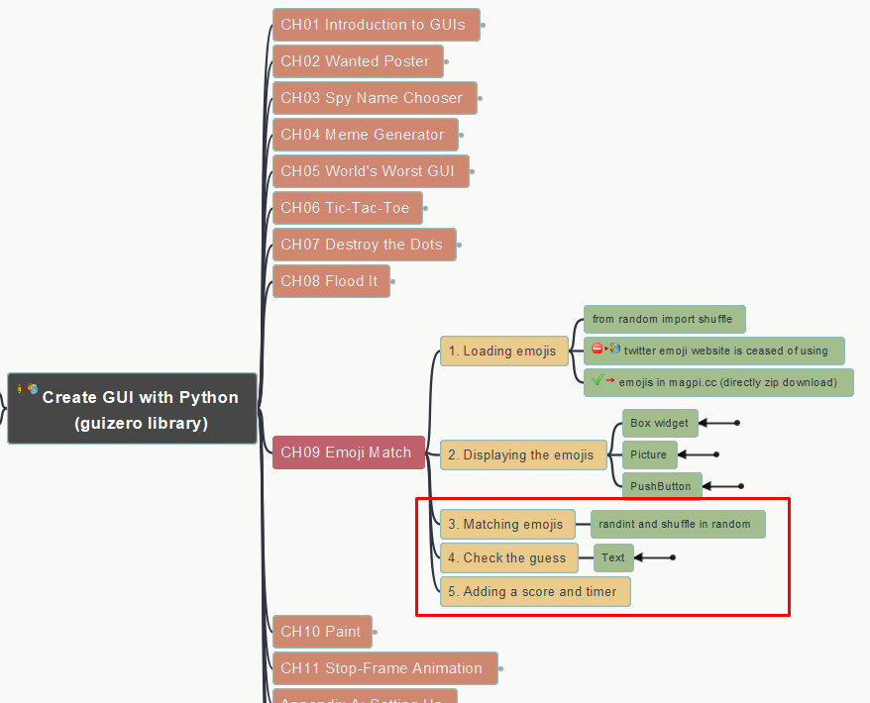
Create GUI with Python 017 Ch09 Emoji Match (part 2)
https://github.com/yasenstar/python/tree/master/GUI_Python

Slide 18
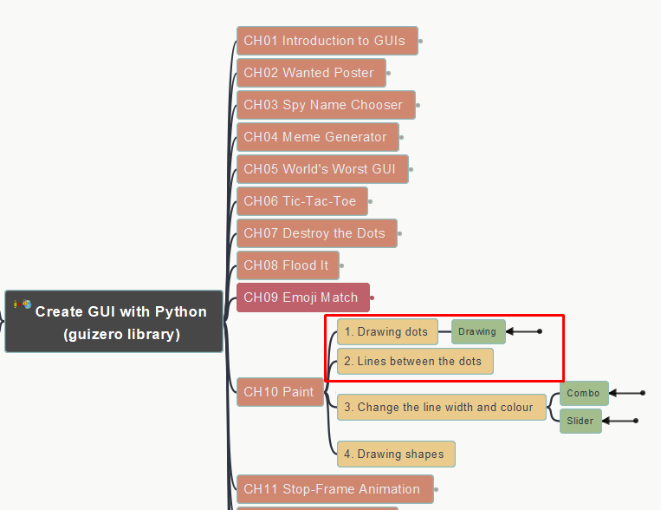
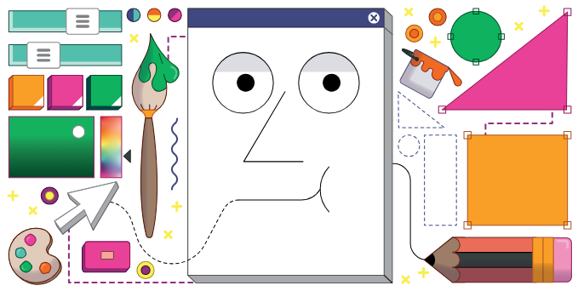
Create GUI with Python 018 Ch10 Paint (part 1)
https://github.com/yasenstar/python/tree/master/GUI_Python

Slide 19
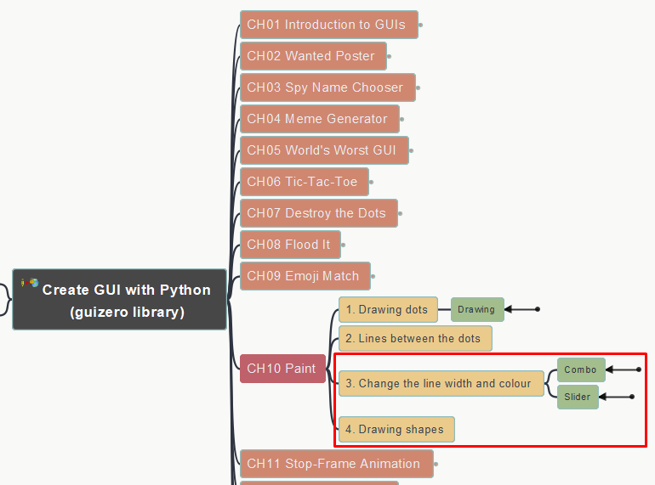
Create GUI with Python 019 Ch10 Paint (part 2)
https://github.com/yasenstar/python/tree/master/GUI_Python

Slide 20
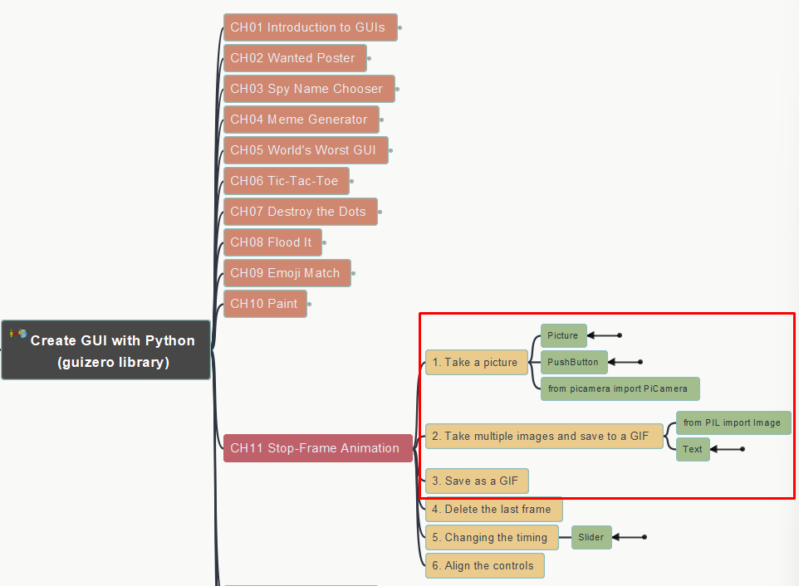
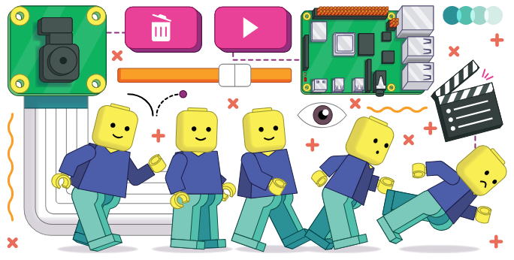
Create GUI with Python 020 Ch11 Stop-frame Animation (Part 1)
https://github.com/yasenstar/python/tree/master/GUI_Python

Slide 21
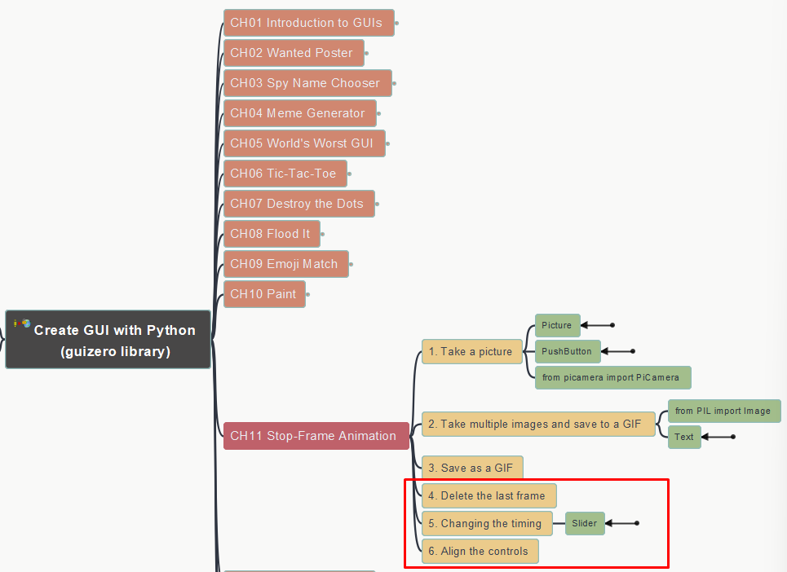
Create GUI with Python 021 Ch11 Stop-frame Animation (Part 2)
https://github.com/yasenstar/python/tree/master/GUI_Python

Slide 22


