Slide 1
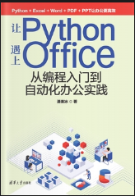
让Python遇上Office (Python with Office)
Opening and Introduction
https://github.com/yasenstar/python_with_office

