Slide 1
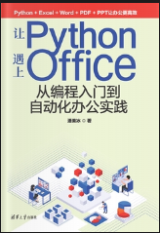
让Python遇上Office (Python with Office)
Opening and Introduction
https://github.com/yasenstar/python_with_office

Slide 2
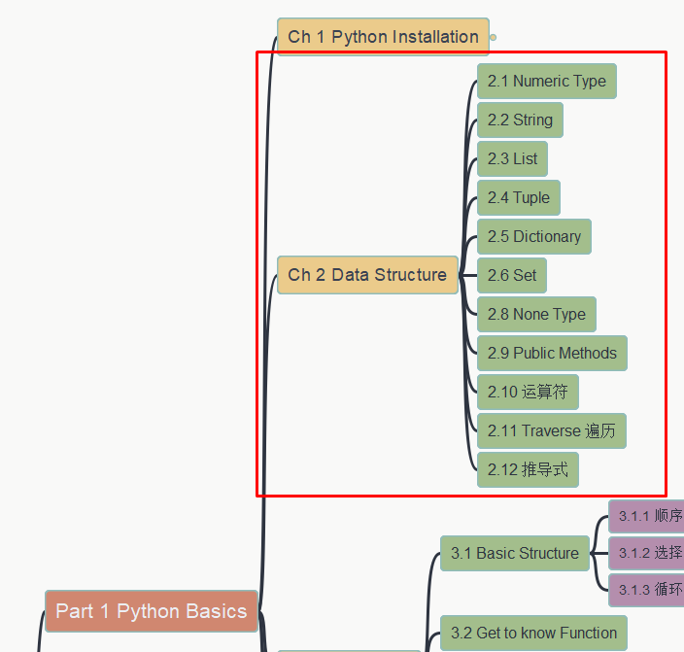
让Python遇上Office (Python with Office)
Chapter 2 Data Structure
2.1 Numeric Type
第二章 数据结构
2.1 数字类型
https://github.com/yasenstar/python_with_office

Slide 3
让Python遇上Office (Python with Office)
Chapter 2 Data Structure
2.2 String Type
第二章 数据结构
2.2 字符串
https://github.com/yasenstar/python_with_office

Slide 4
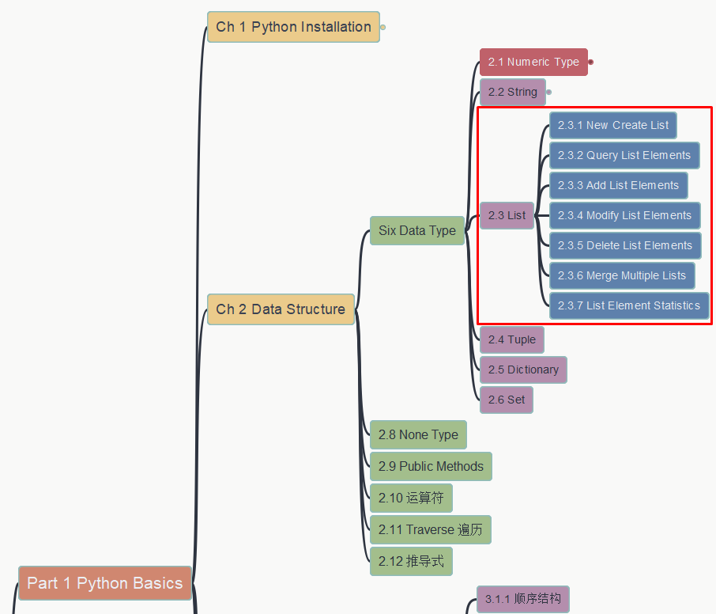
让Python遇上Office (Python with Office)
Chapter 2 Data Structure
2.3 List
第二章 数据结构
2.3 列表
https://github.com/yasenstar/python_with_office

Slide 5
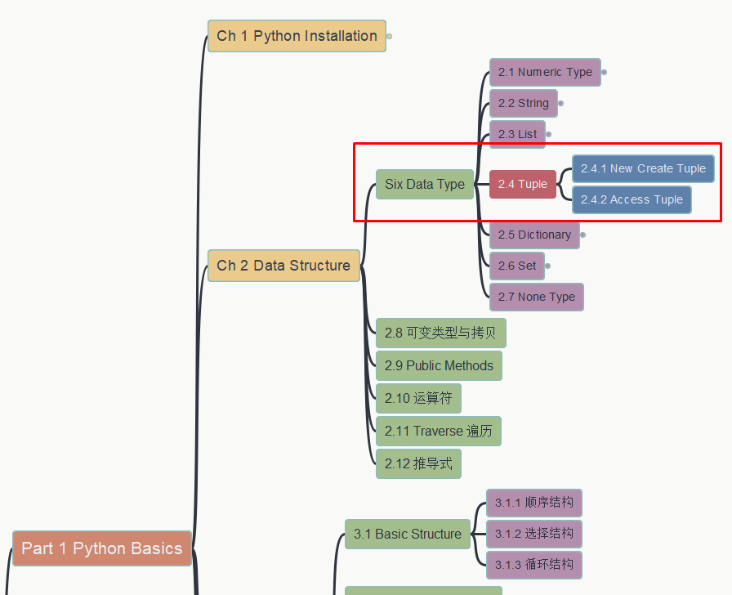
让Python遇上Office (Python with Office)
Chapter 2 Data Structure
2.4 Tuple
第二章 数据结构
2.4 元组
https://github.com/yasenstar/python_with_office

Slide 6
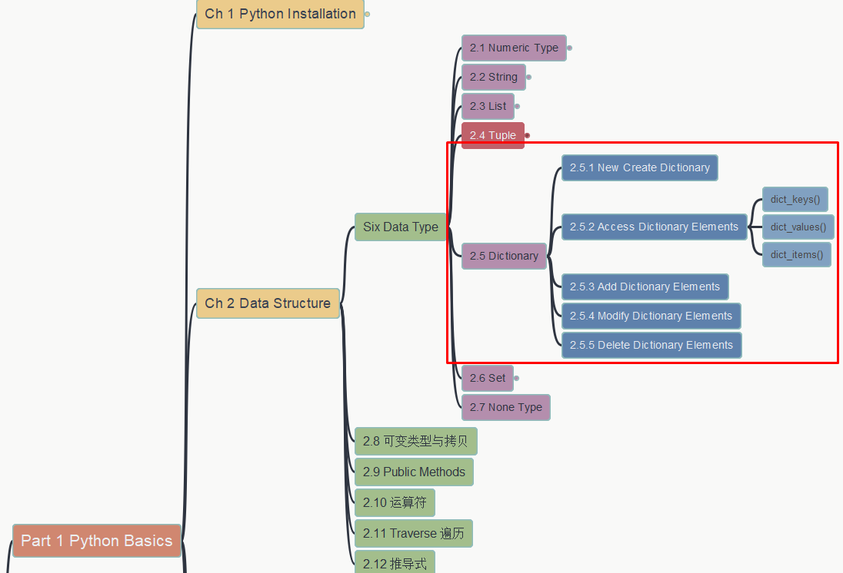
让Python遇上Office (Python with Office)
Chapter 2 Data Structure
2.5 Dictionary
第二章 数据结构
2.5 字典
https://github.com/yasenstar/python_with_office

Slide 7
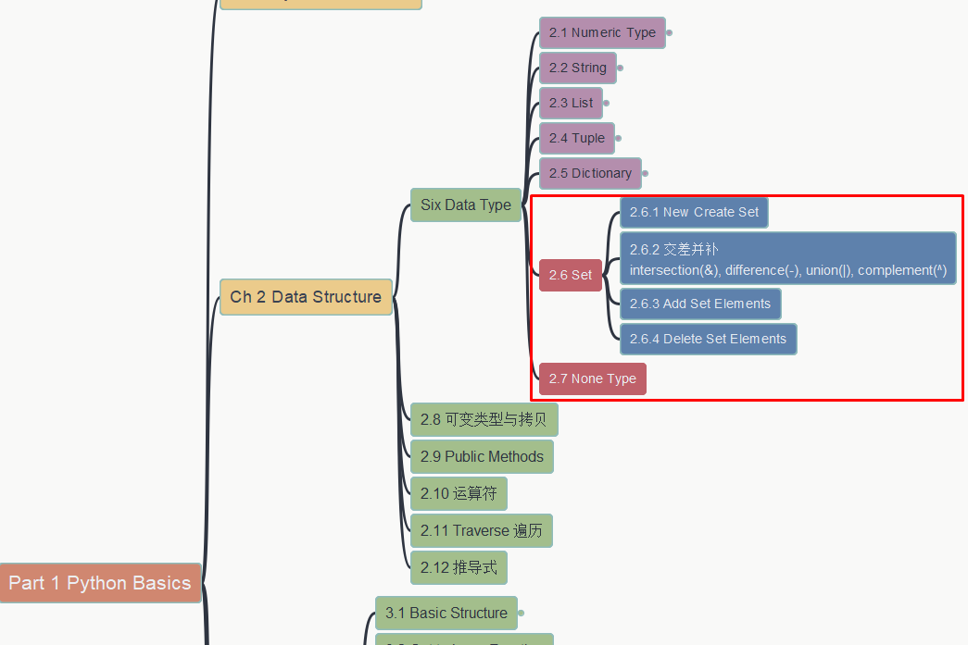
让Python遇上Office (Python with Office)
Chapter 2 Data Structure
2.6-2.7 Set and None Type
第二章 数据结构
2.6-2.7 集合和None类型
https://github.com/yasenstar/python_with_office
https://gitee.com/yasenstar/python_with_office

Slide 8
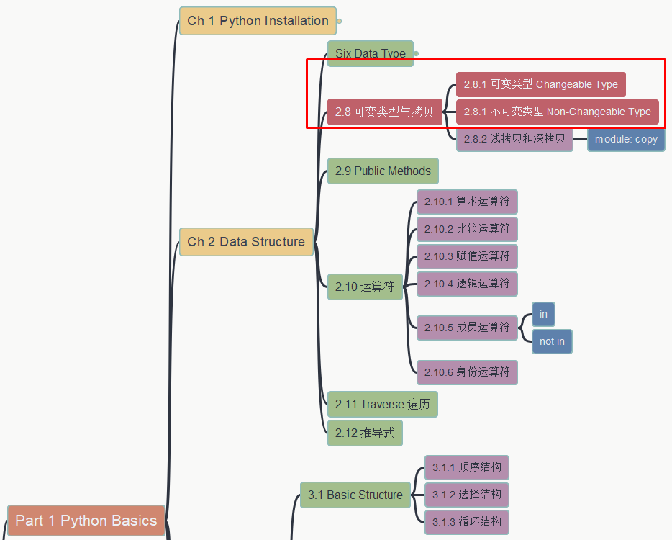
让Python遇上Office (Python with Office)
Chapter 2 Data Structure
2.8.1 Changeable & Non-Changeable Data Types
第二章 数据结构
2.8.1 可变与不可变类型
https://github.com/yasenstar/python_with_office
https://gitee.com/yasenstar/python_with_office

Slide 9
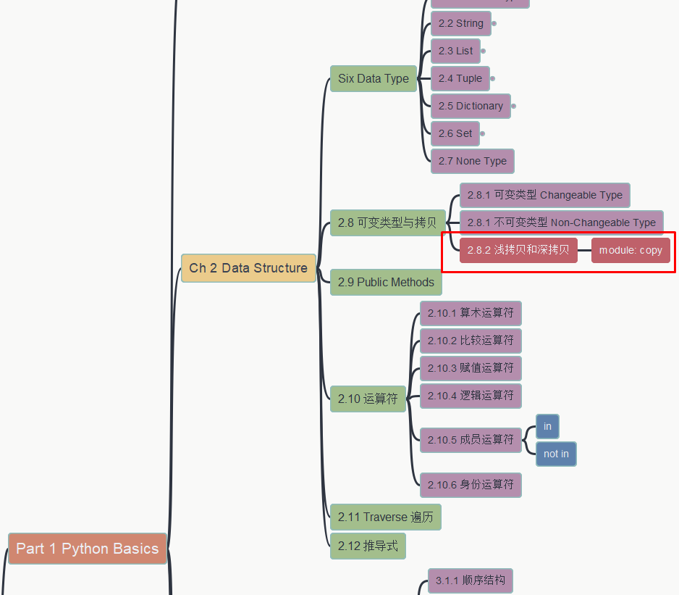
让Python遇上Office (Python with Office)
Chapter 2 Data Structure
2.8.2 Copy – Light & Deep
第二章 数据结构
2.8.2 浅拷贝和深拷贝
https://github.com/yasenstar/python_with_office
https://gitee.com/yasenstar/python_with_office

Slide 10
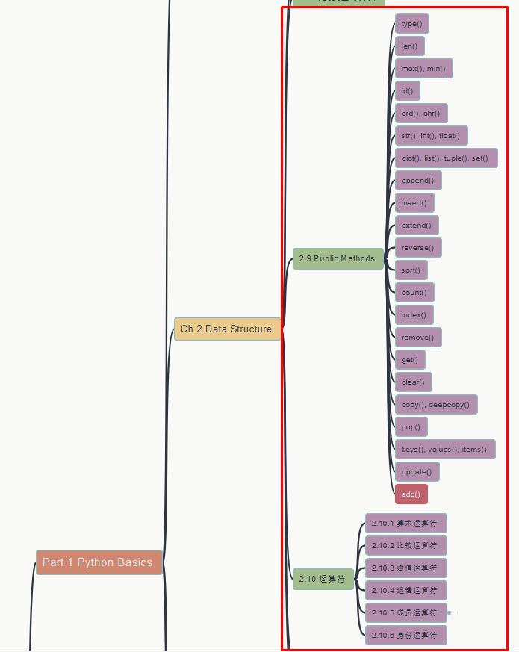
让Python遇上Office (Python with Office)
Chapter 2 Data Structure
2.9 Public Methods
2.10 Operators
第二章 数据结构
2.9 公共方法 2.10 运算符
https://github.com/yasenstar/python_with_office
https://gitee.com/yasenstar/python_with_office

Slide 11
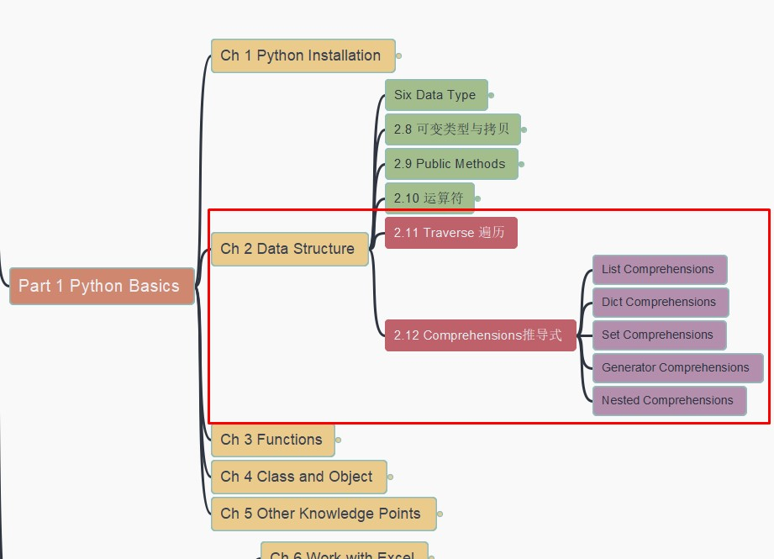
让Python遇上Office (Python with Office)
Chapter 2 Data Structure
2.11 Traverse
2.12 Comprehensions
第二章 数据结构
2.11 遍历 2.12 推导式
https://github.com/yasenstar/python_with_office
https://gitee.com/yasenstar/python_with_office

Slide 12
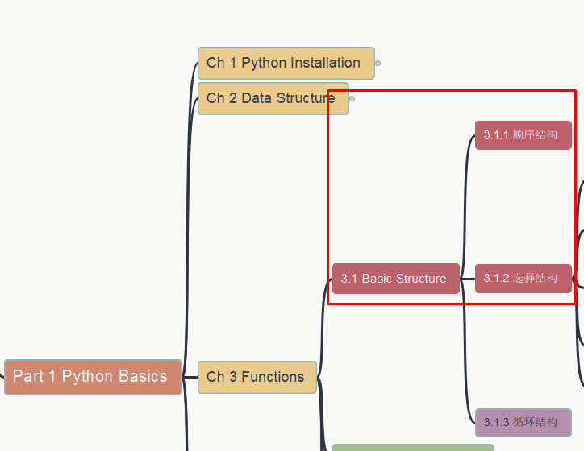
让Python遇上Office (Python with Office)
Chapter 3 Functions
3.1 Three Basic Structure
第三章 函数
3.1 三大基本结构
https://github.com/yasenstar/python_with_office
https://gitee.com/yasenstar/python_with_office

Slide 13
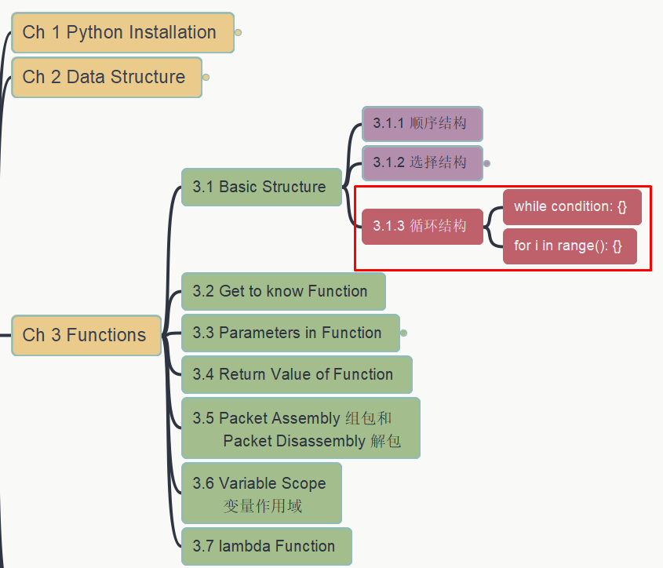
让Python遇上Office (Python with Office)
Chapter 3 Functions
3.1 Three Basic Structure
第三章 函数
3.1 三大基本结构
https://github.com/yasenstar/python_with_office
https://gitee.com/yasenstar/python_with_office

Slide 14
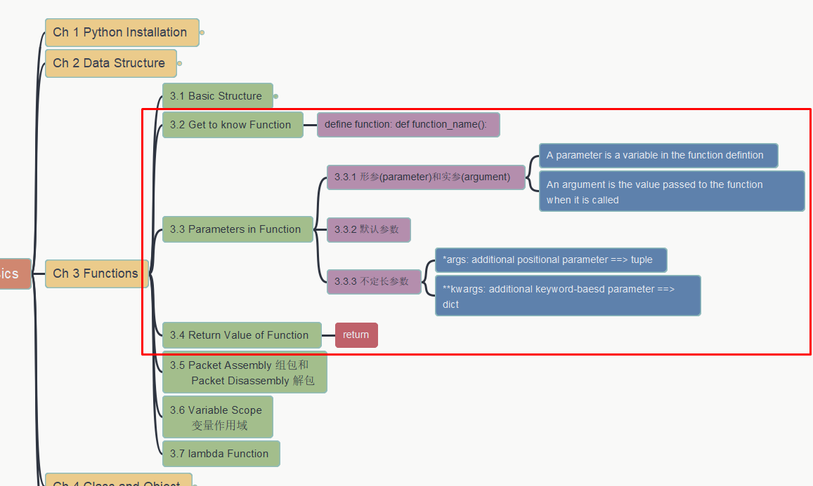
让Python遇上Office (Python with Office)
Chapter 3 Functions
3.2~3.4 Function Basics
第三章 函数
3.2~3.4 函数基本知识
https://github.com/yasenstar/python_with_office
https://gitee.com/yasenstar/python_with_office

Slide 15
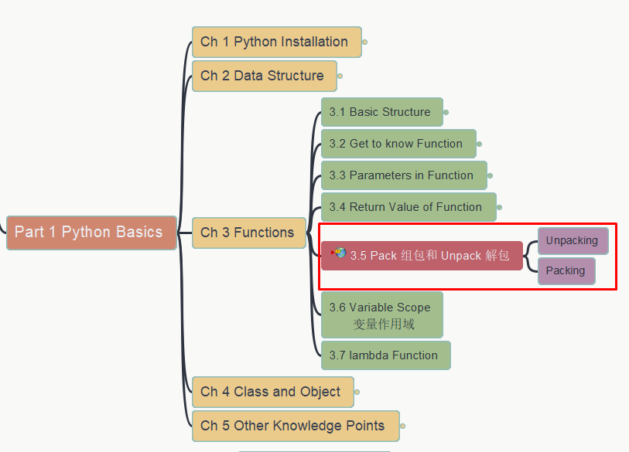
让Python遇上Office (Python with Office)
Chapter 3 Functions
3.5 Packing & Unpacking
第三章 函数
3.5 组包与解包
https://github.com/yasenstar/python_with_office
https://gitee.com/yasenstar/python_with_office

Slide 16
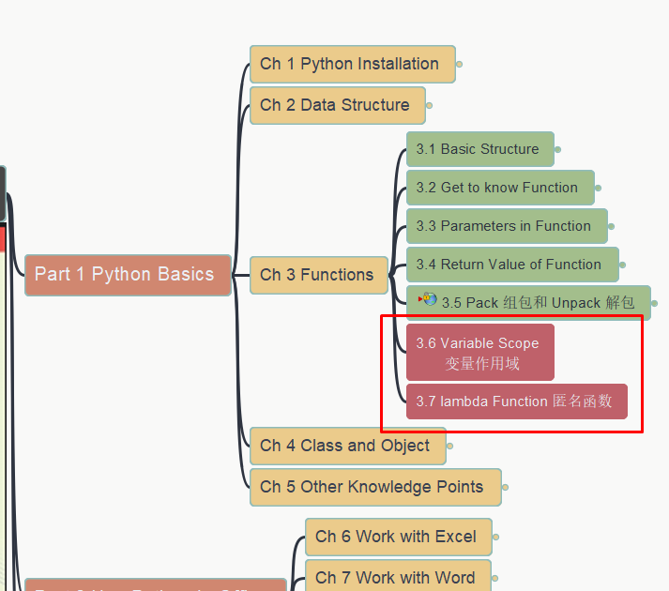
让Python遇上Office (Python with Office)
Chapter 3 Functions
3.6 Variable Scope
3.7 Lambda Function
第三章 函数
3.6 变量作用域 3.7 匿名函数
https://github.com/yasenstar/python_with_office
https://gitee.com/yasenstar/python_with_office

Slide 17
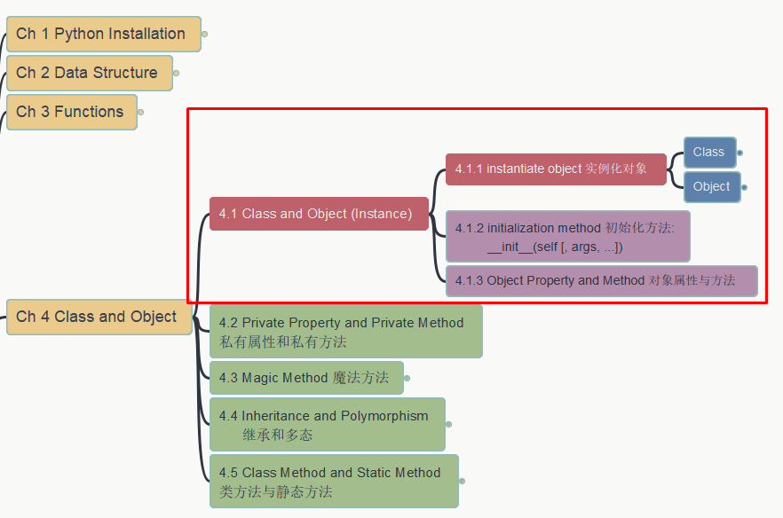
让Python遇上Office (Python with Office)
Chapter 4 Class and Object (4.1)
第四章 类与对象 (4.1)
https://github.com/yasenstar/python_with_office
https://gitee.com/yasenstar/python_with_office

Slide 18
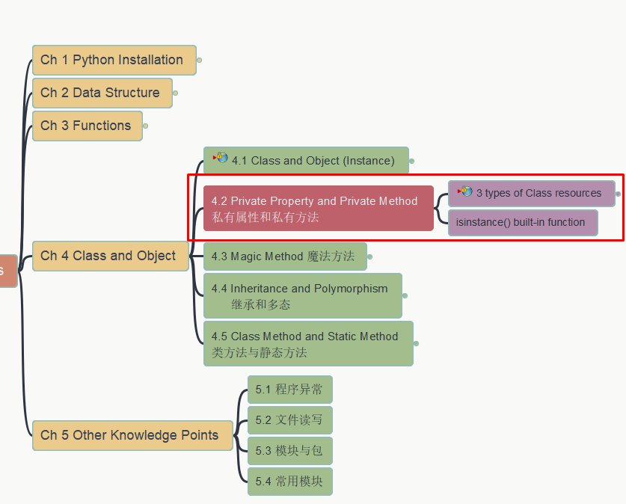
让Python遇上Office (Python with Office)
Chapter 4 Class and Object 4.2 Private Property/Method
第四章 类与对象
4.2 私有属性和私有方法
https://github.com/yasenstar/python_with_office
https://gitee.com/yasenstar/python_with_office

Slide 19
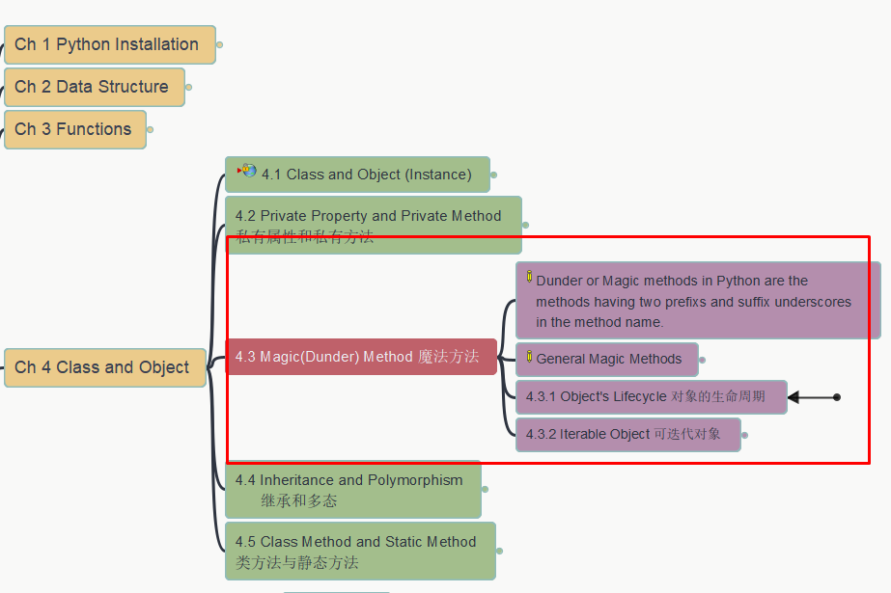
让Python遇上Office (Python with Office)
Chapter 4 Class and Object 4.3 Magic Methods
第四章 类与对象
4.3 魔法方法
https://github.com/yasenstar/python_with_office
https://gitee.com/yasenstar/python_with_office

Slide 20
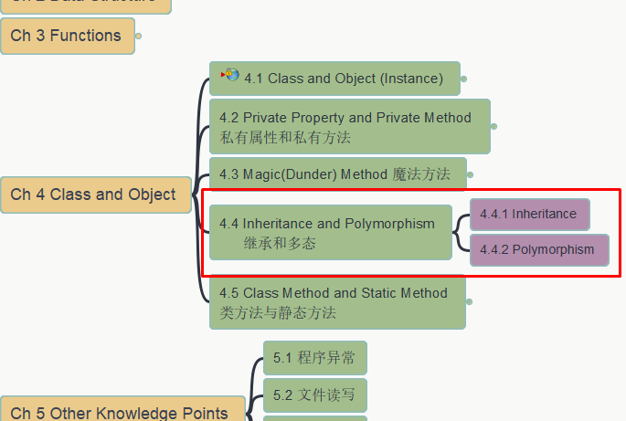
让Python遇上Office (Python with Office)
Chapter 4 Class and Object
4.4 Inheritance, Polymorphism
第四章 类与对象
4.4 继承和多态
https://github.com/yasenstar/python_with_office
https://gitee.com/yasenstar/python_with_office

Slide 21
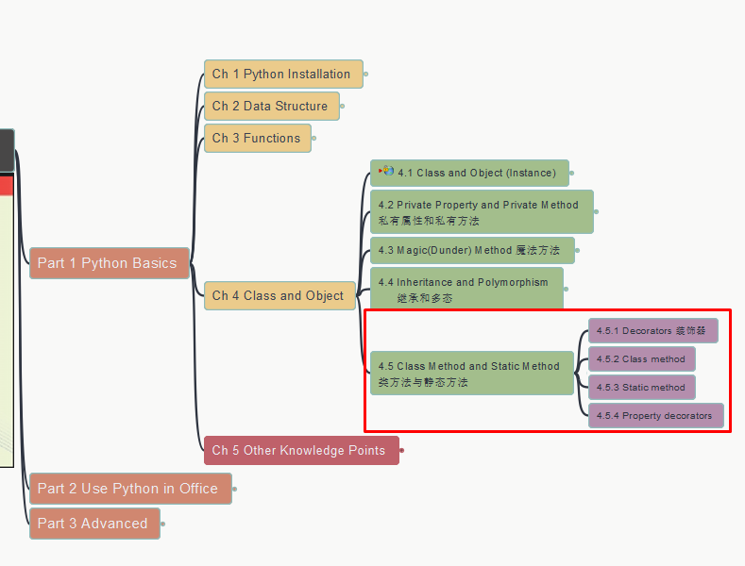
让Python遇上Office (Python with Office)
Chapter 4 Class and Object
4.5 Class & Static Method
第四章 类与对象
4.5 类方法与静态方法
https://github.com/yasenstar/python_with_office
https://gitee.com/yasenstar/python_with_office

Slide 22
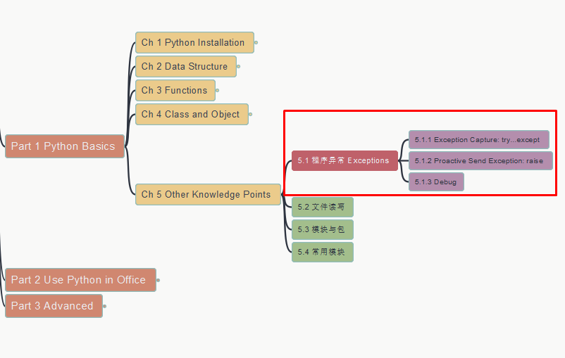
让Python遇上Office (Python with Office)
Chapter 5 Other Knowledge
5.1 Program Exceptions
第五章 其他知识点
5.1 程序异常
https://github.com/yasenstar/python_with_office
https://gitee.com/yasenstar/python_with_office

Slide 23
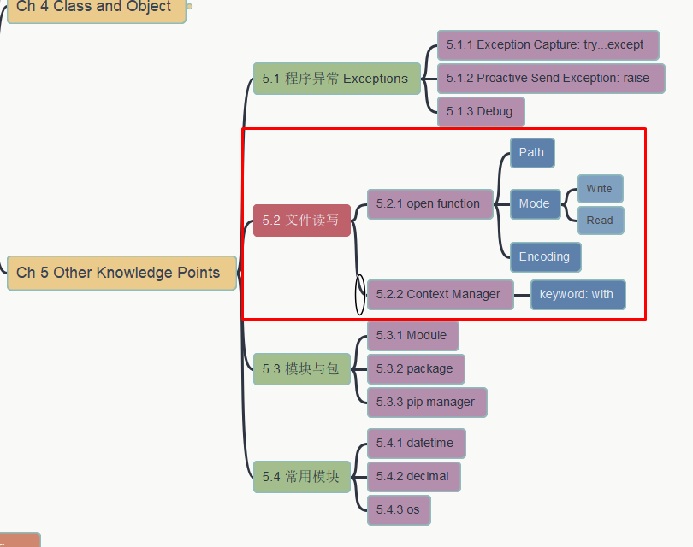
让Python遇上Office (Python with Office)
Chapter 5 Other Knowledge
5.2 File input/output
第五章 其他知识点
5.2 文件读写
https://github.com/yasenstar/python_with_office
https://gitee.com/yasenstar/python_with_office

Slide 24
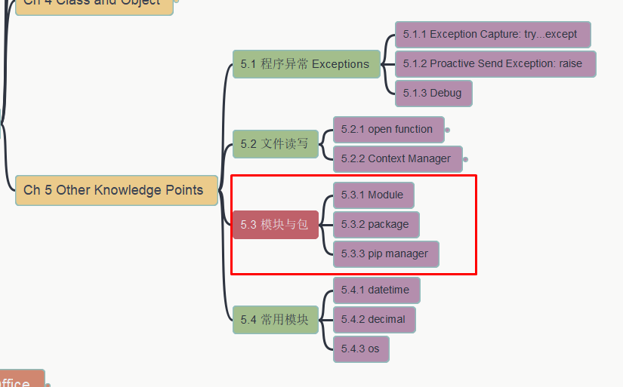
让Python遇上Office (Python with Office)
Chapter 5 Other Knowledge
5.3 Modules and Packages
第五章 其他知识点
5.3 模块和包
https://github.com/yasenstar/python_with_office
https://gitee.com/yasenstar/python_with_office

Slide 25
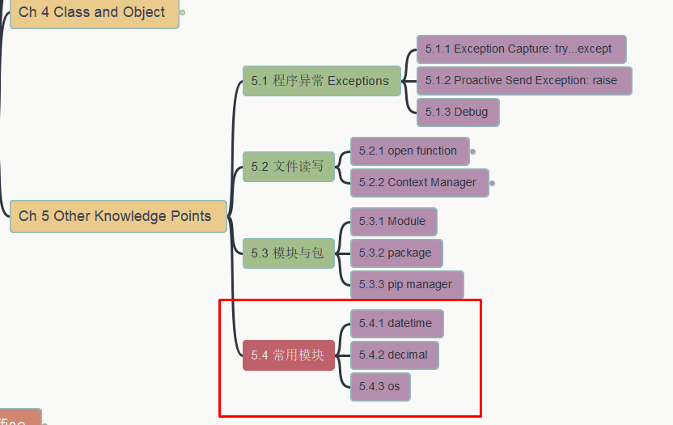
让Python遇上Office (Python with Office)
Chapter 5 Other Knowledge
5.4 Common Used Modules
第五章 其他知识点
5.4 常用模块
https://github.com/yasenstar/python_with_office
https://gitee.com/yasenstar/python_with_office

Slide 26
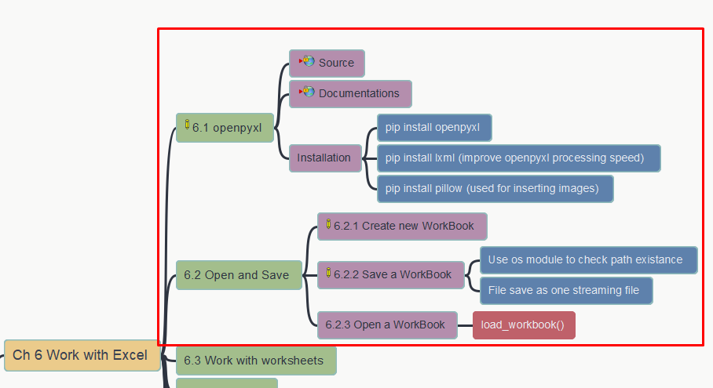
让Python遇上Office (Python with Office)
Chapter 6 Work with Excel
6.1 openpyxl 6.2 Open/Save
第六章 操作Excel
6.1 openpyxl 6.2 打开与保存
https://github.com/yasenstar/python_with_office
https://gitee.com/yasenstar/python_with_office

Slide 27
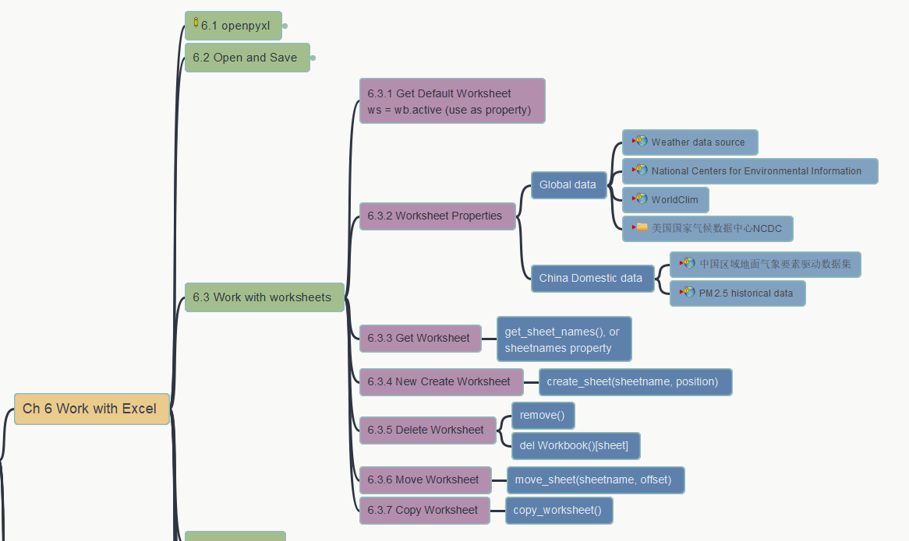
让Python遇上Office (Python with Office)
Chapter 6 Work with Excel
6.3 Operate Worksheets
第六章 操作Excel
6.3 操作工作表 – 6.3.1, 6.3.2
https://github.com/yasenstar/python_with_office
https://gitee.com/yasenstar/python_with_office

Slide 28
让Python遇上Office (Python with Office)
Chapter 6 Work with Excel
6.3 Operate Worksheets
第六章 操作Excel
6.3 操作工作表 – 6.3.3, 6.3.4
https://github.com/yasenstar/python_with_office
https://gitee.com/yasenstar/python_with_office

Slide 29
让Python遇上Office (Python with Office)
Chapter 6 Work with Excel
6.3 Operate Worksheets
第六章 操作Excel
6.3 操作工作表: 6.3.5~6.3.7
https://github.com/yasenstar/python_with_office
https://gitee.com/yasenstar/python_with_office

Slide 30
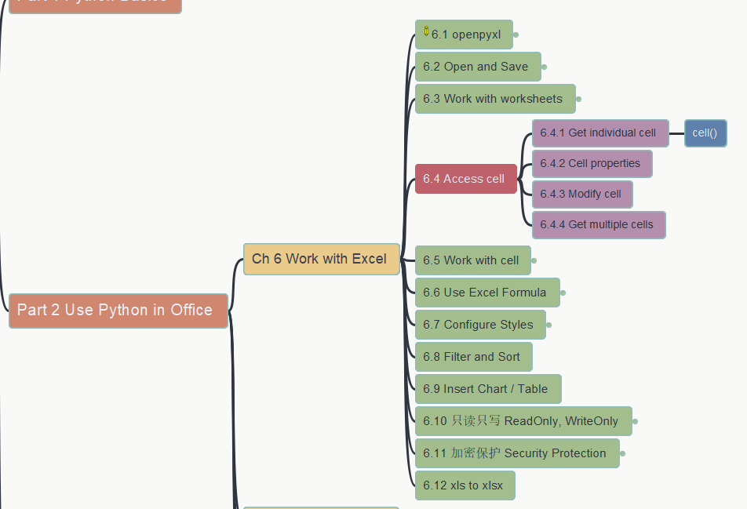
让Python遇上Office (Python with Office)
Chapter 6 Work with Excel
6.4 Access Cells
第六章 操作Excel
6.4 访问单元格
https://github.com/yasenstar/python_with_office
https://gitee.com/yasenstar/python_with_office

Slide 31
让Python遇上Office (Python with Office)
Chapter 6 Work with Excel
6.4 Access Cells
第六章 操作Excel
6.4 访问单元格
https://github.com/yasenstar/python_with_office
https://gitee.com/yasenstar/python_with_office

Slide 32
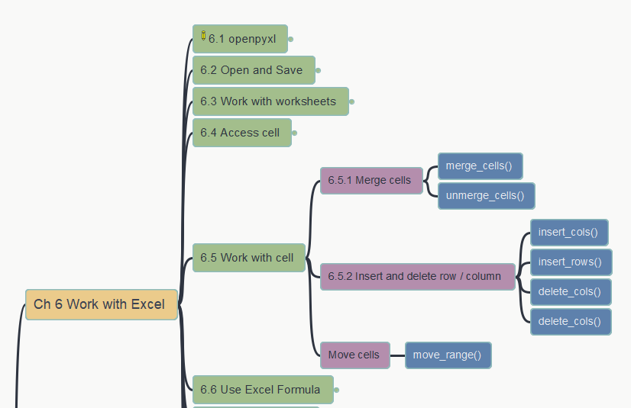
让Python遇上Office (Python with Office)
Chapter 6 Work with Excel
6.5 Work with Cells
– 6.5.1 Merge Cells
第六章 操作Excel
6.5 操作单元格 – 6.5.1 合并
https://github.com/yasenstar/python_with_office
https://gitee.com/yasenstar/python_with_office

Slide 33
让Python遇上Office (Python with Office)
Chapter 6 Work with Excel
6.5 Work with Cells
– 6.5.2 Insert 6.5.3 Move
第六章 操作Excel
6.5 操作单元格 – 插入数据与移动
https://github.com/yasenstar/python_with_office
https://gitee.com/yasenstar/python_with_office

Slide 34
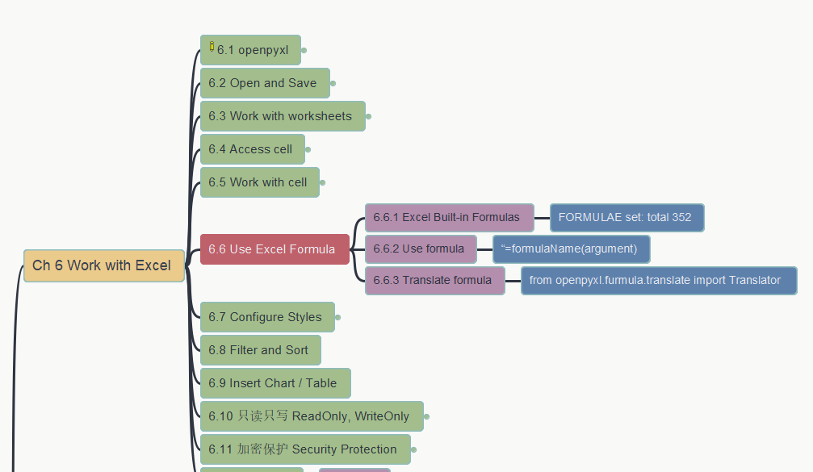
让Python遇上Office (Python with Office)
Chapter 6 Work with Excel
6.6 Excel Formulas
第六章 操作Excel
6.6 使用公式
https://github.com/yasenstar/python_with_office
https://gitee.com/yasenstar/python_with_office

Slide 35
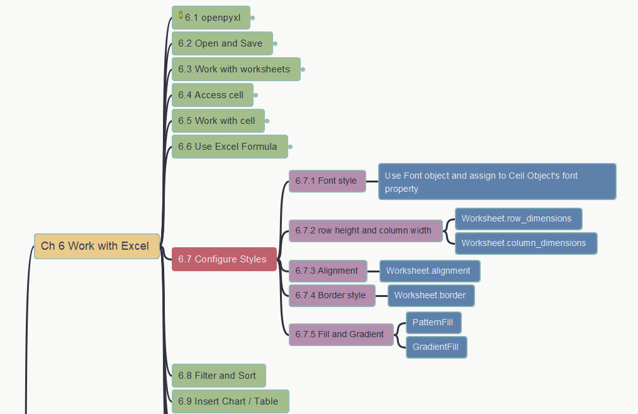
让Python遇上Office (Python with Office)
Chapter 6 Work with Excel
6.7 Set Style in Excel: Font, Dimension & Alignment
第六章 操作Excel
6.7 设置样式：字体，尺寸，对齐
https://github.com/yasenstar/python_with_office
https://gitee.com/yasenstar/python_with_office

Slide 36
让Python遇上Office (Python with Office)
Chapter 6 Work with Excel
6.7 Set Style in Excel: Border, Fill & Gradient
第六章 操作Excel
6.7 设置样式：边框，填充，渐变
https://github.com/yasenstar/python_with_office
https://gitee.com/yasenstar/python_with_office

Slide 37
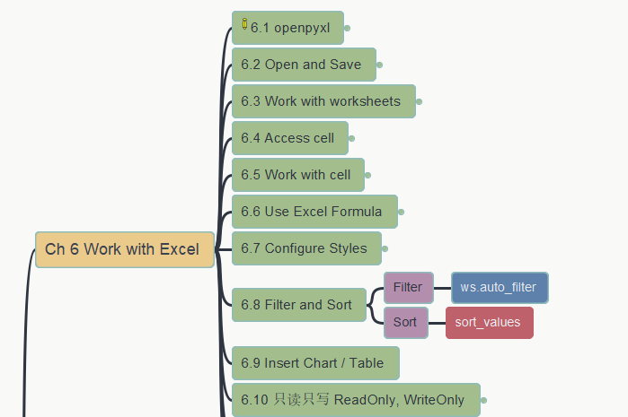
让Python遇上Office (Python with Office)
Chapter 6 Work with Excel
6.8 Filtering and Sorting
第六章 操作Excel
6.8 过滤和排序
https://github.com/yasenstar/python_with_office
https://gitee.com/yasenstar/python_with_office

Slide 38
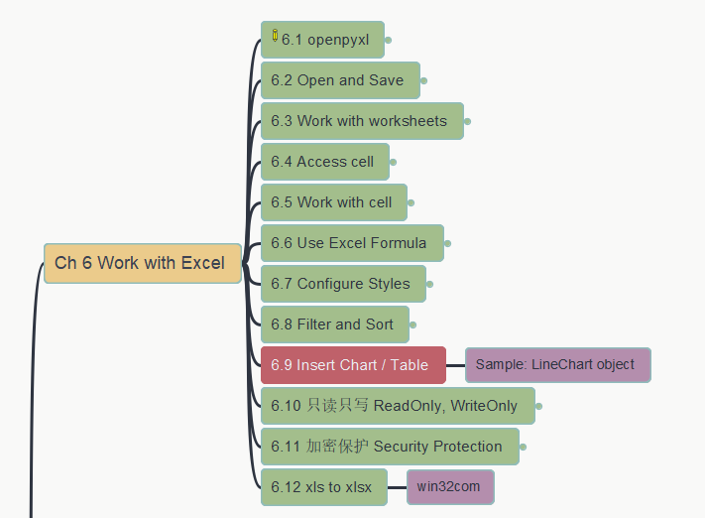
让Python遇上Office (Python with Office)
Chapter 6 Work with Excel
6.9 Insert Chart
第六章 操作Excel
6.9 插入图表
https://github.com/yasenstar/python_with_office
https://gitee.com/yasenstar/python_with_office

Slide 39
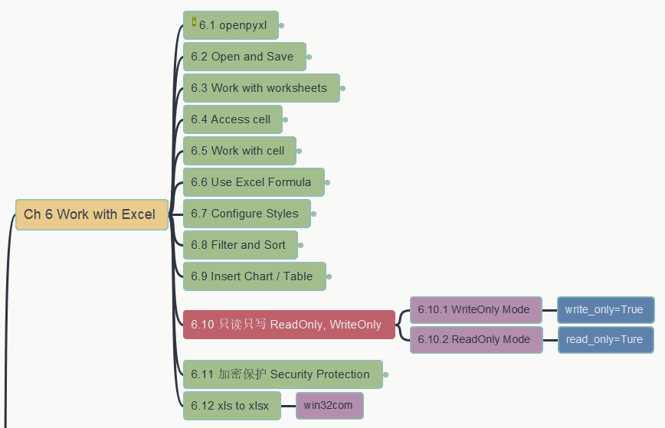
让Python遇上Office (Python with Office)
Chapter 6 Work with Excel
6.10 Read-Only, Write-Only
第六章 操作Excel
6.10 只读只写
https://github.com/yasenstar/python_with_office
https://gitee.com/yasenstar/python_with_office

Slide 40
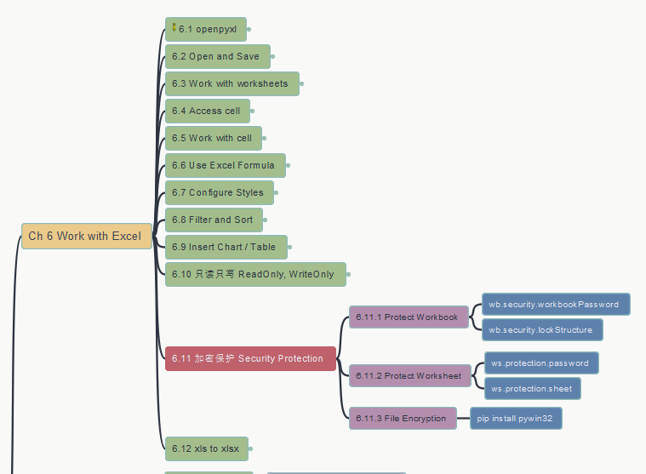
让Python遇上Office (Python with Office)
Chapter 6 Work with Excel
6.11 Security Protection
第六章 操作Excel
6.11 加密保护
https://github.com/yasenstar/python_with_office
https://gitee.com/yasenstar/python_with_office

Slide 41
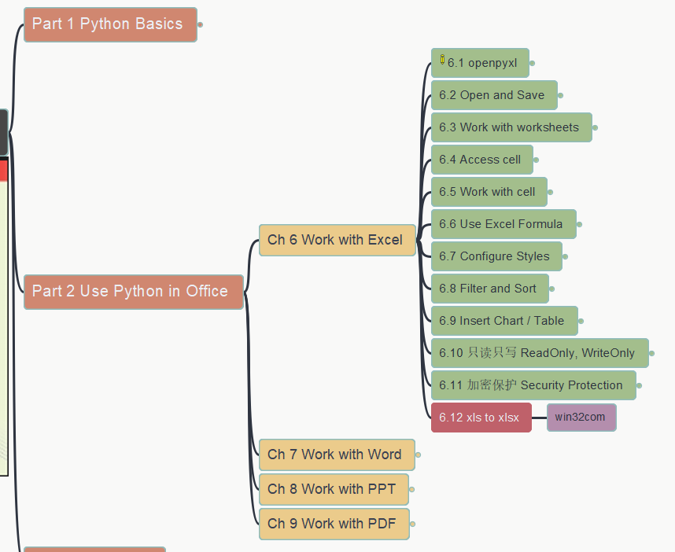
让Python遇上Office (Python with Office)
Chapter 6 Work with Excel
6.12 xls to xlsx
第六章 操作Excel
6.12 xls 转 xlsx
https://github.com/yasenstar/python_with_office
https://gitee.com/yasenstar/python_with_office

Slide 42
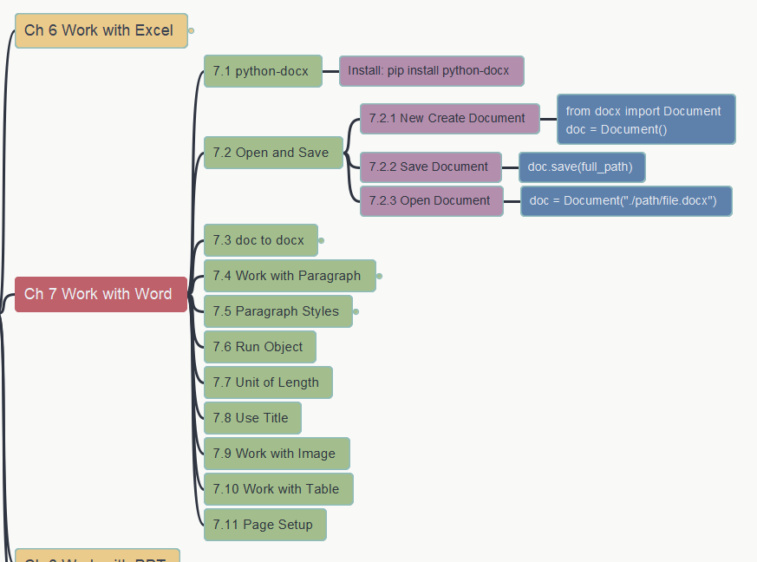
让Python遇上Office (Python with Office)
Chapter 7 Work with Word
7.1&7.2 Open and Save docx
第七章 操作Word
7.1&7.2 打开和保存docx文件
https://github.com/yasenstar/python_with_office
https://gitee.com/yasenstar/python_with_office

Slide 43
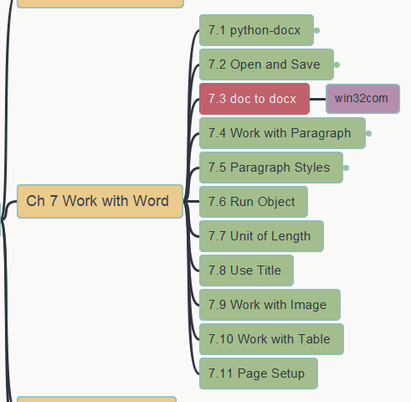
让Python遇上Office (Python with Office)
Chapter 7 Work with Word
7.3 doc to docx converting
第七章 操作Word
7.3 doc 转换为 docx
https://github.com/yasenstar/python_with_office
https://gitee.com/yasenstar/python_with_office

Slide 44
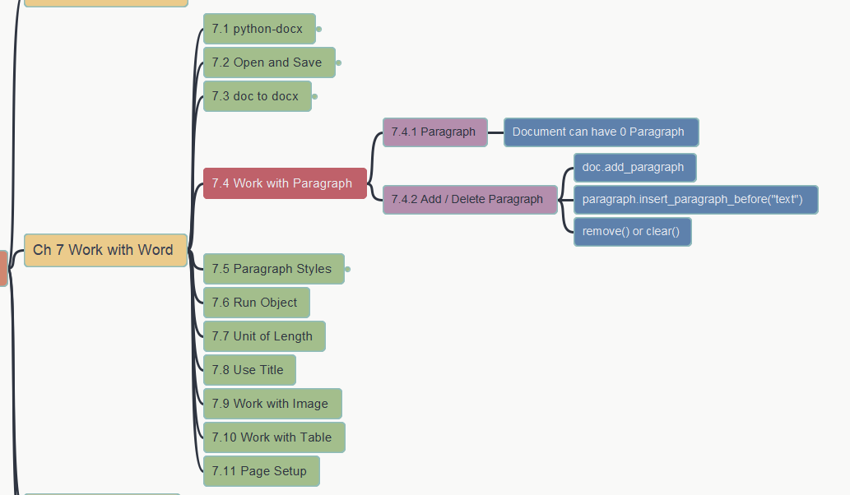
让Python遇上Office (Python with Office)
Chapter 7 Work with Word
7.4 work with paragraph
第七章 操作Word
7.4 段落操作
https://github.com/yasenstar/python_with_office
https://gitee.com/yasenstar/python_with_office

Slide 45
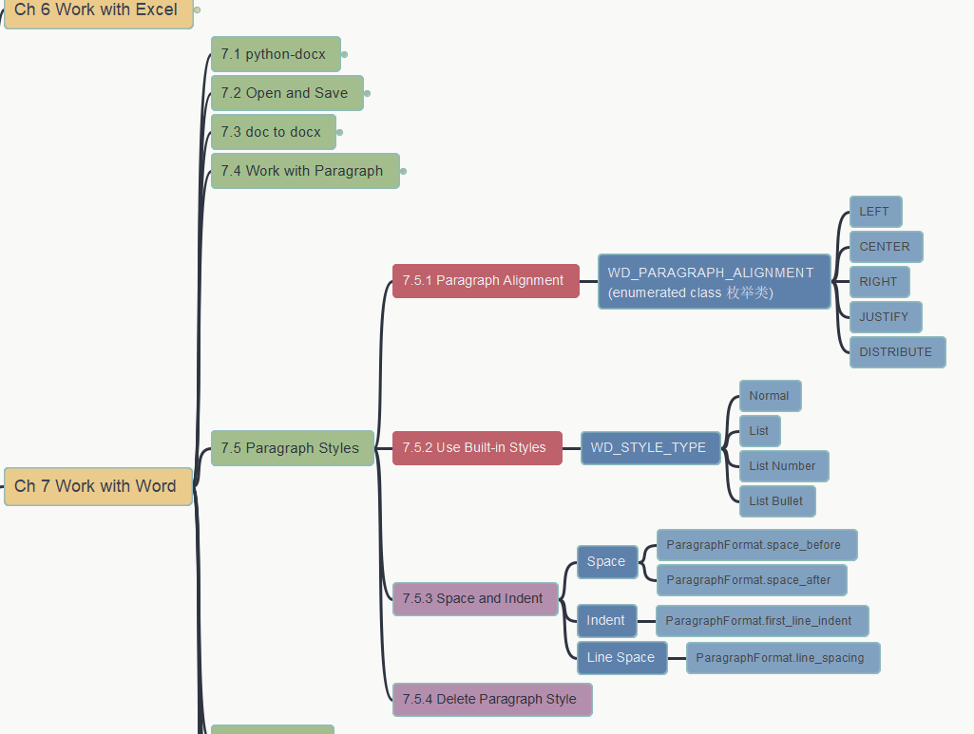
让Python遇上Office (Python with Office)
Chapter 7 Work with Word
7.5 paragraph styles (1)
第七章 操作Word
7.5 段落样式 (1)
https://github.com/yasenstar/python_with_office
https://gitee.com/yasenstar/python_with_office

Slide 46
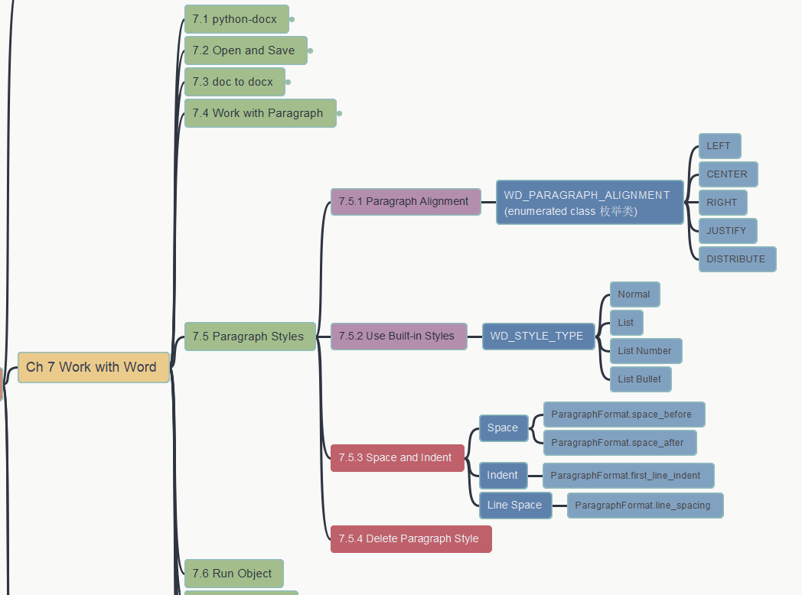
让Python遇上Office (Python with Office)
Chapter 7 Work with Word
7.5 paragraph styles (2)
第七章 操作Word
7.5 段落样式 (2)
https://github.com/yasenstar/python_with_office
https://gitee.com/yasenstar/python_with_office

Slide 47
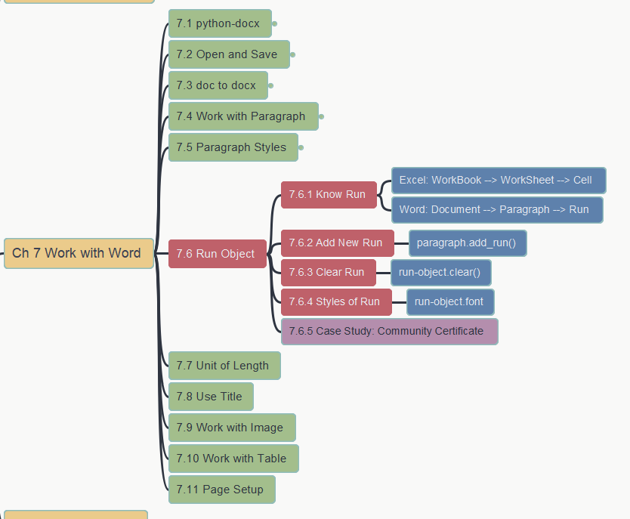
让Python遇上Office (Python with Office)
Chapter 7 Work with Word
7.6 Run Object (1)
第七章 操作Word
7.6 Run对象 (1)
https://github.com/yasenstar/python_with_office
https://gitee.com/yasenstar/python_with_office

Slide 48
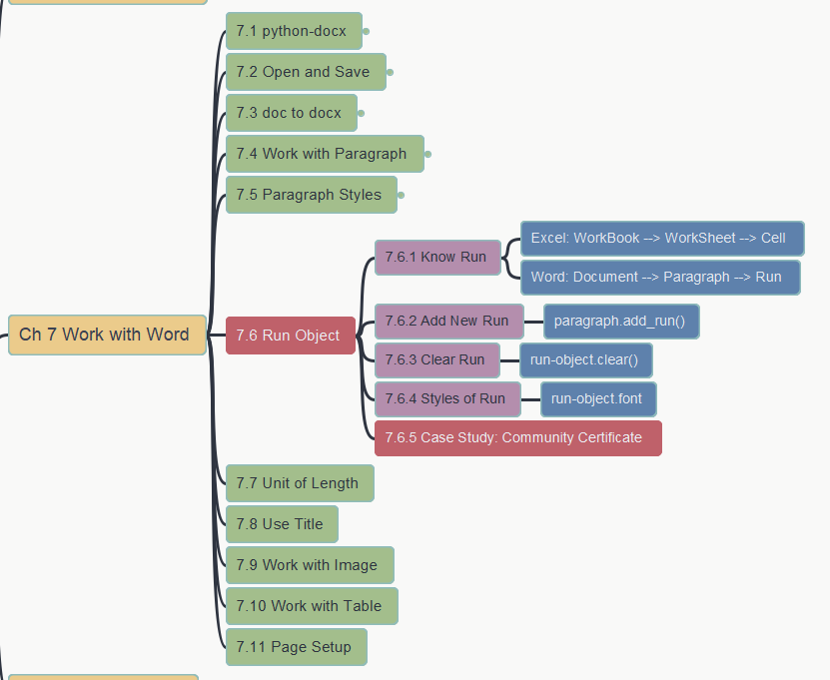
让Python遇上Office (Python with Office)
Chapter 7 Work with Word
7.6 Run Object (2) - 1
第七章 操作Word
7.6 Run对象 (2) - 1
https://github.com/yasenstar/python_with_office
https://gitee.com/yasenstar/python_with_office

Slide 49
让Python遇上Office (Python with Office)
Chapter 7 Work with Word
7.6 Run Object (2) - 2
第七章 操作Word
7.6 Run对象 (2) - 2
https://github.com/yasenstar/python_with_office
https://gitee.com/yasenstar/python_with_office

Slide 50
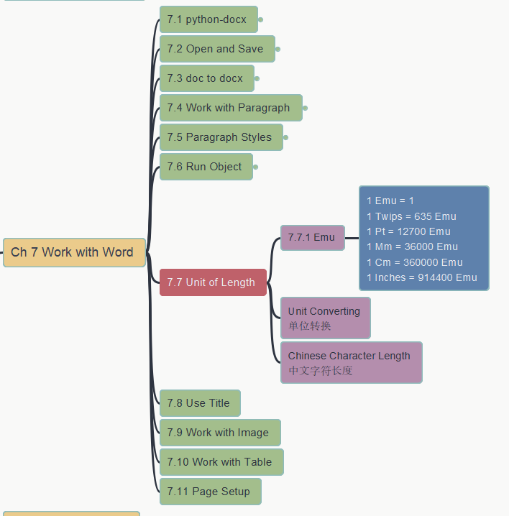
让Python遇上Office (Python with Office)
Chapter 7 Work with Word
7.7 Unit of Length
第七章 操作Word
7.7 长度单位
https://github.com/yasenstar/python_with_office
https://gitee.com/yasenstar/python_with_office

Slide 51
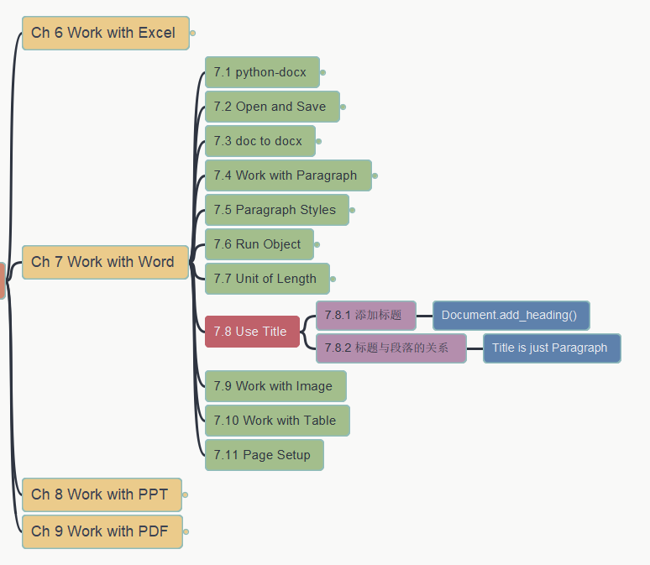
让Python遇上Office (Python with Office)
Chapter 7 Work with Word
7.8 Use Title
第七章 操作Word
7.8 使用标题
https://github.com/yasenstar/python_with_office
https://gitee.com/yasenstar/python_with_office

Slide 52
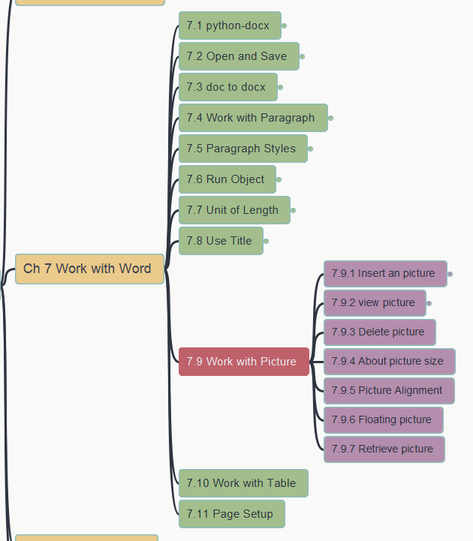
让Python遇上Office (Python with Office)
Chapter 7 Work with Word
7.9 Work with Pictures (1)
第七章 操作Word
7.9 插入图像 (1)
https://github.com/yasenstar/python_with_office
https://gitee.com/yasenstar/python_with_office

Slide 53
让Python遇上Office (Python with Office)
Chapter 7 Work with Word
7.9 Work with Pictures (2)
第七章 操作Word
7.9 插入图像 (2)
https://github.com/yasenstar/python_with_office
https://gitee.com/yasenstar/python_with_office

Slide 54
让Python遇上Office (Python with Office)
Chapter 7 Work with Word
7.9 Work with Pictures (3)
第七章 操作Word
7.9 插入图像 (3)
https://github.com/yasenstar/python_with_office
https://gitee.com/yasenstar/python_with_office

Slide 55
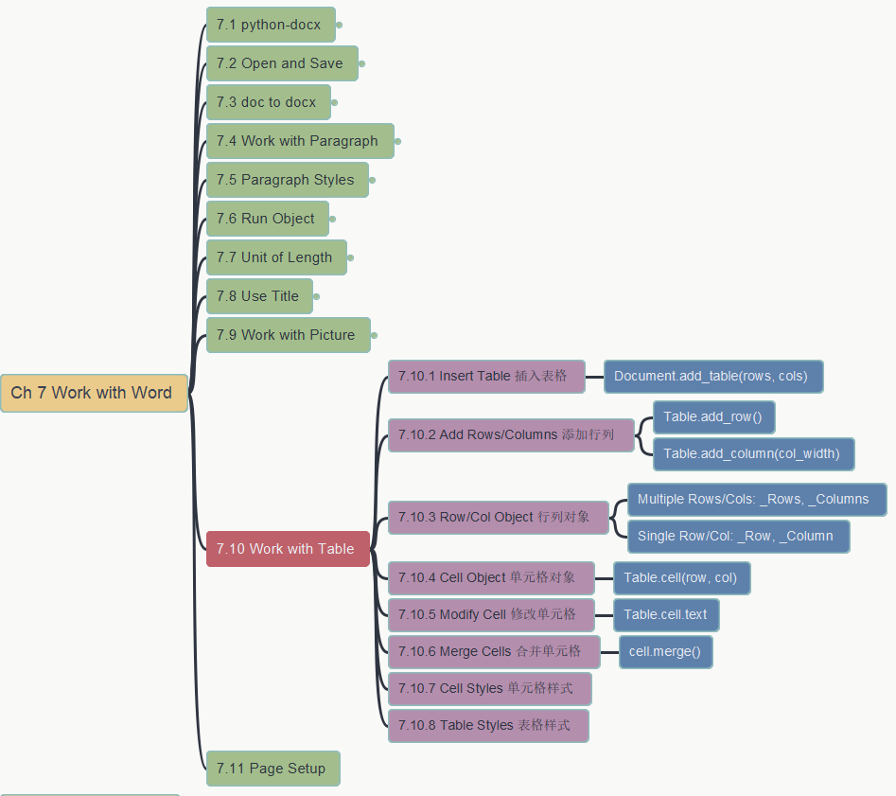
让Python遇上Office (Python with Office)
Chapter 7 Work with Word
7.10 Work with Tables (1)
第七章 操作Word
7.10 操作表格 (1)
https://github.com/yasenstar/python_with_office
https://gitee.com/yasenstar/python_with_office

Slide 56
让Python遇上Office (Python with Office)
Chapter 7 Work with Word
7.10 Work with Tables (2)
第七章 操作Word
7.10 操作表格 (2)
https://github.com/yasenstar/python_with_office
https://gitee.com/yasenstar/python_with_office

Slide 57
让Python遇上Office (Python with Office)
Chapter 7 Work with Word
7.10 Work with Tables (3)
第七章 操作Word
7.10 操作表格 (3)
https://github.com/yasenstar/python_with_office
https://gitee.com/yasenstar/python_with_office

Slide 58
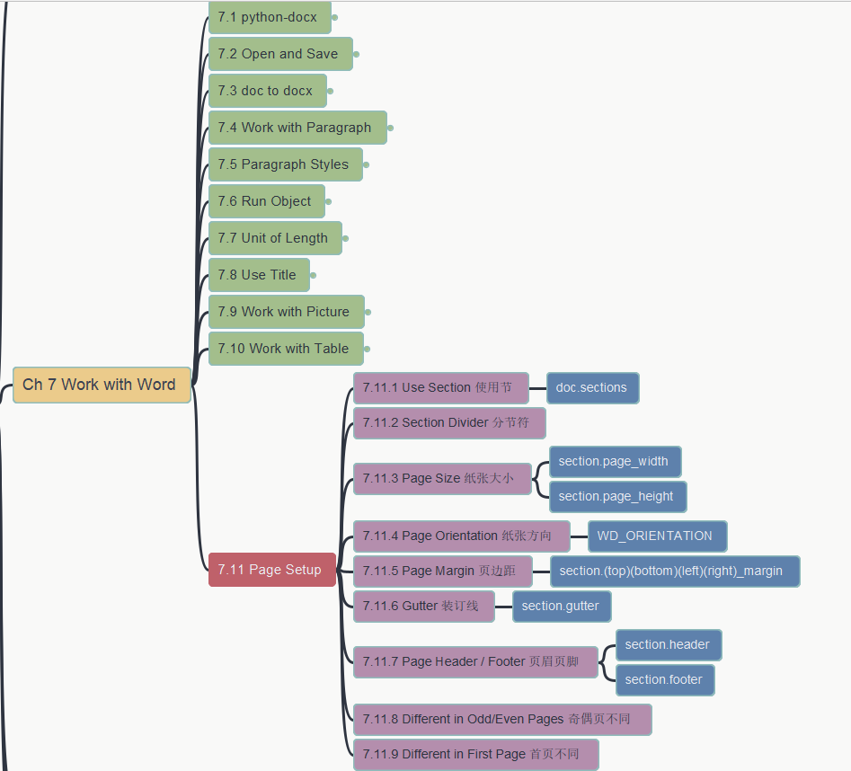
让Python遇上Office (Python with Office)
Chapter 7 Work with Word
7.11 Page Settings (1)
第七章 操作Word
7.11 页面设置 (1)
https://github.com/yasenstar/python_with_office
https://gitee.com/yasenstar/python_with_office

Slide 59
让Python遇上Office (Python with Office)
Chapter 7 Work with Word
7.11 Page Settings (2)
第七章 操作Word
7.11 页面设置 (2)
https://github.com/yasenstar/python_with_office
https://gitee.com/yasenstar/python_with_office

Slide 60
让Python遇上Office (Python with Office)
Chapter 7 Work with Word
7.11 Page Settings (3)
第七章 操作Word
7.11 页面设置 (3)
https://github.com/yasenstar/python_with_office
https://gitee.com/yasenstar/python_with_office

Slide 61
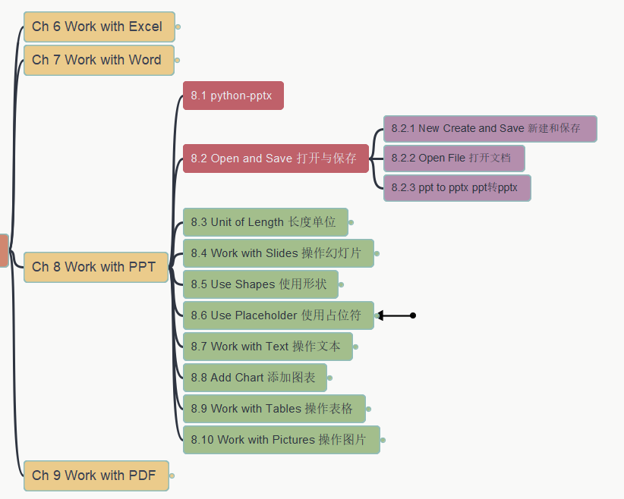
让Python遇上Office (Python with Office)
Chapter 8 Work with PPT
8.1 / 8.2 python-pptx, open/save
第七章 操作PPT
8.1 / 8.2 python-pptx, 打开与保存
https://github.com/yasenstar/python_with_office
https://gitee.com/yasenstar/python_with_office

Slide 62
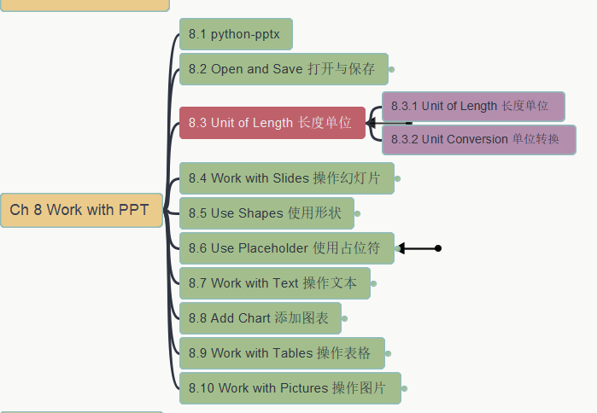
让Python遇上Office (Python with Office)
Chapter 8 Work with PPT
8.3 Unit of Length
第七章 操作PPT
8.3 长度单位
https://github.com/yasenstar/python_with_office
https://gitee.com/yasenstar/python_with_office

Slide 63
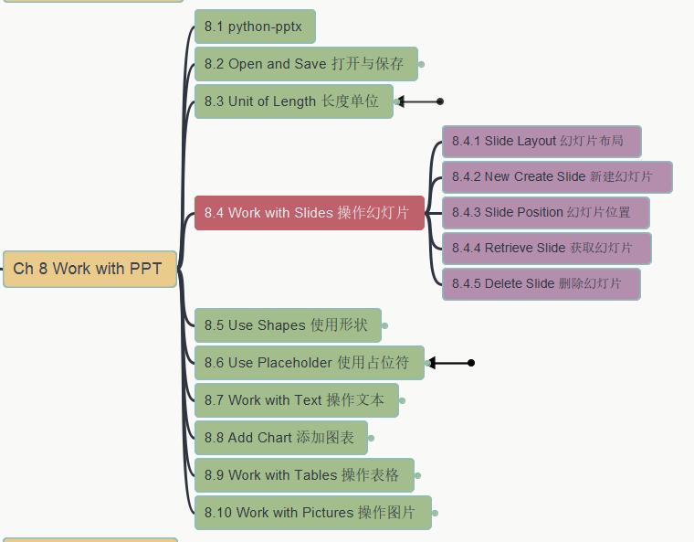
让Python遇上Office (Python with Office)
Chapter 8 Work with PPT
8.4 Work with Presentation
第七章 操作PPT
8.4 操作幻灯片
https://github.com/yasenstar/python_with_office
https://gitee.com/yasenstar/python_with_office

Slide 64

让Python遇上Office (Python with Office)
Chapter 8 Work with PPT
8.4 Work with Presentation
第七章 操作PPT
8.4 操作幻灯片
https://github.com/yasenstar/python_with_office
https://gitee.com/yasenstar/python_with_office

