Slide 1


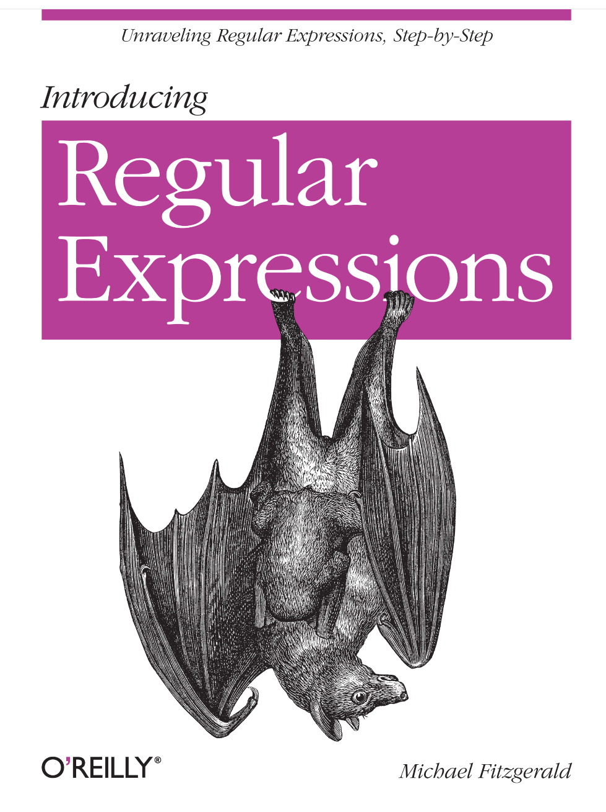
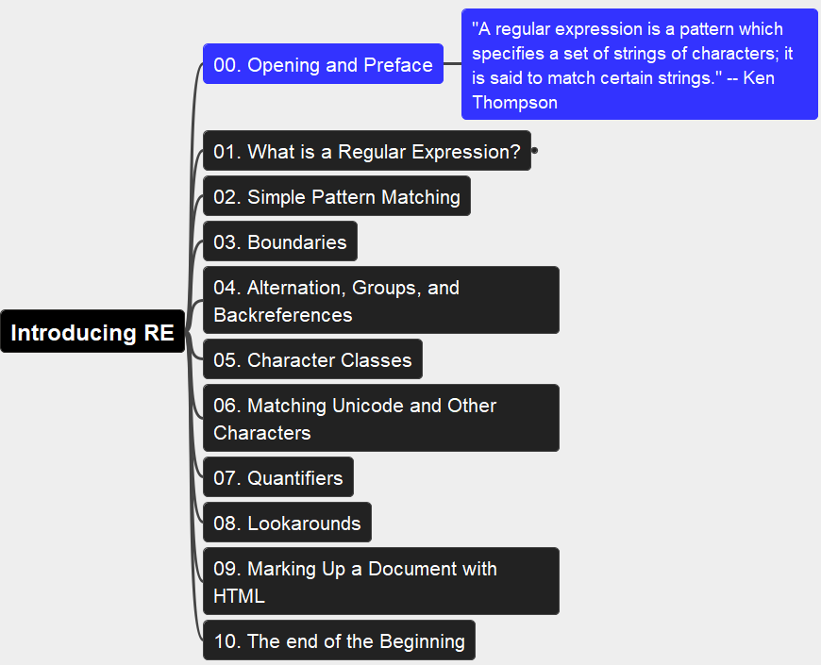
Introducing Regular Expressions
001
Opening and Preface
Thanks for Author: Michael Fitzgerald

Slide 2
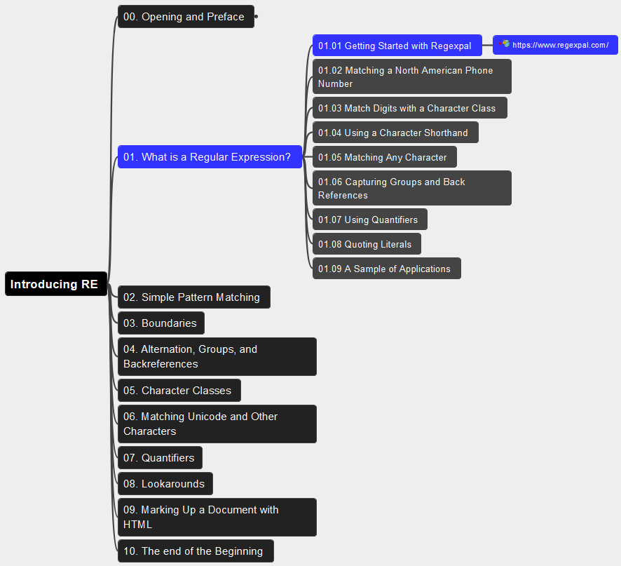
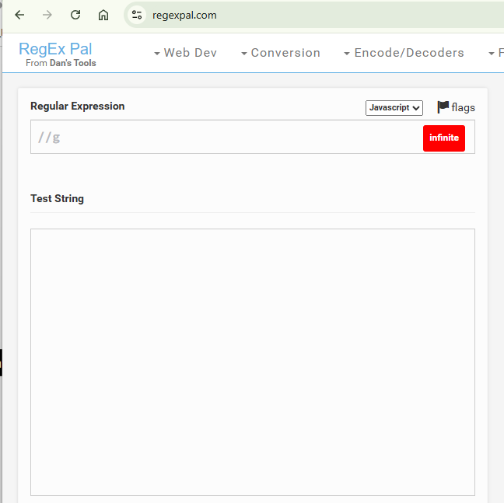
01. What is a Regular Expression? 01.01 Getting Started with Regexpal
002

Slide 3
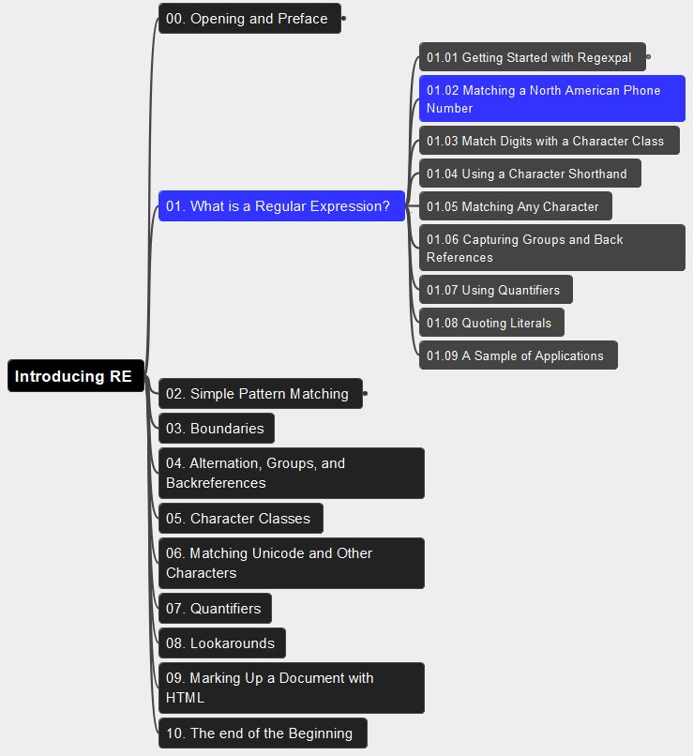
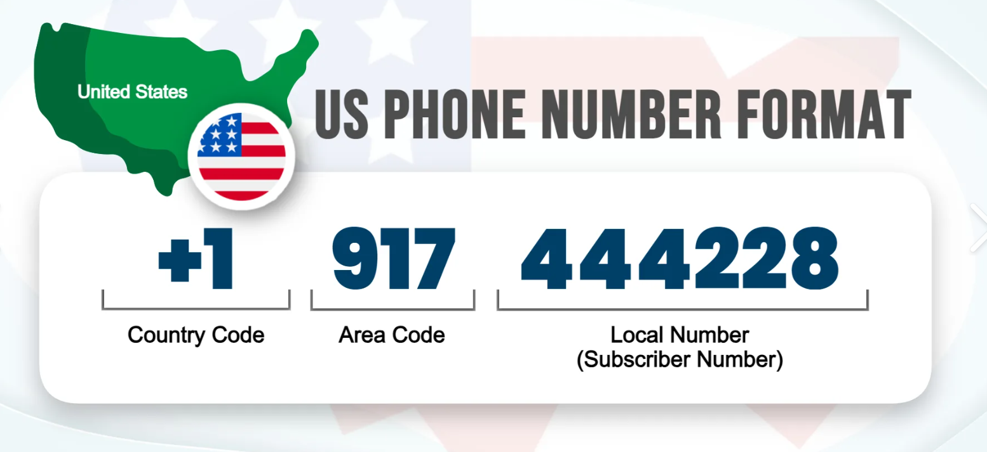
01. What is a Regular Expression? 01.02 Matching a North American Phone Number
003

Slide 4
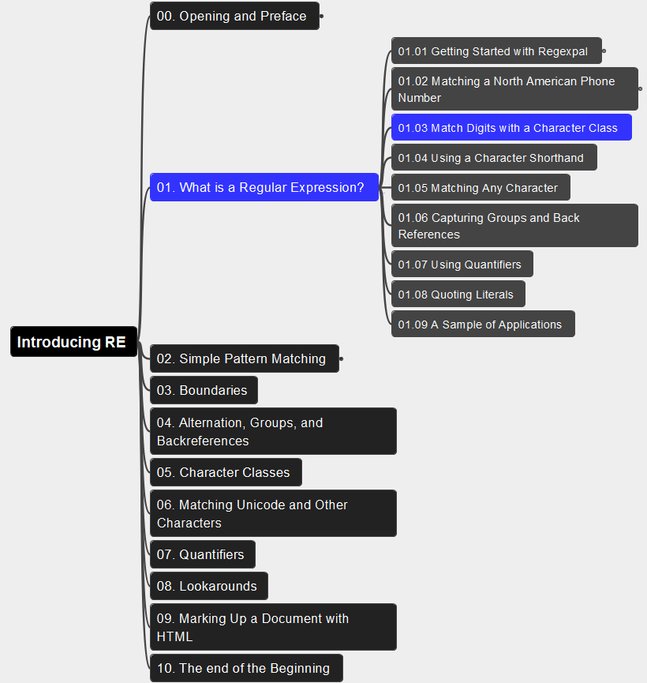
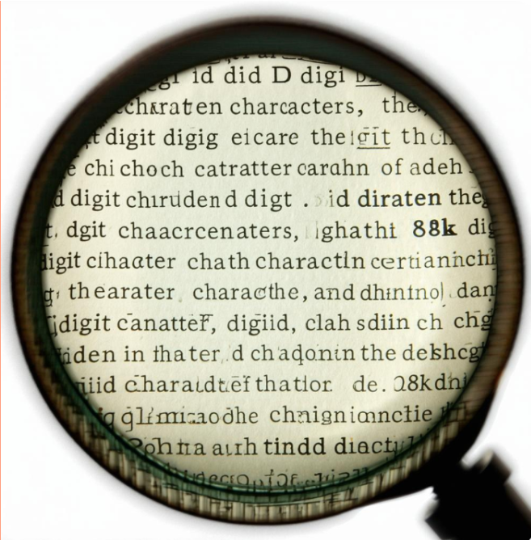
01. What is a Regular Expression? 01.03 Match Digits with a Character Class
004

Slide 5
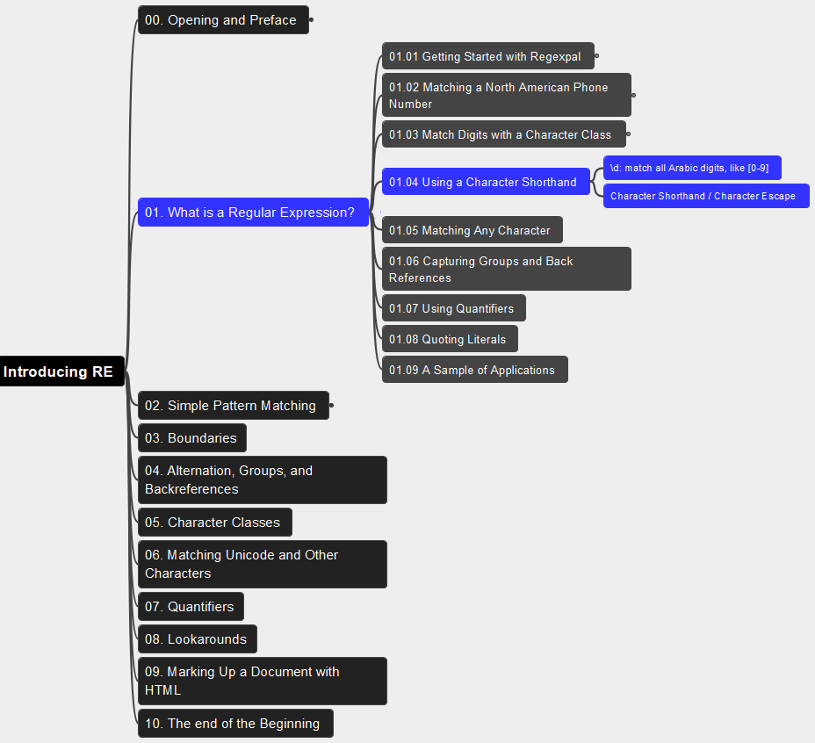
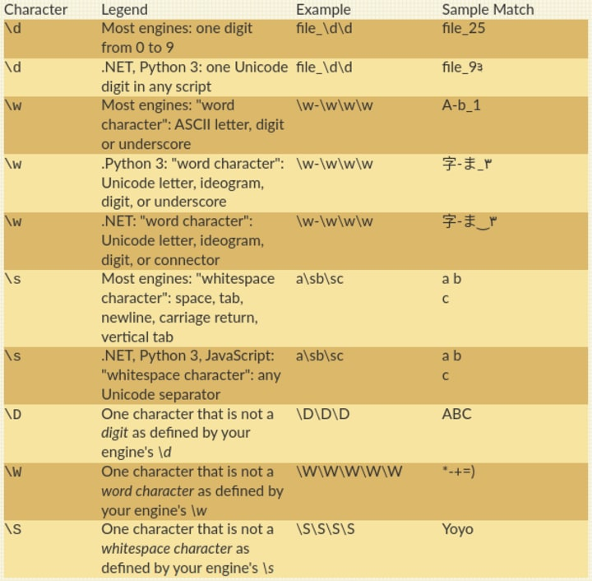
01. What is a Regular Expression? 01.04 Using a Character Shorthand
005

Slide 6
01. What is a Regular Expression? 01.05 Matching Any Character
006

Slide 7
01. What is a Regular Expression? 01.06 Capturing Groups and Back References
007

Slide 8
01. What is a Regular Expression? 01.07 Using Quantifiers
008

Slide 9
01. What is a Regular Expression? 01.08 Quoting Literals
009

Slide 10
01. What is a Regular Expression? 01.09 A Sample of Applications
010

Slide 11

Thank You!
someone@Example.com

