Slide 1


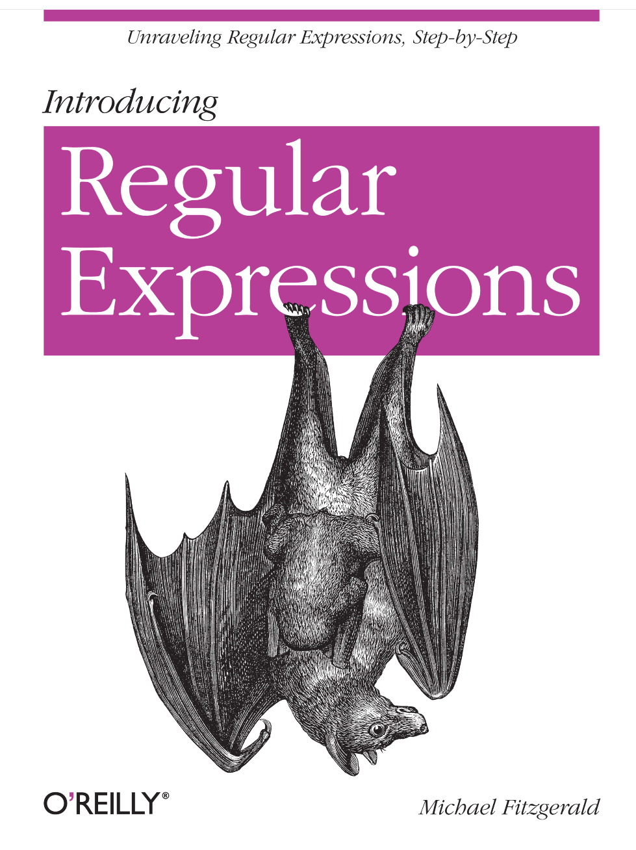
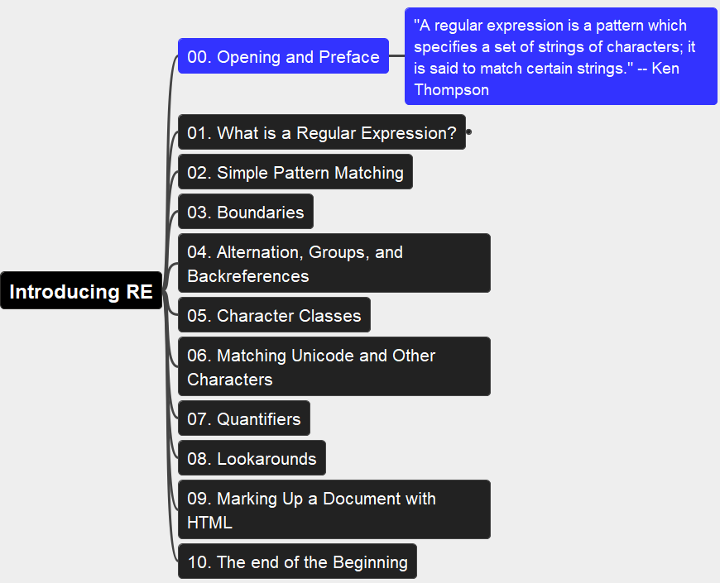
Introducing Regular Expressions
001
Opening and Preface
Thanks for Author: Michael Fitzgerald

Slide 2
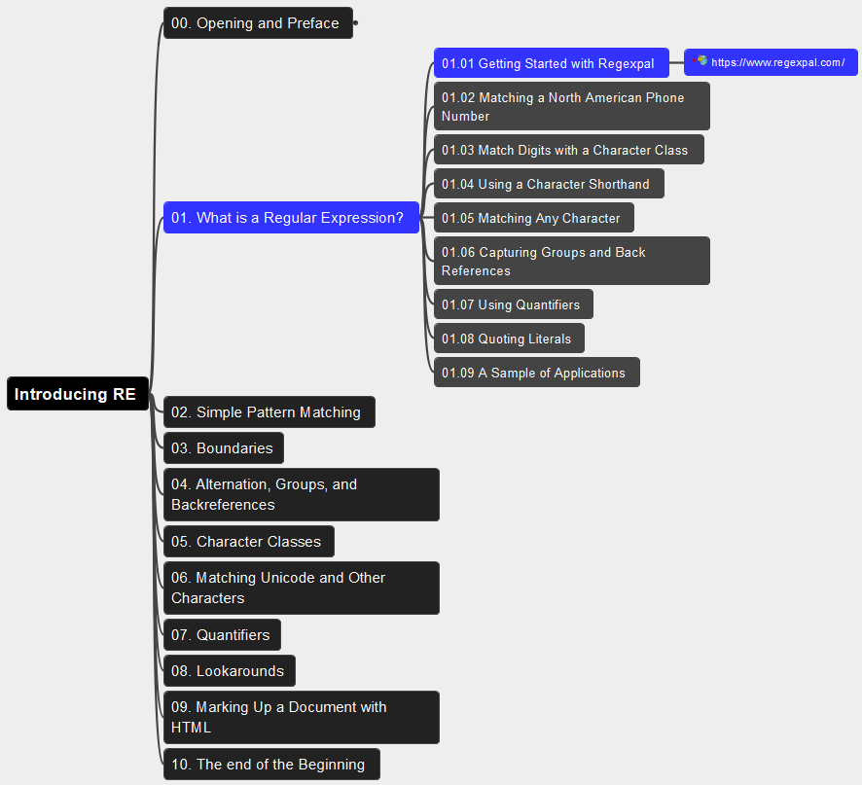
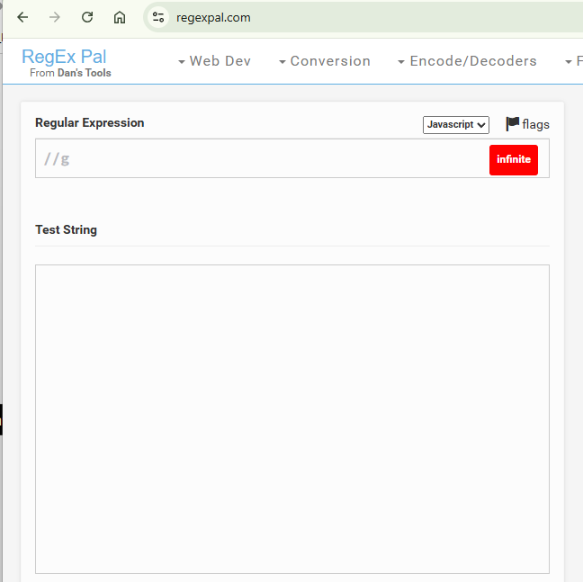
01. What is a Regular Expression? 01.01 Getting Started with Regexpal
002

Slide 3
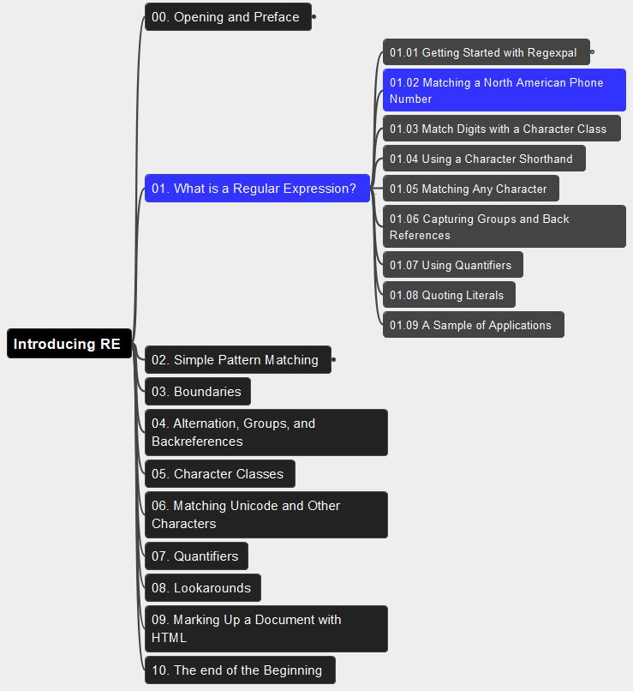
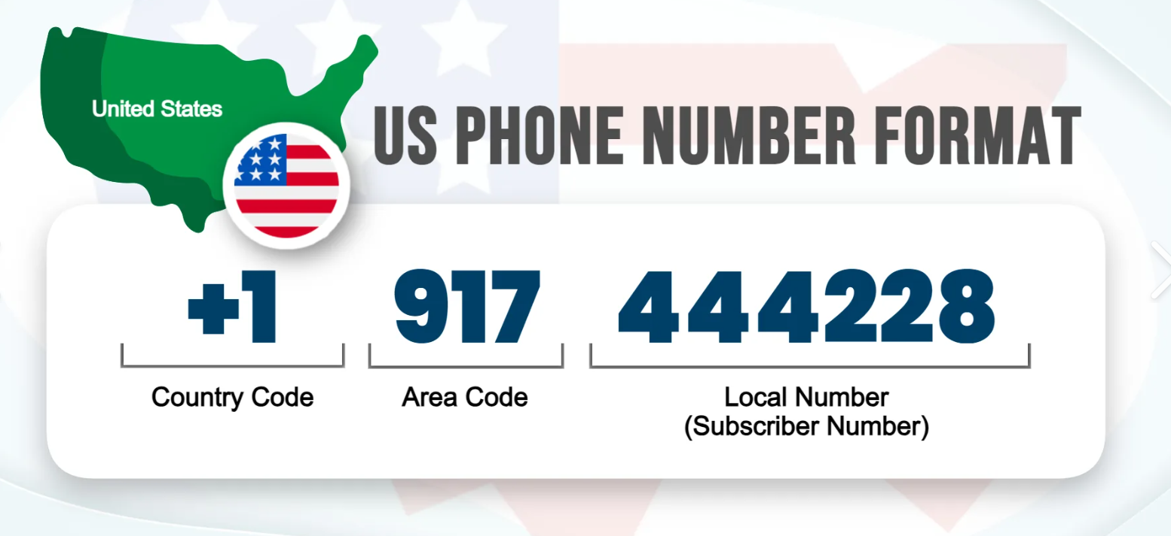
01. What is a Regular Expression? 01.02 Matching a North American Phone Number
003

Slide 4

Thank You!
someone@Example.com

