Slide 1


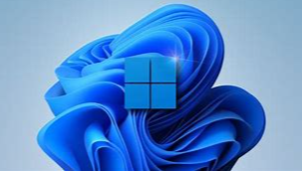

How to Find and Download Windows Spotlight Wallpaper
Enable Spotlight as Your Personalized Wallpaper
Find and Get Favorite Wallpaper Image
Use Windows App to Browse and Download Spotlight Wallpaper

