Slide 1

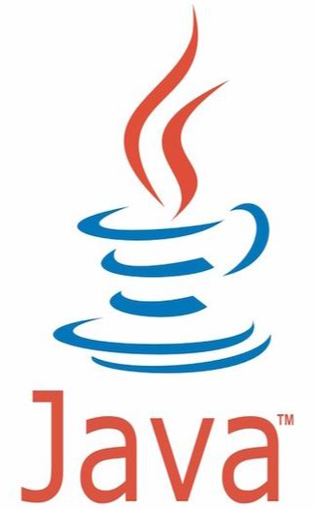

Constructor – Java vs. Python

Slide 2
Definition of Constructor Method
Java
Java’s constructor method is one method having same name as class
No return type, even no “void”
Using “new” to call when object is creating
No “self” or “this” as default argument, able to use “this” key word to call current object
Python
Python’s constructor method is one special method, called “__init__”
“__init__” is automatically called when the object is created, used for initializing the properties of object
The first argument of “__init__” must be “self”, refers to the class’ instance itself

Slide 3
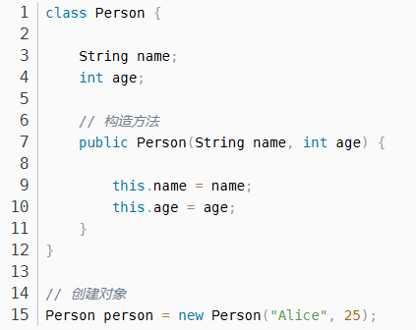
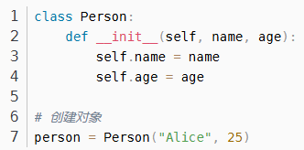
Definition of Constructor Method
Java
Python

Slide 4
Calling Constructor Method
Java
Use “new” to call explicitly
Must use “new” to create object then call
Python
Call automatically when the object is created, no need call explicitly
When creating the object, directly call the class name and transit the arguments

Slide 5
构造方法 Constructor – Java vs. Python

Slide 6
构造方法的定义
Java
Java的构造方法是一个与类同名的方法，没有返回类型（连void也没有）
构造方法在对象创建时通过new关键字调用
Java的构造方法没有self或this作为默认参数，但可以使用this关键字访问当前对象
Python
Python的构造方法时一个特殊的方法，名为__init__
__init__方法在对象创建时自动调用，用于初始化对象的属性
__init__方法的第一个参数必须是self，表示类的实例本身

Slide 7
构造方法的定义
Java
Python

Slide 8
构造方法的调用
Java
Java的构造方法通过new关键字显式调用
创建对象时，必须使用new关键字并调用构造方法
Python
Python的构造方法在对象创建时自动调用，不需要显式调用
创建对象时，直接调用类名并传递参数即可

