Slide 1
HTML/CSS Exercises
-Borders
-Fonts
-Tables
-Images
-Links
-Pseudo-Classes
-Descendant Selectors

Slide 2
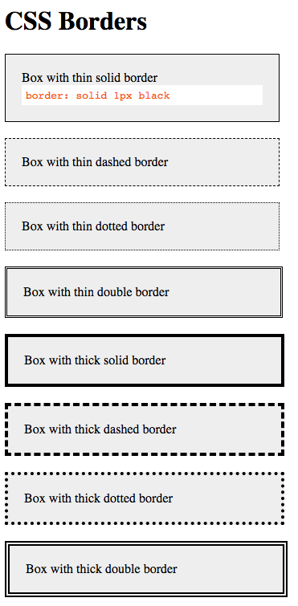

Slide 3
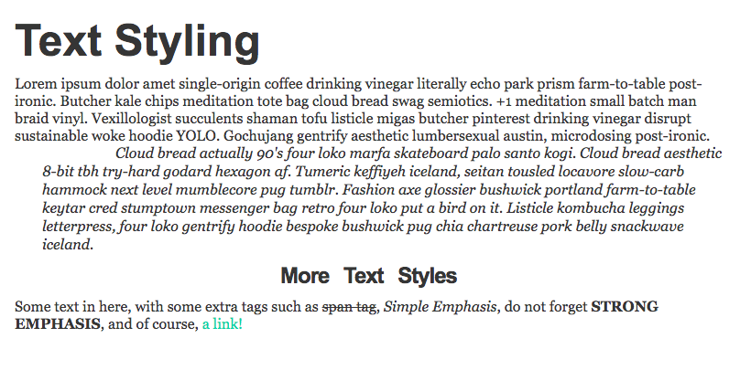

Slide 4
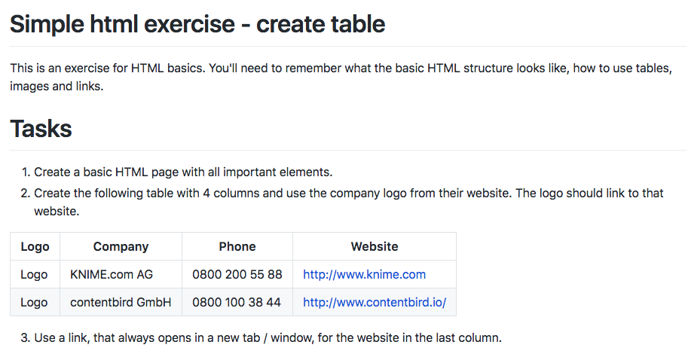

Slide 5
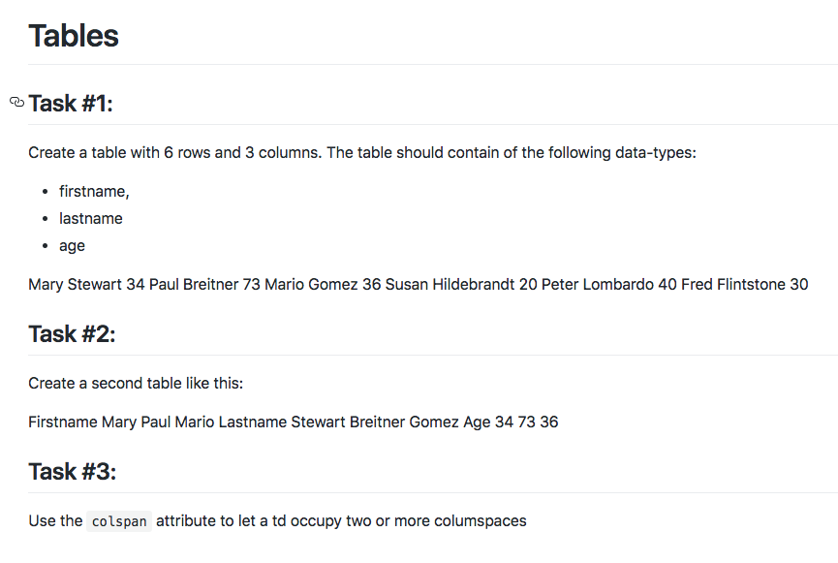

Slide 6
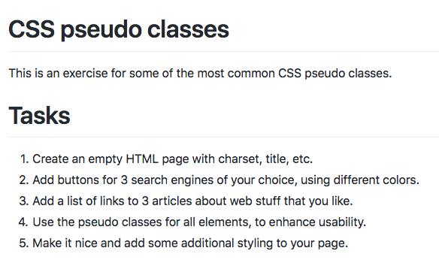

Slide 7
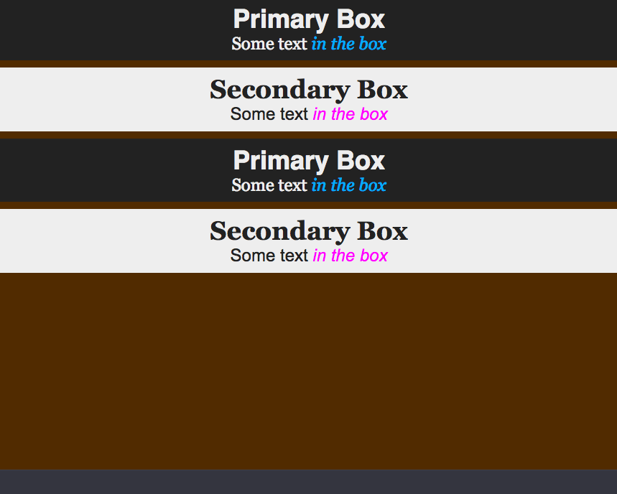
Create the following layout using descendant selectors.

