Slide 1
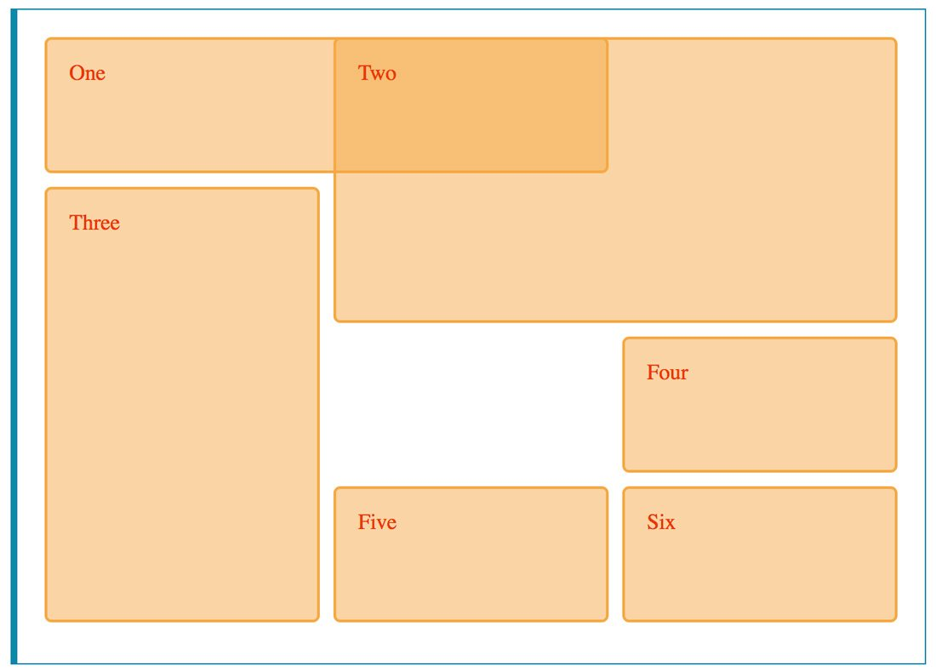
CSS Grid Layout

Slide 2
CSS Grid Layout is an extremely powerful tool that allows developers to divide and style the page using columns and rows. We can also manipulate the container’s child elements to overlap and layer without using positioning or float.

Slide 3
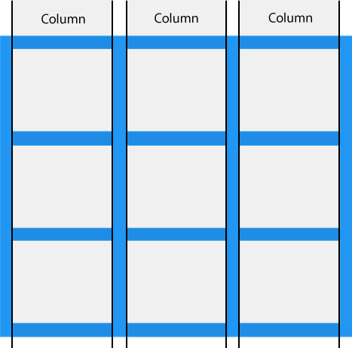
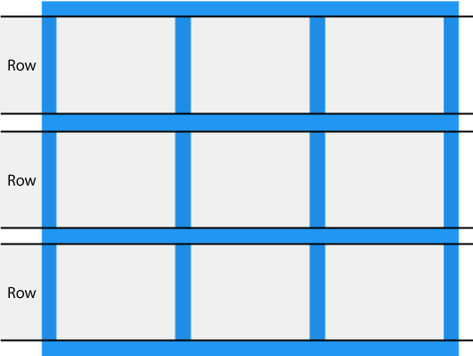

Slide 4
A grid layout is made up of a parent element and one or more child elements. We need to set the parent element to display: grid or display: inline-grid. Then, all children automatically become grid items.
.grid-container {
display: grid;
}
.grid-container {
display: inline-grid;
}
block-level grid container inline-level grid container

Slide 5
We need to add the number of columns and rows to the container AND we need to specify the columns’ and rows’ width by using grid-template-columns and grid-template-rows
.grid-container {
display: grid;
grid-template-columns: 30px 200px auto 100px;
grid-template-rows: 100px 100px 100px 100px;
}

Slide 6
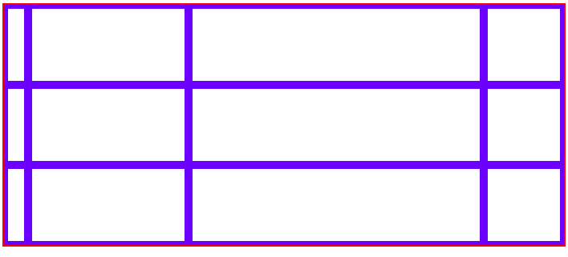
.grid-container {
border: 2px solid red;
display: grid;
grid-template-columns: 30px 200px auto 100px;
grid-template-rows: 100px 100px 100px;
}

Slide 7
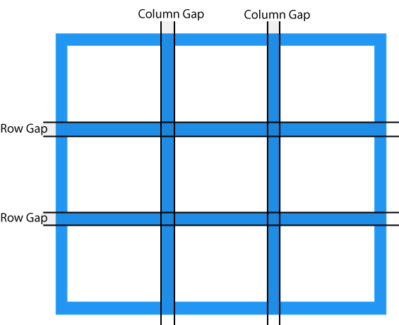
Grid Gaps We can adjust the gap size by using one of the following properties: grid-column-gap grid-row-gap grid-gap

Slide 8
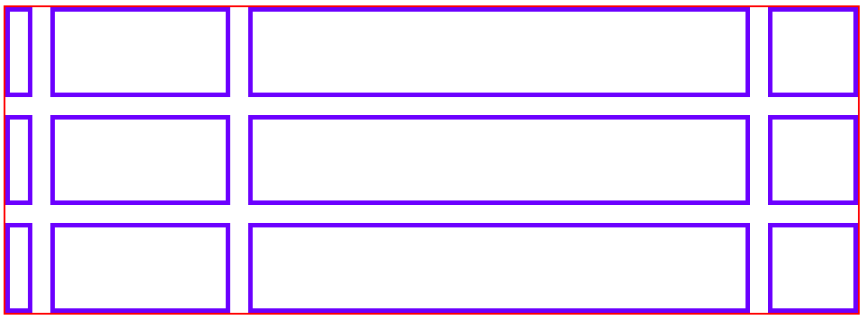
.grid-container { border: 2px solid red; display: grid; grid-template-columns: 30px 200px auto 100px; grid-template-rows: 100px 100px 100px 100px; grid-gap: 20px; }

Slide 9
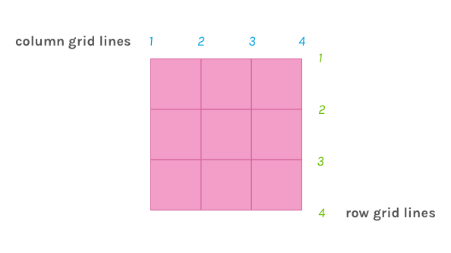
Grid lines are horizontal and vertical lines which divide the grid.

Slide 10
The grid line numbers are used when placing grid items inside the container. We can specify that a grid item should be placed at a specific grid line OR span from one grid line to another by using the line numbers. We specify this in the grid item itself.

Slide 11
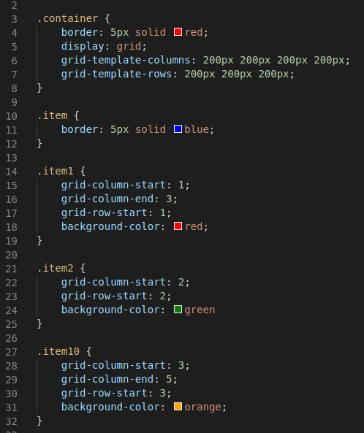
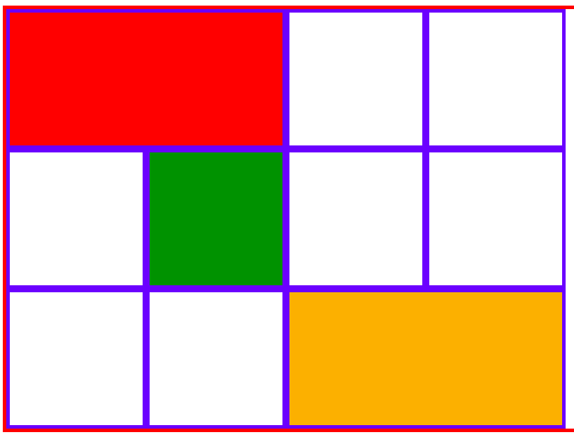
1
2
3
4
5
1
2
3
4

Slide 12
We can also use shorthand to indicate grid-column-start, grid-column-end, grid-row-start, grid-row-end.
The item will start at column 1 and end at column 3. It will start on row 1 and end on row 1.
.item1 {
grid-column: 1/3;
grid-row: 1;
}

Slide 13
When defining our grid’s rows and columns, we can also name our grid lines. We can use these names instead of the grid line numbers.

Slide 14
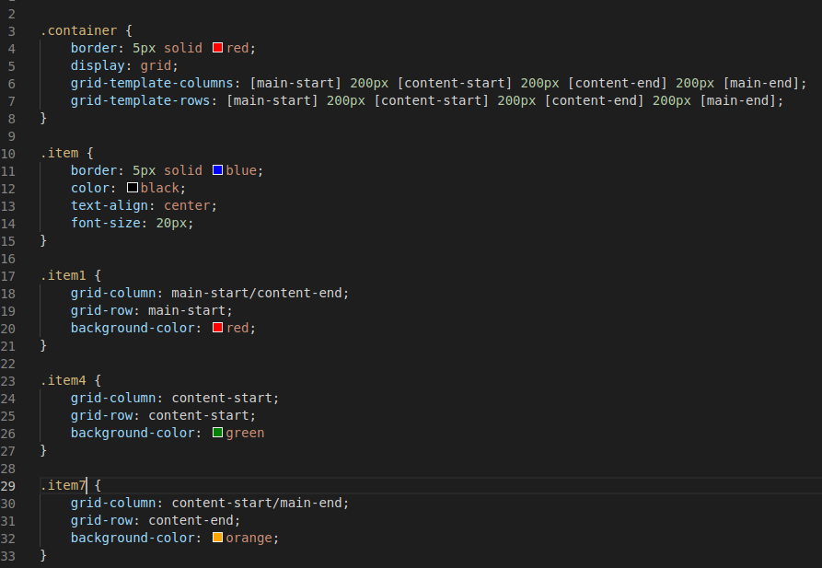
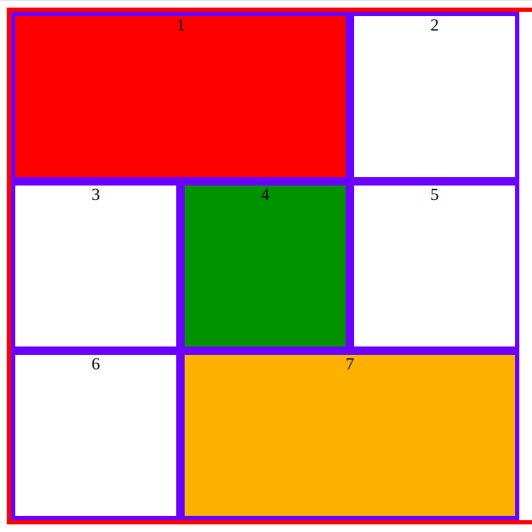

Slide 15
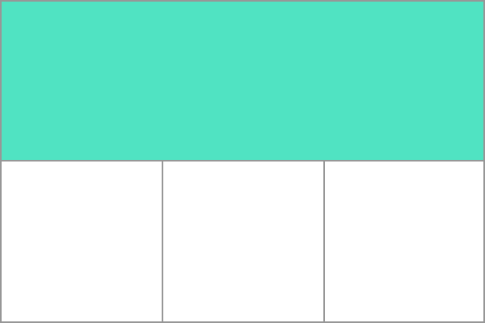
Grid Areas Just as we can specify how many columns and rows we can have, we can also target grid areas.

Slide 16
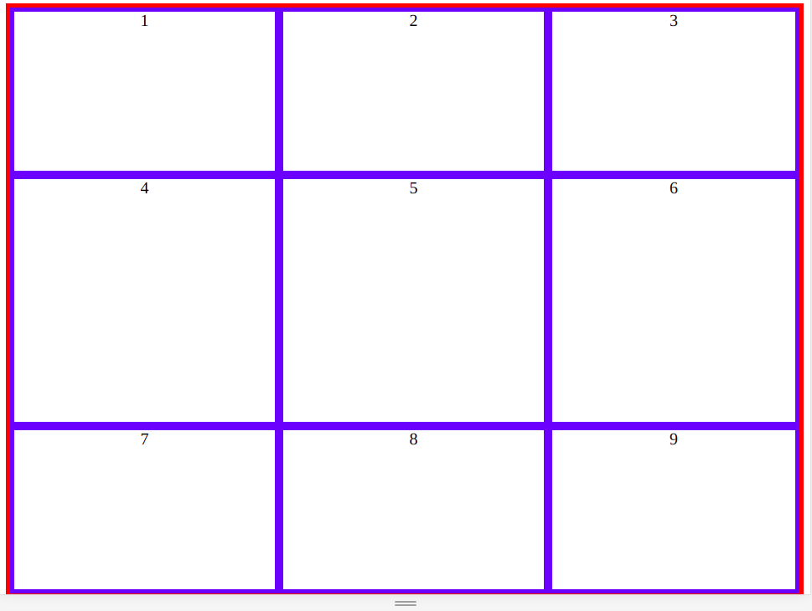
If we want to target items 1, 2, 4 and 5 as a whole, we can do so by using grid-template-areas on our container.

Slide 17
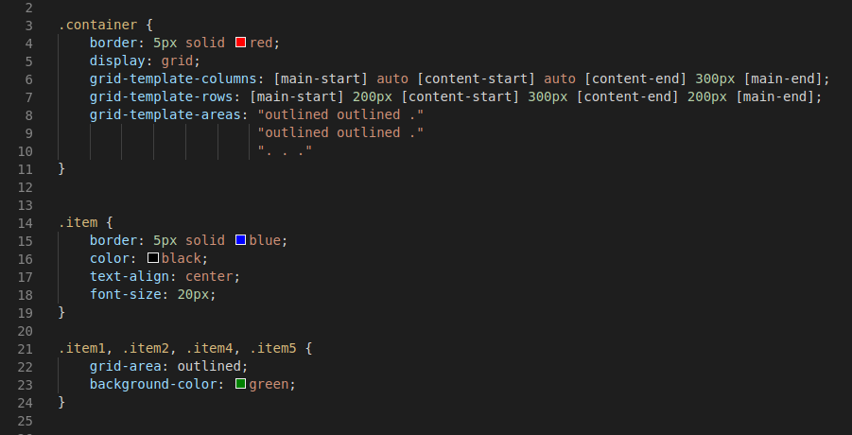
We can name and specify the grid area in the container.
A “ . ” represents a grid cell that is NOT part of our grid area.
We can then select the items that we want in our grid area.

Slide 18
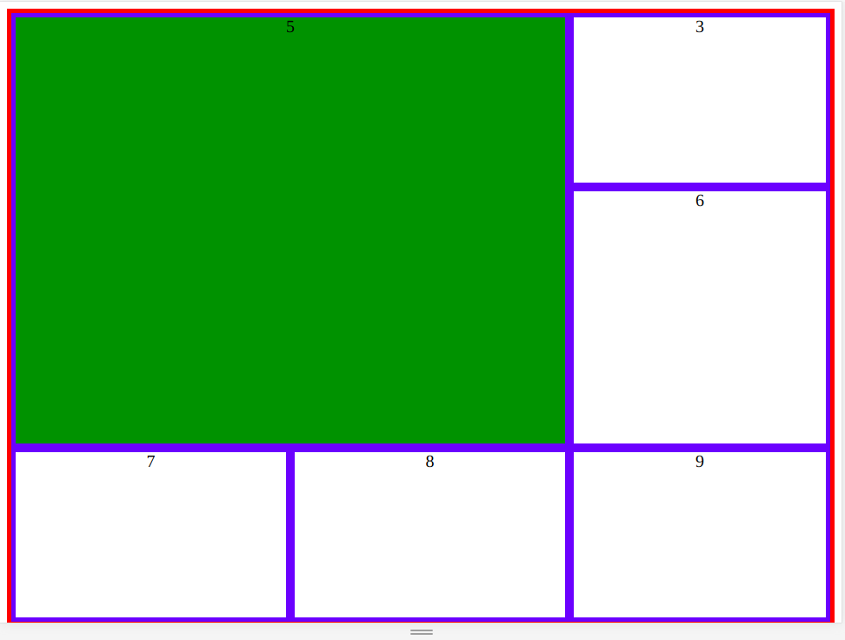
Note: there are no borders around the grid cells since we are targeting an area and NOT individual grid cells
We can name and specify the grid area in the container.
A “ . ” represents a grid cell that is NOT part of our grid area.
We can then select the items that we want in our grid area.

Slide 19
The Fr Unit With Grid Layout, we can use a flexible unit: fr. 1fr is equal to 1 part of the available space.

Slide 20
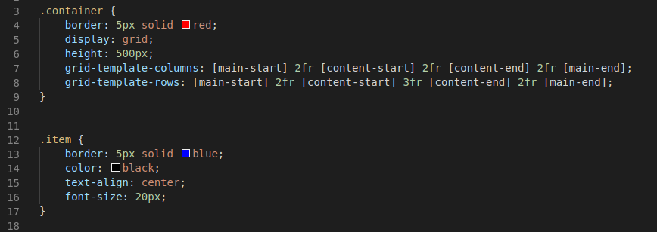
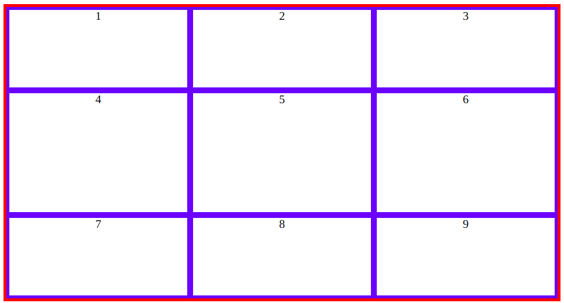
All columns are taking up 2 parts of the available space. Rows 1 and 3 are taking up 2 parts, while row 2 is taking up 3 parts of the available space.

Slide 21
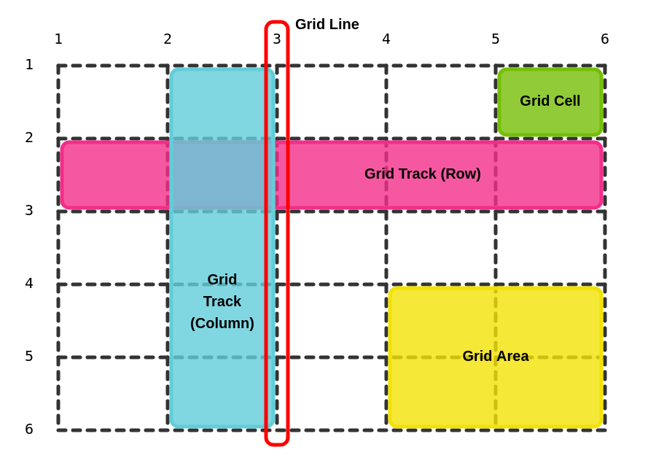
For Reference

Slide 22
Game to Practice! https://cssgridgarden.com/

