Slide 1
CSS Selectors Exercises

Slide 2
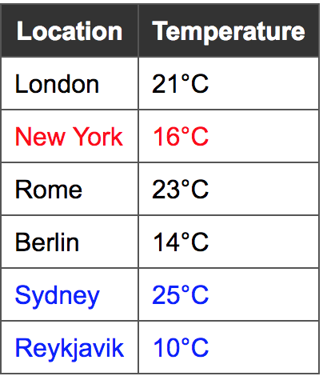
Q1. Use Combinator selectors

Slide 3
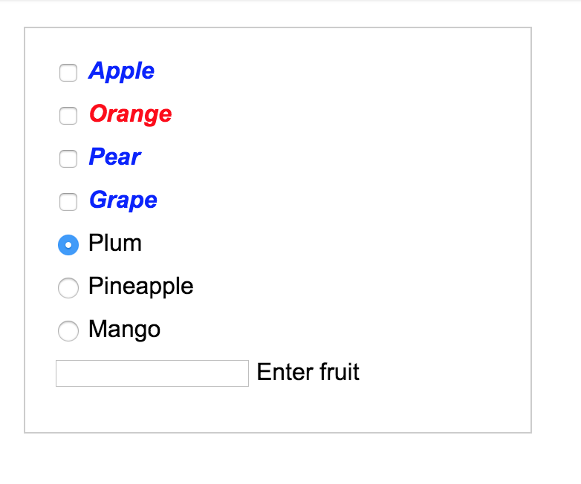
Q2. Use Attribute selectors

Slide 4
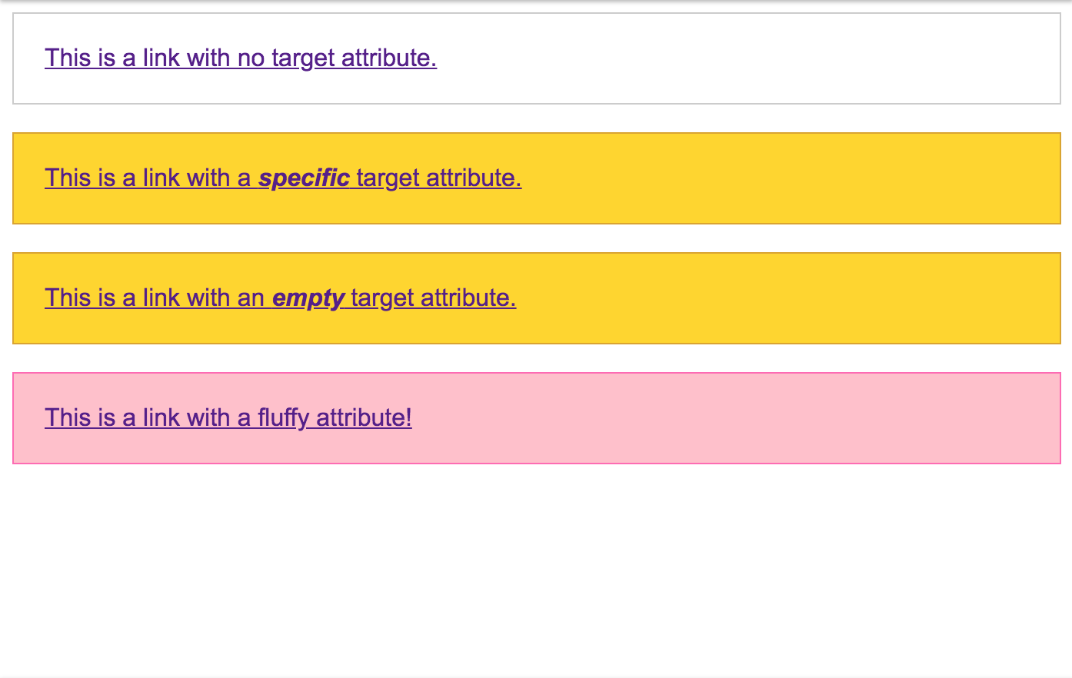
Q3. Use Attribute selectors

Slide 5
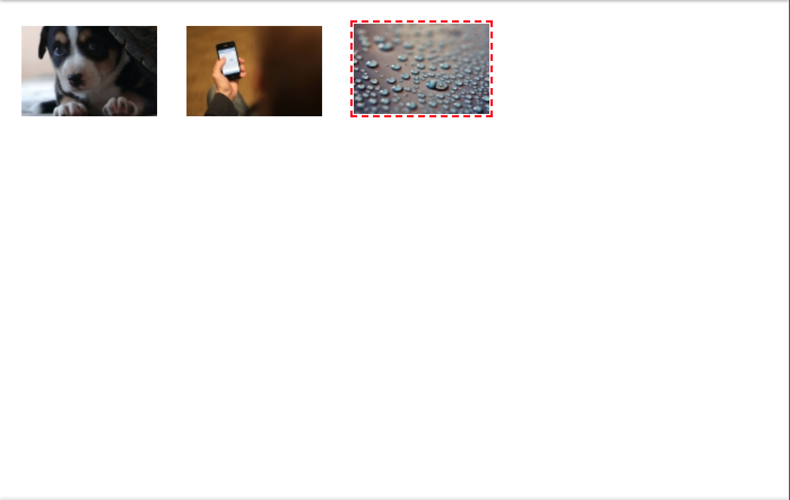
Q4. Use Attribute selectors

Slide 6
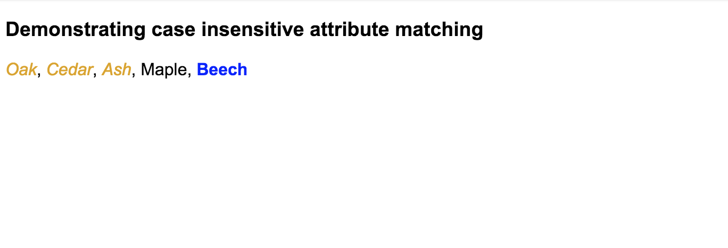
Q5. Use Attribute selectors

Slide 7
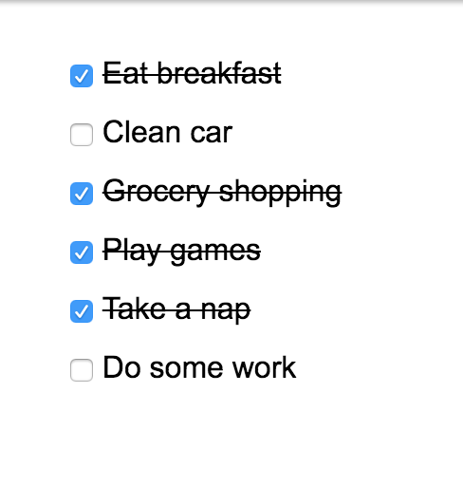
Q6. Use :not

Slide 8
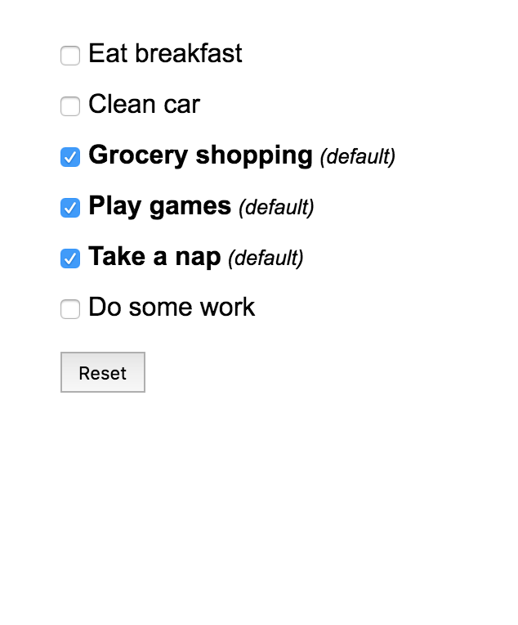
Q7. Use :nth-child()

Slide 9
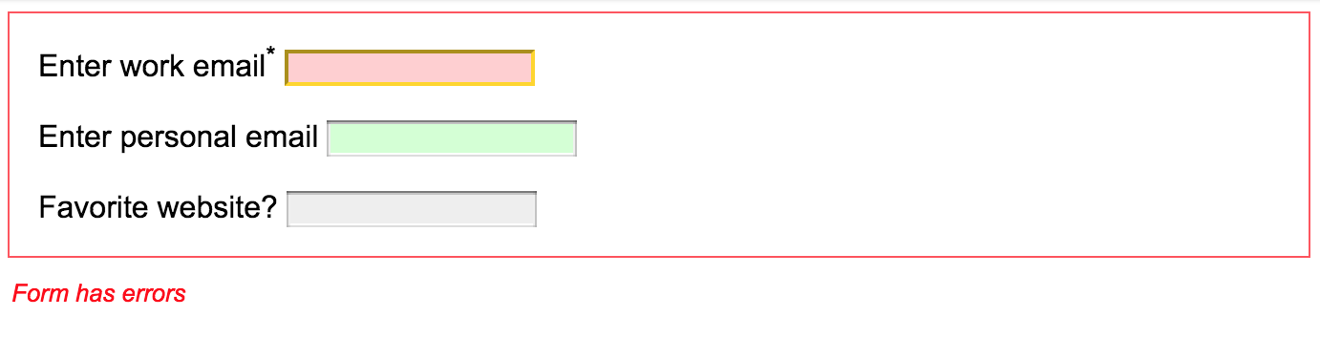
Q8. Use Combinators/ Pseudo-Classes

Slide 10
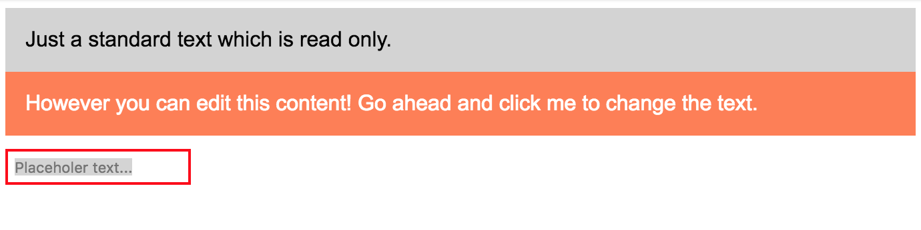
Q9. Use Pseudo-Classes/Combinators

Slide 11
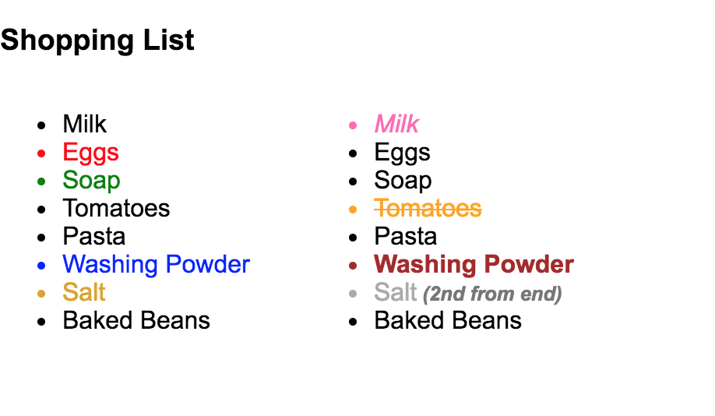
Q10. Use Pseudo-Classes/Combinators

Slide 12
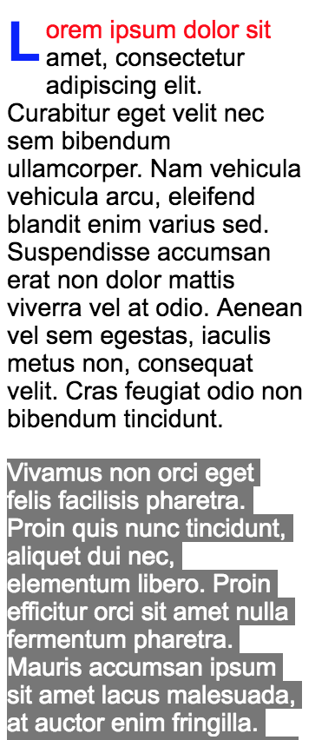
Q11. Use Pseudo-Classes/Combinators

Slide 13
Q12. Solve the following
https://github.com/Dorcolac/css-selectors-exercise
https://repl.it/@ChrisSg/

Slide 14
Q14. In the provided html, do the following:
<div id="target"> <h2>Where the Buggalo Roam</h2> <p>Alright, let's mafia things up a bit. Joey, burn down the ship. Clamps, burn down the crew. No! Don't jump! Dr. Zoidberg, that doesn't make sense.</p> <div> <p>Does anybody else feel jealous and aroused and worried?</p> </div> <h2>The Mutants Are Revolting</h2> <p>But, okay! I just want to talk. It has nothing to do with mating. Fry, that doesn't make sense.</p> <h2>Space Pilot 3000</h2> <p>Now, now. Perfectly symmetrical violence never solved anything.</p> </div>
https://benhowdle.im/cssselectors/

Slide 15
Q14. Continued
Use “first-of-type” selector on the p tag to make it green.
Use “first-child” selector on the p tag to make it green.
Make all p tags green.
Make only the direct children p tags of #target green.
Use “nth-child” to make the first child of #target green/
Make the first line of all p tags green.

Slide 16
Q15. repl.it
https://repl.it/@synesthesia/

Slide 17
https://blog.logrocket.com/level-up-your-css-selector-skills-5d7bb45ddd37

