Slide 1
HTML

Slide 2
HTML Formatting Elements
<b> - Bold text
<strong> - Important text
<i> - Italic text
<em> - Emphasized text
<mark> - Marked text
<small> - Small text
<del> - Deleted text
<ins> - Inserted text
<sub> - Subscript text
<sup> - Superscript text
Browsers display <strong> as <b>, and <em> as <i>. However, there is a difference in te meaning of these tags: <b> and <i> defines bold and italic text, but <strong> and <em> means that the text is important.

Slide 3
HTML5 Semantic Elements
Semantic elements are those elements which clearly define their content. Semantic tag clearly describes it’s meaning to both the browser and developer.
<article> Defines an article
<aside> Defines content aside from the page content
<details> Defines additional details that the user can view or hide
<figcaption> Defines a caption for a <figure> element
<figure> Specifies self-contained content, like illustrations, diagrams, photos, code listings, etc.
<footer> Defines a footer for a document or section
<header> Specifies a header for a document or section
<main> Specifies the main content of a document
<mark> Defines marked/highlighted text
<nav> Defines navigation links
<section> Defines a section in a document
<summary> Defines a visible heading for a <details> element
<time> Defines a date/time. It can also be used to encode dates and times in a machine-readable way so that user agents can offer to add birthday reminders or scheduled events to the user's calendar, and search engines can produce smarter results.

Slide 4
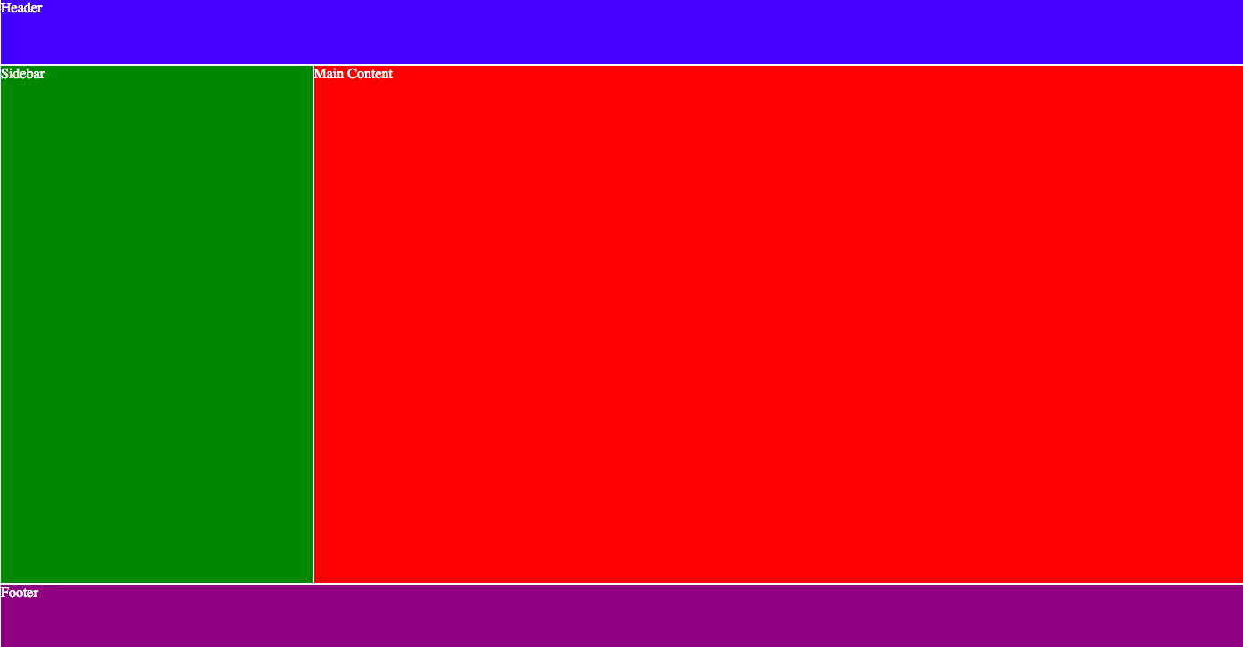

Slide 5
HTML Non-Semantic Elements
Non-semantic elements tell nothing clearly about their contents,
<div> is a block level non-semantic element, which you should only use if you can't think of a better semantic block element to use, or don't want to add any specific meaning.
<span> is an inline non-semantic element, which you should only use if you can't think of a better semantic text element to wrap your content, or don't want to add any specific meaning.

Slide 6
Hyperlinks
Hyperlinks allow linking documents to any other document.
Absolute URL: a full web address
Relative URL: without https://www…
Target Attribute: The target attribute specifies where to open the linked document.
The target attribute can have one of the following values:
_blank - Opens the linked document in a new window or tab
_self - Opens the linked document in the same window/tab as it was clicked (this is default)
_parent - Opens the linked document in the parent frame
framename - Opens the linked document in a named frame

Slide 7
Title attribute specifies extra information about an element. The information is most often shown as a tooltip text when the mouse moves over the element.
Link Colors: By default, a link will appear like this (in all browsers):
An unvisited link is underlined and blue
A visited link is underlined and purple
An active link is underlined and red
You can change the default colors, by using CSS.

Slide 8
Hyperlinks
Clear link wording is a good practice (avoid “click here”)
Accessibility: screen readers jump from link to link, search engines use links text, readers often skim the page
Don't repeat the URL as part of the link text
Don't say "link" or "links to" in the link text
Keep your link label as short as possible
Minimize instances where multiple copies of the same text are linked to different places

Slide 9
Exercise
Create a home page with navigation menu linking to home, projects, pictures, contacts.

Slide 10
HTML Character Entities
Character entities are used to display reserved characters in HTML.
&lt : <
&gt : >
&nbsp : non-breaking space
&quot : "
&cent : ¢
&yen : ¥
4568 : ©
&reg : ®

Slide 11
Non-Breaking Space
A non-breaking space is a space that will not break into a new line.
Two words separated by a non-breaking space will stick together (not break into a new line). This is handy when breaking the words might be disruptive.
Another common use of the non-breaking space is to prevent browsers from truncating spaces in HTML pages.
If you write 10 spaces in your text, the browser will remove 9 of them. To add real spaces to your text, you can use the &nbsp;character entity.
Checkout more HTML symbols here.

Slide 12
HTML Page Structure
header: <header>. navigation bar: <nav>.
main content: <main>, with various content subsections represented by <article>, <section>, and <div> elements.
sidebar: <aside>; often placed inside <main>.
footer: <footer>

Slide 13
Exercise
Recreate the following mockup using HTML. You will need to apply your knowledge about headings, formatting elements, links, span, ets. Do not use CSS for this exercise.

Slide 14
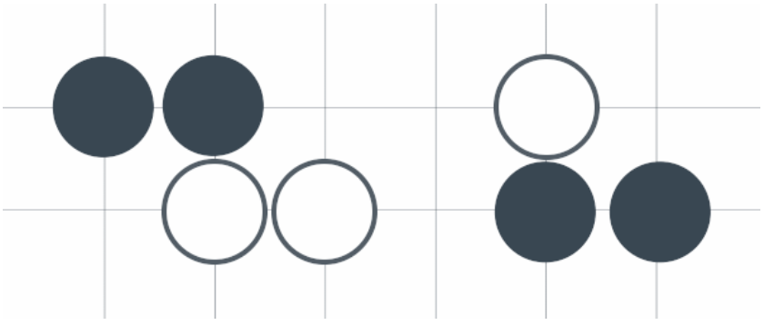
Use the following image to recreate the mockup.

Slide 15
Validation
The W3C has built both HTML and CSS validators that will scan code for mistakes
http://validator.w3.org/
http://jigsaw.w3.org/css-validator/

