Slide 1
FLEXBOX

Slide 2
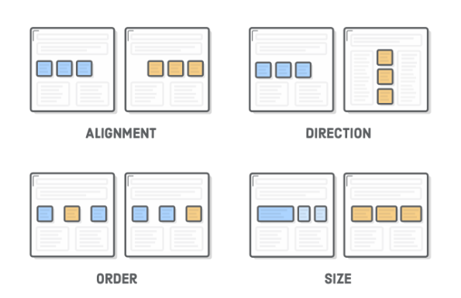

Slide 3
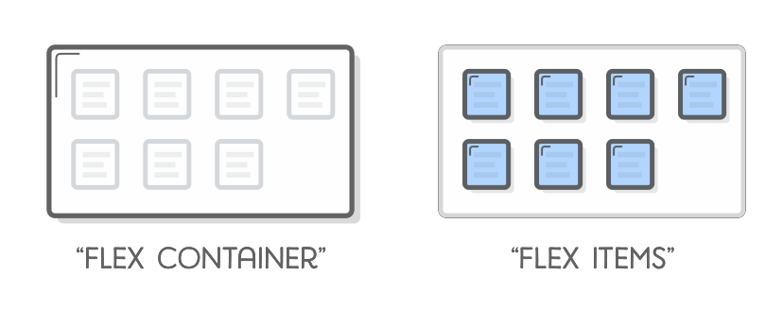
flexbox
Flexboxes contain of two types: flex items and flex containers

Slide 4
Flex-items
child of a flex container
main purpose: let container know the number of items to arrange
Flex-container
determine the layout of the flex items

Slide 5
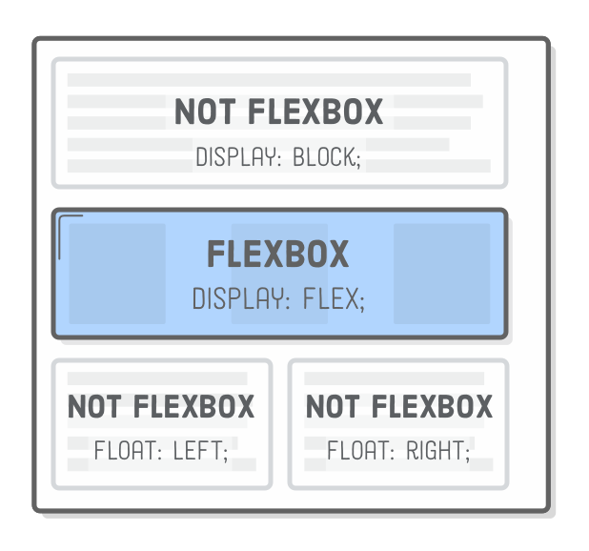

Slide 6
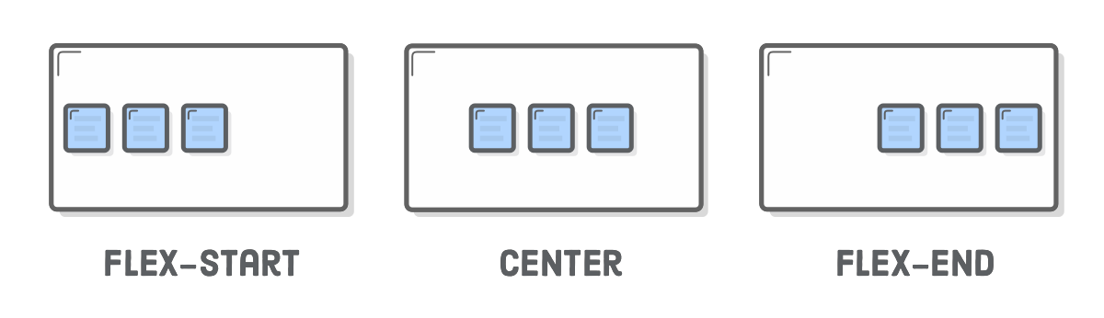
Vertical Alignment of Flex Items

Slide 7
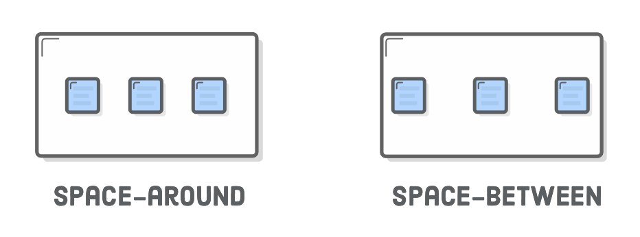
Vertical Alignment of Flex Items

Slide 8
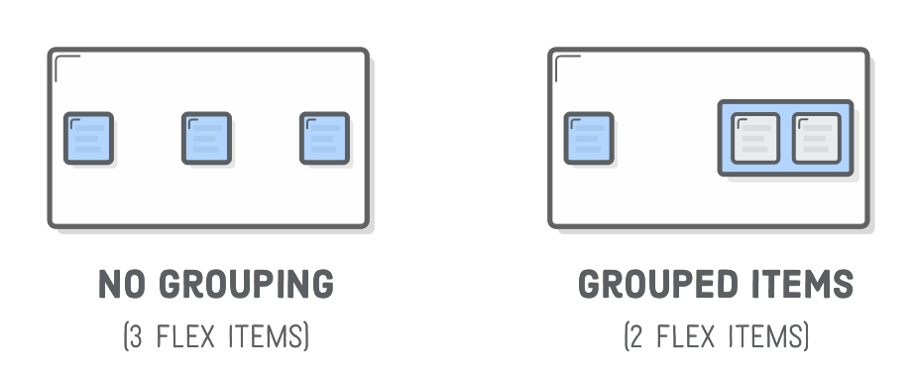
Vertical Alignment of Flex Items

Slide 9
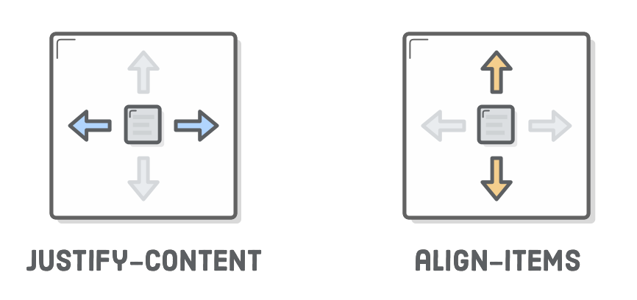
Horizontal Alignment of Flex Items

Slide 10
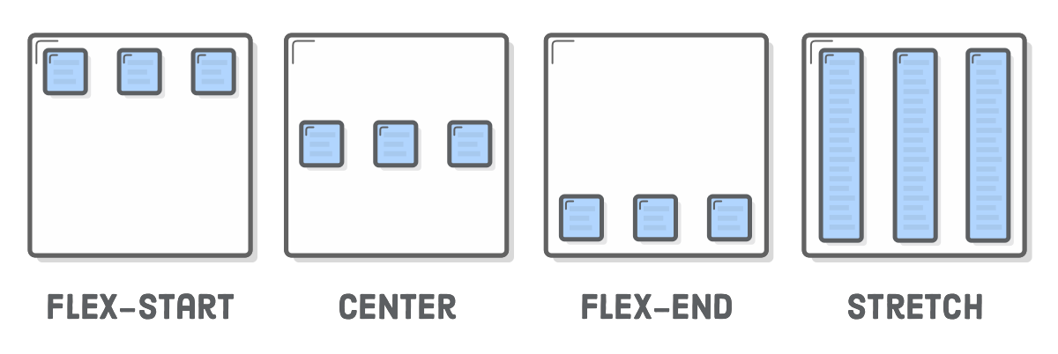
Horizontal Alignment of Flex Items

Slide 11
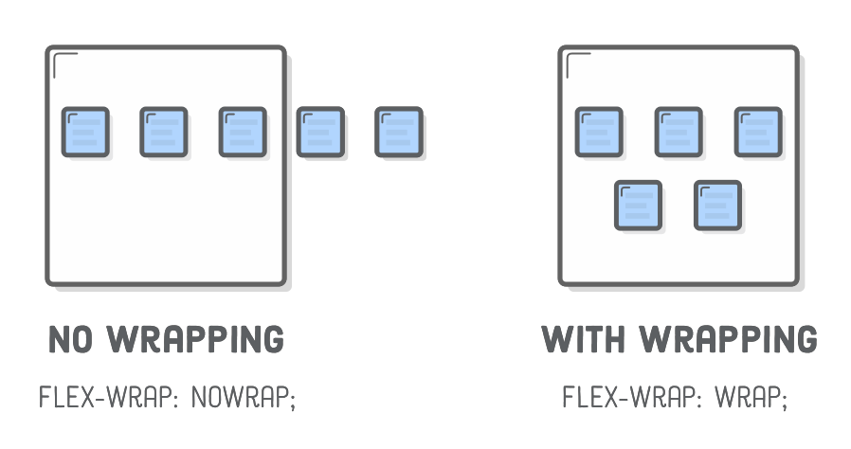
Wrapping Flex Items

Slide 12
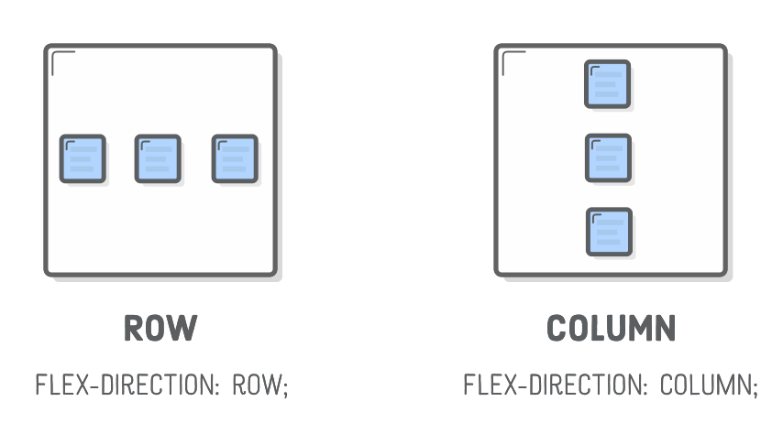
Flex Container Direction

Slide 13
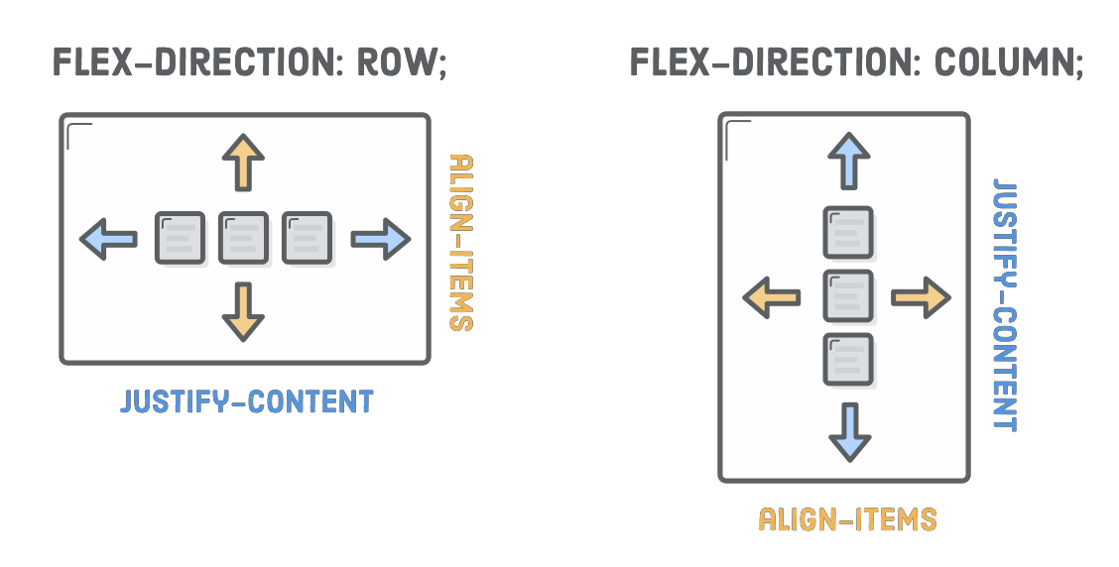
Alignment Considerations

Slide 14
Alignment Considerations
Alignment works vertically, also,
center
flex-start (start)
flex-end (end)
stretch
baseline

Slide 15
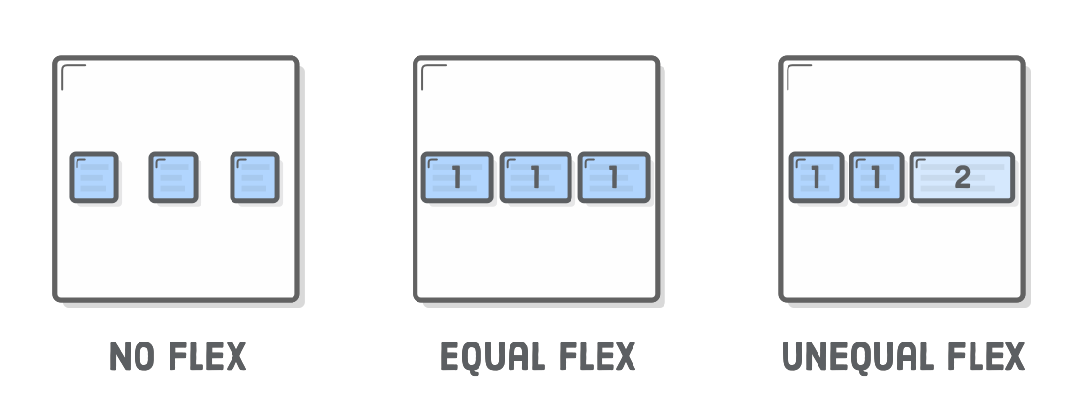
Flexible Items
flex property defines the width of individual items in a flex container
width is flexible, is defined as a weight
flex = 2, grows twice as fast as items with flex = 1 (default value)

Slide 16
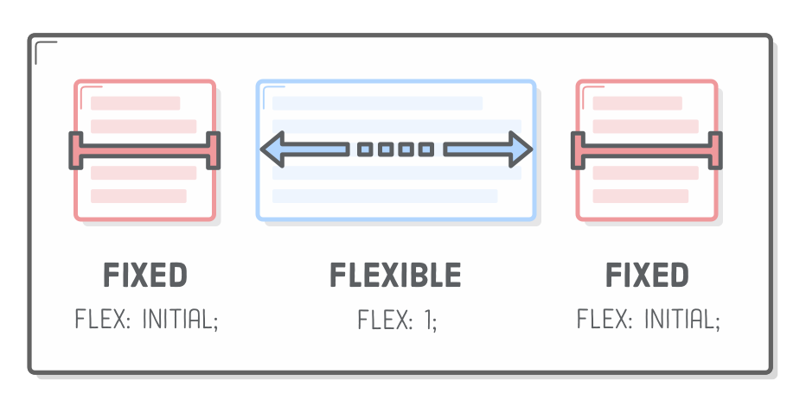
Flexible Items
flex property defines the width of individual items in a flex container
width is flexible, is defined as a weight
flex = 2, grows twice as fast as items with flex = 1 (default value)

Slide 17
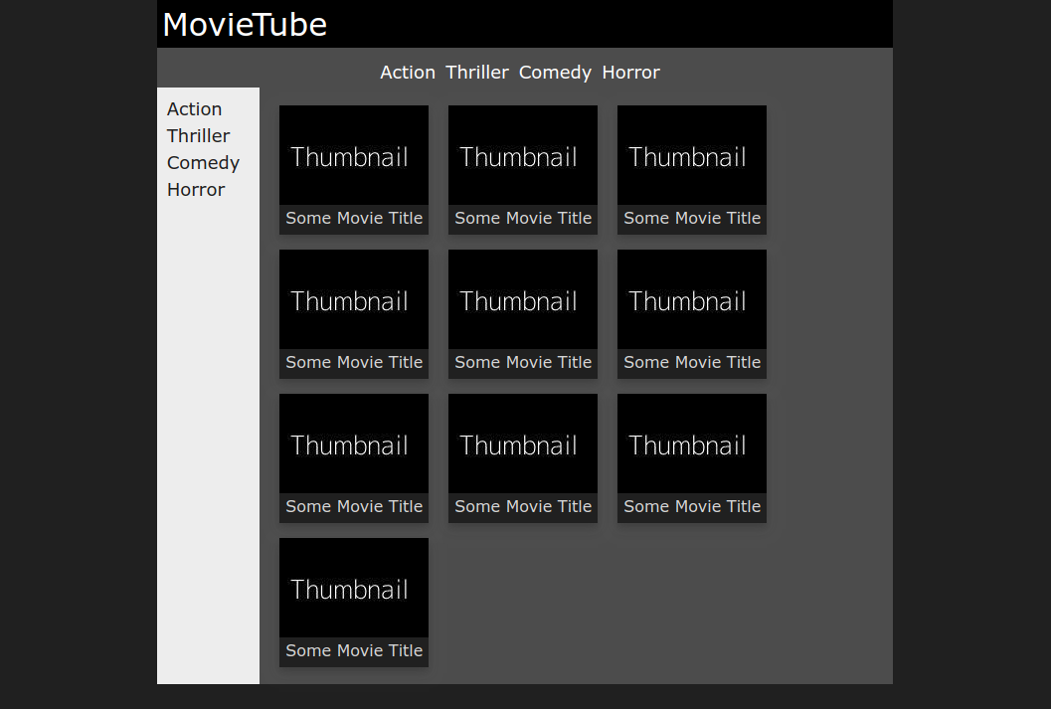
Task: Implement the following layout

Slide 18
Task: Implement the following layout
3 flexboxes

Slide 19
Task: Implement the following layout
#000
#1a1a1a
#4b4b4b

Slide 20
Task: Implement the following layout
Besides the given information, please
Implement a dark shadow for the thumbnail elements
When not being hovered: dark
When hovered: white
2. All Menu Elements are links, that do not have any text-decoration except underline when hovered
3. The width of the main container is minimum 600px and else 70%

Slide 21
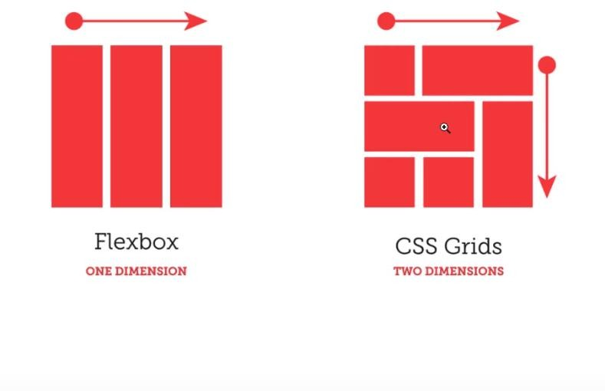
Grids

Slide 22
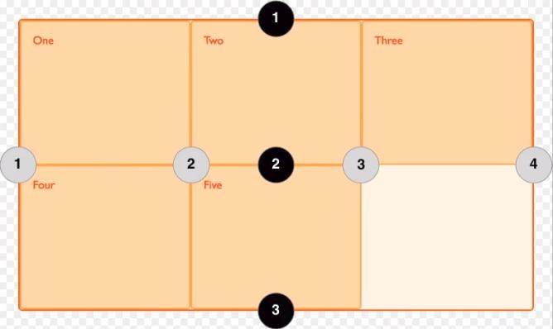
Grids

Slide 23
Flexbox
This is an exercise for Flexbox. You'll need to remember how to use the most common flexbox properties, to finish this exercise.
Task
Create an instagram profile using your own code with flexbox and demo images from LoremFlickr.
Mockups
Look at all three expected layouts, before you start.

Slide 24
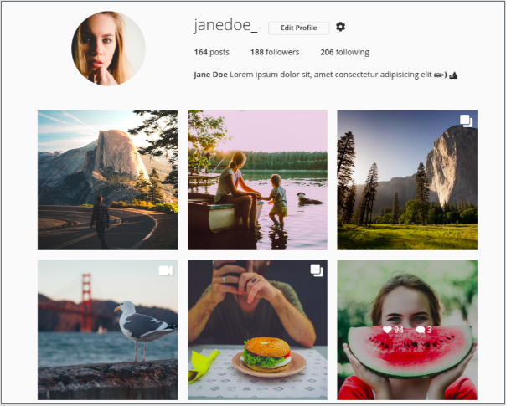
Desktop

Slide 25
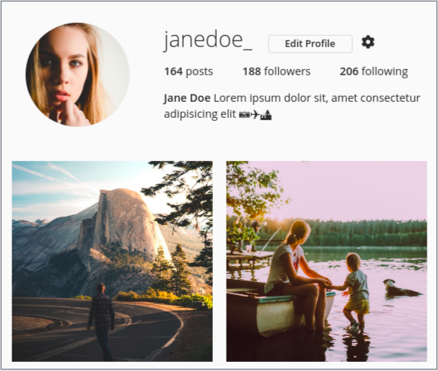
Tablet

Slide 26
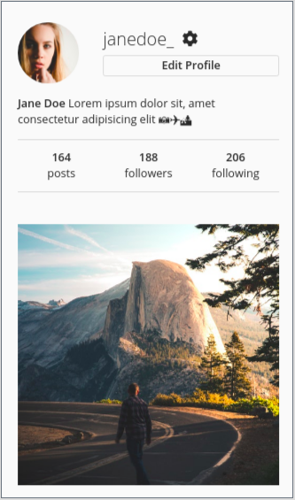
Mobile

