Slide 1
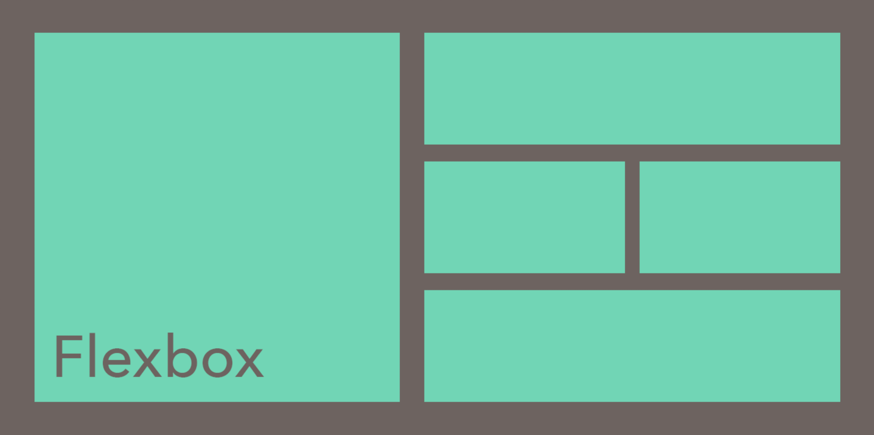

Slide 2
What is flexbox?
Flexbox is an extremely powerful tool in CSS. It is a layout model which makes it easier to design responsive websites.
It allows you to manipulate the positions of child items (flex items) in a flex container.

Slide 3
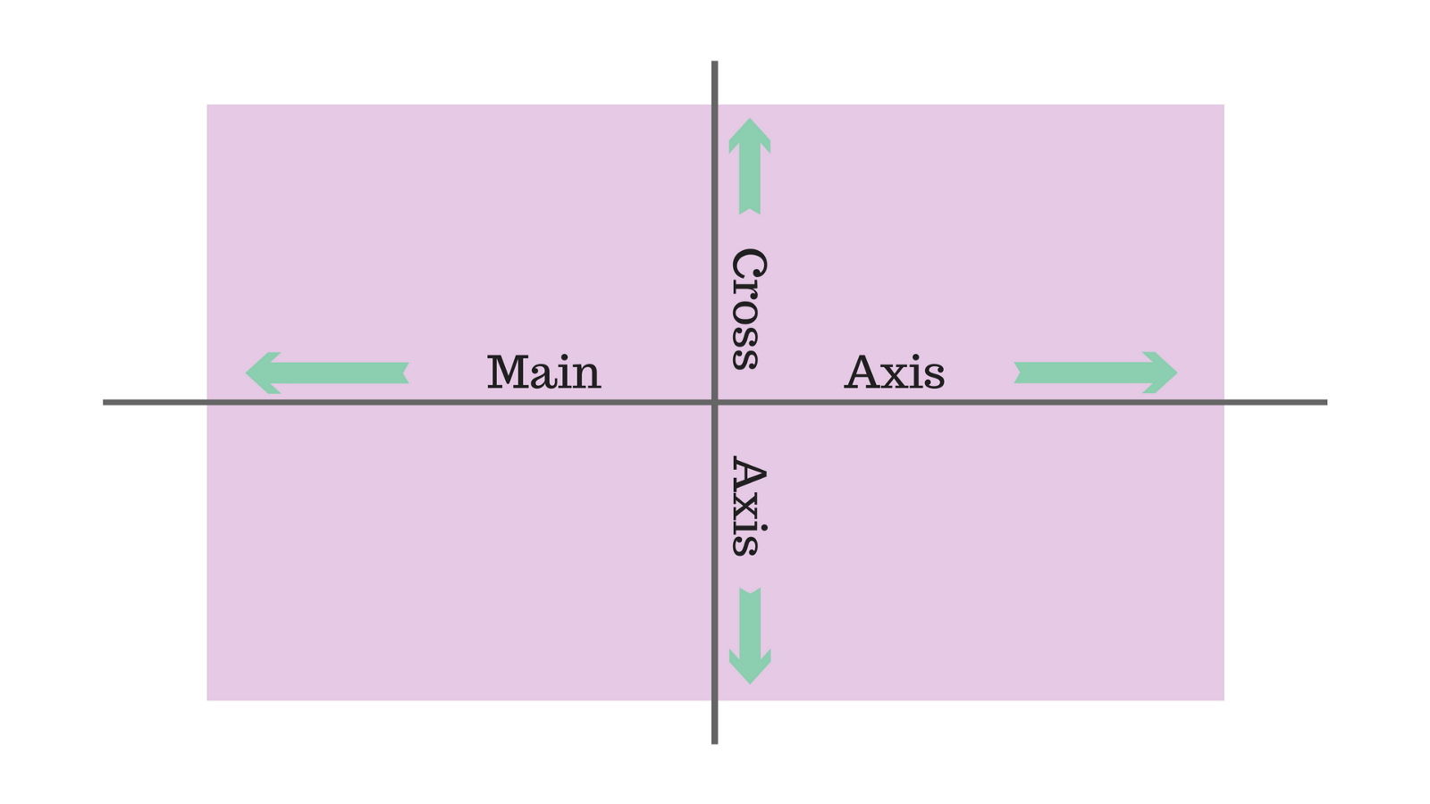
A flexbox container has two axes: a main axis and a cross axis. The main axis defaults to row, and the cross axis defaults to column.

Slide 4
Once you apply display: flex to your container, flex items will take on a horizontal alignment (the default of the main axis).
We can change the direction of the main axis by using the property flex-direction

Slide 5
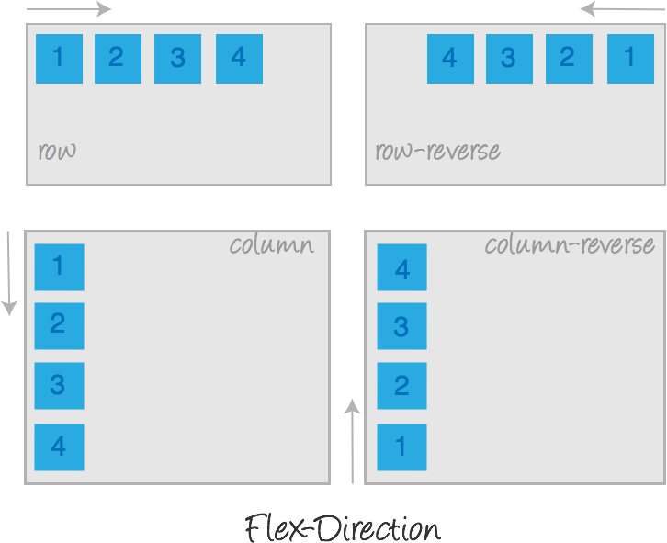

Slide 6
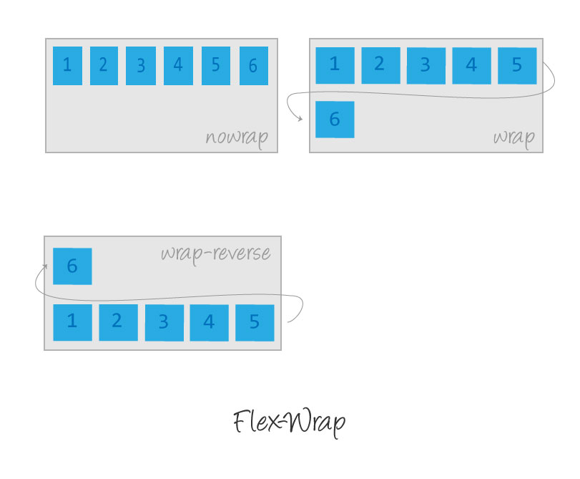
The flex-wrap CSS property sets whether flex items are forced onto one line or can wrap onto multiple lines.

Slide 7
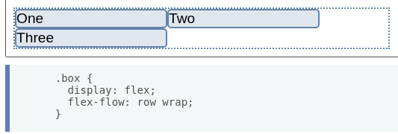
You can combine the two properties flex-direction and flex-wrap into the flex-flow shorthand.
The first value specified is flex-direction and the second value is flex-wrap.

Slide 8
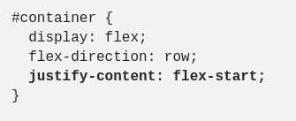
justify-content
Justify-content allows you to control how to align flex items on the main axis.

Slide 9
We can use six different alignments:
flex-start
flex-end
center
space-between
space-around
space-evenly

Slide 10
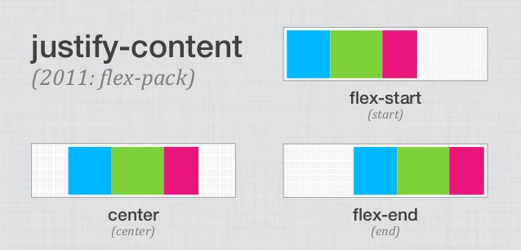

Slide 11
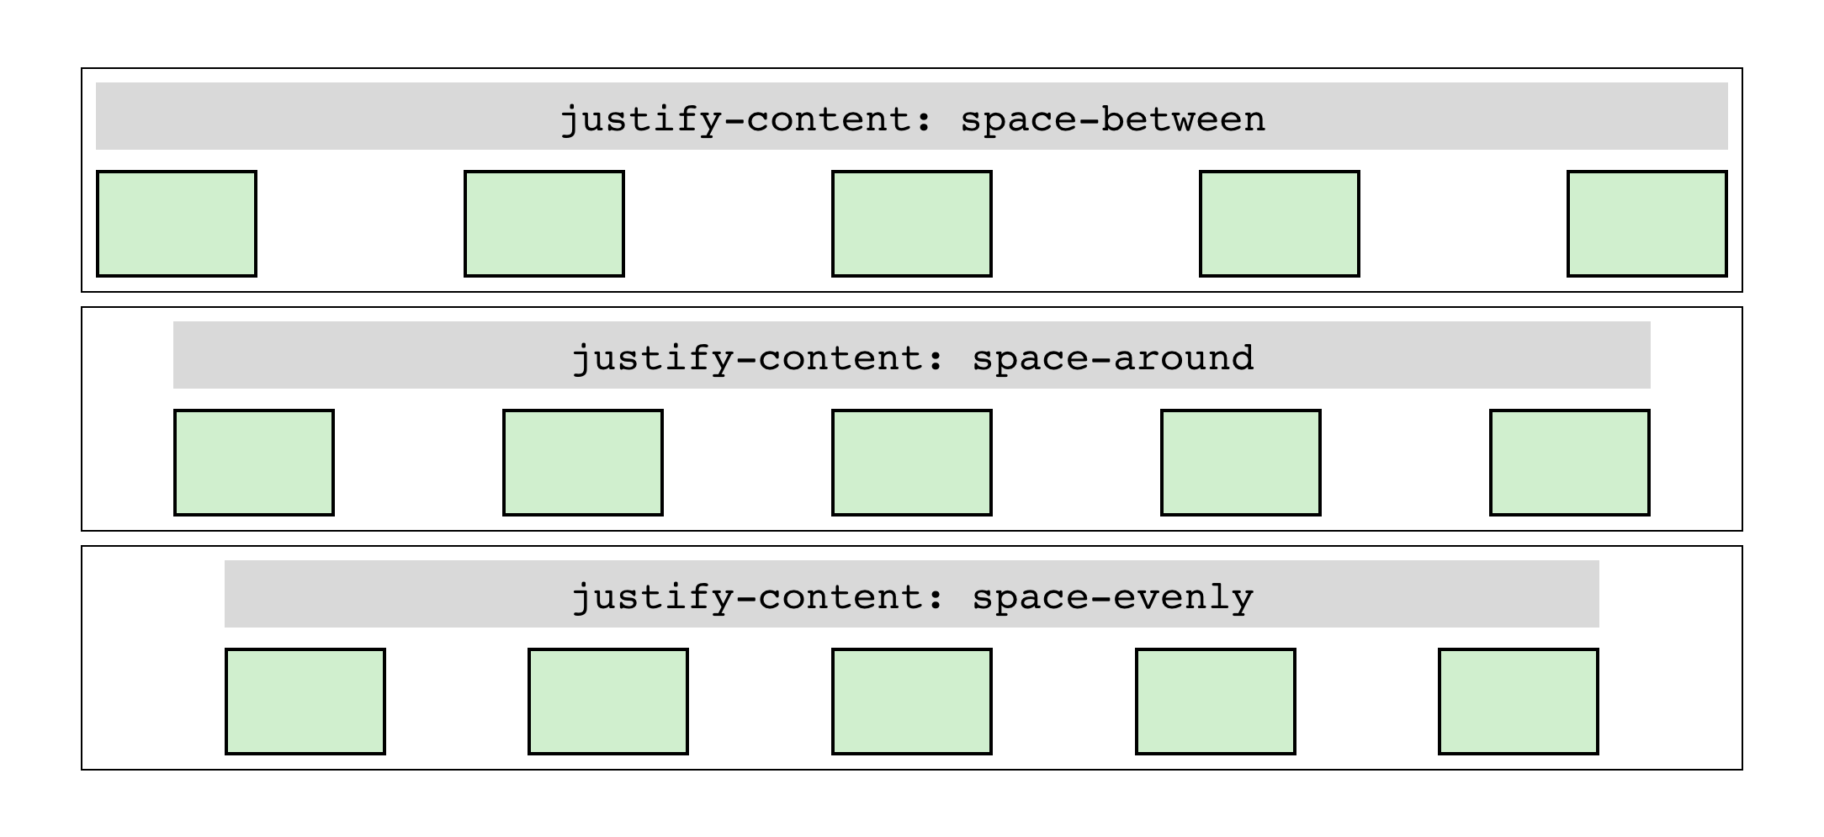

Slide 12
Space-between puts equal space between the flex items, but not the container.
Space-around puts space between the flex items as well as the container.
Space-evenly puts an equal amount of space between the flex-items and the container.

Slide 13
align-items
Align-items allows you to control how to align flex items on the cross axis.

Slide 14
We can use five different alignments:
flex-start
flex-end
center
stretch
baseline

Slide 15
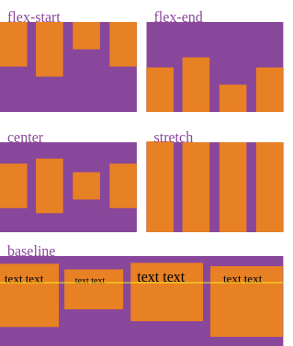

Slide 16
Stretch: the flex items take up the entirety of the container.
Baseline: the flex items are aligned by the bottom of the paragraph tags. If there are no paragraphs present, the bottom of the flex items are aligned instead.

Slide 17
align-self
Allows you to manipulate the alignment for one particular flex-item.

Slide 18
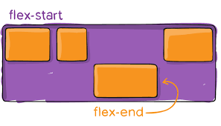

Slide 19
Properties applied to flex items
flex-basis
flex-grow
flex-shrink
When we change the value of these flex properties, we change the way that the available space is used among the flex items.

Slide 20
flex-basis
It specifies the initial size of the flex item, before any available space is distributed.
A flex-basis value set to auto sizes the element according to its size property (which can itself be the keyword auto, which sizes the elements according to its contents).

Slide 21
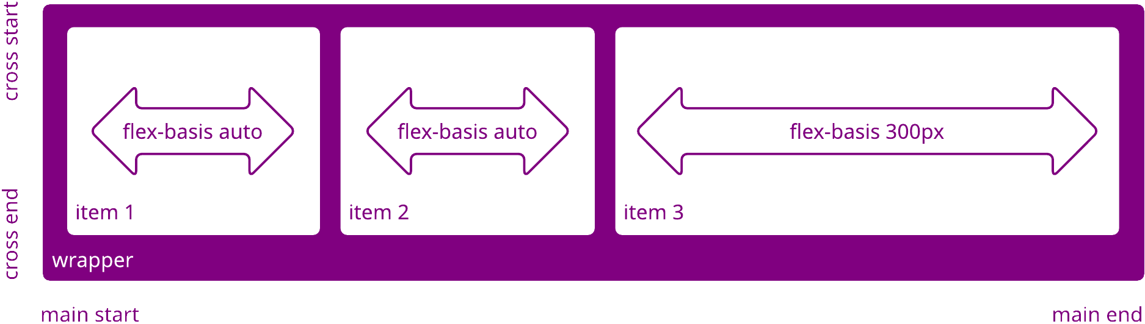

Slide 22
flex-grow
It allows the flex item to grow if needed. It accepts a unitless value that serves as a proportion. It assigns the amount of space that a flex item should take up in the flex container.
For example, if all items have flex-grow set to 1, every child will be the same size in the container. If you were to give one of the children a value of 2, that child would take up twice as much space as the others.

Slide 23
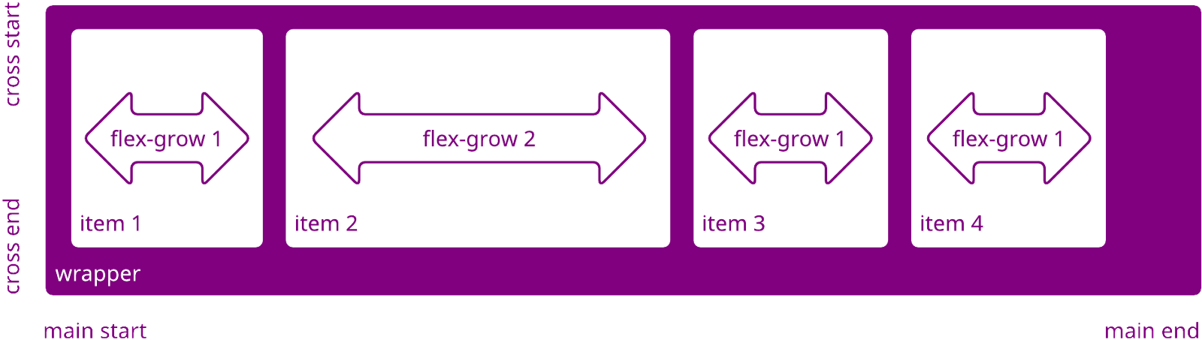

Slide 24
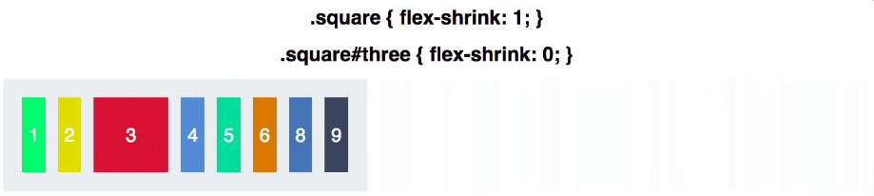
flex-shrink
It determines how much the flex item will shrink relative to the rest of the flex items in the flex container when there isn't enough space in the row.

Slide 25
order
Flex items are displayed in the same order as they appear in the source document by default. The order property can be used to change this ordering.

Slide 26
