Slide 1

Git & Instructions for test!

Slide 2
Using branches in git!
What is a branch?

Slide 3
Branches
In git, we have a master branch, where our main code is stored.
Branches are used so that you can work on small features, bug fixes or experiments, in complete isolation, without affecting other branches.

Slide 4
Master REPO
Commit
Make a branch
Branch
Commit
Merge with master
Commit
Commit

Slide 5
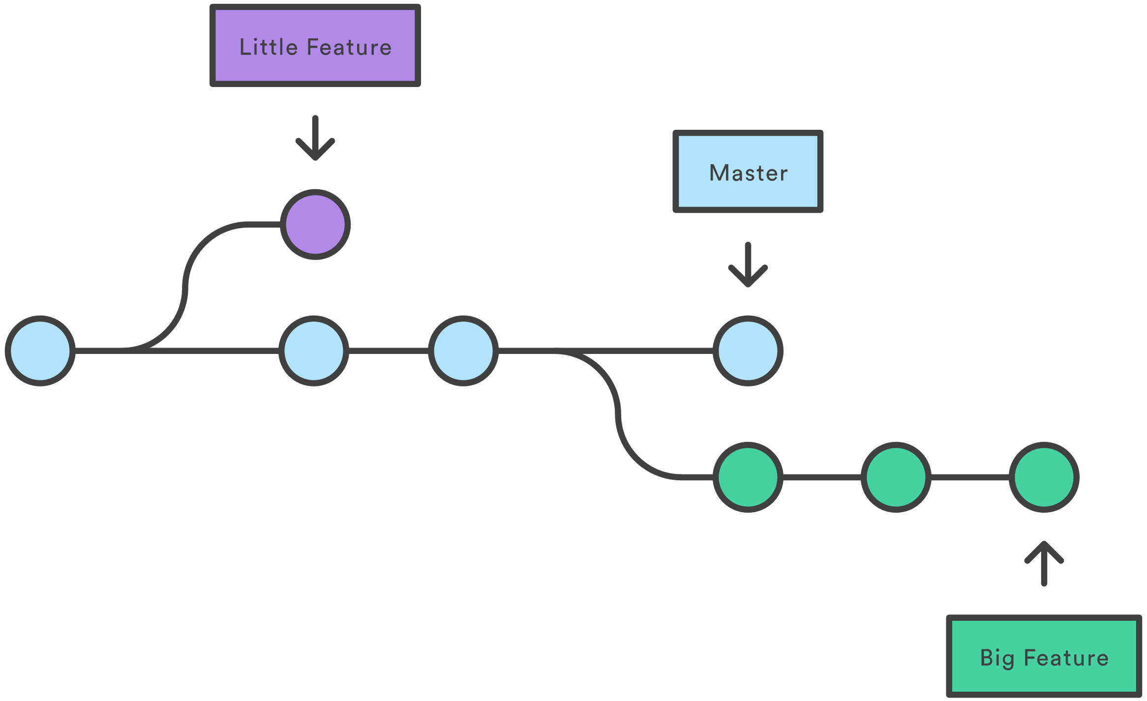

Slide 6

Forks
A fork is a copy of a repository. It allows you to make changes and experiment without affecting the original repository.
Forking can be used to make changes when you do not have access to collaborate on the original repository.
Your changes can then be submitted to the original repository via a pull request.

Slide 7
Pull Requests
In order to merge, we sometimes make a pull request. Pull requests let you tell others about changes you've pushed to a GitHub repository.
Once a pull request is sent, others can review the set of changes, discuss modifications, and even push follow-up commits if necessary.
We can make a pull request on github.

Slide 8
Instructions for test

Slide 9
Go to *link will be given later*

Slide 10
Fork the repo!
Click “Fork” on the top right-hand side of the page.

Slide 11
Clone the fork in your terminal.
git clone <https link>

Slide 12
Open the directory that you just cloned.
Inside you will find the test!

Slide 13
Copy the test folder and rename it to “answers_yourname”
cp -r test answers_yourname
PLEASE work from this new folder “answers_yourname”.
E.g. “answers_fran”

Slide 14
When you’re finished with your test, go to the command line and add your folder named “answers_yourname”
git add answers_yourname

Slide 15
Then, commit your folder.
git commit -m “test answers -fran”

Slide 16
Then, push your folder.
git push

Slide 17
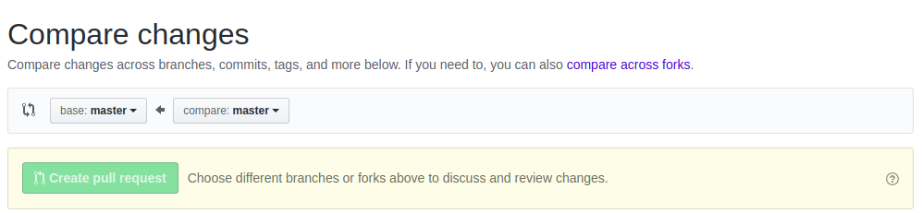
Then, go to github, find the original repo and click “New pull request”.
Then click “compare across forks”

Slide 18
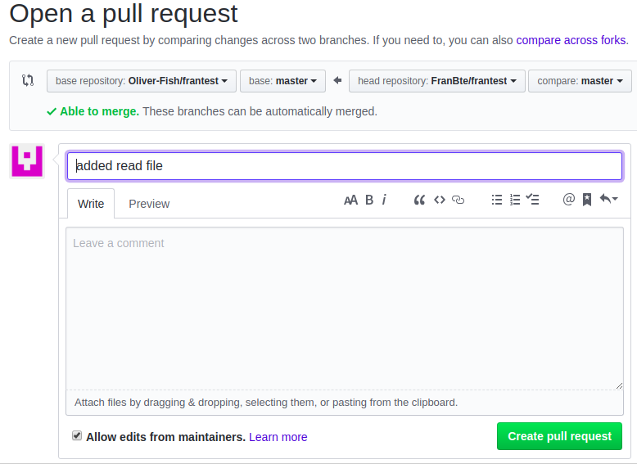
Make sure that you are comparing the original repo and your fork.
Then press create pull request.

Slide 19
That’s it!
Do not merge the pull request, we will look over your test answers.

