Slide 1
GRID-BASED LAYOUT

Slide 2
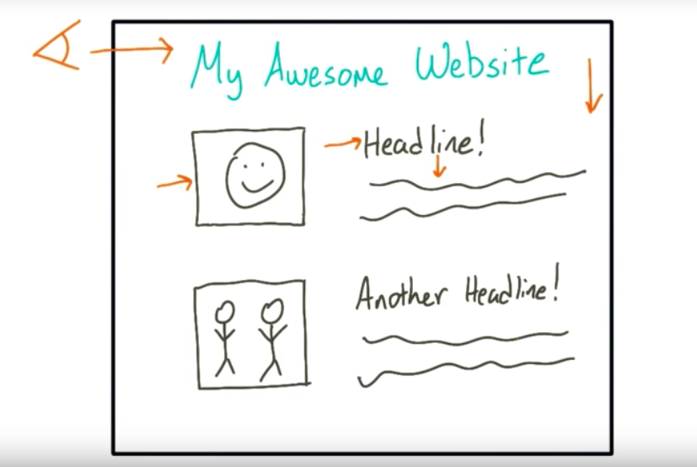

Slide 3


Slide 4
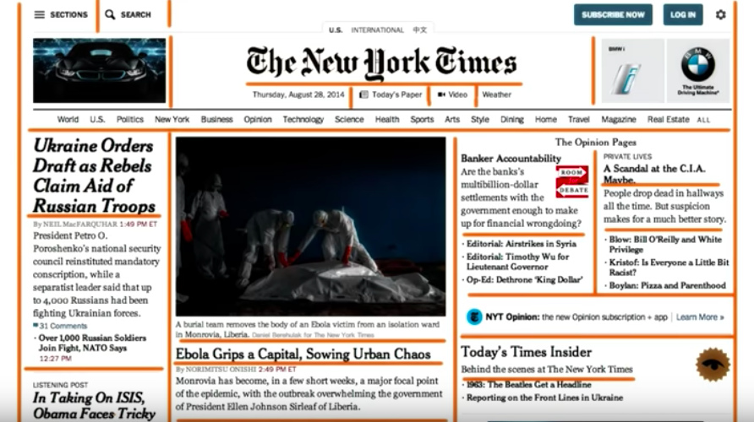

Slide 5


Slide 6
Grid-Based Layout
Grids enable stability and structure in a web layout, giving the designer a logical template to build the site on.
A grid is the division of a layout with vertical and/or horizontal guidelines to incorporate margins, spaces and columns in order to provide a framework for organizing content.
Grids aid in creating a uniform structure to start the design with.
Using a grid within your designs helps bring structure to your content and gives you a place to start from.

Slide 7
How to create your grids
Grids are a great way to line up items, keeping your designs clean, user-friendly, and streamlined.
Your grid can be as complex or as simple as you like. The more complex and elaborate your grid layout is, the more freedom you have within it. The simpler it is, the more room for interpretation there is. The choice is up to you.

Slide 8
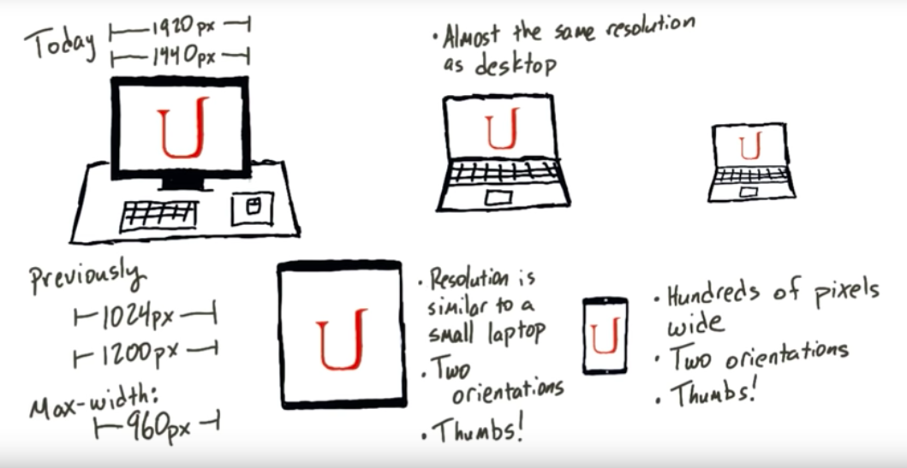

Slide 9
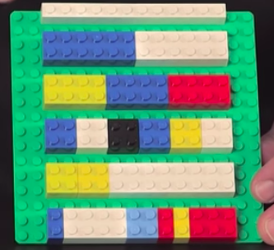

Slide 10
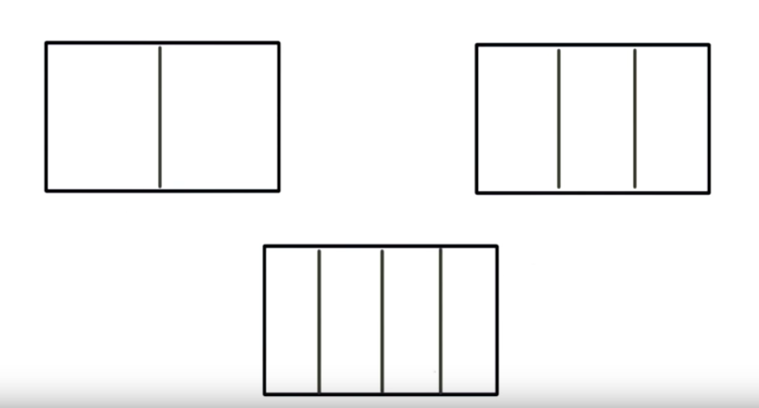

Slide 11
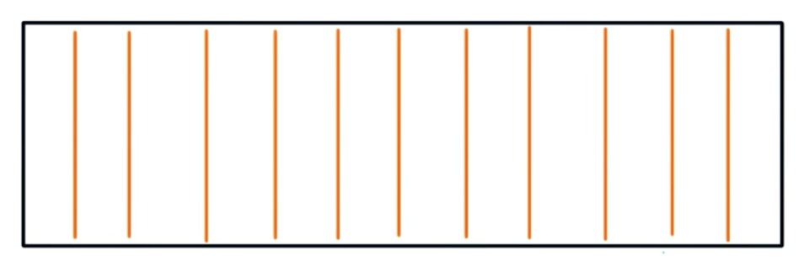
12 Column Grid System

Slide 12
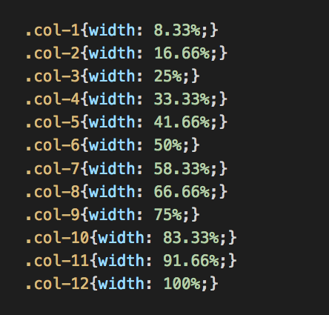
Dividing our page into 12 equal grids:

Slide 13

Negative Space
Space that does not contain anything.
We can create negative space by giving padding or margins to our elements.
Margins push elements away from each other. While padding creates space internally.

Slide 14
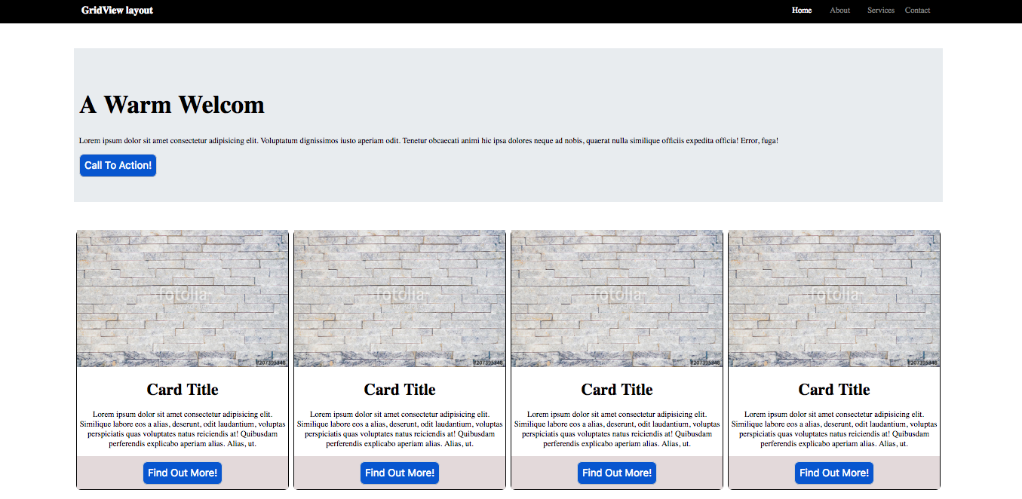
Exercise: Recreate the following mockup using grid-based layout. Divide the page into rows and columns.Use relative units like percentage.

Slide 15
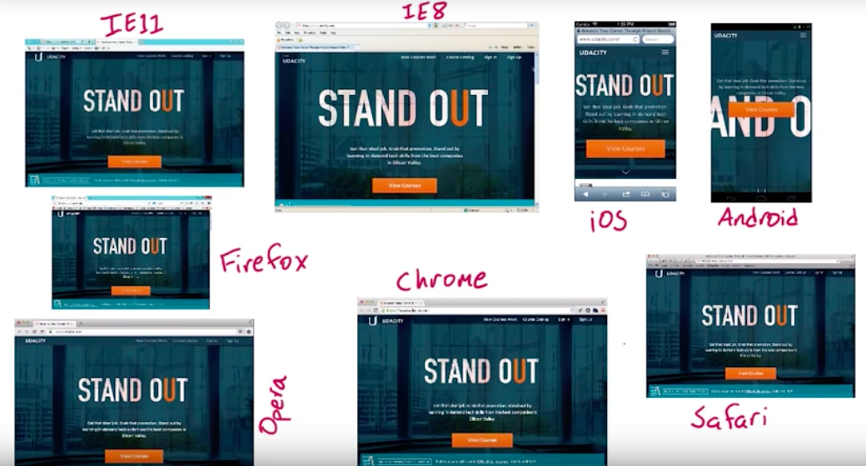

Slide 16
CSS Normalize
Makes sure that your CSS styles are interpreted the same across all browsers.
cdn(Content Delivery Network):
<link rel="stylesheet" href="https://cdnjs.cloudflare.com/ajax/libs/normalize/8.0.1/normalize.min.css" />
https://cdnjs.com/libraries/normalize

