Slide 1
JavaScript
Ternaries

Slide 2
Ternary Operator
The conditional (ternary) operator is the only JavaScript operator that takes three operands.
Its output / result is dependent on whether the condition is met or not.

Slide 3
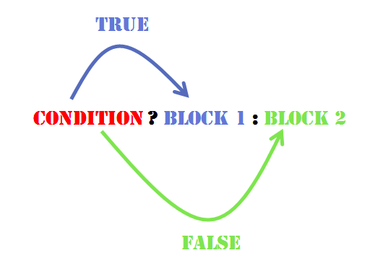

Slide 4
variablename = (condition) ? value1:value2
let voteable = (age < 18) ? “Too young”:”Old enough;

Slide 5
let age = 26;
let beverage = (age >= 21) ? "Beer" : "Juice";
console.log(beverage);

Slide 6
Ternary Operator Vs. If/Else Statements
Generally, we use a ternary operator when we want to set a value to a variable based on a condition.
For example, if x == 42, variable y should be true. If not, then y should be false.
let y = (x == 42) ? true : false;

