Slide 1
JavaScript
Data Types

Slide 2
Two Kinds of Data
Primitive : A primitive is simply a data type that is not an object, and has no methods.
Object: An object is a collection of properties. These properties are stored in key/value pairs. Properties can reference any type of data, including objects and/or primitive values.

Slide 3
Primitive Data Types
Strings (represents textual data)
Number (numbers of any kind)
Boolean (logical type)
Null
Undefined
Symbol

Slide 4
Strings
Strings in JavaScript represent textual data. Eg. let str = “This is a string”.
Writing Strings
Double quotes: "Hello".
Single quotes: 'Hello'.
Backticks: `Hello`.

Slide 5
Strings
Note: there is no character type in JavaScript as there is in some languages. Each element in the String occupies a position in the String.
The first element is at index 0, the next at index 1, and so on. The length of a String is the number of elements in it.

Slide 6
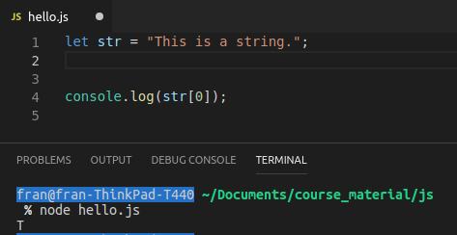
Strings
We can access an element in a String by using square brackets as well as the index.
e.g. str[0].
Note: JavaScript is case sensitive!!

Slide 7
Numbers: Integers & Floats
Integers - numbers without a decimal point. 3, 4, 5
Floats - a floating point number, a number with a decimal point. These are used when more precision is needed. 3.03, 4.17, 5.23

Slide 8
Numbers
Integers and floats form part of the SAME data type in JavaScript - they are both numbers.
In addition to integers and floats, the number type has three symbolic values:
+Infinity, -Infinity and NaN

Slide 9
Numbers: Infinity
The value Infinity (positive infinity) is greater than any other number.
Mathematically, this value behaves the same as infinity: any number multiplied by infinity equals infinity. Any number divided by infinity equals 0.

Slide 10
Numbers: NaN
The global NaN property represents “Not-A-Number”.

Slide 11
A Boolean (logical type)
The Boolean type only has two values: true or false.
The type is commonly used to store yes/no (correct or incorrect) values.

Slide 12
Boolean Example
let nameFieldChecked = true;
// yes, name field is checked
let ageFieldChecked = false;
// no, age field is not checked

Slide 13
falsy values in JavaScript
In JavaScript there are only six falsy values. Both null and undefined are two of the six falsy values. Here’s a full list:
false
0 (zero)
“” (empty string)
null
undefined
NaN (Not A Number)
Any other value in JavaScript is considered truthy.

Slide 14
Undefined
A variable that has not been assigned a value has the value of undefined.

Slide 15
Null
The Null type has exactly one value: null
The value null represents the intentional absence of any object value. It expresses a lack of identification.

Slide 16
undefined vs null
undefined
a variable has been declared but has not yet been assigned a value.
undefined is a type itself (undefined).
Unassigned variables are initialized by JavaScript with a default value of undefined.
eg., let myName;
null
null is an empty or non-existent value.
null must be assigned.
It can be assigned to a variable as a representation of no value.
null is an object.
JavaScript never sets a value to null. That must be done programmatically.
Eg., let varValue = null;

Slide 17
objects
A JavaScript object is a collection of properties. These properties are stored in key/value pairs. Properties can reference any type of data, including objects and/or primitive values.
Objects are variables too.
But objects can contain many values.
var obj = {
key1: 'value',
key2: 'value',
key3: true,
key4: 32,
key5: {}
}

Slide 18
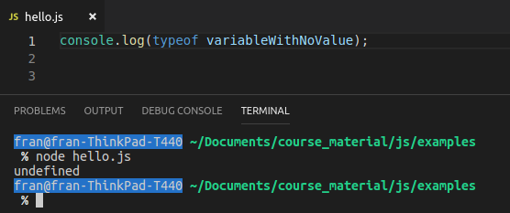
typeof
You can check the data type of something with the typeof operator.
This returns the data type of a given value.
What is the type of a variable with no value?

Slide 19
typeof

