Slide 1
JavaScript
An Introduction and Getting Started!

Slide 2
Content
Introduction to JavaScript
Working with Node
Variables in JavaScript

Slide 3
Introduction to JavaScript
JavaScript is a programming language for the web.
It is one of the three core technologies of the web, along with HTML and CSS.
A programming language is a formal language, which comprises a set of instructions and algorithms that can produce various kinds of outputs.

Slide 4
Introduction to JavaScript
We can use JavaScript to update and change both HTML and CSS. Moreover, we can calculate, manipulate and validate data using JavaScript.

Slide 5
Introduction to JavaScript
HTML: Hypertext Markup Language is a markup language for creating web pages and web applications.
CSS: Cascading Style Sheets is a style sheet language used for describing the presentation of a document.
While HTML and CSS are markup languages, JavaScript is a programming language.
Markup languages are used to describe and define elements within a document.
Programming languages are used to communicate instructions to a machine. They can be used to control the behavior of a machine and express algorithms.

Slide 6
History of JavaScript
JavaScript was created by Brendan Eich in 1995 while working at Netscape Communications. JavaScript was initially made for the Netscape browser.

Slide 7
History of JavaScript
When Netscape’s main competitor, Microsoft, started becoming popular, Netscape began the standardisation of JavaScript to avoid Microsoft gaining control of the JavaScript language. Netscape also began a partnership with Sun.

Slide 8
History of JavaScript
Microsoft’s internet explorer dominated the market.
Before Netscape went down, they set a standard which would guide JavaScript, named ECMAScript. This guides scripting language specifications. It dictates rules and conventions which everyone agrees upon.

Slide 9
History of JavaScript
JavaScript was created by Brendan Eich in 1995 for the web browser Netscape.
Mocha => LiveScript => JavaScript
Microsoft’s Internet Explorer took JavaScript and started making its own implementations like JScript.
Soon Internet Explorer dominated the market and Netscape project shut down.
Before Netscape went down, they decided to start a standard that would guide the path of JavaScript, named ECMAScript.

Slide 10
History of JavaScript
Standard is set of rules and conventions which everybody agrees upon.
Ecma International: an organization that creates standards for technologies.
ECMA-262: a standard published by Ecma International.
ECMAScript is a scripting-language specification standardized by Ecma International in ECMA-262.

Slide 11
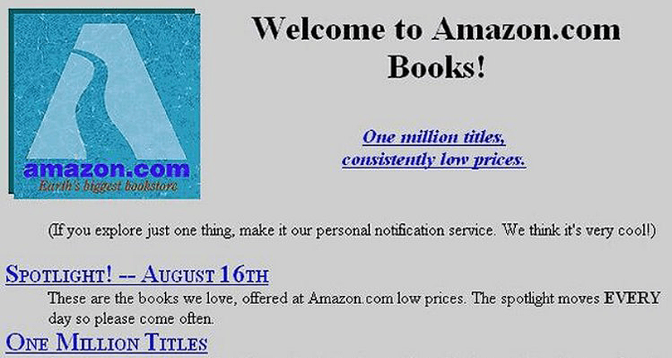
This is how websites looked like in the 90s

Slide 12
A Note on Marketing
Java was created in 1990, and in 1995 there was a lot of hype around the programming language.
JavaScript got its name because the creator and a partnering company wanted JavaScript to benefit from the Java hype. The name is only a marketing ploy. JavaScript has nothing to do with Java!
JavaScript is as related to Java as Carnival is to Car.
Kyle Simpson

Slide 13
JavaScript Program
Code is the text that makes up programs.
A computer program is a collection of instructions that performs a specific task when executed by a computer.
In a programming language, these programming instructions are called statements.
A JavaScript program is a list of programming statements.

Slide 14
JavaScript Syntax
comment: lines of code that JavaScript will intentionally ignore.
// This is a comment.
/* This is a comment. */
semicolon: In JavaScript ending statements with a (;), is a matter of personal/team preference. Read more.
JavaScript is case sensitive.

Slide 15
node.js
Node.js is an open-source, cross-platform JavaScript run-time environment that executes JavaScript code outside of a browser.

Slide 16
Working with node
JavaScript applications do not need to run in the browser. We can run applications that run in the terminal. The most common way to do this is with Node.js (or node for short).

Slide 17
Why Node?
Throughout this module, we are going to be teaching programming basics, logical thinking, pattern recognition, etc. So, for now, the focus should be on the programming language to form a solid basis in the fundamentals!

Slide 18
console.log()
This method outputs a message to the web console (or to the terminal we’re working in).
It is logging a message to the console. This method is EXTREMELY important for debugging.
When in doubt, console.log()!

Slide 19
Let’s create our first JavaScript file!
Create a file named “hello.js”
We’re going to run our first console.log
console.log(‘Hello, world’)

Slide 20
Terminal
You can open the terminal right in Visual Studio Code. The keyboard shortcut is ctrl+`

Slide 21
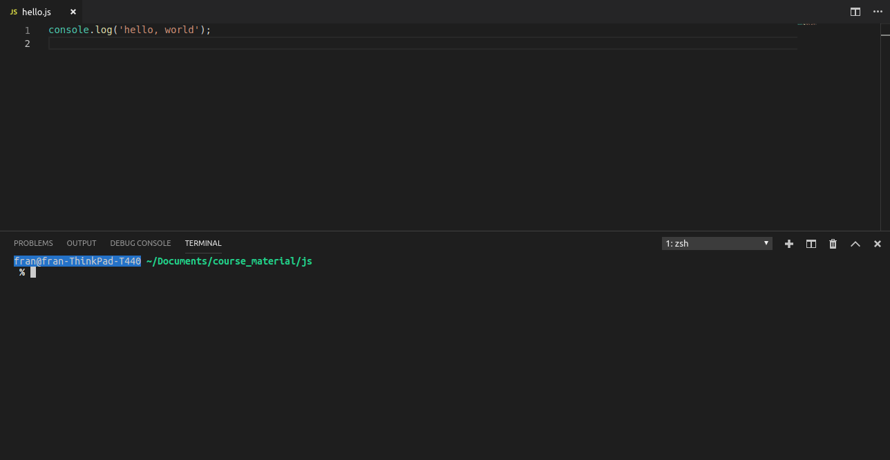

Slide 22
Once you’ve opened the terminal, you can run your script with the command:
node filename
node hello.js

Slide 23
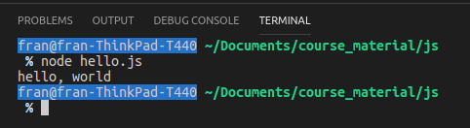
Once you run your script, you should see the message that you console logged right in the terminal.

Slide 24
Variables
Data: Anything that is meaningful to the computer.
Variable: It is a named location for storing data or a value.
Variables allow computers to store and manipulate data in a dynamic fashion.
Variable Identifier: used to name a variable.
Equal Sign(=) is used to assign values to variables.

Slide 25
Variables in JavaScript
JavaScript variables must:
Start with a letter, underscore(_) or dollar sign($).
Subsequent characters can have digits(0-9).
Not contain spaces or start with a digit.
Never use reserved keywords for variable names
Variable declaration grammar and types

Slide 26
Variables in JavaScript
According to ES6 specifications, there are three ways of declaring variables in JavaScript: var, let, const
We assign variables with the equals sign (=).
E.g. let firstName = ‘John’;
Note: never use reserved keywords for variable names

Slide 27
Variables in JavaScript
var allows you to overwrite variable declaration without an error.
let only allows a variable to be be declared once. let variables cannot be redefined in the same scope.
const variables can only be declared once. These are read-only variables. The const variable cannot be updated.

Slide 28
Camel Case (or camelCase)
In order to keep things legible and to code according to convention, we use camel case. This means that multiple words are joined together as a single word. Generally, the first word is all lower case and any subsequent words start with a capital letter.
For example, we use camel case when we name variables.
eg. let firstName = “John”;

