Slide 1
POSITIONING

Slide 2
Document Object Model(DOM)
The Document Object Model (DOM) is a programming API(Application Programming Interface) for HTML and XML(eXtensible Markup Language) documents.
It defines the logical structure of documents and the way a document is accessed and manipulated.
One important objective of the Document Object Model is to provide a standard programming interface that can be used in a wide variety of environments and applications.
The Document Object Model can be used with any programming language
In the Document Object Model, documents have a logical structure which is very much like a tree; to be more precise, it is like a "forest" or "grove" which can contain more than one tree..

Slide 3
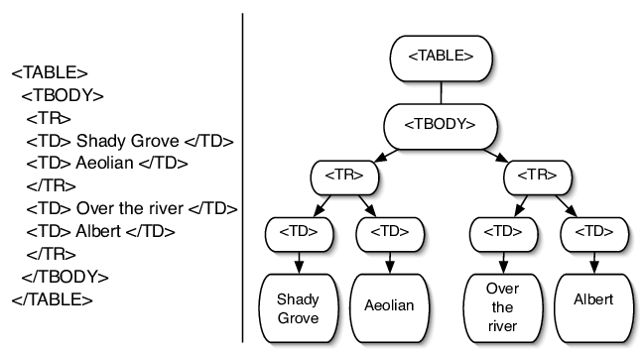
DOM Representation of an HTML Table

Slide 4
Document vs Viewport
The "document" is another name for the entire DOM.
The document is a reference to the DOM - the big tree you’ve been building with HTML elements. The document is the entire page, from top to bottom, header to footer, as far as you can scroll.
The "window" is the visible portion of the DOM.
The viewport is the portion of the DOM that is currently visible inside the browser window. The viewport’s size depends on the browser dimensions, and as such will change depending on factors like screen resolution, window size, device orientation (landscape vs. portrait views on phones and tablets) and device pixel ratio.

Slide 5
Document Flow
By default, a block level element's content is 100% of the width of its parent element, and as tall as its content.
Inline elements: Width or height cannot be set on inline elements.
The normal layout flow:
By default, block level elements are laid out vertically.
Inline elements sit on the same line, as long as there is space.

Slide 6
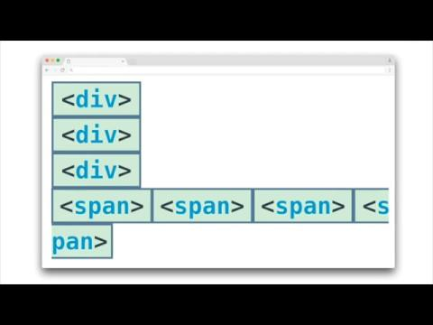

Slide 7
Positioning
Positioning allows you to take elements out of the normal document layout flow, and make them behave differently, for example sitting on top of one another, or always remaining in the same place inside the browser viewport.
CSS allows us to position the HTML elements on the page creating required layouts

Slide 8
Positioning
The position property identifies how an element is positioned on a page and whether or not it will appear within the normal flow of a document. This is used in conjunction with the box offset properties—top, right, bottom, and left—which identify exactly where an element will be positioned by moving elements in a number of different directions.

Slide 9
Unique Positioning
The position property specifies the type of positioning method used for an element.
There are five different position values:
Static
Relative
Fixed
Absolute
sticky
Elements are then positioned using the top, bottom, left, and right properties. However, these properties will not work unless the position property is set first. They also work differently depending on the position value.

Slide 10
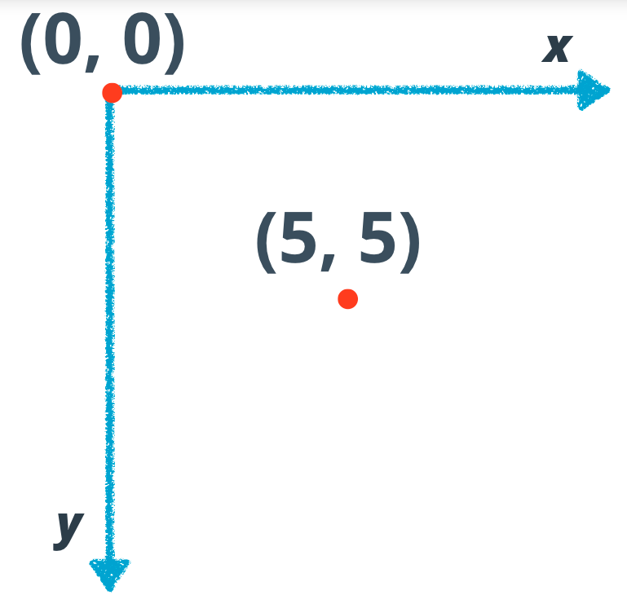
The coordinate system that browsers use. The vertical axis, y, starts at 0 at the top and gets more positive as you go down, while the horizontal axis, x, starts at 0 on the left and gets more positive as you move right.

Slide 11
Static Position:
This is the default position.
Static positioned elements are not affected by the top, bottom, left, and right properties.
An element with position: static; is not positioned in any special way; it is always positioned according to the normal flow of the page.
Fixed Position:
An element with position: fixed; is positioned relative to the viewport, which means it always stays in the same place even if the page is scrolled. The top, right, bottom, and left properties are used to position the element.
top, bottom, left and right indicate a position within the viewport. As the user scrolls the page, fixed elements never move. The most common use cases include headers and side navigation menus.

Slide 12
Relative Position:
An element is moved in relative way to its parent element.
The space which it would occupy is preserved in the document flow.
Value of top: 30px; means the element is pushed down by 30px.
Absolute Position:
An element with position: absolute; is positioned relative to the nearest positioned ancestor (instead of positioned relative to the viewport, like fixed).
However; if an absolute positioned element has no positioned ancestors, it uses the document body, and moves along with page scrolling.

Slide 13
Sticky Position:
An element with position: sticky; is positioned based on the user's scroll position.
This is basically a hybrid between relative and fixed position, which allows a positioned element to act like it is relatively positioned until it is scrolled to a certain threshold point (e.g. 10px from the top of the viewport), after which it becomes fixed.
Overlapping Elements:
When elements are positioned, they can overlap other elements.
The z-index property specifies the stack order of an element (which element should be placed in front of, or behind, the others).
An element can have a positive or negative stack order

Slide 14

position:absolute vs position:relative

Slide 15
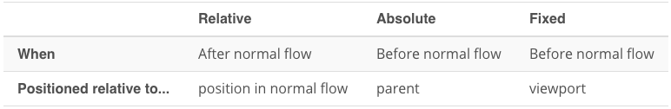

Slide 16
Position fixed navigation bar Exercise
Create a fixed navigation bar which is not overlapping any content.
Add a banner(hero image) behind the navbar using z-index. Also, add some content to your document so that the position:fixed can clearly be seen.

Slide 17
z-index
The z-index property specifies the stack order of an element.
An element with greater stack order is always in front of an element with a lower stack order.
z-index only works on positioned elements (position:absolute, position:relative, or position:fixed).

Slide 18
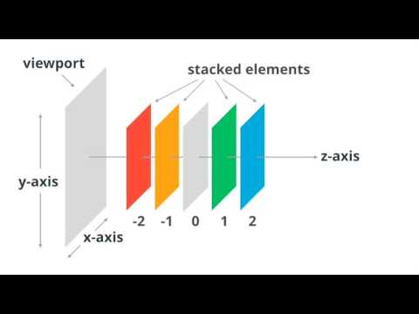

Slide 19
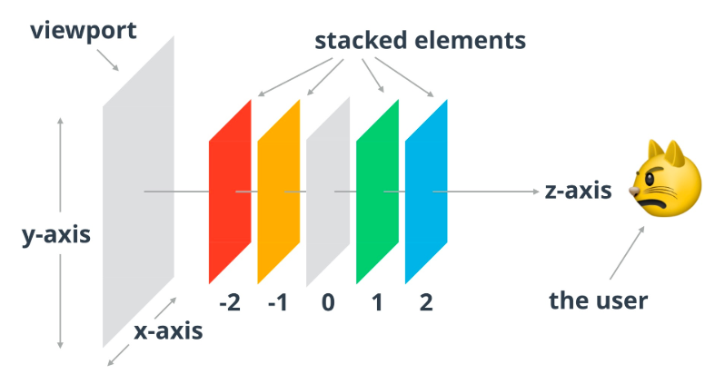
The grumpy cat gives you an idea of the user's perspective. Elements that are higher on the z-axis are closer to the user, which means that they appear above the others.

Slide 20
Positioning with Inline-Block
The display property with inline-block value is mostly useful for laying out pages or for placing elements next to one another within a line.
Accepts all box model properties, including height, width, padding, border, and margin.

Slide 21
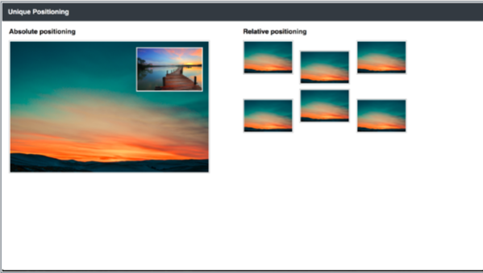
Unique Positioning Exercise
Create the following page layout, that you see as a mockup below. Feel free to be creative and add additional styling, but only after you finished the basic version.
You need to use the position and the z-index properties.

Slide 22
Exercise
Create a page with 5 block elements (div, p, etc) and 5 inline elements (span, strong, em). Give the borders,margins and different background.

Slide 23
Float
The float property allows us to take an element, remove it from the normal flow of a page, and position it to the left or right of its parent element
The most used values are left and right other values are:
none (default)
initial
inherit (a property inherits its value from its parent element)

Slide 24
Float
When an element is floated, it will float all the way to the edge of its parent element. If there isn’t a parent element, the floated element will then float all the way to the edge of the page.
float-based layouts have mostly been replaced with Flexbox in modern websites.

Slide 25
Float: Parent-Child-Sibling Relationship
Float children are not involved in the box-size calculation of normal flow parents.
If a container only contains a float child, the container will not have a height by default - the height has to be set some other way, such as with normal flow content or the height property.
Normal flow block elements ignore the size of child float elements when calculating box size. However, if you were, creating a page layout using floats, it would be reasonable to assume that a sibling to a parent element with float children would respect the boundaries of the children.

Slide 26
Clearing & Containing Floats
Originally float property were design to allow content to wrap around images
There are few things to be aware of:
occasionally the proper styles will not render on an element that it is sitting next to or is a parent element of a floated element
Often margin and padding property values aren’t interpreted correctly, causing them to blend into the floated element; other properties can be affected, too
sometimes unwanted content begins to wrap around a floated element
Floats May Change an Element’s Display Value !

Slide 27
Clearing Float
The clear property, which accepts a few different values: the most commonly used values being left, right, and both
clear: left; clear:right;
clear:both;

Slide 28
CSS basic task
This is an exercise for HTML & CSS basics. You'll need to remember what the basic HTML structure looks like, how to use floats, image, links and lists.
Create the following page layouts, that you see as mockups in the next slides. Feel free to be creative and add additional styling, but only after you finished the basic version.

Slide 29


Slide 30
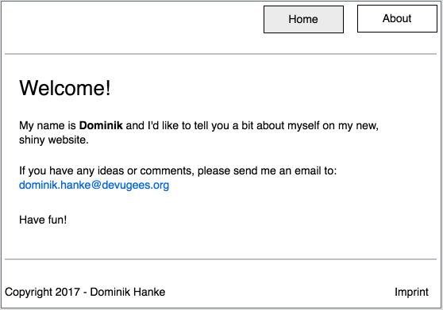

Slide 31
Box Positioning in CSS from Learn CSS Layout

