Slide 1
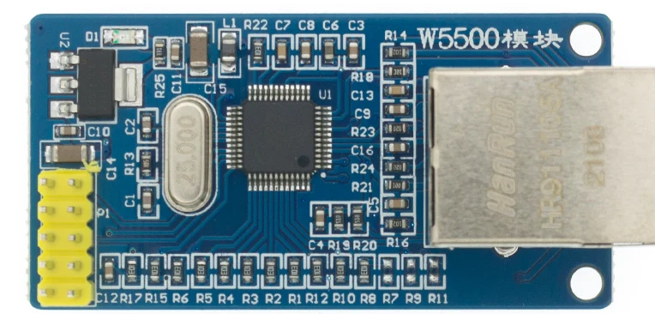
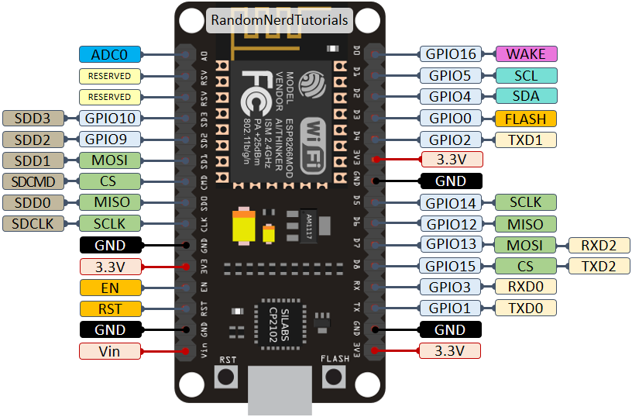
Wiring ESP8266 – W5500 Ethernet Shield
SCS
SCLK
MISO
MOSI
INT
RST
GND
5V

