Slide 1
Image Quality determination
CS731 – Artificial Neural Networks
Syed Yaser Ahmed

Slide 2
Objective
Build a network capable of learning personal image quality preferences
Process image based directly instead of parsing EXIF data
Dataset used: Yelp Photos dataset
Attributes: 5
Classes: 2 (preferred, not preferred)

Slide 3
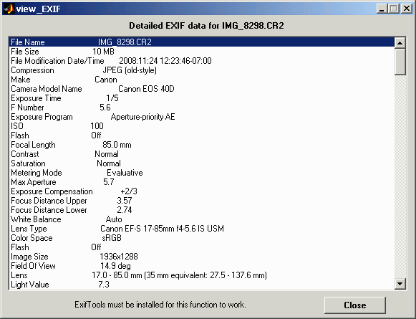
EXIF data
Doesn’t have many useful features
Difficult to calculate features from existing data
Most encoded pictures don’t have EXIF data

Slide 4
Features Building
We extract the following features from Yelp photos dataset
Blur - the aesthetic quality of the out-of-focus parts of an image
Signal to noise ratio - compares the level of a desired signal to the level of background noise
Luminance - A photometric measure of the luminous intensity per unit area

Slide 5
Features Building
Saturation - colorfulness of an area judged in proportion to its brightness
Descriptors - They describe elementary characteristics such as the shape, the color, the texture or the motion

Slide 6
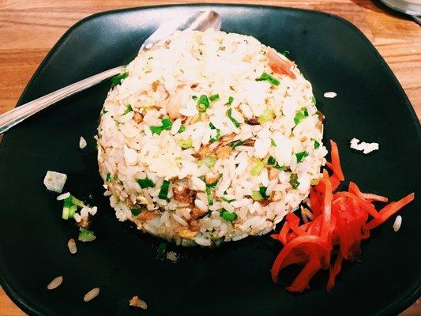

Example
Preferred
Not Preferred
15.9477087 | 1.04460159 | 0.38064286 | 60.0089878 | 0.00053007
.47494987 | 2.4554994 | 0.6111536 | 55.050903 | 1.25E-05

Slide 7
Accuracy for different classifiers

Slide 8
Tuning Hyper Parameters
Tuned Learning rate of Back propagation algorithm.
Learning rate | Accuracy
0.1 | 0.424
0.2 | 0.981
0.3 | 0.992
0.4 | 0.992
0.5 | 0.983
0.6 | 0.991
0.7 | 0.98
0.8 | 0.987
0.9 | 0.978
1.0 | 0.981

Slide 9
Back propagation Algorithm results
Accuracy | Mean Square Error
0.98385 | 0.89595
0.99201 | 0.89505
0.99067 | 0.8969
0.99217 | 0.8951
0.98884 | 0.8804
0.98284 | 0.88975
0.99099 | 0.886
0.98595 | 0.8983
0.97784 | 0.87585
0.98511 | 0.8818

Slide 10
Distribution of MSE over 100 epochs

Slide 11
Distribution of MSE over 100 epochs

Slide 12
Conclusion
We can train our network to subjectively identify a preferred picture.
Backpropagation algorithm was comparatively better for this application.
Mean accuracy ~98%
Convergence time is very less

Slide 13
Improvements
Use Convolutional networks to extract features.
Reduce size of dataset for real world applications.

Slide 14
References
[1] Yelp Dataset. (2017). Yelp.com. Retrieved 13 October 2017, from https://www.yelp.com/dataset/challenge
[2] DxOMark. (2017). En.wikipedia.org. Retrieved 14 October 2017, from https://en.wikipedia.org/wiki/DxOMark
[3] Backpropagation algorithm (2017). Retrieved 14 October 2017, from https://machinelearningmastery.com

