Slide 1

Quantum Innovation and the Next Big Wave: Preparing Enterprises for a Transformative Future
Evaluating the Future of Computing – Ethical and Security Challenges
MSc Artificial Intelligence
17/01/2026

Slide 2

What is quantum computing ?
Qubits: can represent 0 and 1 simultaneously
Superposition: where quantum systems can exist in multiple states at once
Entanglement: correlated quantum states
Enables new computational models that surpass classical limits for certain problems.
Notes:
Slide 3 – Why This Matters: Real-World Potential (3:00–5:00)
“The economic implications are massive. Analysts such as McKinsey estimate that quantum computing could generate multitrillion-dollar value across sectors like finance, life sciences, mobility, and materials by 2035. Oxford Economics reports potential productivity boosts of up to 7% in national GDP by mid-century with proper investment and government support.
Beyond economics, quantum is already influencing cybersecurity, drug discovery, optimization, and AI research.”
Slide 4 – Quantum and Cybersecurity Risks (5:00–7:00)
“But there’s a critical downside: quantum threatens today’s foundational security systems. Experts warn of an event nicknamed Q-Day — when quantum systems can break widely used cryptographic standards like RSA and ECC.
Security organizations, including Europol-led groups and UK cyber authorities, are already urging financial institutions and governments to prepare for quantum threats now, because malicious actors might capture and store encrypted data today to break later with quantum processors.
This aligns with a core principle from our unit: “Cybersecurity is a human problem first, and a technical problem second.” Technology may break codes, but human decision-making in design, policy, and risk management determines whether systems fail or survive.”
Slide 5 – Human Factors and Professional Responsibility (7:00–9:00)
“Unit 7 of our textbook emphasizes that security systems must be designed around real human cognitive limitations, not idealized rational actors. Users don’t behave consistently or perfectly; they shortcut, ignore warnings, or defer to tools and experts. That’s dangerous in cybersecurity, because tools cannot replace strategic thinking. Our profession must anticipate human failure, not assume human perfection.
This means designing systems that reduce complexity and support human decision-making — such as Rational Centeringmechanisms that help users stay logical when they feel overwhelmed.”
Slide 6 – Ethics, Policy, and Governance (9:00–11:00)
“Quantum also raises legal, ethical, and governance concerns. Policies must be succinct, measurable statements of protection properties, not vague managerial language. This reflects Ross Anderson’s definition that a policy should clearly articulate what protections are provided, not just sound good on paper.
On the ethical front, transparency isn’t just a buzzword — it’s a cornerstone of trust. As we’ve learned with AI, transparency and explainability aren’t mere technical prerequisites; they’re essential for accountability, fairness, and public trust.”
🔹 Slide 7 – Enterprise Readiness (Final Version)
“Quantum computing is no longer confined to research labs — leading companies are already preparing for its business impact.
NVIDIA, for example, is investing in accelerated quantum computing by integrating quantum processors with classical GPUs. Their strategy shows that near-term value will come from hybrid systems, where quantum handles specific optimization and simulation tasks while classical computing ensures stability and scalability.
Waymo represents a similar forward-looking approach. Although known for autonomous driving, Waymo relies heavily on probabilistic modeling, massive simulation environments, and optimization problems — exactly the types of challenges quantum computing is expected to enhance in the future. Waymo demonstrates how enterprises are already designing architectures compatible with post-classical computation.
At the same time, organizations are guided by NIST — the National Institute of Standards and Technology, which is leading global efforts in post-quantum cryptography. NIST’s work confirms that quantum readiness is not optional; it is becoming a formal cybersecurity and compliance requirement.
Together, these examples show that enterprise readiness is not about replacing today’s systems, but about building infrastructures that can safely and strategically integrate quantum capabilities as they mature.”
🔹 Slide 8 – Innovation Balance (With CEO Quote – Health Tech)
(13:00–14:30)
“A useful perspective comes from a CEO of a health-tech software company managing more than 10 million patient data records. When asked:
“From your perspective as a CEO, where do you see the most realistic opportunities for quantum computing to add value to healthcare software over the next ten years?”
He answered by referencing Moore’s Law, explaining that quantum computing will not suddenly replace classical systems, but will follow a gradual curve of adoption — where value increases progressively as hardware stability, error correction, and accessibility improve.
His message reinforces an important principle: innovation is evolutionary, not instantaneous. Quantum computing will first enhance specific domains such as molecular simulation, optimization, and predictive modeling before becoming mainstream in healthcare software.
This perspective supports responsible innovation — investing early, but with realistic expectations, ethical oversight, and security-first strategies.”
Slide 9 – Conclusion (14:30–15:00)
“In conclusion, quantum computing offers transformative advantages — from unprecedented processing power to novel market opportunities — but it also demands responsible preparation, ethical governance, and human-centered design thinking. Enterprise leaders, technologists, and policymakers must collaborate now to harness quantum’s promise while mitigating its risks. The quantum era is not tomorrow — it’s unfolding now.”

Slide 3

Quantum vs AI
AI optimizes within classical computation limits
Quantum computing redefines computational complexity classes.
Potential synergy: quantum accelerating future AI models

Slide 4
Closer to Reality
“Quantum computing’s power and speed will enable us to solve some of civilization’s hardest problems.”
— Chuck Brooks, The Economist
Cryptography
Drug discovery
Optimization
quantum technologies could generate up to $2 trillion in economic value by 2035.
Real-world quantum systems are advancing rapidly

Slide 5

Security risks
Potential to break current encryption standards
Q-Day
Cybersecurity threat models must evolve
RSA and ECC are particularly vulnerable to Shor’s algorithm

Slide 6
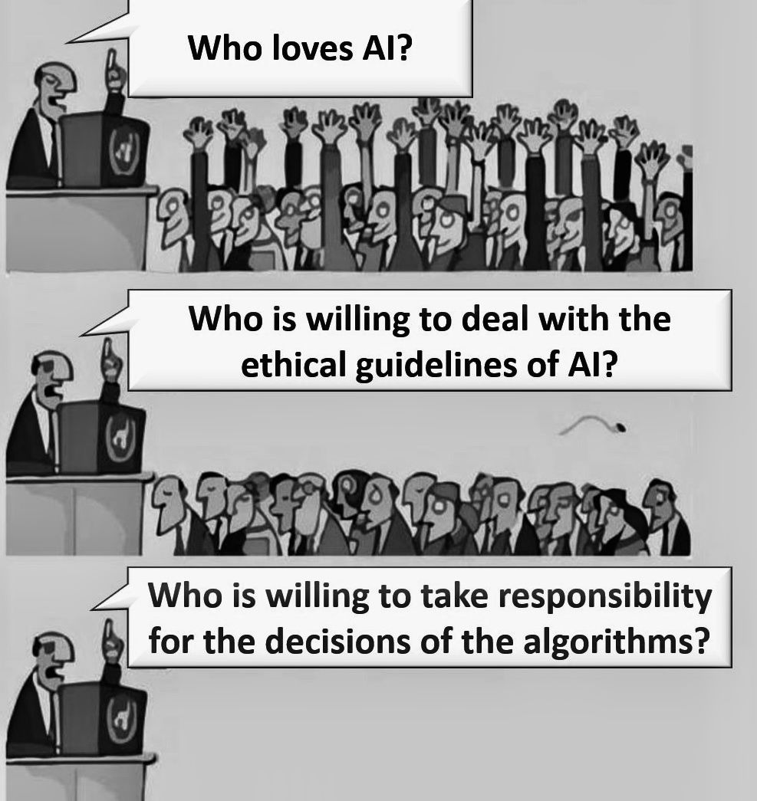
Ethics & Governance
Data privacy – EU Act relevance
Inequality risk – NIST role in standardisation
Transparency
Governance

Slide 7
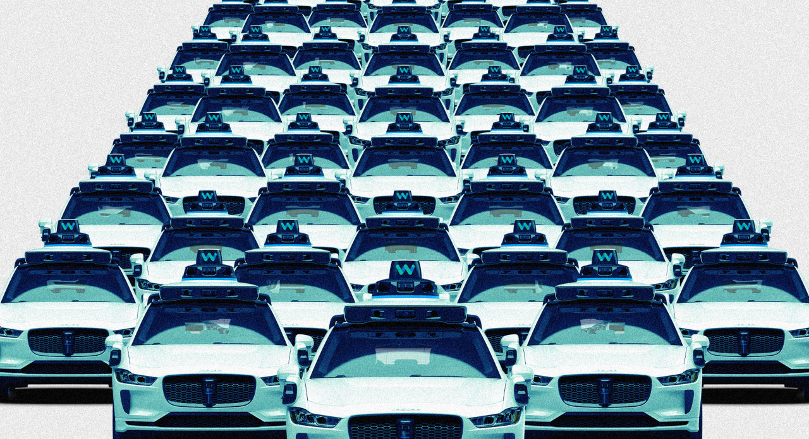

Enterprise Readiness
Quantum-ready strategies and early planning
Post-quantum cryptography adoption
NVIDIA Accelerated Quantum Computing
“It’s Waymo’s World. We’re All Just Riding in It.”
The Wall Street

Slide 8
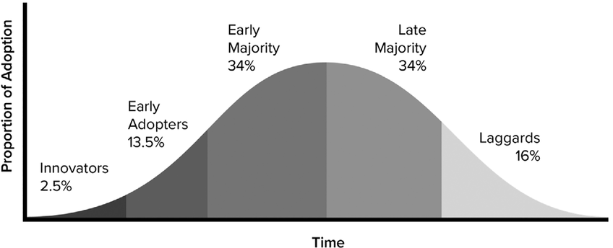

Innovation Balance
Responsible Innovation • Ethical Review • Security Investment
“
Quantum computing will not suddenly replace classical systems, but will follow a gradual curve of adoption.
Luciano Regus, CEO of Intelectah,
Health Tech Software

Slide 9
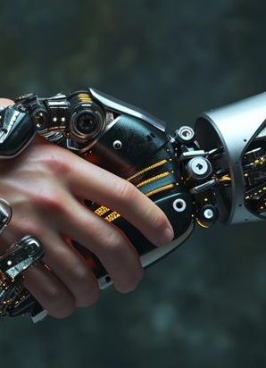
Conclusion
Enterprises that fail to adopt post-quantum strategies risk long-term systemic vulnerability.
Quantum
is near
Risk
is real
Preparation is critical

Slide 10
References
Binsar, S., Kumar, P. and Ranjan, V. (2025) ‘Synergistic integration of AI, cybersecurity and software engineering for sustainable automation’, Journal of Intelligent Systems and Applications, 18(1), pp. 45–56.
Bose, M. (2024) Bias in AI: A societal threat. IGI Global.
Downey, A. (2024) Think Python. O’Reilly.
European Commission (2024) Artificial Intelligence Act (EU 2024/1689). Available at: eur-lex.europa.eu
Forbes (2022) ‘Risks of quantum computing’. Available at: forbes.com
Forbes (2025) ‘Quantum computing impact’. Available at: forbes.com
Forbes (2025) ‘Real-world quantum applications’. Available at: forbes.com
Jobin, A., Ienca, M. and Vayena, E. (2019) ‘AI ethics guidelines’, Nature Machine Intelligence, 1(9), pp. 389–399.
NIST (2025) Quantum computing explained. Available at: nist.gov
Nature (2025) Quantum computing article. Available at: nature.com
Sreerangapuri, A. (2024) ‘AI-driven service transformation’, IJSRCSEIT, 10(6), pp. 132–140.
SSH Academy (2025) NIST PQC standards explained. Available at: ssh.com
The Quantum Insider (2023; 2025) Quantum computing and governance articles.
Walton, D.J. (2024) Culturally responsive computing. ROTEL.
OpenAI (2026) ChatGPT: AI-assisted generation of visual content for educational presentations.

