Slide 1

Exploring and Analyzing Diabetes Data Through Statistical Techniques in R
Yasmin Almeida Ferrera
MSc Artificial Intelligence
Module : Numerical Analysis
MODULE TUTOR : Ali Edisen
University of Essex
July 2026
Notes:
Good morning everyone, and thank you for taking the time to watch my presentation.
My name is Yasmin Ferrera, and today I will be presenting my statistical analysis of the Pima Indians Diabetes dataset using R.

Slide 2
Study Objectives
Objectives
Explore the demographic and clinical characteristics of the diabetes dataset.
Examine the relationship between diabetes and key risk factors.
Evaluate statistical associations using hypothesis testing.
Develop regression models to predict glucose levels and diabetes outcome.
Statistical Methods
Descriptive Statistics
Data Visualisation
Hypothesis Testing
Correlation Analysis
Linear Regression
Logistic Regression
Aim: To identify the main predictors of diabetes and evaluate their statistical significance.
"Statistics is the art and science of learning from data."
(RSS International, 2024)
Notes:
Diabetes is one of the most common chronic diseases worldwide and represents a major public health challenge. Understanding the factors associated with diabetes can help identify individuals at higher risk and support earlier intervention. According to the American Diabetes Association (2024), risk factors such as age, obesity and elevated blood glucose play an important role in the development of Type 2 diabetes.
In this presentation, I will first introduce the dataset and explore its main characteristics using descriptive statistics and visualisations. I will then perform inferential statistical analyses, including hypothesis testing, correlation analysis and regression modelling. Finally, I will discuss the main findings, limitations of the study and recommendations for future research.

Slide 3

Dataset Description
Variable | Description
Pregnancies | N of pregnancies
Glucose | Plasma glucose concentration
Blood Pressure | Diastolic blood pressure
Skin Thickness | Triceps skinfold thickness
Insulin | Serum insulin
BMI | Body Mass Index
DiabetesPedigreeFunction | Diabetes family history score
Age | Age in years
Outcome | 0 = no diabetes 1 = diabetes
Dataset: Pima Indians Diabetes Database
Source: National Institute of Diabetes and Digestive and Kidney Diseases (NIDDK)
768 observations
8 predictor variables
1 binary response variable (Outcome)
https://www.kaggle.com/datasets/akshaydattatraykhare/diabetes-dataset/data
dim(diabetes)
names(diabetes)
str(diabetes)
Notes:
"The analysis is based on the Pima Indians Diabetes Dataset, a well-known benchmark dataset in healthcare analytics. It contains information from 768 female participants and includes eight clinical and demographic predictors alongside a binary outcome indicating the presence or absence of diabetes. These variables provide the foundation for both exploratory and predictive analyses. You'll also notice a small R logo on some slides, which indicates that the corresponding R code used for the analysis is included in the hidden section. This keeps the slides clean while still demonstrating how each result was produced

Slide 4

Methodology
"…make both calculations and graphs. Both sorts of output should be studied; each will contribute to understanding."
Anscombe (1973)
Descriptive Statistics
Import Dataset
Data exploration
Exploratory Visualisation
Hypothesis Testing
Regression Models
Model Evaluation
library(ggplot2) library(dplyr)
Notes:
The analysis followed a structured workflow beginning with data exploration and descriptive statistics. Visualisations were created using ggplot2 to identify patterns and potential anomalies before applying inferential statistical tests and regression models. This approach follows Anscombe's recommendation that numerical summaries and graphical analysis should be used together to understand data effectively."

Slide 5
Sample Charactheristics
Characteristic | Value
Participants | 768
Variables | 9
No Diabetes | 500 (65.1%)
Diabetes | 268 (34.9%)
ggplot(diabetes,
aes(x = factor(Outcome))) +
geom_bar(fill = "#2E86C1") +
labs(title = "Distribution by Diabetes Status")
Notes:
"This slide presents the main characteristics of the study sample. The dataset contains 768 participants, of whom 500 (65.1%) were classified as non-diabetic and 268 (34.9%) as diabetic. This indicates a moderate class imbalance, which is common in medical datasets and is important to consider when interpreting the results of predictive models."

Slide 6
Summary Statistics
Table 1. Descriptive statistics of the main clinical variables.
Glucose showed the greatest variability.
BMI and Age were widely distributed.
Summary statistics guided subsequent analyses.
Variable | Mean | Median | Mode | SD | Min | Max
Glucose | 120.89 | 117 | 100 | 31.97 | 0 | 199
BMI | 31.99 | 32.0 | 32 | 7.88 | 0.0 | 67.1
Age | 33.24 | 29 | 22 | 11.76 | 21 | 81
Blood Pressure | 69.11 | 72 | 70 | 19.36 | 0 | 122
Pregnancies | 3.85 | 3 | 1 | 3.37 | 0 | 17
.
From the Royal College of Radiologists guide:
«Descriptive statistics summarise the data before more advanced analyses. »
summary(diabetes)
describe(diabetes)
Notes:
Table 1 summarises the descriptive statistics for the principal variables included in the analysis. The average participant was approximately 33 years old, with a mean BMI of 32 kg/m². Blood glucose levels exhibited notable variability, reflecting differences in metabolic health among participants. The table also highlights the presence of zero values in some clinical variables, a known characteristic of this dataset that should be considered during interpretation."

Slide 7
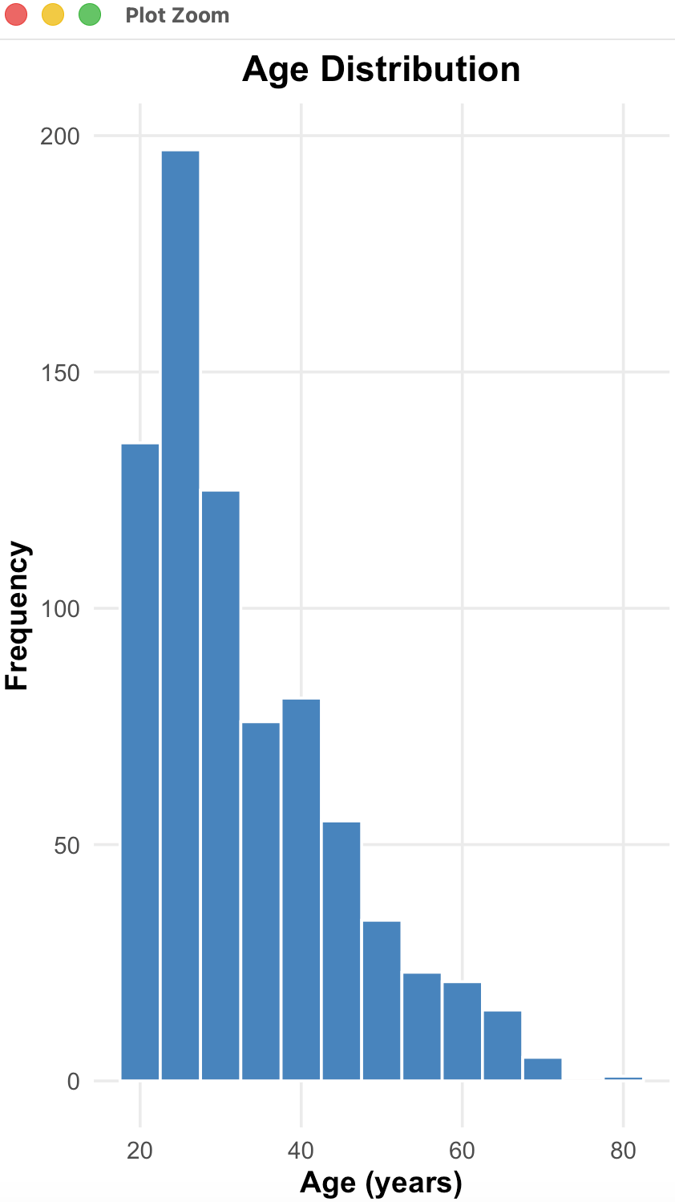
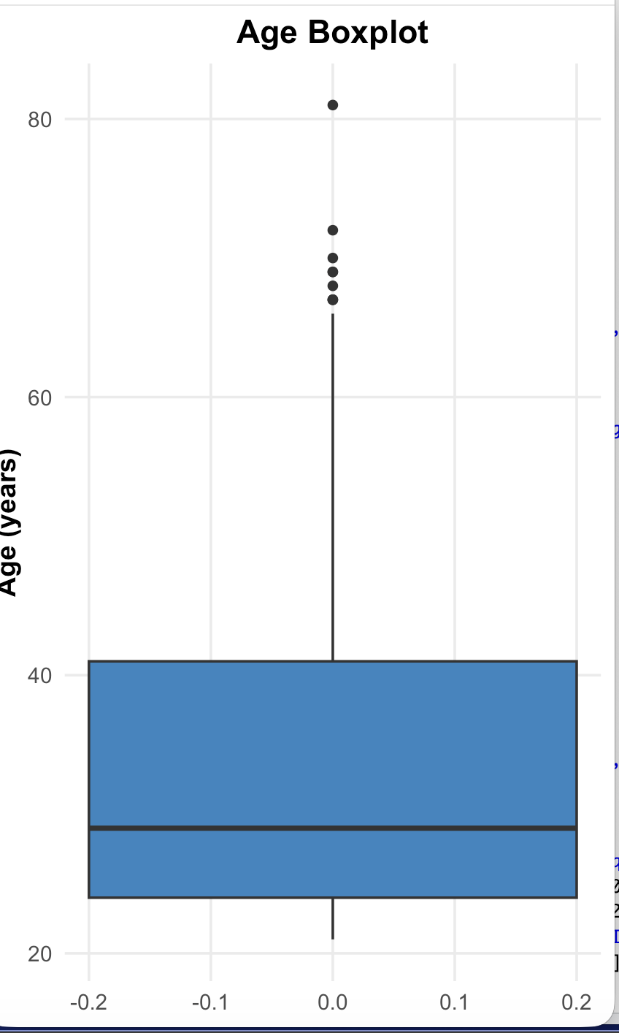
Age Distribution
• Most participants were between 21 and 41 years.
• Median age was 29 years.
• Age distribution was positively skewed.
• Several older participants (>65 years) were identified as outliers.
Q1 | 24
Median | 29
Q3 | 41
Max | 81
IQR | 17
ggplot(diabetes, aes(x = Age)) + geom_histogram()
ggplot(diabetes, aes(y = Age)) + geom_boxplot()
Autodesk article:
«Similar summary statistics can hide different underlying distributions, highlighting the importance of visualising the data.»
Notes:
The age distribution indicates that most participants were relatively young adults. The median age was 29 years, and half of the participants were between 24 and 41 years of age. The histogram demonstrates a positively skewed distribution, meaning there are fewer older participants. The boxplot also identifies several observations above approximately 65 years as potential outliers, although these values remain clinically plausible.

Slide 8
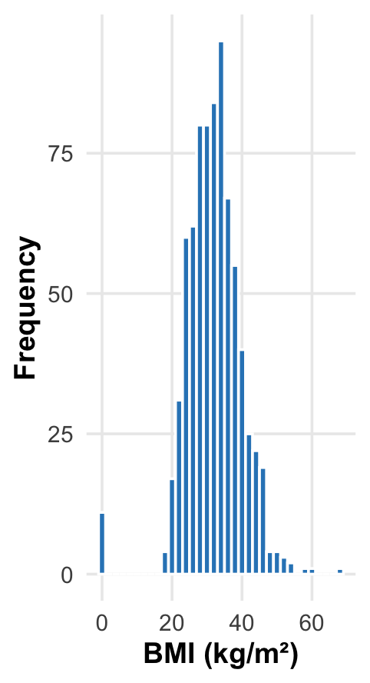
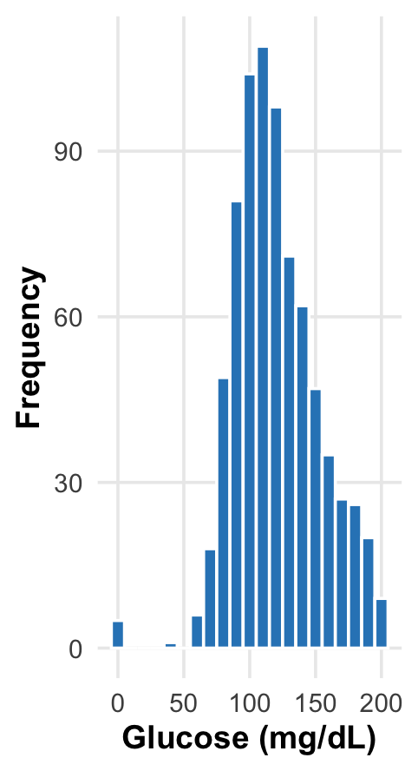
BMI and Glucose Distribution
• BMI is concentrated around 30–35 kg/m².
• Glucose shows greater variability than BMI.
• Both variables exhibit right-skewed distributions.
ggplot(diabetes, aes(x = BMI)) + geom_histogram()
ggplot(diabetes, aes(x = Glucose)) + geom_histogram()
Notes:
These histograms illustrate the distribution of BMI and glucose levels in the dataset. BMI values are concentrated around 30–35 kg/m², indicating that many participants fall within the overweight or obese range. Glucose values exhibit greater variability and a slight positive skew, reflecting differences in metabolic status among participants. Both variables also contain zero values, which are likely to represent missing clinical measurements."

Slide 9
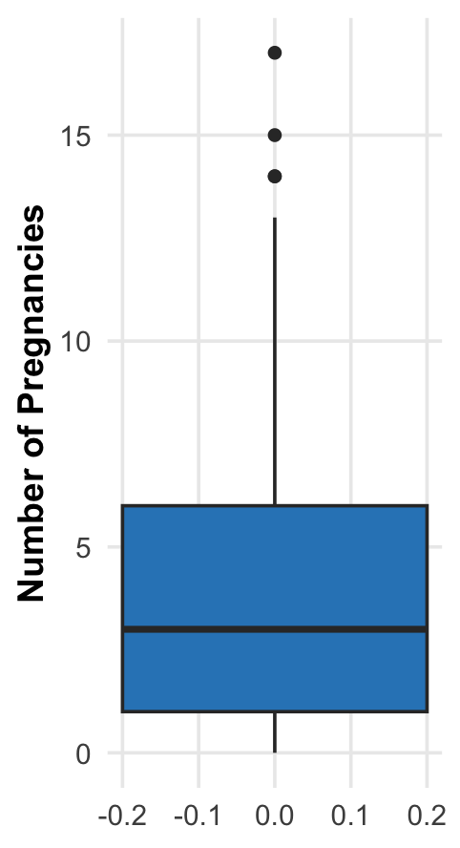
Blood pressure and pregnancies
• Pregnancies shows a positively skewed distribution with several high-value outliers (14–17 pregnancies).
• Blood Pressure contains impossible values (0 mmHg), suggesting missing values were encoded as zero.
• These observations indicate that data cleaning should be considered before predictive modelling.
• Boxplots provide a simple way to detect unusual observations that may influence statistical analyses.
ggplot(diabetes, aes(y = Pregnancies)) +
geom_boxplot(fill = "steelblue") +
labs(title = "Pregnancies Boxplot")
ggplot(diabetes, aes(y = BloodPressure)) +
geom_boxplot(fill = "steelblue") +
labs(title = "Blood Pressure Boxplot")
Notes:
"The boxplots illustrate the variability of blood pressure and the number of pregnancies within the study population. Blood pressure values are centred around 72 mmHg, although several observations with a value of zero indicate likely missing clinical measurements. The pregnancy variable is positively skewed, with most participants reporting relatively few pregnancies and a small number exhibiting substantially higher values."

Slide 10
Diabetes Rates Across Age and BMI Categories
# Create age groups
diabetes$AgeGroup <- cut(
diabetes$Age,
breaks = c(20, 29, 39, 49, Inf),
labels = c("<30", "30-39", "40-49", "50+")
)
# Create BMI categories
diabetes$BMICategory <- cut(
diabetes$BMI,
breaks = c(-Inf, 18.5, 25, 30, Inf),
labels = c("Underweight", "Normal",
"Overweight", "Obese")
)
# Calculate diabetes rates
prop.table(table(diabetes$AgeGroup,
diabetes$Outcome), 1)
prop.table(table(diabetes$BMICategory,
diabetes$Outcome), 1)
Diabetes prevalence generally increased with age and BMI, with the highest prevalence observed among participants aged 40–49 and those classified as obese.
Notes:
This slide presents the diabetes prevalence across different age groups and BMI categories.
Looking first at the age groups, the percentage of participants diagnosed with diabetes increased considerably with age. The prevalence rose from approximately 21% in participants under 30 years old to over 46% in the 30–39 group, reaching its highest value of 55% in the 40–49 age group. Although the prevalence was slightly lower in the 50+ group, it remained substantially higher than in younger participants.
A similar pattern was observed across BMI categories. Participants with a normal BMI had the lowest diabetes prevalence, at around 6%, whereas almost 46% of obese participants were diagnosed with diabetes. This suggests that increasing BMI is strongly associated with a higher prevalence of diabetes.
These descriptive findings provide an initial indication that both age and BMI are important factors related to diabetes. In the next section, these observations are formally tested using inferential statistical methods."

Slide 11
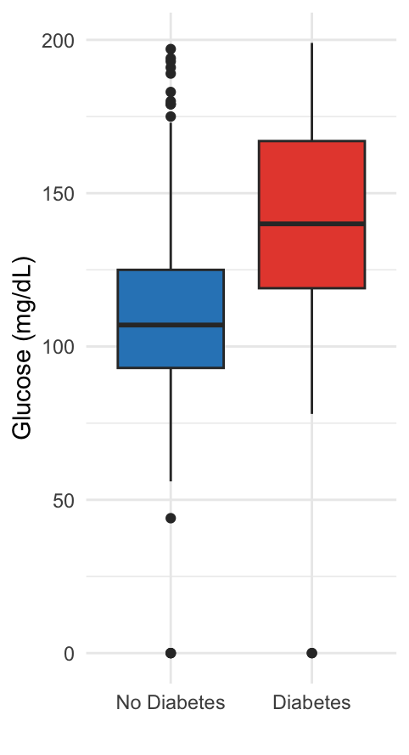
Glucose Levels by Diabetes Outcome
Key Findings
• Participants with diabetes had substantially higher glucose levels.
• Mean glucose increased from 110 to 141 mg/dL.
• The difference was statistically significant (p < 0.001).
ggplot(diabetes, aes(x = factor(Outcome, labels = c("No Diabetes","Diabetes")), y = Glucose, fill = factor(Outcome))) + geom_boxplot() + labs(title = "Glucose Levels by Diabetes Outcome", x = "", y = "Glucose (mg/dL)") + theme_minimal() + theme(legend.position = "none")
t.test(Glucose ~ Outcome, data = diabetes)
Notes:
This boxplot compares glucose levels between participants with and without diabetes. The diabetic group shows noticeably higher glucose values, with a mean of approximately 141 mg/dL compared with 110 mg/dL in the non-diabetic group. A Welch two-sample t-test confirmed that this difference is statistically significant (p < 0.001), suggesting that glucose is strongly associated with diabetes in this dataset."

Slide 12
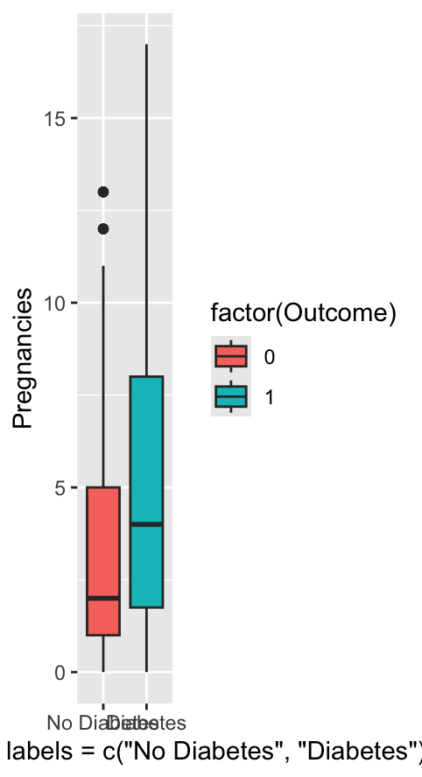
Pregnancies by Diabetes Outcome
# Pregnancy groups
diabetes$PregnancyGroup <- cut(
diabetes$Pregnancies,
breaks = c(-1, 0, 2, 4, Inf),
labels = c("0", "1-2", "3-4", "5+")
)
# Diabetes rates
prop.table(
table(diabetes$PregnancyGroup,
diabetes$Outcome), 1
)
# Group comparison
t.test(Pregnancies ~ Outcome,
data = diabetes)
Key Findings
Mean pregnancies: 4.87 vs 3.30
Significant difference (p < 0.001)
Highest diabetes rate in 5+ pregnancies (47.8%)
Notes:
On this slide, I examined whether the number of pregnancies differs between women with and without diabetes.
The boxplot shows that women diagnosed with diabetes generally had a higher number of pregnancies than those without diabetes. This is also reflected in the summary statistics. Women without diabetes had an average of 3.30 pregnancies, while women with diabetes had a higher average of 4.87 pregnancies. The median also increased from 2 pregnancies in the non-diabetic group to 4 pregnancies in the diabetic group.
To determine whether this difference was statistically significant, I performed an independent Welch's t-test. The test produced a p-value smaller than 0.001, indicating that the difference between the two groups is statistically significant.
In addition, I categorised pregnancies into four groups: 0, 1–2, 3–4, and 5 or more pregnancies. The bar chart shows that the proportion of diabetes increases as the number of pregnancies increases. Nearly half of the women with five or more pregnancies were diagnosed with diabetes, compared with much lower rates in the other groups.
Overall, these findings suggest that a higher number of pregnancies is associated with an increased prevalence of diabetes within this dataset

Slide 13
Correlation Matrix
Key Findings
Glucose shows the strongest positive association with Outcome.
BMI and Age exhibit moderate positive relationships.
No strong correlations (>0.70) were observed, indicating low multicollinearity among predictors.
The correlation analysis provides the basis for the regression models presented next.
cor_matrix <- cor(diabetes)
round(cor_matrix, 2)
Notes:
Pearson's correlation coefficients were calculated to examine the relationships between the predictor variables and diabetes outcome. Glucose demonstrated the strongest positive association with diabetes (r = 0.47), followed by BMI (r = 0.29) and Age (r = 0.24). Blood Pressure and Skin Thickness showed very weak correlations. Importantly, no correlation exceeded 0.70, indicating that multicollinearity is unlikely to be a concern. These findings support the inclusion of multiple predictors in the subsequent regression analyses."

Slide 14
Hypothesis Testing
Analysis | Test | Statistic | P-value | Decision
Diabetesx age groups | Chi-square | χ² = 69.92 | <0.001 | Reject H₀
DiabetesxBMI Categories | Chi-square | χ² = 76.43 | <0.001 | Reject H₀
Glucose by Age Groups | ANOVA | F = 19.62 | <0.001 | Reject H₀
Post-hoc (Tukey HSD)
50+ years had significantly higher glucose levels ( p < 0.01).
30-39 and 40-49 years showed no significant difference (p = 0.998).
chisq.test(table(diabetes$AgeGroup, diabetes$Outcome))
chisq.test(table(diabetes$BMICategory, diabetes$Outcome))
anova_model <- aov(Glucose ~ AgeGroup, data = diabetes)
summary(anova_model)
TukeyHSD(anova_model)
Diabetes prevalence differed significantly across age and BMI categories. In addition, older participants (50+) had significantly higher mean glucose levels than younger participants.
Notes:
To investigate group differences, two Chi-square tests and a one-way ANOVA were conducted. The Chi-square analyses demonstrated significant associations between diabetes status and both age group and BMI category, indicating that diabetes prevalence varies across these groups. The ANOVA further showed that mean glucose levels differed significantly by age group. Tukey's post-hoc analysis revealed that participants aged 50 years and older had significantly higher glucose levels than all younger groups, while there was no significant difference between the 30–39 and 40–49 age groups.

Slide 15
Multiple Linear Regression
Significant Predictors
Model Performance
Predictor | β Estimate | p-value | Significant
Age | +0.645 | <0.001 | ☑️
BMI | +0.750 | <0.001 | ☑️
Insulin | +0.100 | <0.001 | ☑️
Skin Thickness | -0.334 | <0.001 | ☑️
DPF | +6.316 | 0.046 | ☑️
Pregnancies | +0.059 | 0.871 | ❌
Blood Pressure | +0.070 | 0.220 | ❌
Metric | Result
Observations | 768
R² | 0.230
Adjusted R² | 0.223
F-statistic | 32.46
Model p-value | < 0.001
Model significant (p < 0.001)
R² = 23%
Age, BMI, Insulin and DPF were significant predictors
linear_model <- lm(
Glucose ~ Age + BMI + Pregnancies +
BloodPressure + SkinThickness +
Insulin + DiabetesPedigreeFunction,
data = diabetes
)
summary(linear_model)
Notes:
To identify the factors associated with glucose levels, I developed a multiple linear regression model using Age, BMI, Pregnancies, Blood Pressure, Skin Thickness, Insulin, and Diabetes Pedigree Function as predictor variables.
The overall model was statistically significant, with an F-statistic of 32.46 and a p-value below 0.001. The model explained approximately 23% of the variation in glucose levels, as indicated by an R-squared value of 0.23.
Looking at the individual predictors, Insulin was the strongest predictor of glucose levels and showed a highly significant positive relationship. Age and BMI were also significant positive predictors, indicating that older individuals and those with a higher BMI tended to have higher glucose levels.
Interestingly, Skin Thickness showed a significant negative association with glucose levels, while Diabetes Pedigree Function had a smaller but still statistically significant positive effect.
On the other hand, Pregnancies and Blood Pressure were not statistically significant after accounting for the other variables in the model. This suggests that their independent contribution to predicting glucose levels was limited.
Overall, these findings indicate that glucose levels are influenced by multiple clinical factors, with insulin, age, and BMI providing the greatest predictive value in this dataset."

Slide 16
Logistic Regression
Model Results
Model Performance
Predictor | Odds Ratio | P-value | interpretation
BMI | 1.09 | <0.001 | Higher BMI increases diabetes risk
Age | 1.03 | <0.001 | Older age increases diabetes risk
Glucose | 1.03 | <0.001 | Higher glucose increases diabetes risk
Metric | Result
Hosmer-Lemeshow t | P = 0.349
Classification Accuracy | 76.8%
Sensitivity | 56.3%
Specificity | 87.8%
hoslem.test(diabetes$Outcome,
fitted(log_model))
predicted <- ifelse(
predict(log_model, type = "response") > 0.5,
1, 0
)
All three predictors (BMI, Age and Glucose) were statistically significant.
The Hosmer–Lemeshow test was not significant (p = 0.349), indicating that the model fits the data adequately.
The model correctly classified 76.8% of participants.
The model identified 87.8% of non-diabetic individuals (high specificity) but only 56.3% of diabetic individuals(moderate sensitivity).
log_model <- glm(
Outcome ~ BMI + Age + Glucose,
data = diabetes,
family = binomial
)
summary(log_model)
Notes:
Next, I developed a logistic regression model to predict diabetes status using BMI, age, and glucose as predictors.
All three variables were statistically significant, indicating that they each contribute to predicting the likelihood of diabetes.
The odds ratios show that increasing BMI, age, and glucose are all associated with higher odds of being diagnosed with diabetes. For example, each one-unit increase in BMI increases the odds of diabetes by approximately 8.5%, while each one-unit increase in glucose increases the odds by about 3.3%.
To evaluate the model, I used the Hosmer–Lemeshow goodness-of-fit test. Since the p-value was 0.349, which is greater than 0.05, there is no evidence of poor fit, suggesting that the model fits the data well.
The model achieved an overall classification accuracy of 76.8%. It performed particularly well at identifying non-diabetic individuals, with a specificity of 87.8%, while its sensitivity for identifying diabetic individuals was 56.3%.
Overall, these results indicate that BMI, age, and especially glucose are useful predictors of diabetes risk."

Slide 17
Model Comparison
Logistic Models
Likelihood Ratio Test
Odds Ratios (Model 2)
Model | Predictors
Model 1 | BMI+Age+Glucose+Pregnancies
Model 2 | BMI+Age+Glucose+Pregnancies+BMIxAge
Test | Result
χ² | 0.039
P-value | 0.843
Decision | Interaction not significant
Predictor | OR | P-value
BMI | 1.08 | 0.064
Age | 1.01 | 0.871
Glucose | 1.03 | <0.001
Pregnancies | 1.12 | <0.001
BMI x Age | 1.00 | 0.843
Adding the BMI × Age interaction did not improve the model (Likelihood Ratio Test: p = 0.843).
The interaction term was not statistically significant.
Glucose and Pregnancies remained significant predictors.
Model 1 was preferred because it was more parsimonious while providing a similar fit.
model1 <- glm(
Outcome ~ BMI + Age + Glucose + Pregnancies,
family = binomial,
data = diabetes
)
model2 <- glm(
Outcome ~ BMI * Age + Glucose + Pregnancies,
family = binomial,
data = diabetes
)
anova(model1, model2, test = "Chisq")
Notes:
Finally, I investigated whether age modified the effect of BMI on diabetes risk by comparing two logistic regression models. Model 1 included the main effects of BMI, age, glucose, and pregnancies, while Model 2 additionally included the interaction term between BMI and age.
A likelihood ratio test was used to compare the two models. The test was not statistically significant, with a p-value of 0.843, indicating that adding the interaction term did not improve model performance.
The interaction term itself was also not significant, suggesting that the effect of BMI on diabetes risk does not depend on age in this dataset. Therefore, the simpler main-effects model was preferred because it provides a similar fit while being easier to interpret.
Overall, glucose and pregnancies remained significant predictors of diabetes, whereas the BMI-by-age interaction did not contribute additional predictive value."

Slide 18
Discussion
Age and diabetes
Older adults had higher glucose levels and higher diabetes prevalence, consistent with previous epidemiological studies.
Key Findings
Diabetes prevalence increased with age and BMI.
Individuals with diabetes had significantly higher glucose levels.
Women with diabetes reported more pregnancies on average.
Glucose, BMI and Age were significant predictors of diabetes.
The BMI × Age interaction was not statistically significant.
BMI as a risk factor
Higher BMI significantly increased diabetes risk, supporting evidence that obesity is a major contributor to Type 2 diabetes.
Glucose
Glucose was the strongest predictor in both regression models, which agrees with established clinical knowledge.
Comprehensive statistical analysis helps identify patterns and relationships within health datasets, improving interpretation and supporting evidence-based conclusions.
Notes:
The findings of this study are consistent with previous research on diabetes risk factors. Age and BMI were both significantly associated with diabetes, while glucose emerged as the strongest predictor in the regression models. These results agree with established evidence that increasing age, obesity, and elevated glucose levels are major contributors to Type 2 diabetes.
Interestingly, the interaction between BMI and age was not statistically significant, suggesting that these variables contribute independently rather than modifying each other's effects in this dataset.
This project also highlights the importance of combining statistical tests with appropriate visualisations. As noted by Anscombe, both calculations and graphical exploration contribute to a better understanding of data. Overall, the analyses demonstrate how descriptive statistics, inferential testing, and predictive modelling can be integrated to investigate complex healthcare datasets

Slide 19

Limitations & Future Work
Future Work
Limitations
✔ Data cleaning & missing value imputation
✔ Additional clinical & lifestyle variables
✔ Machine learning models (Random Forest, XGBoost)
✔ External dataset validation
❌ Zero values treated as real observations
❌ Cross-sectional dataset
❌ Limited predictor variables
❌ Moderate model performance (R² = 23%)
Future studies should use larger, cleaner datasets and more advanced predictive models.
Notes:
This study has several limitations. The dataset contains zero values for variables such as glucose, BMI, blood pressure, and insulin, which are unlikely to represent true clinical measurements. In addition, the data are cross-sectional, meaning we can identify associations but not causation. The models also excluded lifestyle factors that may influence diabetes risk. Future work should focus on improved data preprocessing, additional predictors, more advanced machine learning methods, and validation using external datasets."

Slide 20
Conclusion
768 participants were analysed.
34.9% were diagnosed with diabetes.
Age, BMI and Glucose were the strongest factors associated with diabetes.
Significant differences were found in glucose levels and number of pregnancies between diabetic and non-diabetic individuals.
Logistic regression achieved 76.8% classification accuracy.
Key Findings
Statistical modelling successfully identified key diabetes risk factors and demonstrated the value of regression techniques for healthcare data analysis.
Notes:
In conclusion, this project analysed data from 768 individuals to investigate factors associated with diabetes. Approximately 35% of participants had diabetes. The descriptive and inferential analyses showed that glucose levels and the number of pregnancies differed significantly between diabetic and non-diabetic individuals. Regression analyses further demonstrated that age, BMI and glucose were the strongest predictors of diabetes risk, while the logistic regression model achieved an overall classification accuracy of 76.8%. Overall, this project demonstrates how statistical analysis and predictive modelling can be applied to healthcare data to identify important risk factors and support evidence-based decision-making.
Thank you very much for your time and attention. I hope this presentation has provided a clear overview of the analysis and its findings. I appreciate the opportunity to present my work, and I hope you have found it both informative and insightful. Have a great day.

Slide 21
References
American Diabetes Association (2024) Standards of care in diabetes—2024. Diabetes Care, 47(Suppl. 1), pp. S1–S350.
Hosmer, D.W., Lemeshow, S. and Sturdivant, R.X. (2013) Applied logistic regression. 3rd edn. Hoboken, NJ: Wiley.
James, G., Witten, D., Hastie, T. and Tibshirani, R. (2021) An introduction to statistical learning: with applications in R. 2nd edn. Cham: Springer.
R Core Team (2025) R: A language and environment for statistical computing. Vienna: R Foundation for Statistical Computing. Available at: https://www.R-project.org/ (Accessed: 11 July 2026).
Revelle, W. (2024) psych: Procedures for psychological, psychometric, and personality research (R package). Available at: https://CRAN.R-project.org/package=psych (Accessed: 11 July 2026).
Smith, J.W., Everhart, J.E., Dickson, W.C., Knowler, W.C. and Johannes, R.S. (1988) 'Using the ADAP learning algorithm to forecast the onset of diabetes mellitus', Proceedings of the Annual Symposium on Computer Application in Medical Care, pp. 261–265.
Wei, T. and Simko, V. (2024) corrplot: Visualization of a correlation matrix (R package). Available at: https://CRAN.R-project.org/package=corrplot (Accessed: 13 July 2026).
Wickham, H. (2016) ggplot2: Elegant graphics for data analysis. 2nd edn. Cham: Springer.
Wickham, H., François, R., Henry, L., Müller, K. and Vaughan, D. (2023) dplyr: A grammar of data manipulation (R package).
Available at: https://CRAN.R-project.org/package=dplyr (Accessed: 14 July 2026).

