Slide 1
Overview
The data is which I am going to analyze is the sales data which contains all the transactions, purchases, quantity and price of different products which are sold to different customers from 1st December, 2010 to 9th December, 2011.
The description suggests that the sales transactions are a combination of both wholesale and retail customers. I will give a brief overview about this in later part of the slides.

Slide 2
Description of Data Files
Sales_data.xlsx:
transaction id : a 6-digit integer to unniquely identify each transaction. A prefix of 'c' in the transaction id indicates a cancelled transaction.
product id : Unique identifier of the item sold.
product description : Name of the product being sold.
quantity sold : quantity of the item sold.
transaction timestamp : the time at which transaction happened. This column can be used to join this table with the date.xlsx to obtain attributes of timestamp.
unit price : per piece price of the item sold.
customer id : Unique identifier of the customer who made the purchase.
transaction country : The country where product was sold.

Slide 3
date.xlsx:
timestamp : time at which the transaction happened
date : Only the date part of the timestamp
day_name : Day name of the timestamp
day_of_month : Day number of the month
month_of_year : month name of timestamp
time_of_day(hh:mm:ss) : time of timestamp

Slide 4
Visualization tool
I will be using Power BI for data visualization and manipulation which help me to analyze and make visualizations on the data. Power BI lets you easily connect to your data sources, visualize and discover what’s important and insights of data.
I upload both the excel files on Power BI and then read and process the data and analyse the insights of data.
Let’s take overview of 20 rows of sales_data table.
NOTE : I am not going to use date table because I can extract all date related fields like day, month name and all other fields from the timestamp field in sales table.

Slide 5
Why Power BI
I have chosen Power BI for visualisation and analysis of data. Power BI is business intelligence tool which is perfectly suitable for the business sales type data. It provides very interactive visualizations which helps to find and highlight important trends for the sales data and insights.

Slide 6
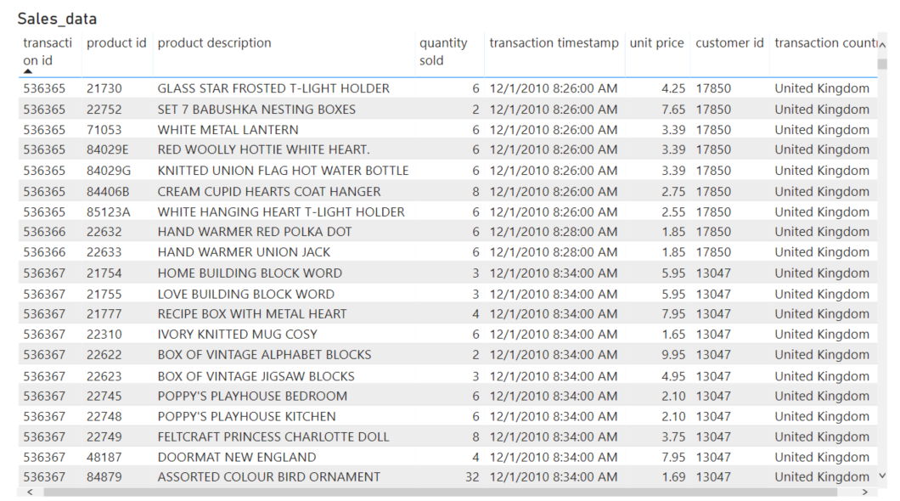

Slide 7
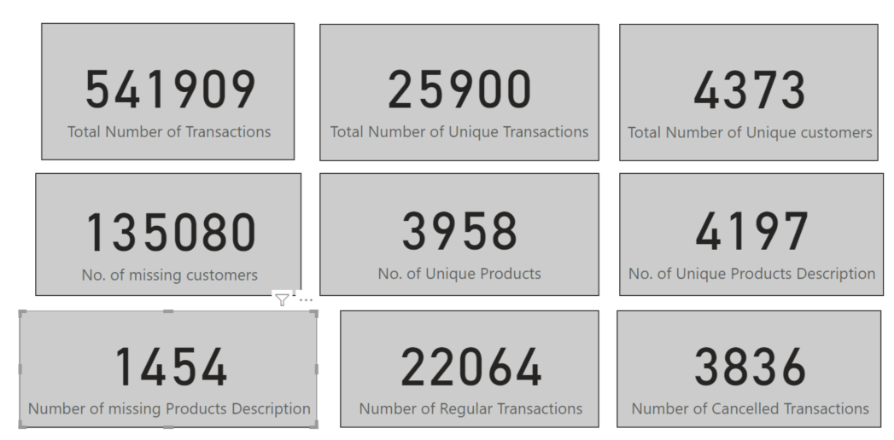
Aggregation of data
As we can clearly see that only 25900 out of 541909 transactions are unique i.e almost 4.7%.It seems that mostly customers are wholesalers.
Most interestingly out of 541909 transactions 135080 i.e almost 25% have no Customer Id. They can be retail customers or unregistered retail customers.
Number of unique products description is also little larger than unique products Id, it means same product Id have multiple descriptions. It can be possible because of name corrections or having missing description with product Id.

Slide 8
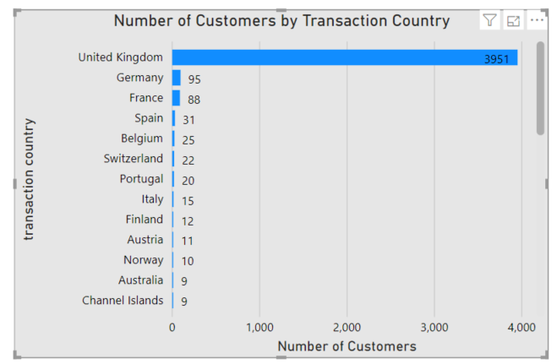
Distribution of customers by Country
Based on the visualisation as shown we can see that the country with the most number of distinct customers are from United Kingdom with 3951 customers and then followed by other countries.
Almost 90% percent of the total unique customers are from United Kingdom.

Slide 9
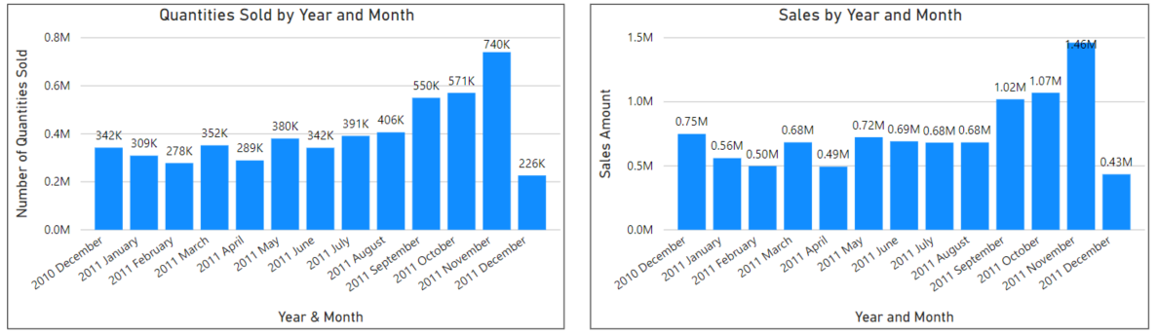
Analysis of Sales And Quantities

Slide 10
From the above two visualisations we can analyze that quantities sold and sales amount from December, 2010 to November, 2011 first decreases little bit and then increases drastically.
Peak months for the higher number of quantities sold and sales amount is September, October, and November 2011.
November 2011 is the peak month for the highest number of sales.
We can prioritize the increase of stock products for the month of September, October and November, so that it can avoid the out of stock situations in these months.
Almost 36.4% of total sales comes from in these three months.

Slide 11
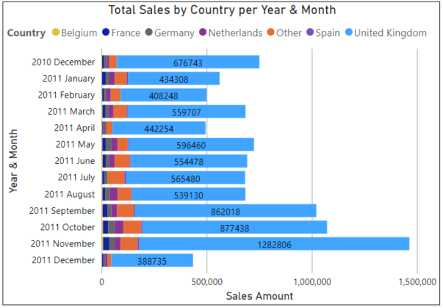
The visualization as shown in figure shows the total sales by different countries and we can clearly see the United Kingdom is dominating the sales in all months.
It seems that it’s the stores home market.
Other than UK, sales is mostly coming from neighbouring countries like Netherlands and Germany.

Slide 12
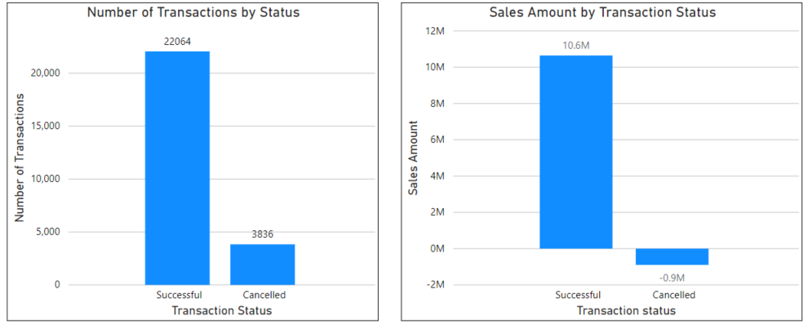
Analysis of Transactions

Slide 13
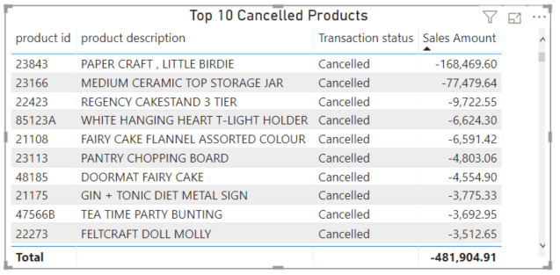

Slide 14
Above two visualisations shows that transaction status of successful and cancelled transactions.
Negative values of quantity sold implies that it’s a cancelled transaction.
We can clearly see that number of cancelled transactions is little bit higher compared to successful transactions almost 14.8% of transactions is being cancelled it implies that every 6th transaction is cancelled.
We should have to take a feedback from the customers why they cancelling the orders.
On the sales amounts side almost 8.4% of total sales amounts have been cancelled.
The most cancelled product that affects our sale is ‘PAPER CRAFT, LITTLE BIRDIE’, we should take a look of this product and should take action according to that on the top cancelled products.

Slide 15
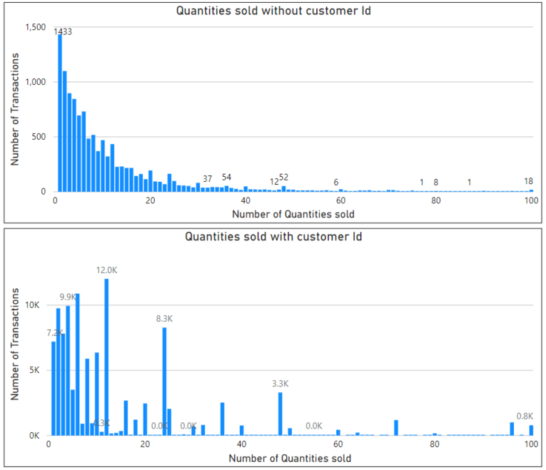
Retail and Wholesale Customer Analysis

Slide 16
In the above visualizations I compare the distributions of items for the two groups, one for with no customer Id and the other with Customer Id.
The visualisation confirms my assumption that group without customer Id tends to have fewer items than with Customer Id group because it is clearly visible that customers with no customer Id are buying in less quantity as compare to the customers with customer Id.
Group that have lot more transactions with low number of items are retailers while the group that makes transactions with large number of items are wholesalers.
From the above two visualizations the top one is of retailers and the bottom one is for wholesalers.
Let’s now see in the below visualizations the total number of transactions and sales amount for these two groups.

Slide 17
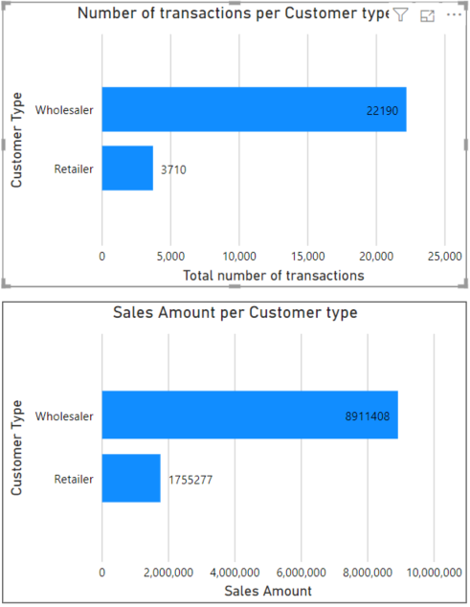
As we can clearly see in the visualization as shown retail business is quite small as compared to the wholesale business.
Almost 16% of the total business is from retailers while the rest of from wholesalers.
This visualizations implies that focus should be on the wholesale side of the business to maximize the sales amount.

Slide 18
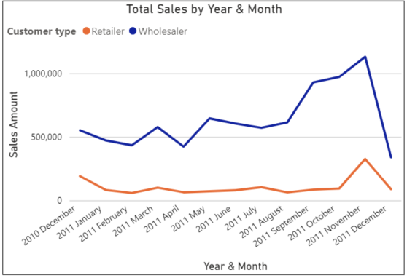
As we can see total sales is dominated by wholesalers over all period of time.
Peak startinseason for both type of customers.
We cannot say much about the sales in the month of December 2011 because we only have 9 days of data for December 2011.

Slide 19
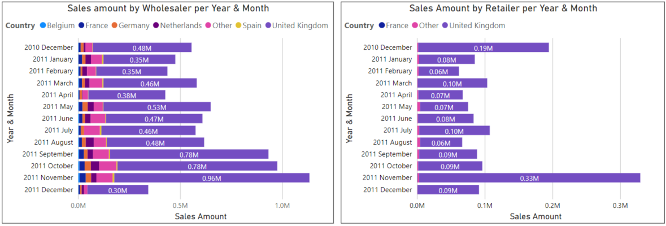
The above visualizations reveal couple of insights: UK sales heavily dominates in wholesale, almost 85% of total sales comes from UK, sales is mostly coming from neighbouring countries and from rest of the countries it’s very less.
In retail business sales is also coming almost from the UK.
Above two points implies that marketing actions should be focussed and prioritize in the UK market.
Now the focus on the UK sales let’s further analyze the UK sales.

Slide 20
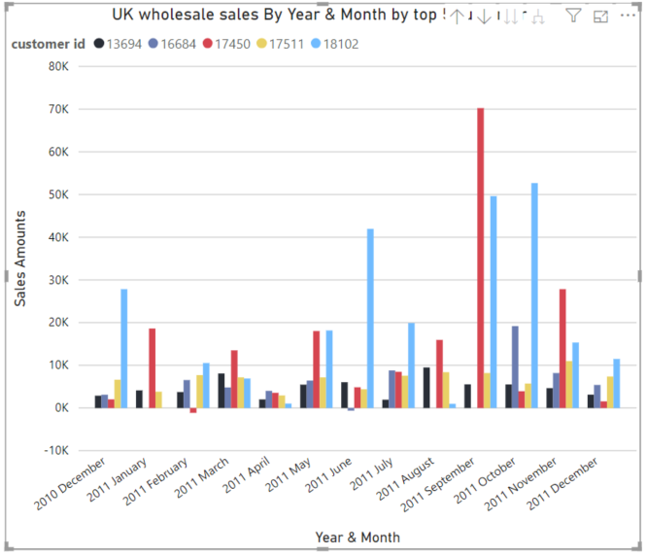
This chart shows the top 5 buyers or customers of UK sales.
Customer with ID 17450 is the top most buyer and have some increased spending in September and October 2011.
We can give some discounts and free gifts to these customers to so that they will remain loyal customers in the future and increase our sales.

Slide 21
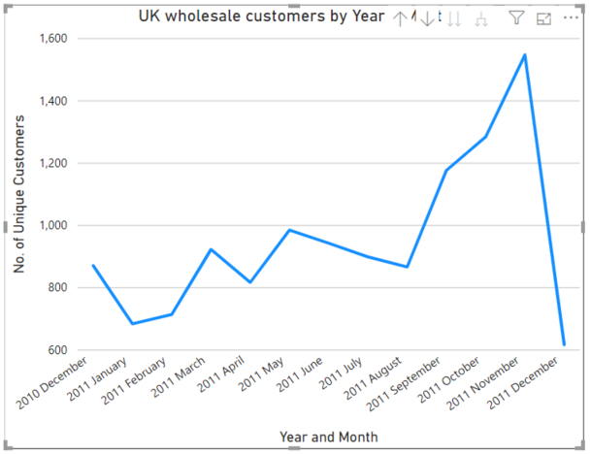
This visualization also reveal amazing fact that whole UK wholesale growth is not coming from the top buyers but also from increasing number of different new customers.
As we can see that addition of new customers increasing in the month of September, October and November 2011.
This information is really a beneficial insight for the sales purposes.

Slide 22
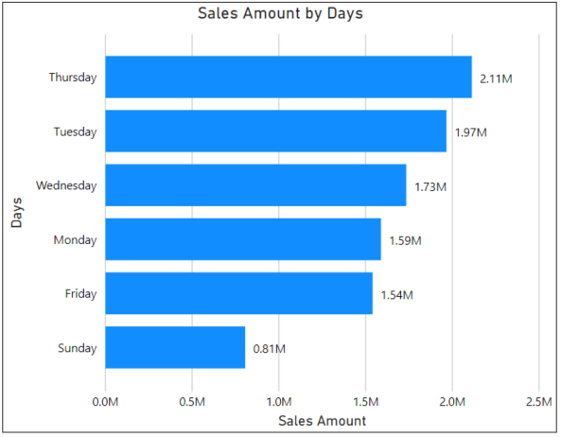
This chart shows the total sales by days.
From the chart we can analyze most of the sales happened on Thursday followed by Tuesday.
This is a good insightful information.
We can prioritize this day so that our servers don’t get down because of high number of sales on this day.

Slide 23
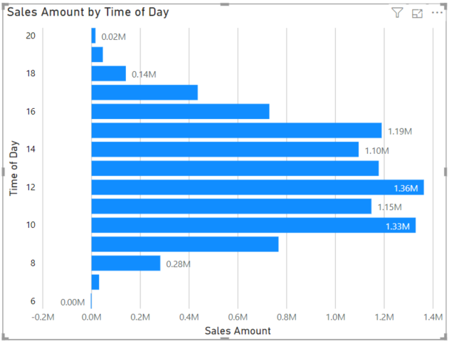
This chart further reveals at which time most of the sales happened.
As we can see that the most crowded hour is at 12 afternoon with almost 1.36M of sales and continues to be crowded until 3pm. At 11 and 10 there is also a larger amount of sales.

Slide 24
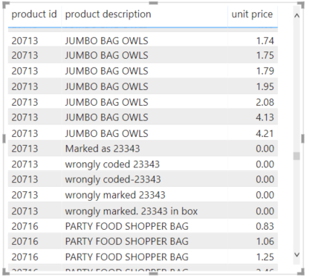
Product level Analysis
At the beginning of the slides I show that there are some products which have multiple product descriptions with same product Id.
There are total of 3958 products with unique product Id but have 4197 products description.
We can see variations in product descriptions, some of product description showing ‘wrongly coded 2343’ which doesn’t make any sense and don’t affect our sales because it priced zero.
I will clean these product names.
At the beginning of the slides I show that there are some products which have multiple product descriptions with same product Id.
There are total of 3958 products with unique product Id but have 4197 products description

Slide 25
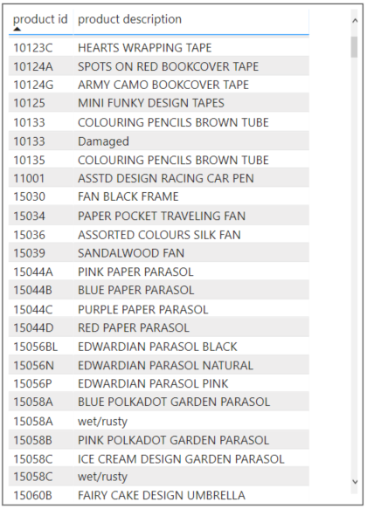
Relationship between product id and description
As we can see the from the metric that there is a character in suffix in some of the product ids which is for the same product but with different color variation like 15056BL for black and 15056N for Natural. It seems that variations are handles by suffixes.
However this relationship is not consistent.

Slide 26
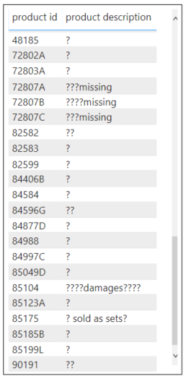
There is also some random and awkward descriptions there which is shown in the figure like ‘?’, ‘missing’ and many more like that doesn’t make any sense.
I have to simply clean this product descriptions.

Slide 27
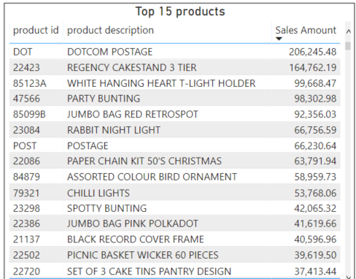
Top Sold Products
This table shows the top 15 sold products with their product Id.
We can see from the figure that some of the top products aren’t really products at all like ‘DOTCOM POSTAGE’ which is not a real revenue.
I will simply exclude those items from my visualizations.
In next slide I clean these products and then made visualizations.

Slide 28
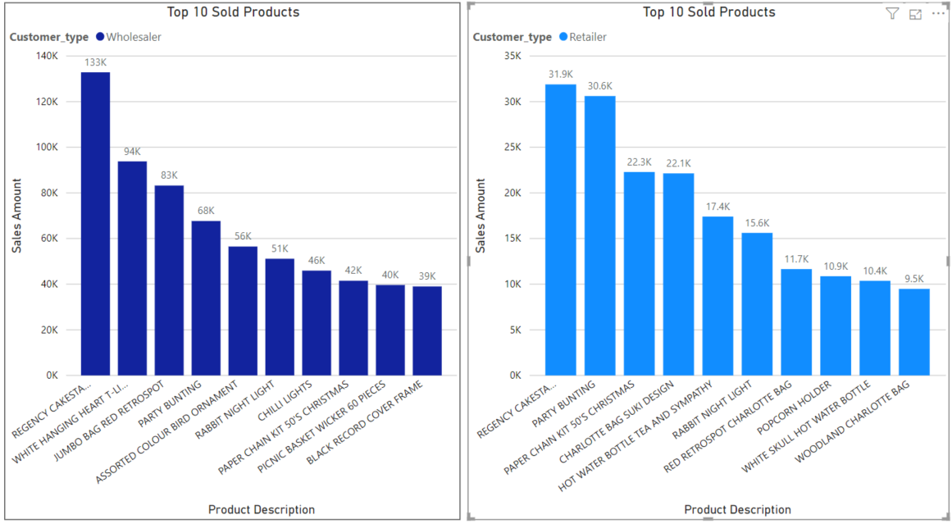
Top 10 Sold Products by Wholesaler and Retailer

Slide 29
CONCLUSIONS
After all analyzing the data and making relevant visualizations I think that company’s performance is improving over time especially in the month of September, October and November 2011 considering the sales. I can’t say about sales for December 2011 because only 9 days of data of that month I have.
90% of the unique customers are from United Kingdom.
36.4% of total sales comes from September, October and November 2011.
PAPER CRAFT, LITTLE BIRDIE’ is the most cancelled product.
Mostly Wholesale customers which are from UK typically buy from us.
We can build customer loyalty by providing free gifts and high discounts to our regular customers and new customers we can provide some vouchers, free coupons and some value deals.

Slide 30
There is a relationship between some product Id and product decription, for the same product but with different color we have a character in suffixes of product ids like ‘BL’ for black, ‘N’ for natural,etc however this relationship is not consistent.
I have to clean various blank product descriptions.

Slide 31
Initiatives to be taken based on the data
To take a proper overview of top cancelled products why it has been cancelled so many times, fix the issues with cancelled products, if any so that it doesn’t decrease the growth of our sales.
Business optimization should be focussed on the wholesale side of the business to maximize the impact on sales.
Marketing actions should be focussed on the UK market since sales is coming almost exclusively from the UK.
We should Influence new customers by providing some discounts and coupons.
We should give free gifts and complimentary incentives to regular customers.
We should increase the stock of products with the most sales to avoid out of stock situations.
Increase the computing resources or the number of staff depend on the type of business on Thursday especially at 12 afternoon.

Slide 32
Thank You

