Slide 1


Capstone_Gym_Project
<Yaswanth K>

Slide 2
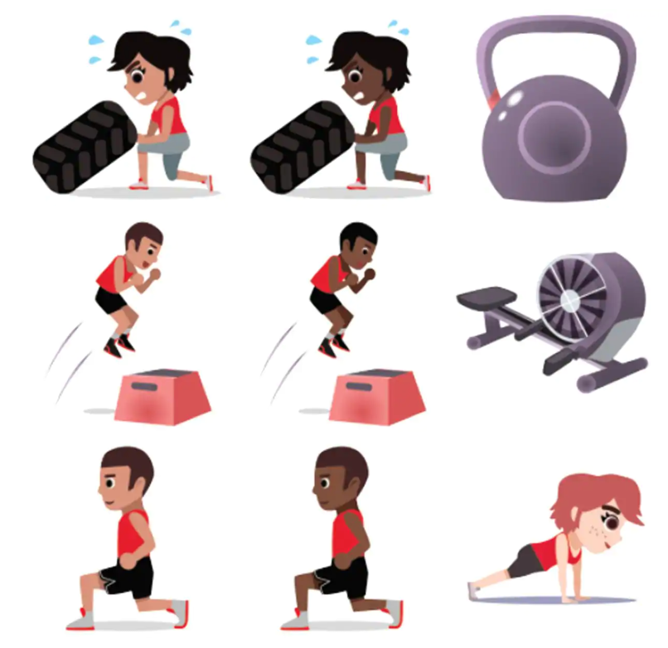
INTRODUCTION:
Note: Throughout the project, I use All Fit YK Center1 which is a fictitious business name chosen for this capstone project.
Each year, millions of people join fitness centers to get fit and lose weight. The global health club industry rakes in a cool $85 billion each year. American fitness centers alone enjoy a market size of just under $26 billion a year and they’re not struggling for customers, either. Approximately one in six adults have got at least one gym membership. But just because the market is great does not mean you should dive into the industry without doing a bit of research and planning.
Opening a fitness center could potentially be a great business opportunity, but there are quite a few factors you’ll need to bear in mind before you’re ready to start up. One key factor is the strategic location to attract members

Slide 3
DATASETS
The following are the data sets that will be using for this project:
Dataset#1:
The data of the Boroughs, Neighbourhoods, Latitudes, and Longitudes of New York City: https://cocl.us/new_york_dataset. This data set contains the required information. And we will use this data set to explore various neighborhoods of new york city and combine with Foursquare API data.
Dataset#2:
All the relevant New york City Fitness centers information from the Foursquare API

Slide 4
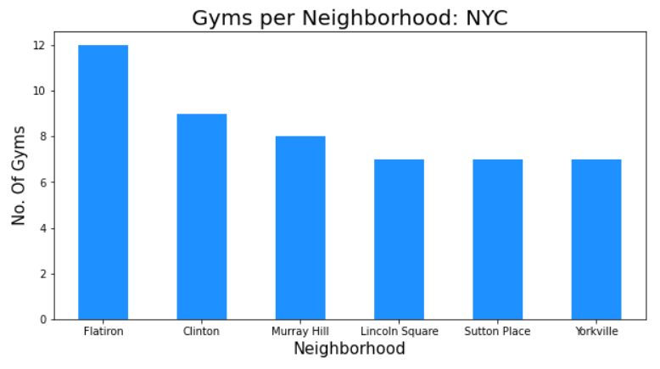
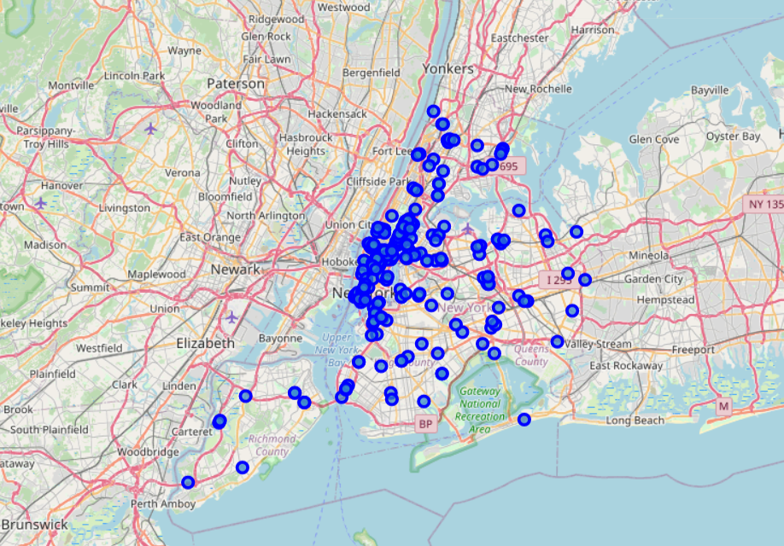
GYM RESULTS

Slide 5
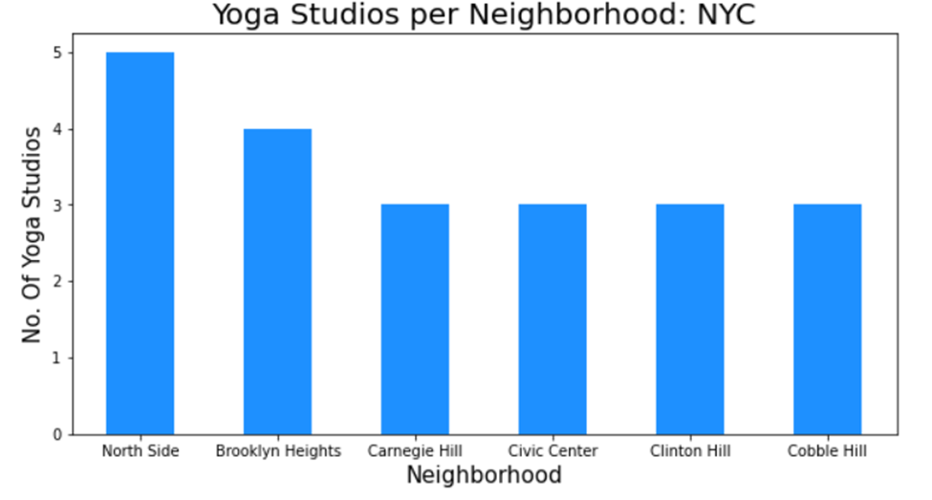
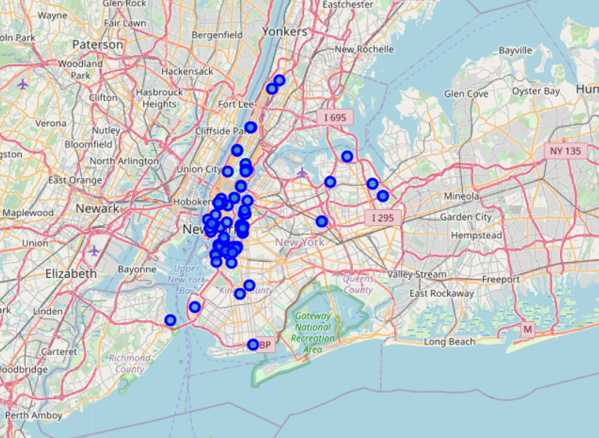
YOGA STUDIO RESULTS

Slide 6
CONCLUSION:
From the results discovered and presented, the following observations and recommendations can be made:
Based on the criteria given by the All-Fit YK Center, the main neighborhood recommendation would be for the neighborhood of the Flatiron for the Gyms and Northside for the Gym Studios. These two areas will be the prime location for opening the Gym and Yoga Studio.
A secondary recommendation is made for the neighborhood of Clinton for Gyms and Brooklyn Heights for the Yoga Studio.
In conclusion, the scope of this analysis is only in the first stage. The second stage is to compare the user ratings and consider the account of the population in the neighborhoods. The Fitness industry is ever-changing, and the information afforded us may be dated due to relying on user information via Foursquare. Overall though, the model created can easily be replicated again and again with monitored data via the Foursquare API.

