Slide 1



OSSP PROJECT | TEAM 15
MULTI-USER CHAT APPLICATION USING LINUX SYSTEM CALLS
Client 1
Client 2
A TCP-Based Client-Server Communication System
Koneru Lakshmaiah Education Foundation (KLEF)
Operating Systems and Systems Programming (OSSP)
Section S-04 | Team 15
Faculty Guide: Dr. Soumya
Academic Year 2026–2027, Term I
Client 3
Client 4
Ch. Yashwanth
V. Bharath
B. Praneeth
2520030259
2520030169
2520030186

Slide 2
ABSTRACT AND INTRODUCTION
Abstract
The Multi-User Chat Application is a network-based communication system developed using the C programming language and Linux system calls. It allows multiple users to connect to a central server and exchange messages in real time.
It uses TCP socket programming for reliable communication, process management using fork(), and inter-process communication using pipes.
User 1
User 2
Introduction
Provides communication between multiple users.
Uses centralized client-server architecture.
Supports private messaging and broadcast messaging.
Demonstrates important Operating System concepts.
Implements networking and process management using Linux system calls.
User 3
Real-time messaging through a central server

Slide 3







PROBLEM STATEMENT AND OBJECTIVES
Objectives
Problem Statement
Basic chat implementations may not demonstrate how operating system concepts such as process creation, inter-process communication, socket programming, and resource management work together in a multi-user environment.
This project aims to develop a multi-user chat application that demonstrates these concepts through a practical client-server implementation.
Main objective
Develop a multi-user chat application using C.
Establish reliable communication using TCP sockets.
Handle multiple connected clients.
Demonstrate process creation using fork().
Implement IPC using pipes.
Process creation
IPC
Support private and broadcast messaging.
Demonstrate practical usage of Linux system calls.
Socket programming
Resource management

Slide 4



EXISTING SYSTEM AND PROPOSED SYSTEM
Existing System
Proposed System
Basic chat implementations may support limited communication.
Some systems do not demonstrate Linux process management.
Multiple-client handling may be limited.
Inter-process communication may not be demonstrated clearly.
Limited practical exposure to operating system system calls.
Centralized TCP client-server architecture.
Supports multiple client connections.
Uses fork() for child process creation.
Uses pipes for parent-child communication.
Supports private and broadcast messaging.
Demonstrates Linux system calls in a practical application.
Advantages
Multi-user communication
Modular architecture
Practical OS concepts
Reliable TCP communication
Command-based interaction

Slide 5
SYSTEM ARCHITECTURE AND DESIGN
CENTRAL TCP SERVER
Client 1
Yaswanth
TCP
Child Process 1
fork() – handles Client 1
pipe
Parent Server Process
Client 2
Bharath
TCP
Child Process 2
fork() – handles Client 2
pipe
Accepts connections
Keeps client information
Routes messages
Client 3
Another connected user
TCP
Child Process 3
fork() – handles Client 3
pipe
TCP socket connection
IPC pipe (child to parent)
Each client connects to the central server through TCP.
The server accepts incoming client connections.
A child process is created using fork() for each client.
Child processes send events to the parent through pipes.
The parent keeps client information and routes messages.
The server sends messages to the appropriate clients.

Slide 6






WORKING METHODOLOGY
1
2
3
4
5
Server Initialization
Client Connection
Client Handling
Message Communication
Client Disconnection
Creates a TCP socket.
Assigns IP and port using bind().
Starts listening using listen().
Client creates a socket.
Connects using connect().
Enters a username.
Accepts using accept().
Creates a child using fork().
Child handles its assigned client.
Client sends using send().
Server receives using recv().
Parent routes messages to the correct users.
Client enters /quit.
Connection is closed.
Server cleans up processes and resources.
socket() > bind() > listen() > accept() > fork() > send() / recv() > close()

Slide 7


SYSTEM CALLS AND THEIR FUNCTIONS
Networking
Process Management
Inter-Process Comm.
socket() – Creates a communication endpoint.
bind() – Assigns an address and port.
listen() – Makes the server ready for incoming connections.
accept() – Accepts a client connection.
connect() – Connects a client to the server.
send() – Sends data through a socket.
recv() – Receives data through a socket.
fork() – Creates a child process.
getpid() – Returns the process ID.
waitpid() – Waits for a child and collects its exit status.
pipe() – Creates a communication channel.
read() – Reads data.
write() – Writes data.
Signals and Resources
Client Input Monitoring
sigaction() – Configures signal handling.
kill() – Sends a signal to a process.
close() – Closes a file descriptor or socket.
select() – Monitors multiple file descriptors.

Slide 8
PROCESS MANAGEMENT AND INTER-PROCESS COMMUNICATION
Process Management using fork()
The server creates a child process for each connected client.
The parent continues accepting connections and managing client information.
The child process handles its assigned client.
Multiple clients are handled concurrently.
Parent Process
reads events, routes messages
pipe
Inter-Process Communication using Pipes
A pipe is a communication channel between related processes.
Children send client events to the parent through pipes.
The parent reads these events and performs message routing.
Child 1
Client 1
Child 2
Client 2
Child 3
Client 3
Events flow from children to the parent through pipes
Parent process
Child process
Process ID
IPC
Pipe
Process termination
Resource cleanup

Slide 9

CLIENT AND SERVER IMPLEMENTATION
Client-Side Functionality
Server-Side Functionality
Establishes TCP connection with the server.
Accepts username from the user.
Sends and receives messages.
Processes chat commands.
Uses select() to monitor keyboard input and server socket activity.
Creates and initializes the server socket.
Listens for and accepts multiple clients.
Creates child processes using fork().
Maintains client information.
Routes private and broadcast messages.
Handles disconnections and process cleanup.
Supported Commands
/help
Displays available commands
/users
Displays connected users
/msg username message
Sends a private message
/broadcast message
Sends a message to all connected users
/quit
Leaves the chat

Slide 10



TEAM CONTRIBUTIONS
40%
40%
20%
Ch. Yashwanth
V. Bharath
B. Praneeth
2520030259
2520030169
2520030186
Client-side development
TCP connection handling
Username management
Command processing
Client-side testing
Server-side development
Socket programming
Process management using fork()
IPC using pipes
Message routing
Project testing
Functional verification
Bug reporting and testing support
Documentation support
Presentation preparation
Technology Stack
C Programming
Linux / Ubuntu
WSL2
TCP Sockets
Linux System Calls
GCC
Terminal
Application development
Development environment
Ubuntu on Windows
Network communication
OS-level operations
Compilation
Execution and testing

Slide 11
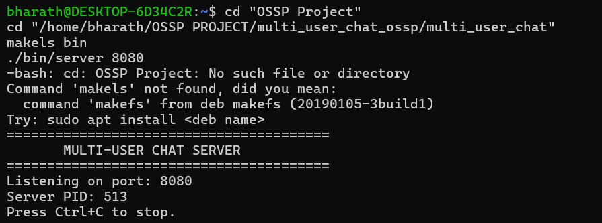
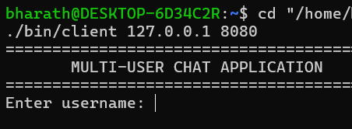
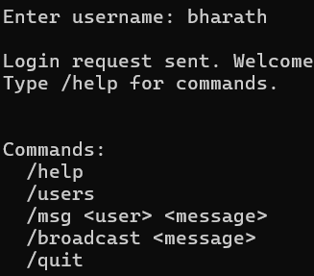
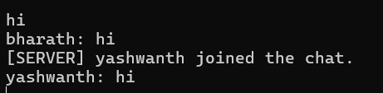


RESULTS AND IMPLEMENTATION
Insert screenshot
Insert screenshot
Insert screenshot
Insert screenshot
1. SERVER RUNNING
Ubuntu terminal showing the server
2. CLIENT CONNECTION
Yaswanth client connected
3. MULTI-USER CHAT
Two or more connected clients
4. MESSAGE DEMONSTRATION
Private and broadcast messages
Testing Scenarios
Example Demonstration
Results
Server startup on port 8080
Client connection to the server
Multiple users joining the chat
Username handling
Broadcast messaging
Private messaging
Displaying connected users
Client disconnection using /quit
User 1: yaswanth
User 2: bharath
/msg bharath Hello Bharath!
/broadcast Hello everyone!
/users
/quit
Implemented TCP-based client-server chat application.
Demonstrated communication between multiple clients.
Demonstrated private and broadcast messaging.
Demonstrated process management using fork().
Demonstrated IPC using pipes.
Demonstrated practical usage of Linux system calls.

Slide 12
CONCLUSION AND FUTURE SCOPE
Conclusion
The Multi-User Chat Application demonstrates network communication and operating system concepts using C programming and Linux system calls.
It combines TCP socket programming, process management using fork(), and inter-process communication using pipes to support multiple connected users.
It provides practical experience in Linux system programming, networking, and resource management.
Future Scope
End-to-end message encryption
File sharing between users
THANK YOU
Graphical user interface
Group chat management
Message history and storage
Improved user authentication
QUESTIONS AND ANSWERS
Better scalability and performance

