Slide 1
DATA ANALYSIS REPORT
Car Sales Performance
Dashboard
Analysis of vehicle transactions between 2014-2015
Tools: Power BI | Dataset: US Car Auction Records | Prepared by: Yashaswi Kumar
Notes:
Welcome. This dashboard analyses over half a million US car auction records from 2014–2015. Walk through the 5 slides — each builds on the previous.

Slide 2
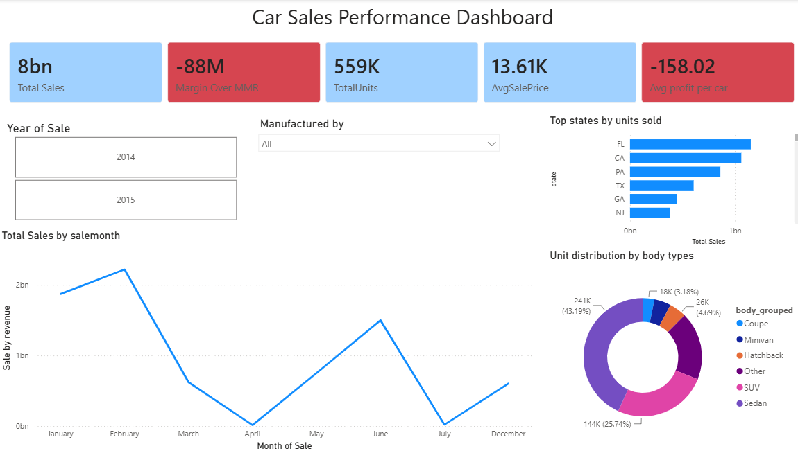
Dashboard
Notes:
These 5 findings are the core takeaways. The underpricing finding (-$158 vs MMR) is the most actionable — it directly affects profitability.

Slide 3
Executive Summary
$8bn total revenue
Florida & California lead
SUV & Sedan dominate
559K units sold across 2014–2015, with the bulk of transactions occurring in early 2015.
FL and CA are the top two states by sales volume, together accounting for over 30% of national transactions.
Together, SUVs and Sedans make up over 55% of all units sold — the clearest signal of buyer preference.
Consistent underpricing
February is peak month
Cars sold at an average of $158 below MMR market value, suggesting a systemic pricing gap across manufacturers.
Sales peak sharply in February. April sees the steepest drop — inventory and marketing should align to this pattern.
Notes:
These 5 findings are the core takeaways. The underpricing finding (-$158 vs MMR) is the most actionable — it directly affects profitability.

Slide 4
KPI Snapshot
Total Sales: Defines top-line gross revenue. It represents the absolute cumulative value of all vehicle transactions before any deductions, indicating market scale and volume.
Margin Over MMR: Defines absolute pricing health against market benchmarks. By tracking the difference between actual sales and the wholesale benchmark ({Total Sales} - {Total MMR}), it reveals whether inventory is moving at a net premium or net loss.
Total Units: It tracks the exact count of transaction records, showing the total asset throughput handled over the selected timeframe.
Avg Sale Price: Defines the mean transaction value per vehicle.
Avg Profit per Car: Defines operational efficiency and individual unit profitability. It calculates the mean variance between actual transaction price and wholesale value per vehicle.
Notes:
Note the two red KPIs — margin over MMR and avg profit per car. These are the signals that pricing strategy needs a review.

Slide 5
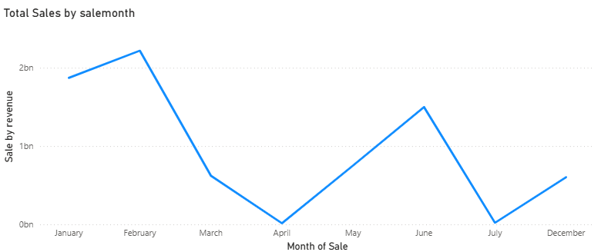
Sale Trend Analysis – via Linechart
⚡ February peaks at ~$2.3bn. April crashes 95% — likely seasonal auction cycle.
Notes:
February is by far the strongest month. April is near-zero — this is likely a data gap or auction off-season. Florida and California are the clear leaders geographically.

Slide 6
Insights & Recommendations
Three data-backed actions to improve car sales performance
01
Finding: Cars sell $158 below market value on average
→ Review pricing strategy for high-volume SUV and Sedan segments. Introduce MMR-anchored floor pricing to close the gap.
High impact
02
Finding: February is peak, April drops 95%
→ Align inventory stocking and marketing campaigns to the Jan–Feb window. Investigate April data gap for auction cycle opportunities.
Medium impact
03
Finding: FL and CA dominate sales volume
→ Prioritise dealership investment, auction partnerships, and digital marketing spend in Florida and California.
High impact
Notes:
Close with a call to action: pricing review is the quickest win. The geographic focus (FL/CA) and seasonality fix (Feb campaign) are medium-term plays.

