Slide 1
Design Implementation and verification of serial Peripheral Interface
Kartikesh Wasankar 240340133011
Deven Prajapati 240340133016
Preeti Maddhyeshya 240340133017
Smriti Karn 240340133021
Vibhu Gupta 240340133027
Yash Dhanak 240340133029

Slide 2
INTRODUCTION OF SPI
SPI (Serial Peripheral Interface) is a synchronous serial communication protocol used for short-distance communication primarily in VLSI/embedded systems. It enables a master device to communicate with one or more slave devices using a full-duplex communication channel.
Developed by Motorola, SPI employs a clock signal generated by the master to synchronize data exchange, ensuring precise timing and alignment between the communicating devices.
This protocol supports full-duplex communication, allowing simultaneous data transmission and reception. SPI's flexibility is further enhanced by its support for multiple slave devices, each identified by a distinct SS line. SPI operates in various modes defined by the clock polarity (CPOL) and clock phase (CPHA), which determine how data is sampled and shifted relative to the clock signal. This configurability ensures compatibility with a wide range of peripheral devices.

Slide 3
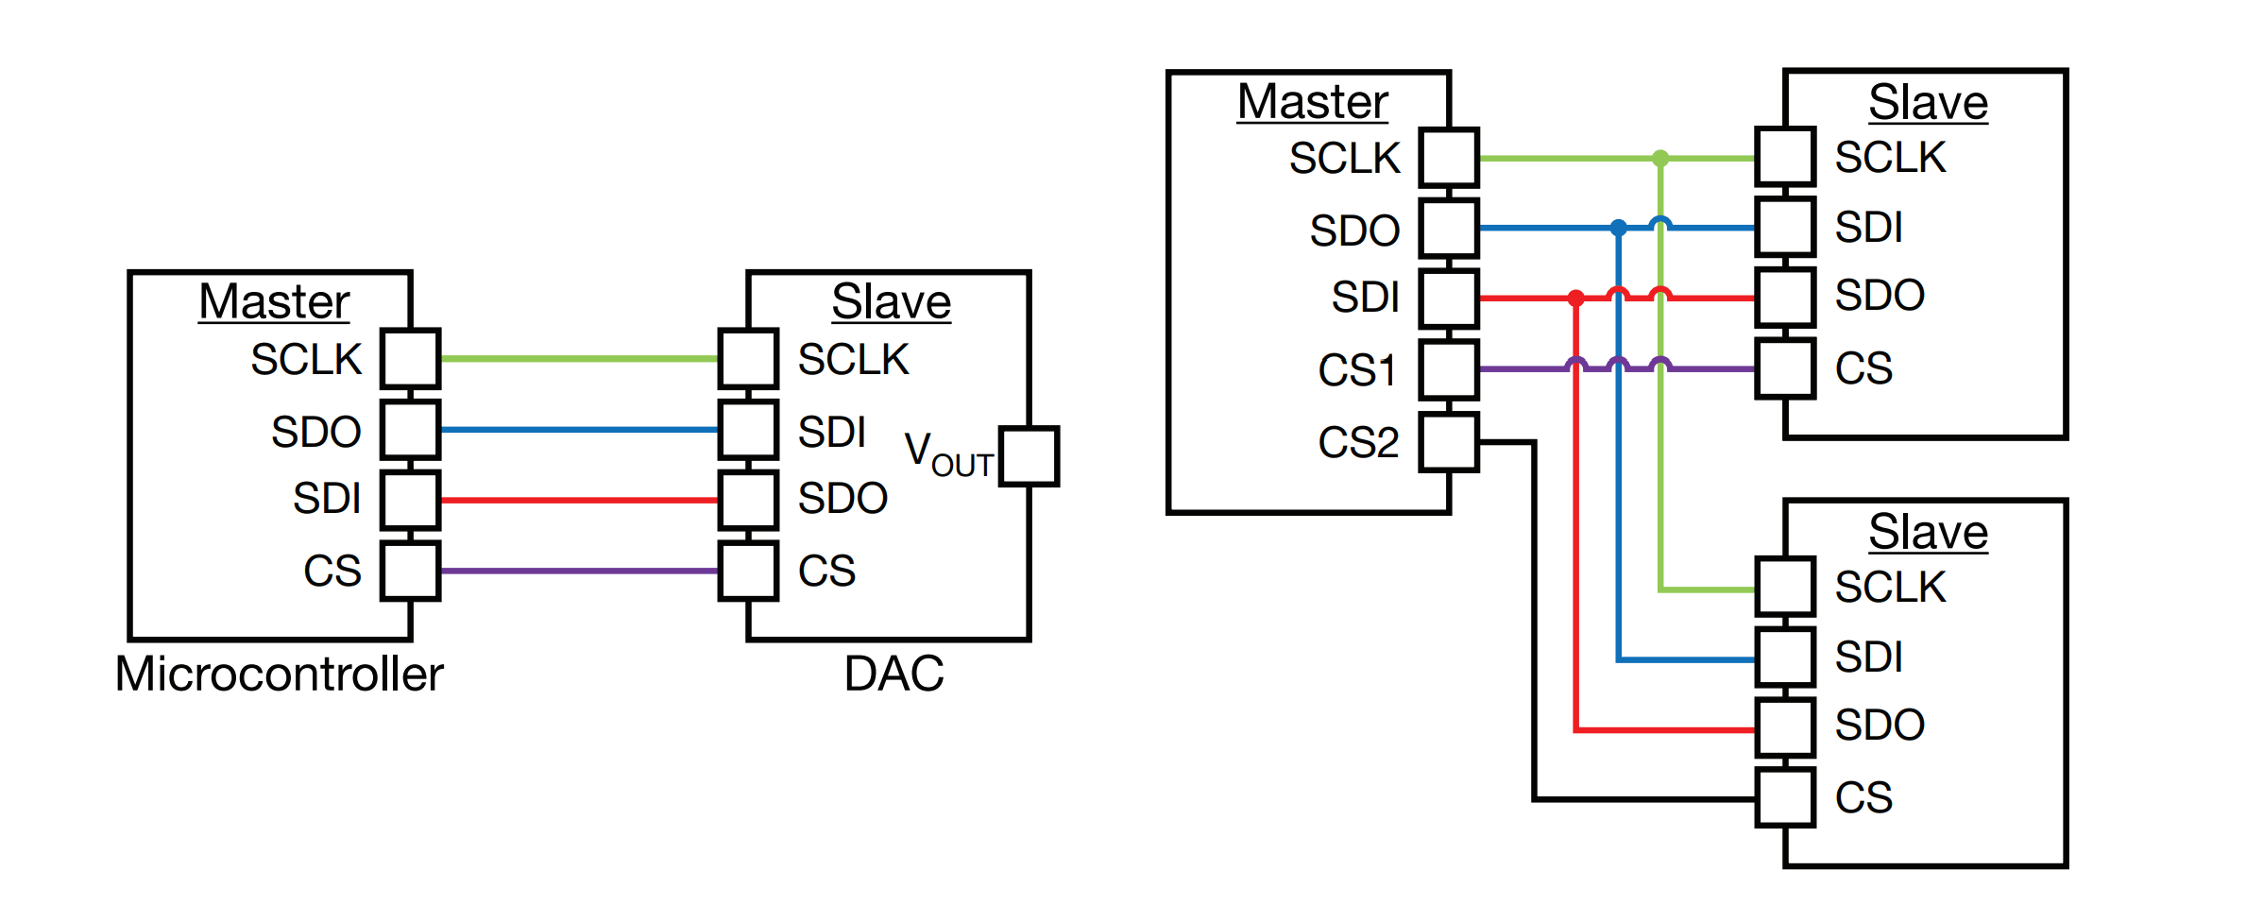
INPUT & OUTPUT
Master
Slave
MISO (Master In Slave Out)
MOSI (Master Out Slave In)
SCLK (Serial Clock)
SS (Slave Select)

Slide 4
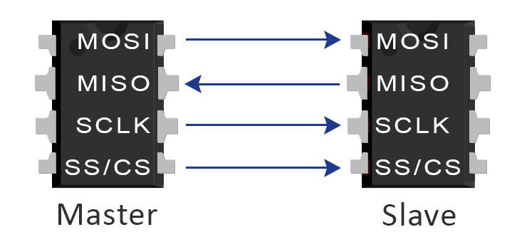
SPI PROTOCOL
SPI Communication involves the master sending a clock signal and data while the slave responds based on the clock signal.
The Timing Diagram illustrates how data is sent and received in relation to the clock signal, including the data setup and hold times.

Slide 5
WORKING OF SPI
Master-Slave Architecture:
Master: The device that initiates communication and controls the clock signal.
Slave: The device that responds to the master’s commands.
Data Transfer:
MOSI and MISO Lines: Data is transmitted from the master to the slave via MOSI, and from the slave to the master via MISO.
SCLK Line: Provides the clock pulses that synchronize the data transfer.
SS Line: Used by the master to select which slave device to communicate with. Each slave device has its own SS line.
Clock Polarity and Phase:
CPOL and CPHA: SPI supports different modes defined by the clock polarity (CPOL) and phase (CPHA), which affect how data is sampled and shifted. This flexibility allows SPI to be compatible with a wide range of devices.

Slide 6
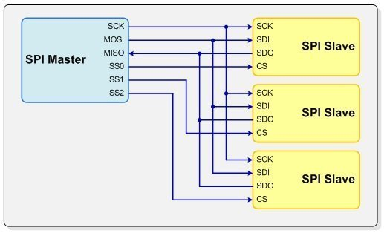
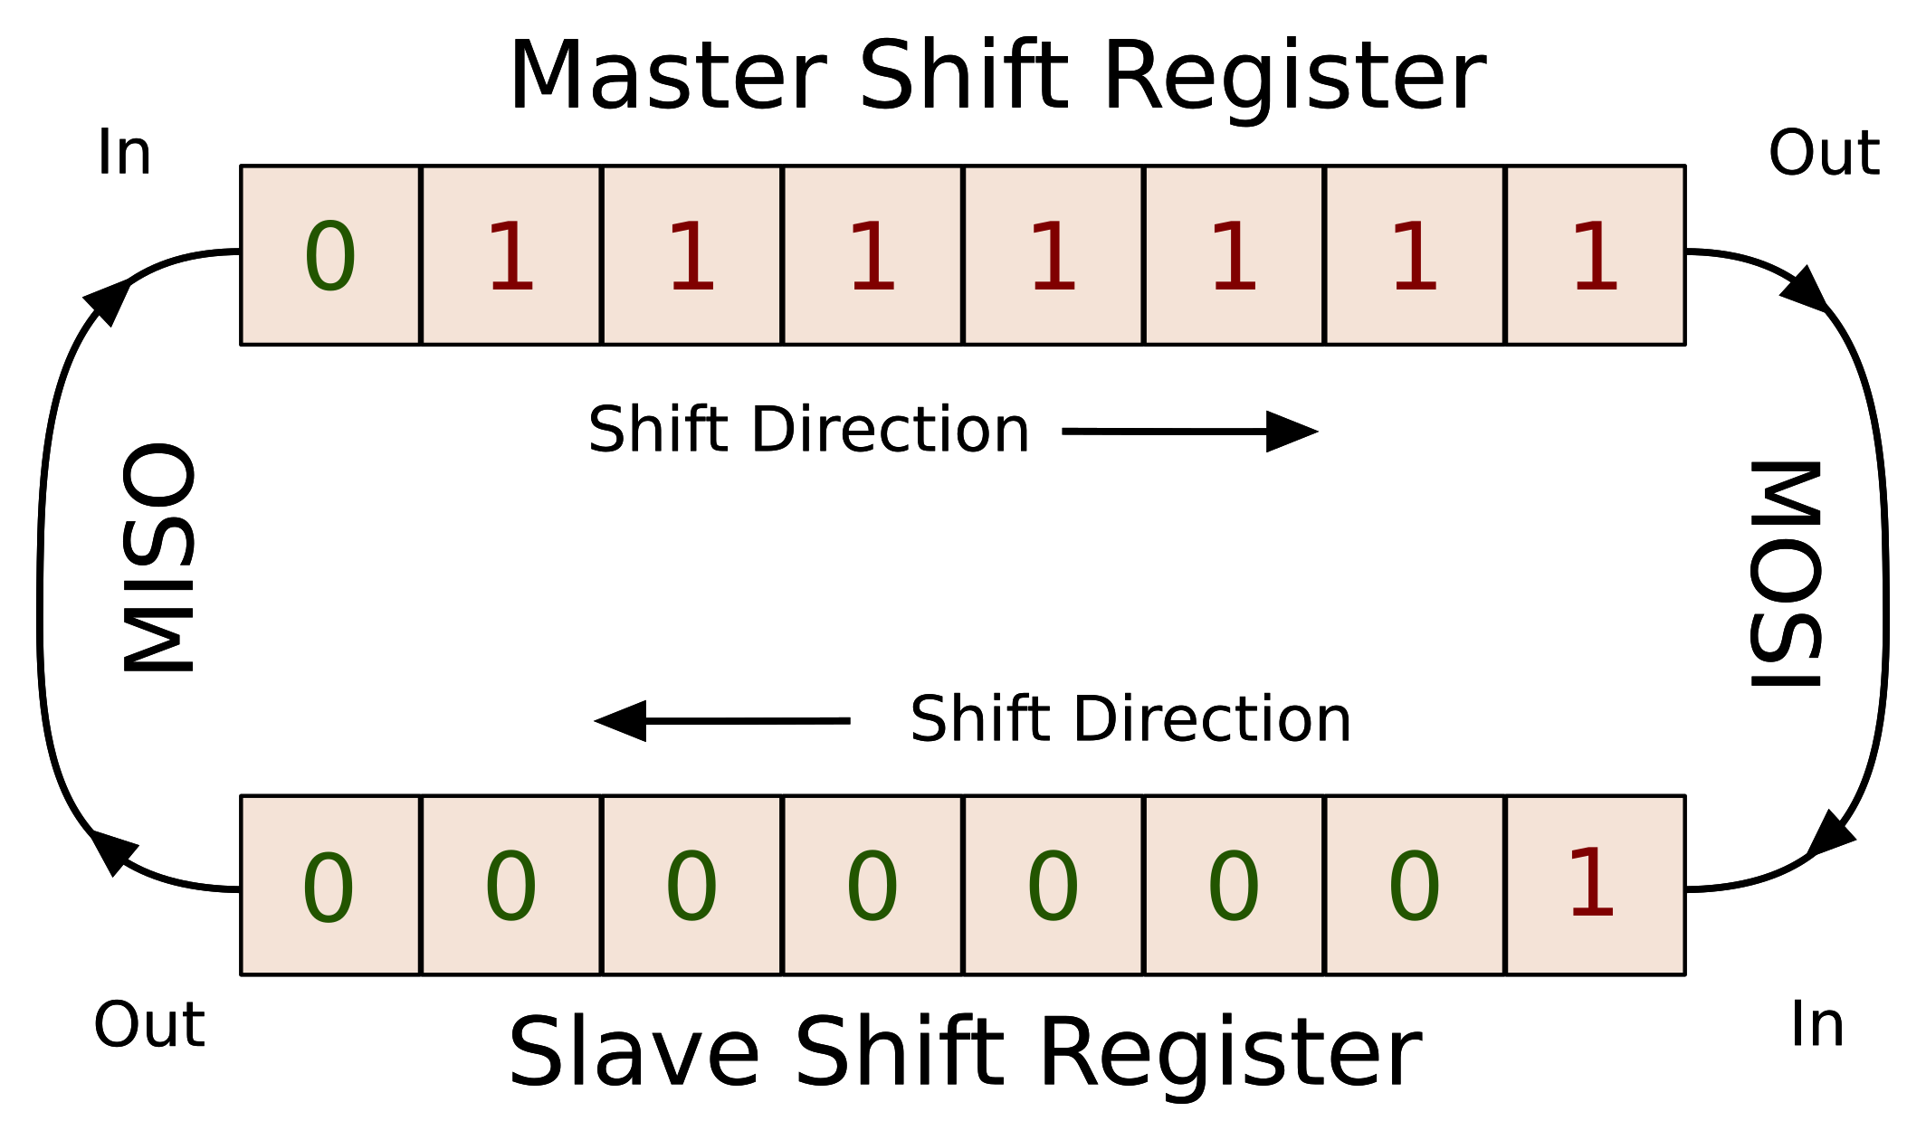
SPI COMMUNICATION FLOW
Master Selects Slave
Clock Pulses
Data Transmission
Slave Response
End Communication

Slide 7
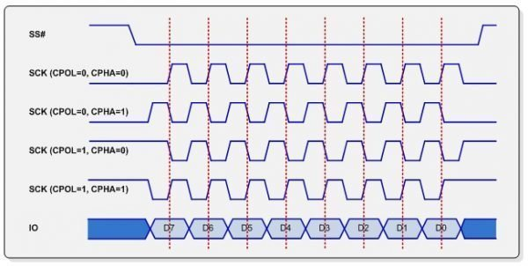
SPI MODES
CPOL (Clock Polarity): Determines the idle state of the clock line. It can be high or low.
CPHA (Clock Phase): Determines when data is sampled.
Mode 0: CPOL = 0, CPHA = 0
Mode 1: CPOL = 0, CPHA = 1
Mode 2: CPOL = 1, CPHA = 0
Mode 3: CPOL = 1, CPHA = 1
Impact: The mode must be the same on both master and slave for correct data communication.

Slide 8
FEATURES OF SPI
Synchronous Communication:
Clock-Driven: SPI uses a clock signal generated by the master device to synchronize the data transfer between the master and slave. This ensures that both devices are aligned in time, reducing the risk of data corruption.
Full-Duplex Data Transfer:
Simultaneous Transmission and Reception: SPI supports full-duplex communication, meaning that data can be sent and received simultaneously. This feature enhances the efficiency of data exchanges.
Minimal Wiring: The SPI protocol requires a small number of signal lines, typically four: MISO (Master In Slave Out), MOSI (Master Out Slave In), SCLK (Serial Clock), and SS (Slave Select). This simplicity makes SPI easy to implement in hardware.
Multiple Devices: SPI can communicate with multiple slave devices, each selected by a separate Slave Select line. This allows the master to control and interface with various peripherals using a single SPI bus.

Slide 9
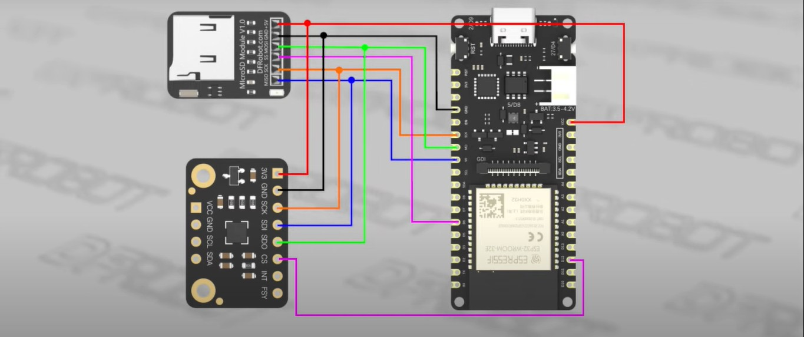
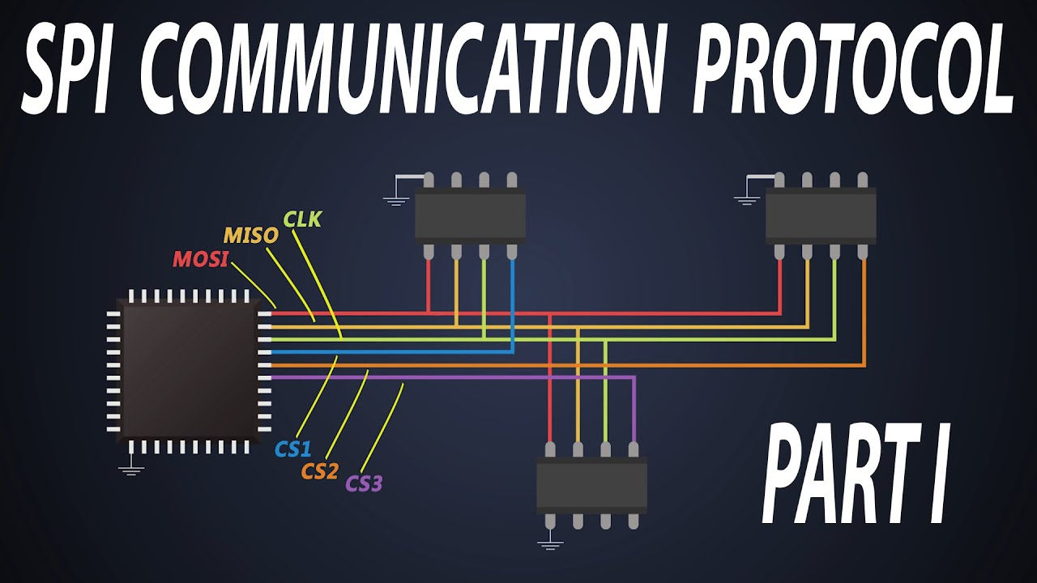
APPLICATIONS OF SPI
Common Uses:
EEPROMs
Sensors
Displays
Examples:
Microcontroller to Memory
Microcontroller to Sensor

Slide 10
CONCLUSION
In summary, the Serial Peripheral Interface (SPI) stands out as a robust and versatile synchronous serial communication protocol, crucial for high-speed, full-duplex data transfer between a master device and one or more slave devices.
High-Speed Communication: SPI’s synchronous nature, coupled with its full-duplex capability, allows for rapid and simultaneous data transmission and reception, making it suitable for high-performance applications.
Flexibility and Versatility: The protocol supports multiple slave devices and various communication modes, defined by clock polarity (CPOL) and clock phase (CPHA), ensuring compatibility with a broad range of peripherals.
Simplicity in Implementation: With its straightforward hardware requirements, including only four primary signal lines, SPI is easy to implement and integrate into embedded systems and microcontroller-based projects.

Slide 11
FUTURE TRENDS
1. Enhanced Versions and Speed Improvements: Ongoing advancements in SPI technology are likely to focus on enhancing the protocol's speed and efficiency. Future versions of SPI may support higher clock speeds and data rates, addressing the need for faster data transfer in high-performance applications. Innovations such as advanced clocking techniques, higher data bus widths, and optimized signaling methods could significantly boost SPI performance.
2. Integration with Other Communication Protocols: As embedded systems become more complex, there is a growing need for communication protocols that can seamlessly interact with each other. Future developments in SPI may involve integrating it with other protocols, such as I²C or UART, to create hybrid solutions that leverage the strengths of multiple communication methods. This integration could simplify system design and enhance interoperability among different components.
3. Increased Connectivity and Multi-Device Support: The ability to connect multiple devices and support complex network configurations is becoming increasingly important. Advanced SPI implementations may introduce features such as multi-slave support with improved arbitration mechanisms and expanded address spaces. These advancements would enable SPI to handle larger, more intricate systems with multiple devices communicating simultaneously.

Slide 12
References and Further Reading
Detailed Explanation: List and describe textbooks, datasheets, academic papers, and online resources used to gather information for the presentation.
Books: “Embedded Systems: Real-Time Operating Systems for ARM Cortex M Microcontrollers” by Jonathan Valvano.
Datasheets: Manufacturer datasheets for SPI-compatible components like EEPROMs and sensors.
Papers: Relevant research papers on SPI advancements and applications.
Websites: Educational resources and technical articles from reputable websites and forums.

