Slide 1

Basic Details of the Team and Problem Statement
Ministry/Organization Name/Student Innovation:
MINISTRY OF LAW AND JUSTICE
PS Code: SIH1286
Problem Statement Title: Incentives based Design for onboarding Legal Service Providers such as Advocates, Arbitrators, Mediators, Notaries, Document Writers, etc on eMarket Place for extending Legal Services to Citizens in India
Team Name: CashDaFlow
Team Leader Name: YASH DHINGRA
Institute Code (AISHE): U-0522
Institute Name: JAYPEE INSTITUTE OF INFORMATION TECHNOLOGY,NOIDA
Theme Name: Miscellaneous

Slide 2
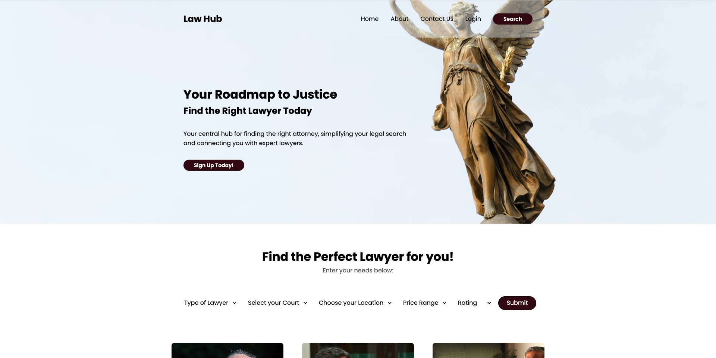
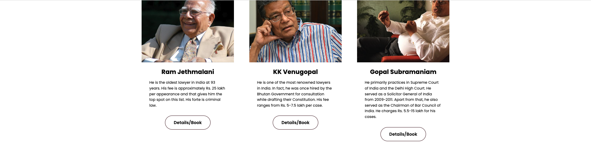
Idea/Approach Details
Describe your idea/Solution/Prototype here:
1. Lawyer Profile Management: Lawyers can create and update their profiles with ease, providing accurate and up-to-date information about their practice.
2. Client Search Functionality: Clients can search for lawyers using various filters, such as consultation fees, location, and specialization, ensuring they find the right legal professional for their needs.
3. Efficient Communication: Clients can easily reach out to lawyers for consultations or inquiries directly through the platform.
4. AI ChatBot: Our Site also offers an AI legal assistant which will be able to Guide the user along his/her problem free of charge.
Describe your Technology stack here:
BACKEND – NODE JS , EXPRESS JS, EJS, MORGAN, MYSQL/ , BODY-PARSER.
FRONTEND- HTML ,CSS ,BOOTSTRAP.
AI CHATBOT- IBM Watson

Slide 3
Idea/Approach Details
Describe your Dependencies / Show stopper here
Describe your Use Cases here
Our system relies on several key dependencies, including a stable and secure web hosting infrastructure, a robust database management system to store lawyer profiles and client data, and a reliable internet connection for seamless communication between clients and lawyers.
One critical dependency is the AI ChatBot, which plays a crucial role in assisting users with low-level legal questions and queries. It must have access to a comprehensive and up-to-date legal knowledge base. The ChatBot can be integrated with an AI engine that constantly updates its legal information, ensuring it provides accurate and relevant responses to users' inquiries.
The ChatBot is designed to help users with common legal queries, offering information, guidance, and solutions for simple legal issues. It can assist in understanding legal terminology, explaining basic legal processes, and even directing users to the appropriate lawyer profiles for more specialized assistance. This functionality not only enhances the user experience but also acts as a valuable resource, potentially reducing the workload on human lawyers for routine questions.
Imagine a platform where lawyers manage their profiles effortlessly, while clients find the perfect legal expert through advanced search filters. Clients can communicate directly with lawyers for inquiries and consultations. Additionally, our AI ChatBot assists users, providing guidance and answers to legal questions free of charge. It's a comprehensive legal ecosystem that simplifies the attorney-client connection and enhances access to legal expertise.

Slide 4
Team Member Details
Team Leader Name: Type Your Name Here : YASH DHINGRA
Branch (Btech/Mtech/PhD etc): BTECH Stream (ECE, CSE etc): CSE Year (I,II,III,IV): II
Team Member 1 Name: Type Your Name Here: ISHA SINGH
Branch (Btech/Mtech/PhD etc): BTECH Stream (ECE, CSE etc): CSE Year (I,II,III,IV): II
Team Member 2 Name: Type Your Name Here: SHANTANU RAI
Branch (Btech/Mtech/PhD etc):BTECH Stream (ECE, CSE etc): CSE Year (I,II,III,IV): II
Team Member 3 Name: Type Your Name Here: SHIV PANDEY
Branch (Btech/Mtech/PhD etc): BTECH Stream (ECE, CSE etc): CSE Year (I,II,III,IV): II
Team Member 4 Name: Type Your Name Here: PRAKRITI YADAV
Branch (Btech/Mtech/PhD etc): BTECH Stream (ECE, CSE etc): CSE Year (I,II,III,IV): II
Team Member 5 Name: Type Your Name Here: SHASHANT BHAT
Branch (Btech/Mtech/PhD etc): BTECH Stream (ECE, CSE etc): CSE Year (I,II,III,IV): II

