Slide 1
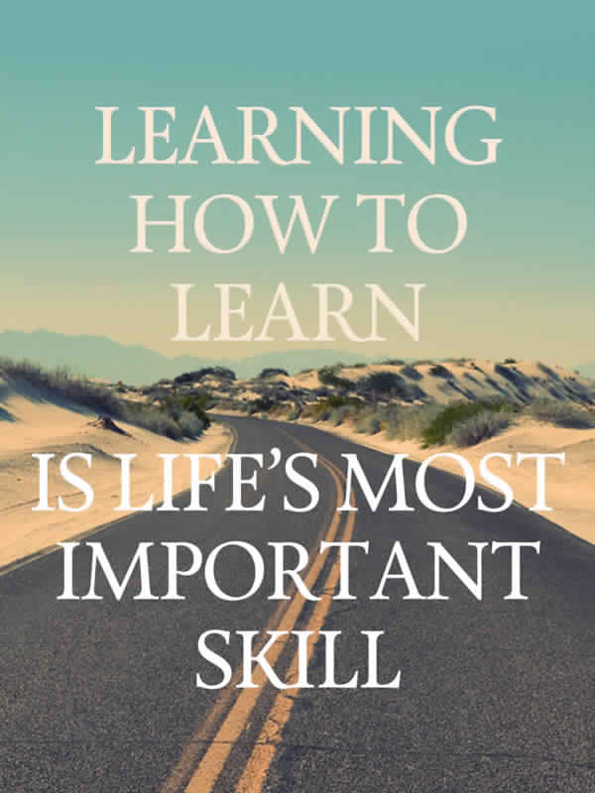
Learning How to Learn?
-Powerful mental tools for mastering tough subjects.
This course gives you easy access to invaluable learning techniques used by experts in art, literature, maths, science, sports and many other disciplines.
Following concepts are covered in this course:
How brain uses two very different learning modes
Encapsulating ‘chunks’ (information)
Illusion of competency
Memory technique
Dealing with Procrastination
Juggling with multiple task

Slide 2
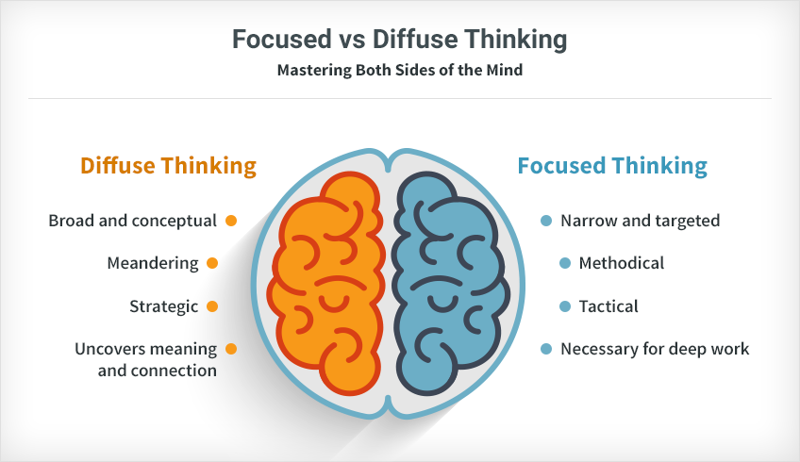
Two different modes of learning.
Focus mode of learning- Useful for Vital task
Diffuse mode of learning-It is the mode when we form connection and subconsciously mull over the problem.

Slide 3
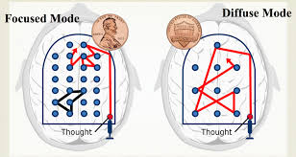
Focused Mode and Diffused Mode
Both modes of thinking are equally valuable but it’s harmony between them which matters.
When we learn some difficult subject our brain should go back and forth between two different mode.
Diffuse
Focus
Brain
Frequently change of mode.

Slide 4

Memory
Memory are of two types:
Working memory-Limited memory part of human memory system that combines temporary storage and manipulation of information.
Long term memory- A system for permanently storing, managing and retrieving information for later use.

Slide 5
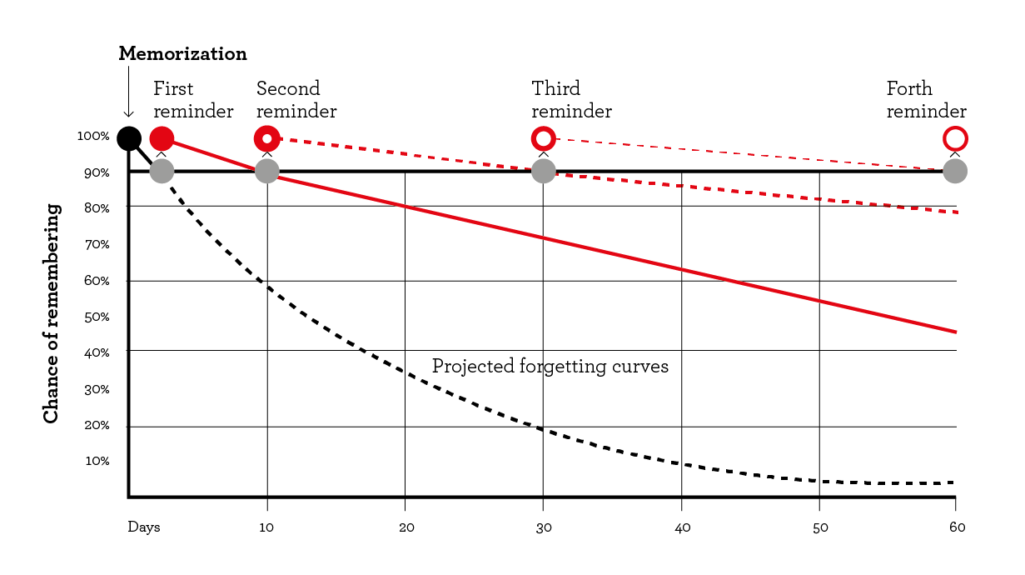
Technique to convert Working memory into long term memory
Spaced Repetition:Reviewing the material at gradually increasing interval.
“Practice Makes Permanent.”

Slide 6

Chunks
Pieces of information that are bond together through meaning is called chunk.
Connecting different chunks forms library of chunk
Creating Conceptual Chunk helps in learning tough subjects easily
Chunk in one area can also be used very different field is called transfer.

Slide 7
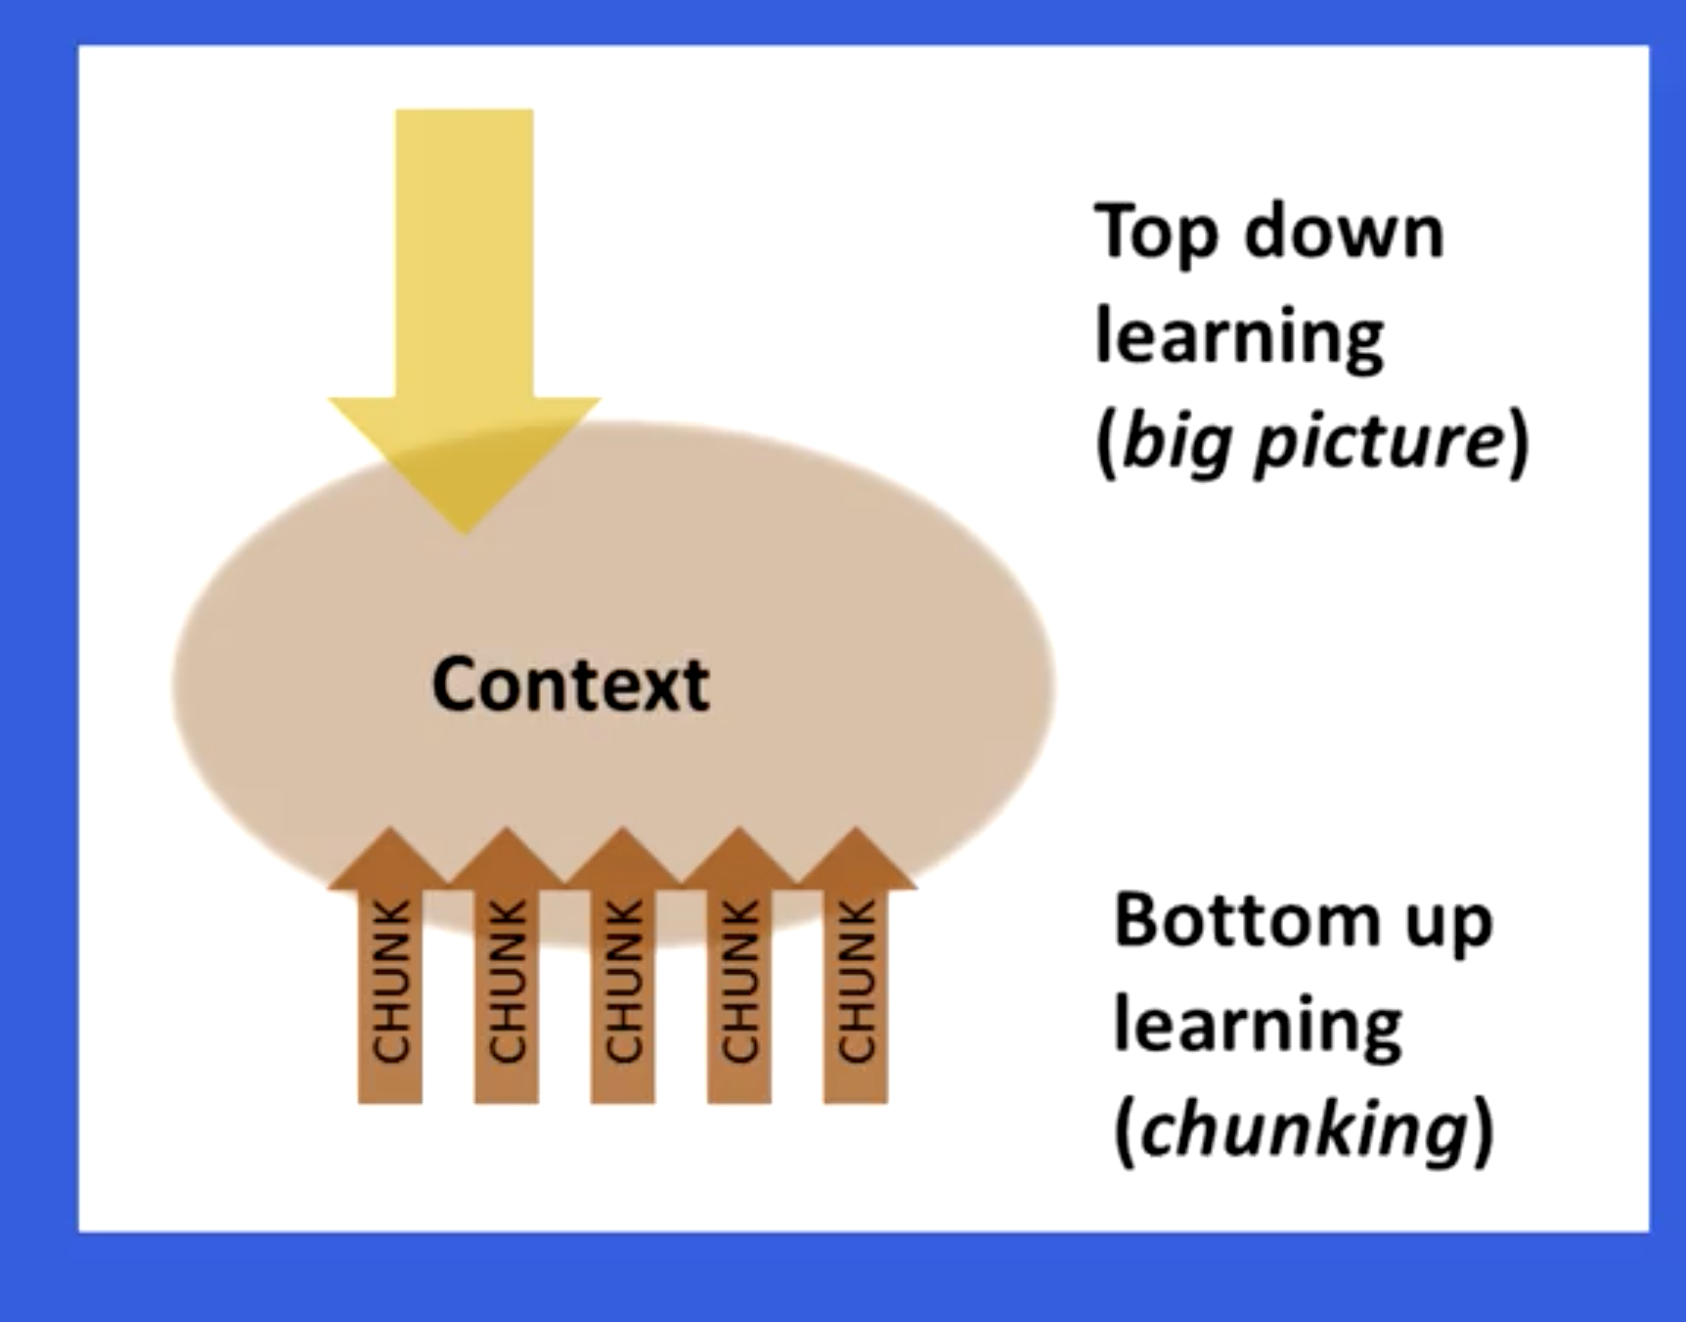
How to form chunk?
Focused attention
Understanding
Practice to gain mastery and sense of big picture context

Slide 8

Procrastination
Procrastination is the avoidance of doing a task that needs to accomplished by a certain deadline.
When we Procrastinate, instead of working on, important ,meaningful task.
We find yourself performing trivial activities
Effects of Procrastination
Waste of time
Unable to reach the goal
Lowering of self-esteem
Making poor decision
Damaging the reputation

Slide 9
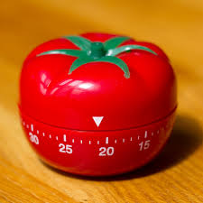
Technique for avoiding procrastination
Pomodoro- This technique uses a timer to break down the work into interval, traditionally 25 minutes is the length, separated by short breaks.
How to use the technique?
Set the timer for 25 minutes.
Choose your work, break it down into 25 minutes block
Work on first block until the alarm goes off
Take 5 minutes break,then reset the timer to 25minutes
Work on the next task until the alarm goes off. After 4 cycles take 30 minutes break.

Slide 10

Benefits of pomodoro technique
Benefits are as follows:
Manages distraction and controls our time
Increases Productivity
Decreases back pain and mental fatigue
Maintains motivation
Improves weekly and quarterly planning

Slide 11
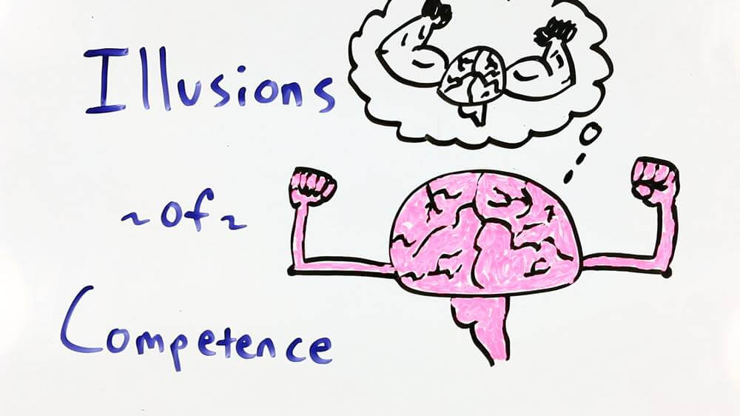
Illusion of Competency in Learning.
Illusion of competency describes a mental situation where you think you have mastered a set of material but you haven’t. That’s it’s an illusion.

Slide 12
Techniques for avoiding illusion of competency
Techniques are as follows:
Testing ourself
Minimizing the highlight of points
Mistakes are good
Deliberate practice

Slide 13


Juggling with Multiple task
To handle or deal with several things at one time so as to satisfy often competing requirements.
Ways to manage multi-tasking
Creating weekly “to do list”
Dividing weekly work into days
Allotting the required time for each task you are juggling with
Allotting goal finish time for each day
Rewarding yourself once daily goal is achieved

Slide 14
Thank you
Presented by
-Yash Ganatra

