Slide 1
Parkinson's Diseases Prediction
By – Yash Gaikwad
Machine Learning - Python
College – Pad. Dr. DY Patil Institute Of Engineering Management & Research
Summer Internship – September 2020

Slide 2
INTRODUCTION

Slide 3
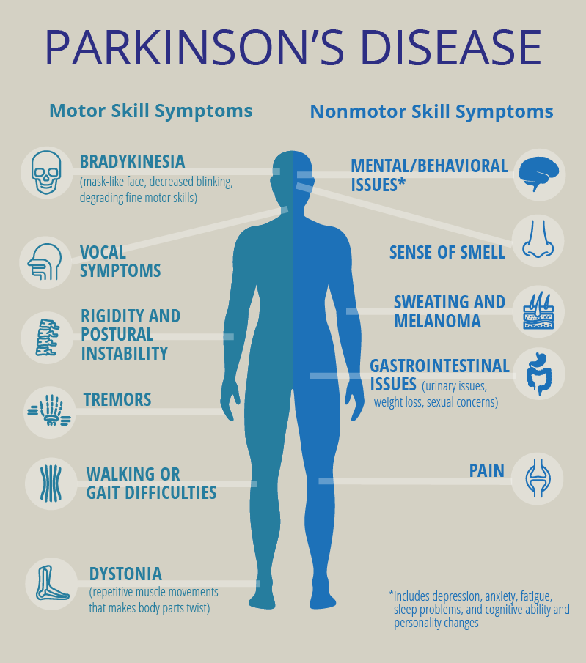
Parkinson’s Disease
Parkinson’s disease is a progressive disorder of the central nervous system affecting movement and inducing tremors and stiffness. It has 5 stages to it and affects more than 1 million individuals every year in India. This is chronic and has no cure yet. It is a neurodegenerative disorder affecting dopamine-producing neurons in the brain.
In the early stages of Parkinson's disease, your face may show little or no expression. Your arms may not swing when you walk. Your speech may become soft or slurred. Parkinson's disease symptoms worsen as your condition progresses over time.

Slide 4
OBJECTIVE

Slide 5

In this Python machine learning project, using the Python libraries scikit-learn, NumPy, pandas, seaborn, Matplotlib, math & time we are predicting Parkinson diseased patient.
Decision support tools are gaining significant research interest due to their potential to improve health-care provision. Among many possible approaches, those that provide noninvasive monitoring and diagnosis of diseases are of increased interest to clinicians and biomedical engineers.
We aim to provide this diagnosis to people in remote areas where healthcare is not just lacking but extremely inadequate.

Slide 6
BACKGROUND

Slide 7
Typically, the symptoms of PD are attenuated by the use of dopaminergic medications such as levodopa. During data collection, patients were asked to give information regard- ing when, relative to taking medication, they provided their data. The options included: Just after Parkinson medication (at your best), Another time, Immediately before Parkinson medication, I don’t take Parkinson medications, and no value. These medication time points were interpreted to mean: time of best symptom control, on medication but not immediately before or after, time of worst symptoms, not on medications, and not applicable, respectively. This information, crossed with the clinical diagnosis responses from the demographics survey led to three groups of patients and data, as shown in Figure 1. Patients that had medication prior to the voice test were not used as participants in the analysis. The rationale for this parameter selection is that the voice of the patient will depict the most extreme effects of the PD without the effect of any medication. The assumption is that the voice features will be noticeably different from those of the controls. The control in this experiment is a participant who has not been professionally diagnosed with PD.

Slide 8
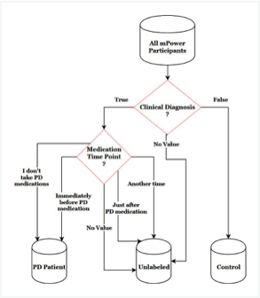
DECISION TREE

Slide 9
HARDWARE AND SOFTWARE REQUIREMENTS

Slide 10
HARDWARE
Processor | i5 or above
Hard Disk | 10GB
RAM | 8GB
Monitor | 17” Coloured
Mouse | Optical
Keyboard | 122 Keys

Slide 11
SOFTWARE
Platform | Windows, Linux or MacOS
Operating System | Windows, Linux or MacOS
Technology | Machine Learning-Python
Scripting Language | Python
IDE | PyCharm

Slide 12

FUTURE SCORE

Slide 13
FOR DOCTORS:
Improving disease accuracy
Anticipation of their patients' disease evolution
Support to decision for choosing treatments for patients
FOR PD PATIENTS:
For people with risk of getting PD: early detection and monitoring
For early-stage/late-stage PD people: monitoring better their disease by knowing the expected evolution
Finding the best treatment that will improve the quality of life of PD people
FOR HOSPITALS:
cost reductions by improved patient management & treatment optimization
operations improvement by predicting patients future visits, med supplies, etc.

Slide 14

CONCLUSION

Slide 15
Disease diagnosis and prediction is possible through automated machine learning architectures using only non- invasive voice biomarkers as features. Our analysis provides a comparison of the effectiveness of various machine learning classifiers in disease diagnosis with noisy and high dimensional data. After thorough feature selection, clinical level accuracy is possible. These results are promising because they may introduce novel means to assess patient health and neurological diseases using voice data. Due to the high accuracy performed by the models with these short audio clips there is reason to believe denser feature sets with spoken word, video, or other modalities would aid in disease prediction and clinical validation of diagnosis in the future.

Slide 16

REFERENCES & BIBILOGRAPHY

Slide 17
Dataset – (https://archive.ics.uci.edu/ml/datasets/Parkinson+Disease+Spiral+Drawings+Using+Digitized+Graphics+Tablet)
Algorithms Reference –
(www.semanticscholar.org),(https://www.ijitee.org)
Differential diagnosis of Parkinsons Disease
(https://www.sciencedirect.com/science/article/pii/ S0933365716000063)

Slide 18



THANK YOU
YOU CAN FIND MY PORJECT AT –
(https://github.com/yash-hash/Machine-Learning-/tree/master/Parkinson's%20Disease%20Prediction)
CONTACT ME –

