Slide 1
LAYERCAKE / STUDENT BUILD
ONE MODEL. THREE DEVICES.
What if a group of devices could combine memory and compute to run one language model?
MAC
IPAD
GPU
Layercake splits model layers across a peer-to-peer mesh.
HACKOHIO 2026 • 01 / 06

Slide 2
LAYERCAKE / STUDENT BUILD
THE BOTTLENECK IS MEMORY
Large models can demand more memory than a team wants to dedicate to one device. Layercake assigns contiguous layer ranges to separate peers; each device loads only its slice.
0–27
28–31
32–63
M2 Pro
M4 iPad
RTX 5060 Ti
One model, partitioned by the work each peer contributes.
HACKOHIO 2026 • 02 / 06

Slide 3
LAYERCAKE / STUDENT BUILD
PROMPT IN. ACTIVATIONS ACROSS.
1 Enter a prompt on the coordinator.
2 Each device computes its assigned layers.
3 Hidden states move peer-to-peer; the final stage selects the next token.
4 Repeat until the response is complete.
COORDINATOR → MAC → IPAD → RTX → NEXT TOKEN
Browser chat + live execution view • Iroh encrypted QUIC peer links
HACKOHIO 2026 • 03 / 06

Slide 4
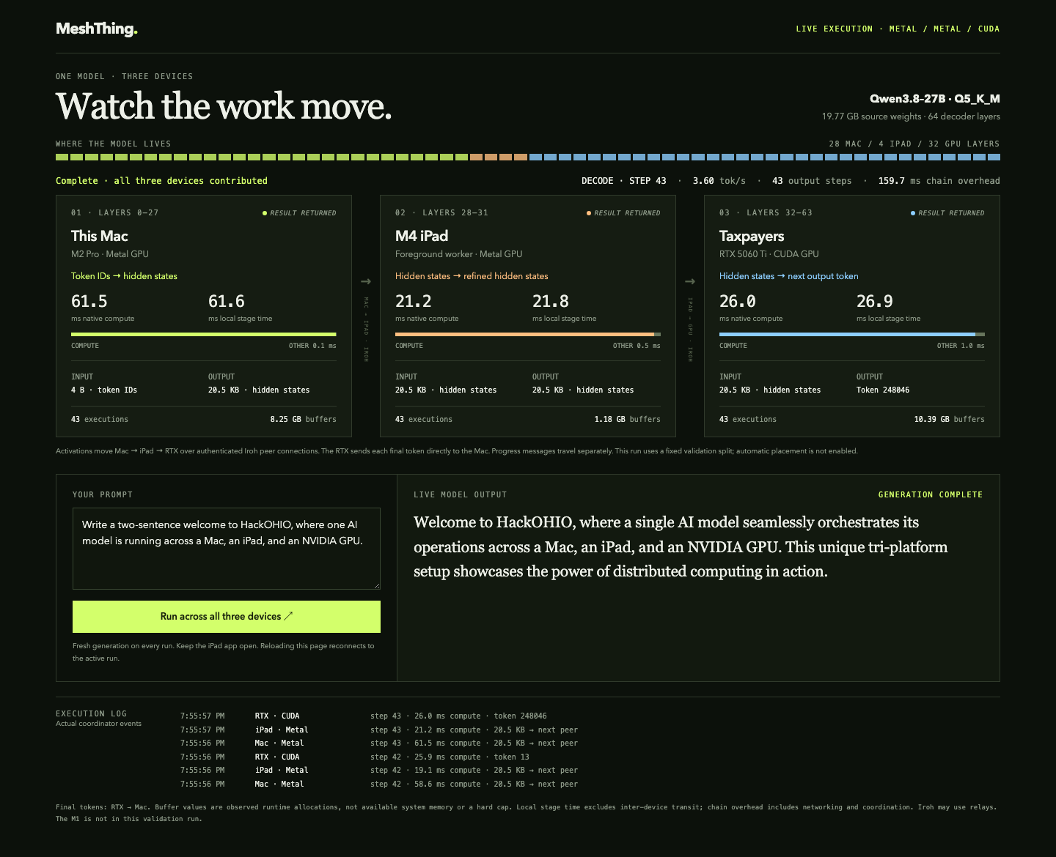
LAYERCAKE / STUDENT BUILD
WE RAN IT ON REAL HARDWARE
QWEN3.8-27B / 64 LAYERS
M2 PRO
Layers 0–27 • Metal
M4 IPAD
Layers 28–31 • Metal
RTX 5060 TI
Layers 32–63 • CUDA
43 output steps • 3.603 decode steps/s
Observed in this fixed validation run.
HACKOHIO 2026 • 04 / 06

Slide 5
LAYERCAKE / STUDENT BUILD
THE ENGINEERING IS IN THE HANDOFF
Rust coordinates mesh membership and task flow. Native Metal and CUDA workers execute layer ranges. Iroh provides peer discovery, encrypted QUIC connections, and relay paths.
3
43
3.603
physical platforms
output steps
decode steps / second
Measured result for this run; not a general performance benchmark.
HACKOHIO 2026 • 05 / 06

Slide 6
LAYERCAKE / STUDENT BUILD
A NEW WAY TO THINK ABOUT COMPUTE
We built a working proof that several devices can execute contiguous parts of one model as a mesh, extending usable capacity.
Next: automatic placement, faster transfers, and recovery when a peer disappears.
Layercake — make the mesh the machine.
HACKOHIO 2026 • 06 / 06

