Slide 1
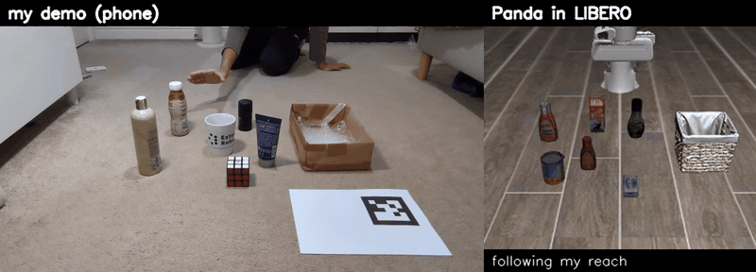
Teaching a robot arm with my own hand
I filmed a pick-and-place task 54 times on my phone, turned my hand into robot demonstrations in the LIBERO simulator and fine-tuned SmolVLA on them. No robot data was used.
96%
success on the LIBERO task, trained only on my videos
Yash Joshi
MEng Robotics and AI, UCL
Humanoid internship challenge
github.com/yash-joshi5379/Real2Sim-Task
Left: one of my phone demos. Right: the Panda arm replaying it in simulation.

Slide 2
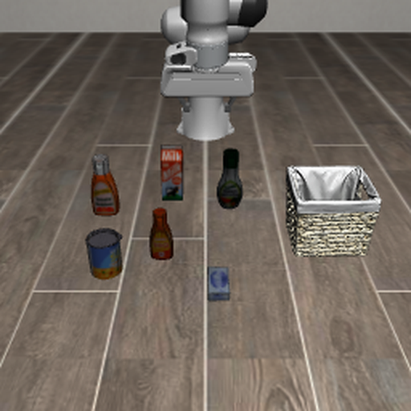
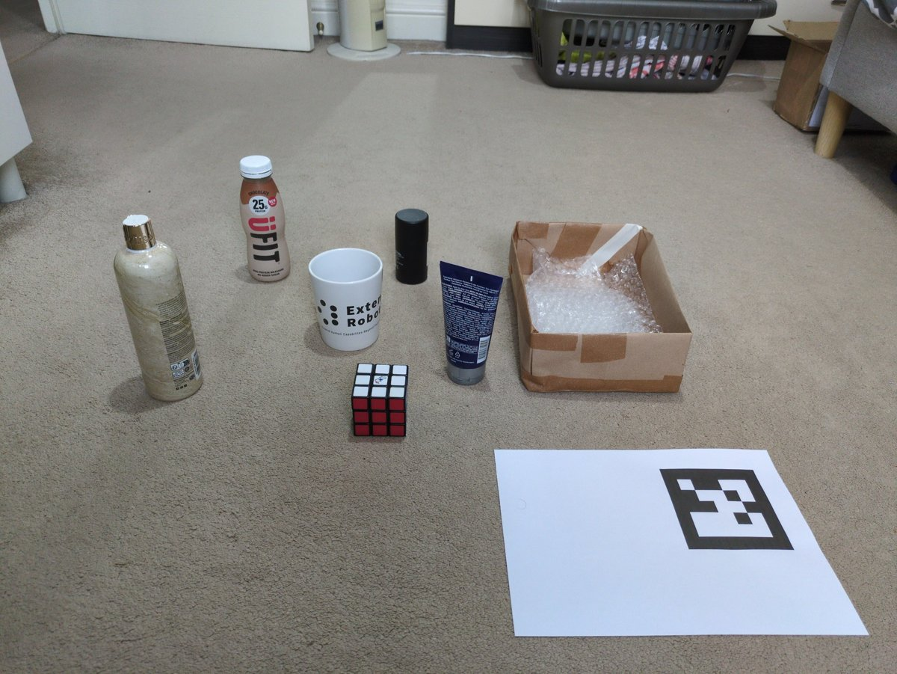
Use data I recorded myself to drive a robot in simulation
THE CHALLENGE
Why this task: I had a bottle and a box at home that match the ketchup and basket, and LIBERO tests it on 50 fixed layouts, so results are comparable
Plan: record, extract my hand's 3-D path, retarget it onto the robot, train a VLA, evaluate the standard LIBERO way
Reference: the same model trained on LIBERO's 45 robot demos of this task, so any gap comes from the data, not the model
The simulator task: LIBERO-Object #4, "pick up the ketchup and place it in the basket"
My version at home: a bottle for the ketchup, a box for the basket
1 Record
2 Extract
3 Retarget
4 Train
5 Evaluate & iterate

Slide 3
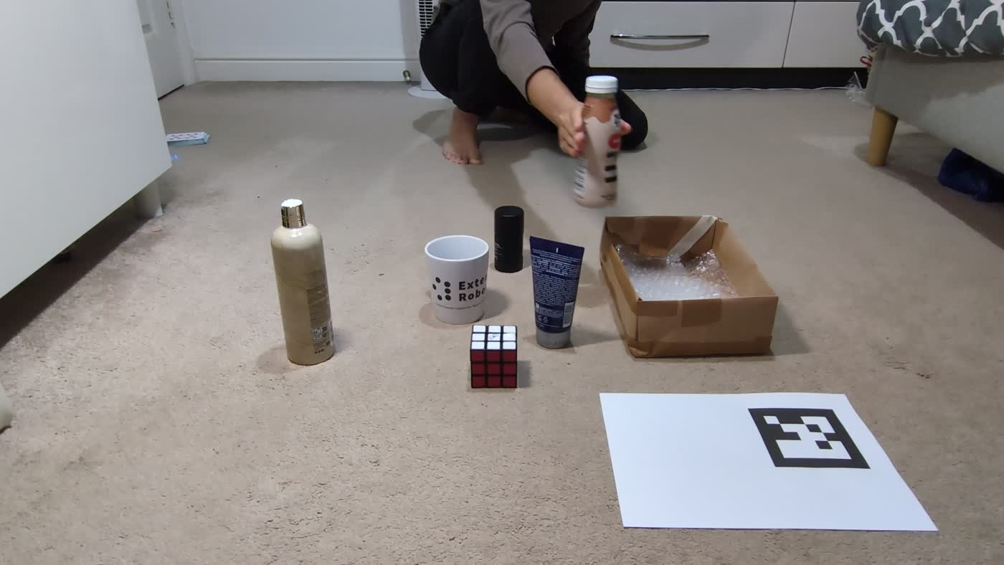
54 demos with a phone and a printed marker
STEP 1 · RECORD
Phone fixed on a stand: the camera never moves, so the marker calibrates a whole clip at once
ArUco marker (100 mm): its known size gives metric scale and the floor plane
Printed on A4: the sheet's known edges give the focal length, so no separate calibration
54 demos: about as many as LIBERO's own 45 for this task, so the comparison is fair
Distractors around the bottle, like the cluttered LIBERO scene
A frame from one of the 54 clips, mid-carry.

Slide 4
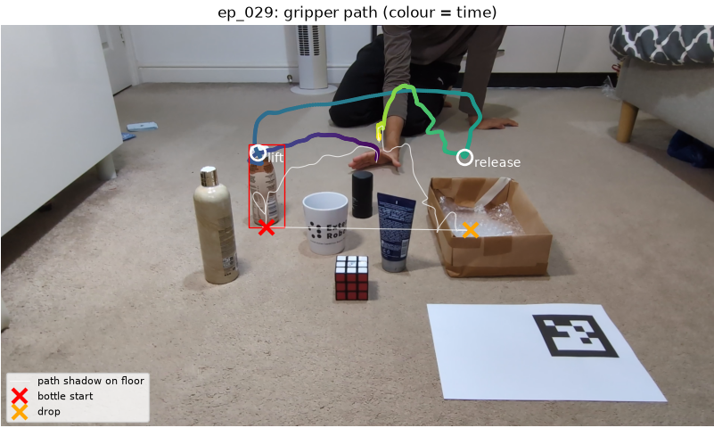
From video to a 3-D path of my hand
STEP 2 · EXTRACT
MediaPipe hands: runs on a laptop CPU and gives a metric 3-D hand model
Grasp point = thumb-index midpoint, where a parallel gripper's fingers close
Bottle start and drop from the first vs last frame: it's the only thing that moved, so no object detector is needed
Carry depth from geometry (hand ray meets the vertical plane between bottle and box), because single-image hand depth was up to 40% off
51/54 clean; 3 neck grasps kept, as their paths are still valid
One demo: the tracked grasp point over time (purple → yellow) and its shadow on the floor.

Slide 5
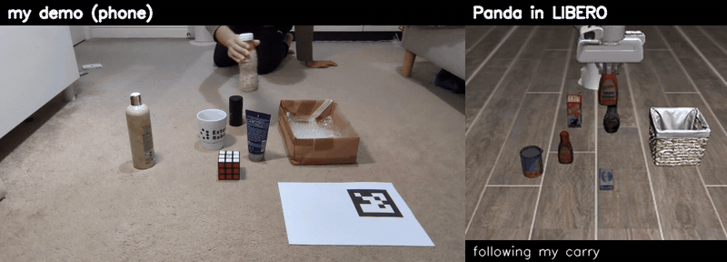
The robot replays every demo in LIBERO
STEP 3 · RETARGET
One transform for all demos, fitted on where my hand let go (the bottle tipped ~6 cm further after release)
Heights rescaled: my bottle is 19 cm, the sim ketchup 14.6 cm
The robot follows my reach and carry (70% of steps) but does the contact itself, because a phone can't see finger contact and copied grasps slipped
Played 1.3× faster to fit LIBERO's 280-step limit; 54/54 succeed
The caption under the robot shows when it follows my hand and when it acts on its own.
Why replay in the simulator instead of training on the video
A VLA learns from robot camera images paired with robot actions. Replaying with LIBERO's own controller turns my motion into exactly that, in the action space LIBERO policies use.

Slide 6
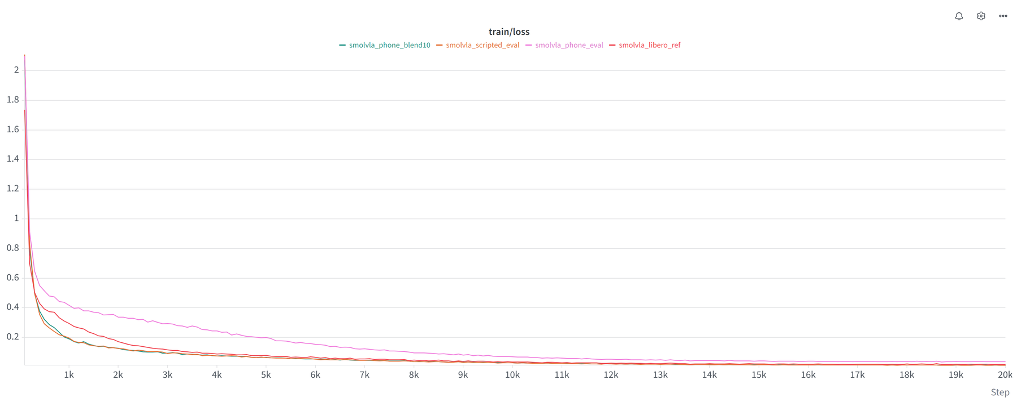
Same model, same settings as for LIBERO's own data
STEP 4 · TRAIN
Same format as LeRobot's LIBERO data, so my runs and the reference share identical code
SmolVLA: pretrained, which matters with 54 demos, and small enough (~450M) for one 16 GB GPU
Same recipe every run (batch 32, 20k steps, seed 1000), so only the data changes
20k steps: the loss has flattened, and D-40k gained nothing
Scored with lerobot-eval on the 50 standard layouts, the way LIBERO results are reported
Training loss in Weights & Biases (B, C2, D, G). D's loss stays highest: its 54 paths are all different.

Slide 7
12 runs in the order I ran them, one change each
STEP 5 · EVALUATE AND ITERATE
Run | What changed | Success | What it told me
A | My demos as extracted | 18% | Far below the reference: something is wrong
B | LIBERO's own robot demos (reference) | 86% | The target
A2 | Bottle at random spots of the spawn area, ×4 | 22% | Spreading the bottle out doesn't help
C | Scripted motion instead of mine (control) | 0% | Even perfect motion fails: not my hand
D | Bottle exactly where evaluation puts it | 50% | Placement was the first problem
C2 | Scripted motion + that placement (control) | 98% | The pipeline works; my paths cost the rest
D4 | D, each demo in 4 layouts | 24% | More copies of the same motions: no
D-40k | D, trained twice as long | 48% | Not under-training
E | D with one fixed timing | 30% | Not the timing
F | D's data, ACT instead of SmolVLA | 18% | Pretraining matters with 54 demos
G | D with the path shapes averaged | 96% | Consistent paths fix it
H | D with tracking jitter filtered out | 52% | Not measurement noise
Success = ketchup in the basket, over LIBERO's 50 test layouts (final checkpoints).

Slide 8
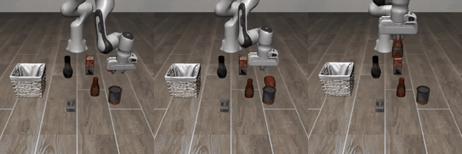
Where the 50% policy went wrong
DIAGNOSIS
Grasps are hesitant: the policy has learned a blur of 54 different paths
The controls ruled out the pipeline (C2: 98%)
E, H and D-40k ruled out timing, tracking noise and training length
What's left: the paths themselves vary too much between demos
Hovers, never grasps
Knocks the ketchup over
Drops it beside the basket
A mistake I corrected
I first blamed C's 0% on the slow approach in the scripted motion. C2 has the same approach and scores 98%, so C was failing because of where the bottle was.

Slide 9
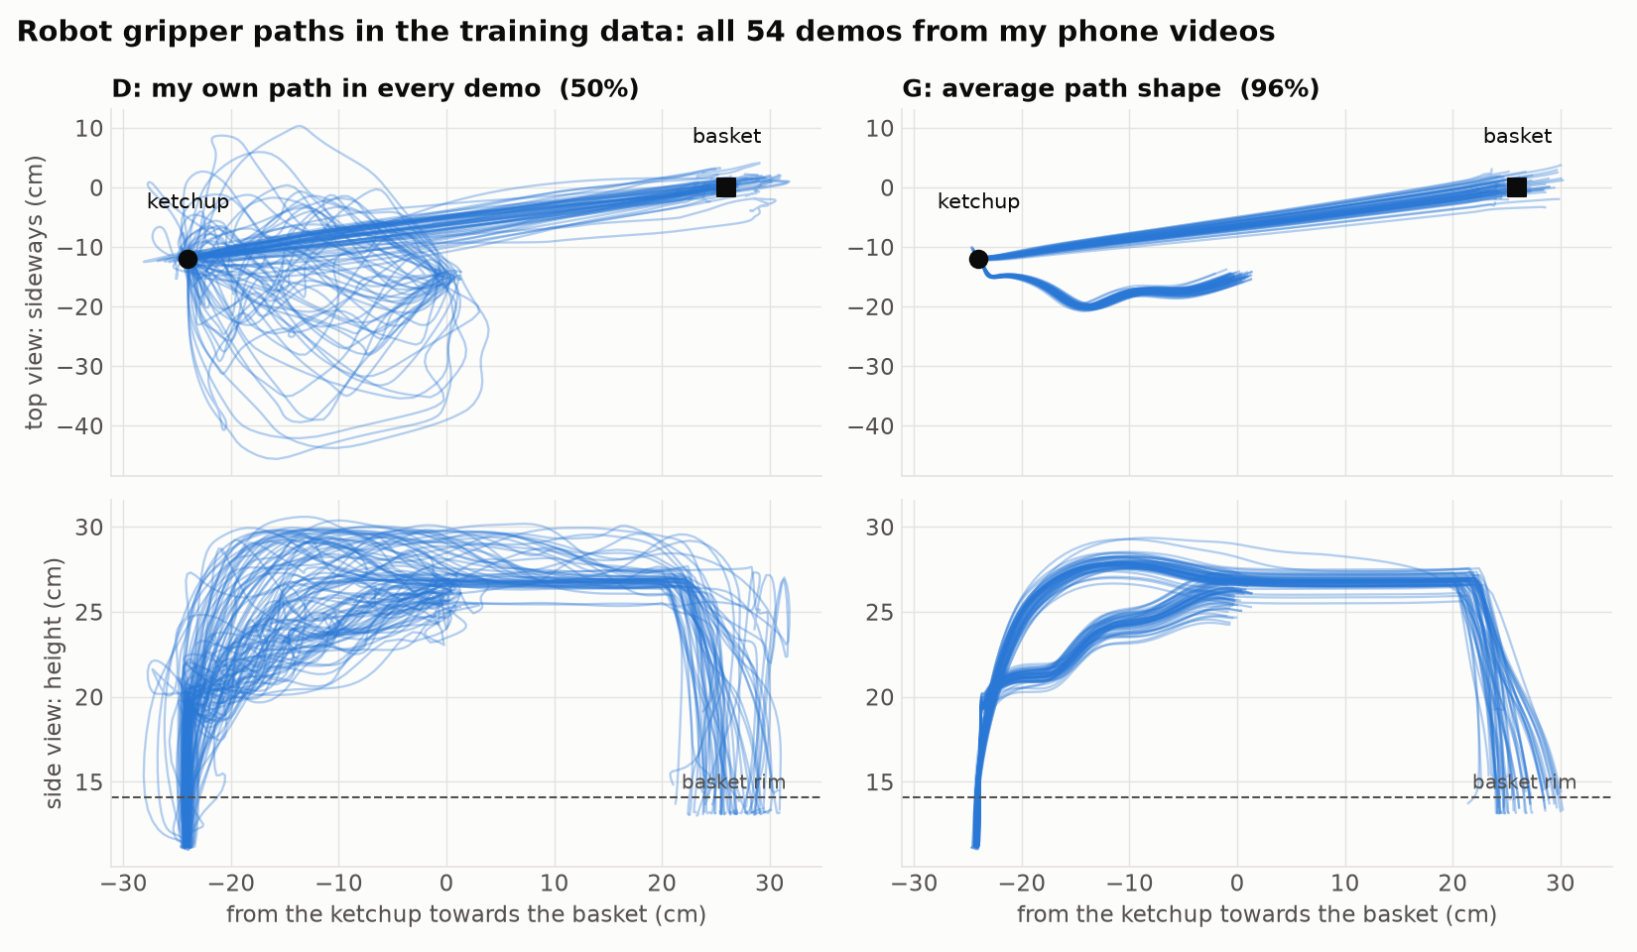
Averaging the shape of my 54 paths
THE FIX
Each path = straight line from its start to its end + how it bends away from that line
The bends are averaged over all 54 demos and put back on each demo's own line
Every demo keeps its own start, grasp, release and timing: it's still my motion, just consistent
Why this fix: more copies (D4) and a spread-out bottle (A2) didn't help, and C2 showed consistent paths reach 98%
Caveat: it works this well because the test always puts the ketchup in the same place

Slide 10
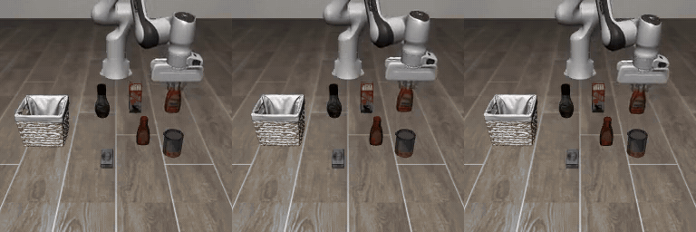
96% from phone videos, above LIBERO's own robot demos
RESULT
96%
G: my demos, averaged paths
86%
B: LIBERO's robot demos
The trained policy (run G) in three of LIBERO's test layouts, real time.
50%
D: my demos, raw paths
Same model, same training, same test
Only the training data differs between G, B and D, so the comparison is like for like. Intervals: G 87–99%, B 74–93% (50 episodes each).

Slide 11
What is different about this approach
TAKEAWAYS
My data drives the robot
70% of every training episode is my own hand motion. The robot only adds the last centimetres of the grasp and release.
A fair comparison
Same controller, data format, model, training and test as LIBERO's own demos, so 96% vs 86% is like for like.
A diagnosis, not just a score
Controls and one-change runs showed why the first version failed and what fixed it.
Cheap to repeat
A phone, a printed marker and a laptop for the data; one command per experiment.

Slide 12
How this matches what the role asks for
ABOUT ME
The role asks for | Evidence from this challenge and my work
Master's or PhD in CS / ML / robotics | MEng Robotics and Artificial Intelligence, UCL (penultimate year, graduating June 2028)
ML foundations, Python, PyTorch | Pipeline in Python; SmolVLA and ACT fine-tuned in PyTorch through LeRobot
Interest in RL, world models, VLAs | VLA post-training on human data, closing the gap between human and robot data; RL and world models are my next steps
Running experiments rigorously | 12 runs, one change each, controls, 95% intervals, and an explanation I retracted when the data disagreed
Ownership, iterating with guidance | Chose the task, recorded the data, built every stage; led a 5-person VLA project with Extend Robotics
Problem solving, attention to detail | Found that the test always uses one ketchup position; fixed depth errors, arm lag and grasp slips
Fast learner, research pace | New to LIBERO, retargeting and hand tracking; first recording to 96% in about two weeks, on a laptop and a shared GPU

Slide 13
With more time, data and compute
NEXT STEPS
More seeds and tasks
One seed and 50 episodes per run means gaps under ~15 points are noise; 3 seeds and more LIBERO tasks would settle them.
Beyond one position
The test keeps the ketchup in one spot, real use won't: demos with the bottle moved, blended only part-way.
RL on top of the VLA
Imitation can't recover from states it never saw; RL in LIBERO starting from G can learn to.
World model
The bottleneck was few, inconsistent demos; a video model trained on my clips could generate more.
Better hand tracking
30% of each episode is scripted because a phone can't see finger contact; a 3-D hand mesh (HaMeR, WiLoR) could.
Faster inference
A real robot has a latency budget; profiling and quantising SmolVLA would show what fits.
Code, results and instructions: github.com/yash-joshi5379/Real2Sim-Task

