Slide 1
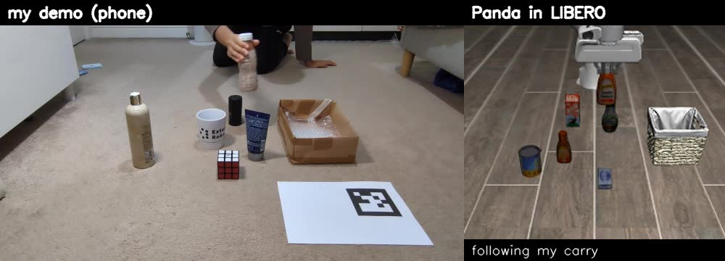
A simulated robot that learned a task from 54 phone videos of my hand
Yash Joshi
Humanoid: Robot Learning Research internship challenge
github.com/yash-joshi5379/Real2Sim-Task
Left: my demo. Right: the Panda in LIBERO replaying it.

Slide 2
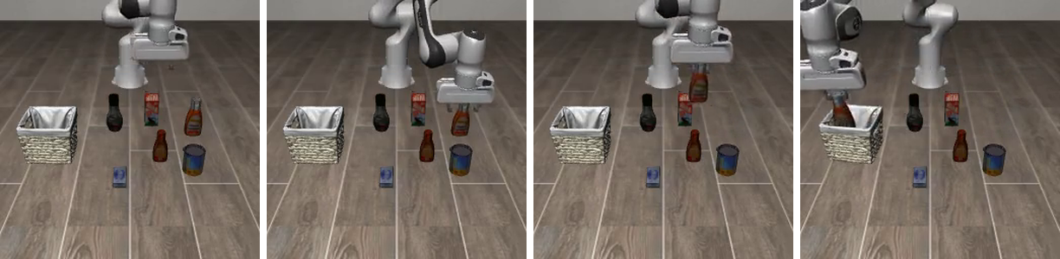
The result in one slide
96%
0
86%
success on LIBERO's 50 layouts
for the ketchup task (run G)
robot demonstrations used:
only my phone videos
same model trained on LIBERO's
own 45 robot demos (run B)
Task: LIBERO-Object #4, "pick up the ketchup and place it in the basket"
Data: 54 demos I filmed on a phone (bottle for ketchup, box for basket)
Model: SmolVLA fine-tuned with LeRobot, evaluated with lerobot-eval
The trained policy (run G) picking up the ketchup and placing it in the basket.

Slide 3
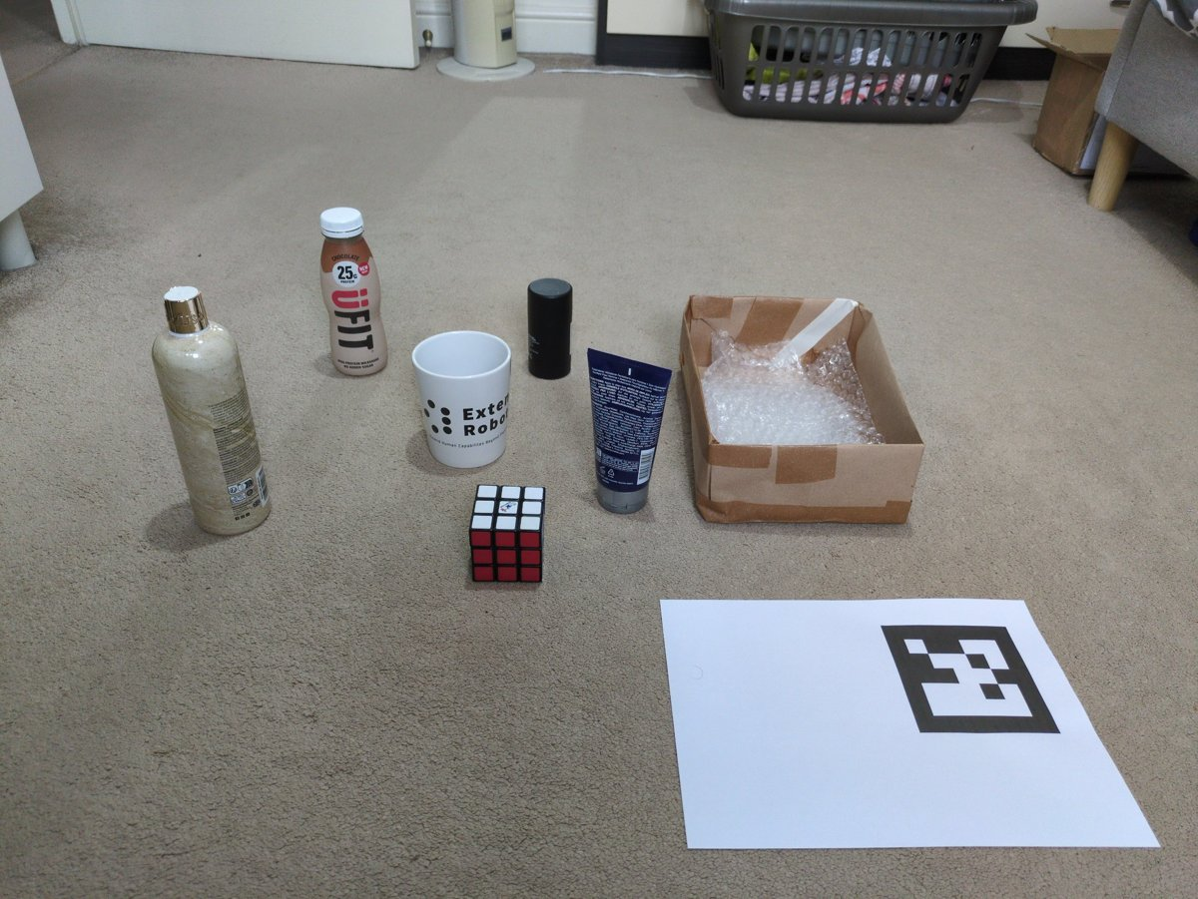
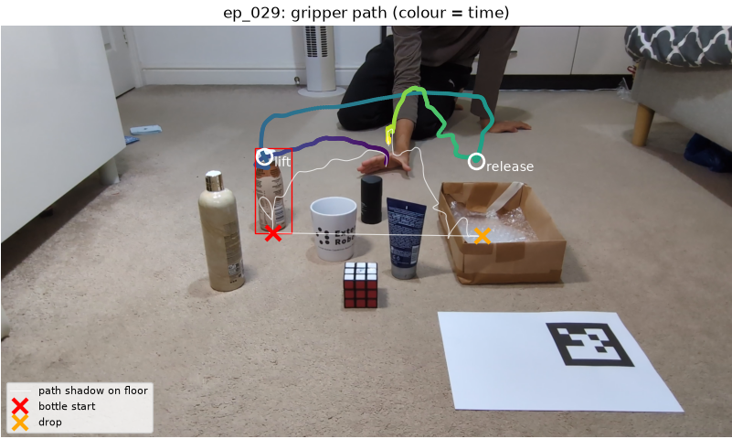
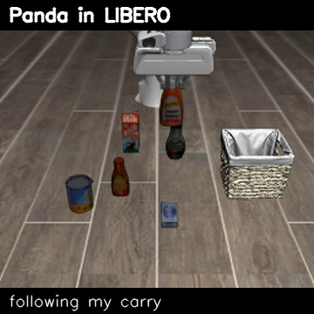
From phone video to robot training data
2. Extraction: 3-D hand path from MediaPipe + geometry
1. Recording: phone on a stand, printed ArUco marker for scale
3. Retargeting: the Panda replays the demo in LIBERO
Why a marker and an A4 sheet
The marker fixes scale and the floor; the sheet's edges give the focal length, so no calibration step.
Depth without a depth camera
During the carry, the hand's camera ray meets the vertical plane between bottle and box: pure geometry.
Same format as LIBERO's data
LIBERO's own controller and action space, LeRobot dataset format: my data and theirs train identically.

Slide 4
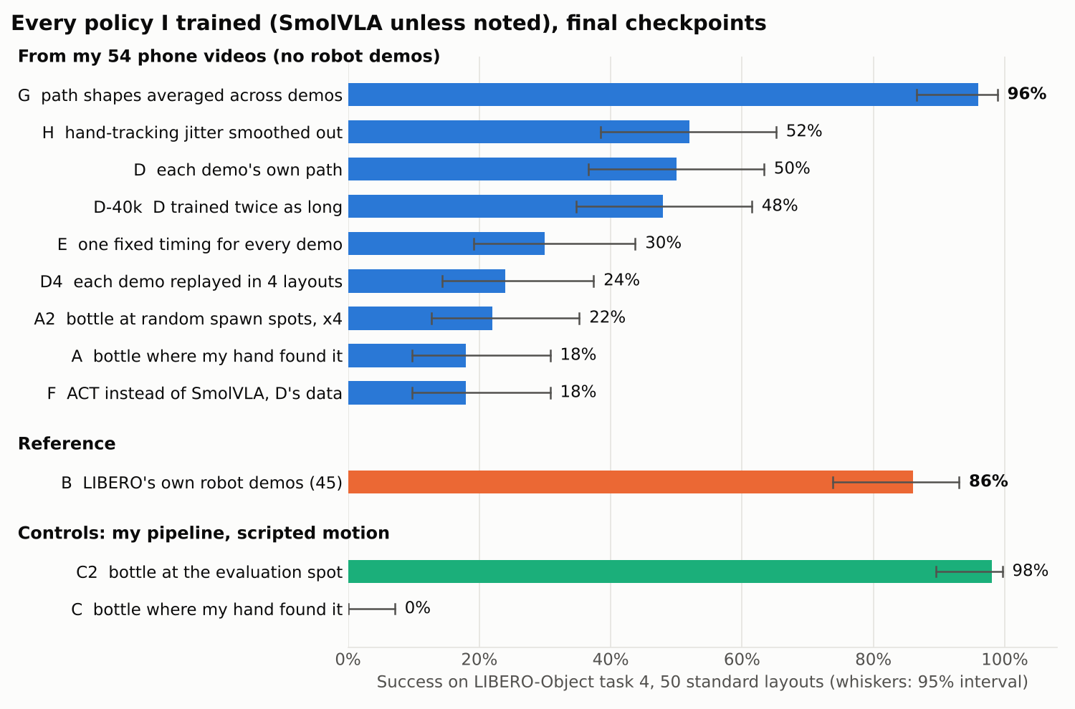
12 training runs, one change at a time
Scripted control C2 reaches 98%, so retargeting, actions and format are sound
Placing the bottle where evaluation puts it: 18% → 50% (A → D)
Timing (E), tracking jitter (H) and training length (D-40k) don't explain the rest
Averaging the 54 path shapes does: 50% → 96% (D → G)
ACT from scratch gets 18% on D's data: pretraining matters with 54 demos

Slide 5
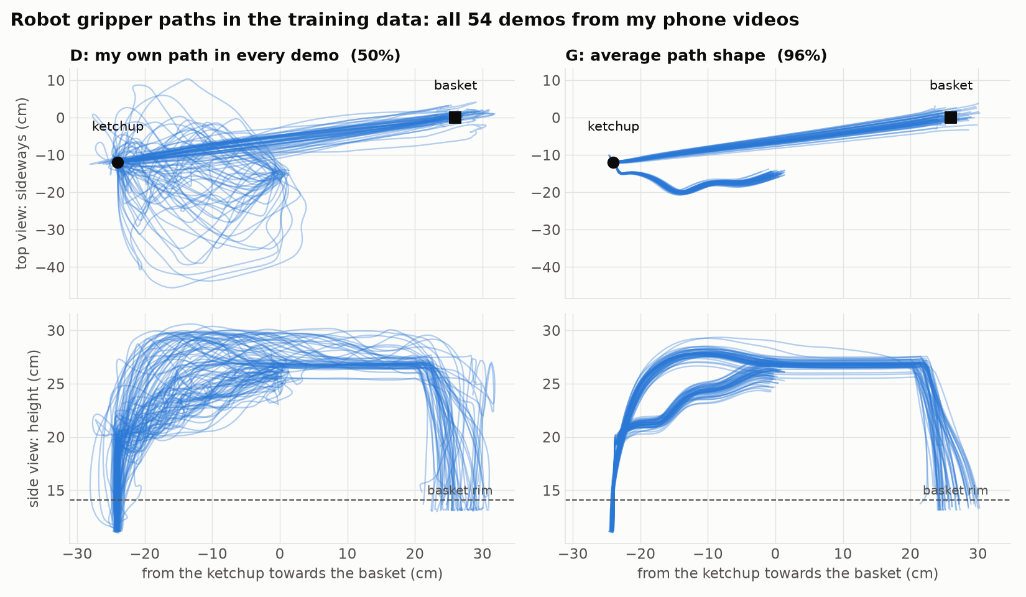
What made the difference: consistent paths
Each path = straight line from its start to its end + how it bends away from that line
The bends of all 54 demos are averaged and put back on every demo's own line
Each demo keeps its own start, grasp, release and duration; nothing is scripted
Why it works here: the ketchup is always in the same place, so one good shape is enough

Slide 6
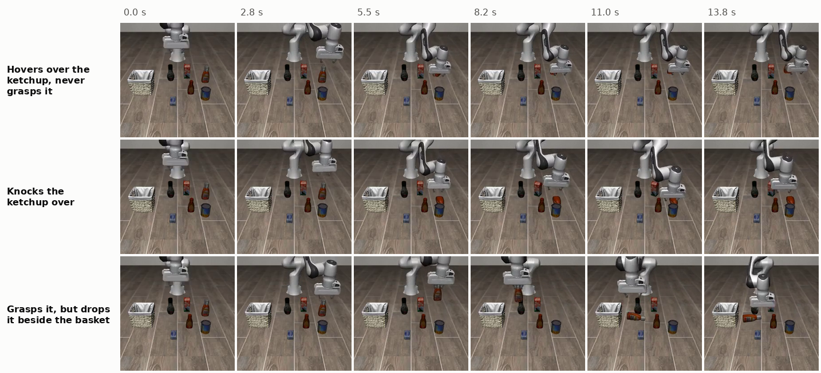
What didn't work, and what I learned from it
Copying the hand's grasp: the ketchup slipped → robot-side grasp in a tested height band
Following the path directly: the arm lagged 4-7 cm and hit the bottle → align, then descend
Fitting the transform on where the bottle landed: releases hit the rim → fit on the hand
My first explanation for C's 0% was wrong; C2 disproved it
Run D's three failure modes, from its evaluation videos.
Rigour
One seed per run and 50 episodes each, so I report 95% intervals and only claim differences that clear them.

Slide 7
What is different about this approach
My data drives the robot
70% of every training episode is my own hand motion, retargeted. The robot only adds the last centimetres of the grasp and release.
Fair comparison with robot data
Same controller, action space, dataset format, model, training and evaluation as LIBERO's own demos, so 96% vs 86% is like for like.
Diagnosis, not just a score
Control runs (C, C2) and one-change ablations (E, H, D-40k, F) show why the first version failed and what fixed it.
Cheap and repeatable
A phone, a printed marker and a laptop for the data; one command per experiment. Anyone can record more demos.

Slide 8
How this matches what the role asks for
The role asks for | Evidence from this challenge and my work
Master's or PhD in CS / ML / robotics | MEng Robotics and Artificial Intelligence, UCL (penultimate year, graduating June 2028)
ML foundations, Python, PyTorch | Pipeline in Python; SmolVLA and ACT fine-tuned in PyTorch through LeRobot
Interest in RL, world models, VLAs | VLA post-training on human data, the gap between human and robot data; RL and world models are my next steps
Running experiments rigorously | 12 runs, one change each, controls, 95% intervals, an explanation I retracted when the data disagreed
Ownership, iterating with guidance | Chose the task, recorded the data, built every stage; led a 5-person VLA project with Extend Robotics
Problem solving, attention to detail | Found that the evaluation always uses one ketchup position; fixed depth, lag and grasp slips
Fast learner, research pace | New to LIBERO, retargeting and hand tracking; from first recording to 96% in about two weeks, on a laptop and a shared GPU

Slide 9
With more time, data and compute
More seeds and tasks
3 seeds per run and the same pipeline on other LIBERO tasks, to separate real effects from noise.
Generalise beyond one position
Record demos with the bottle moved around; blend only part-way to the average, or average neighbouring demos.
RL on top of the VLA
Use G as the starting policy for RL in LIBERO (PPO or residual RL) to recover from mistakes.
World model
Train an action-conditioned video model on my clips to generate more consistent demos, or as a learned simulator.
Better hands
3-D hand mesh (HaMeR / WiLoR) or a second camera, so the gripper follows the fingers instead of scripted grasps.
Faster inference
Profile and quantise SmolVLA and tune the action-chunk size for a real robot's latency budget.

