Slide 1



BUILDATHON
BUILDATHON 3.0
Track and question details
Bob The Coders
Armaan Mulani
Siddhant Jadhav
Pranav Kale
Yash Khapre

Slide 2
PROBLEM STATEMENT
Solving your daily outfit problems by suggesting, outfits on the basis of mood , occasion and weather and making you look more fashionable.

Slide 3
OUR SOLUTION
1. Understanding your style according to your mood , event and wheather.
2. Personalized Recommendations.
3. Organizing effortless dressing.
4. Profession specific Suggestion and elevate your look.

Slide 4
TARGETED SECTOR & AUDIENCE
Our Platform will mainly be targeting India 1 and India 2(Upper middle class), and will
Also include audience from middle income fashion enthusiast suggesting outfit
according to there buget.

Slide 5
MARKET RESEARCH
Target Audience: Fashion-conscious individuals, busy professionals, and online shoppers.
Market Size: Global fashion tech market projected to reach $68.5 billion by 2030.
Trends Driving Demand: AI/ML adoption, sustainability focus, and AR/VR integration.
Competitor Analysis: Apps like Stylish, Cladwell, and Combyne.
Consumer Behavior: 70% prefer personalized recommendations; AR try-ons increase purchase likelihood.
Revenue Potential: In-app purchases, affiliate marketing, and advertisements.
Geographic Insights: High demand in the US, Europe, and Asia; emerging markets in India and Africa.
Pain Points to Address: Outfit planning, event/weather-specific suggestions, and styling confusion.
Sustainability Appeal: Eco-conscious users prefer sustainable fashion recommendations.
Future Opportunities: B2B solutions and social commerce integration.

Slide 6
PRODUCT FEATURES
Our Platform consider your body shape, suggesting flattering styles that Accenture your best features.
Suggests perfect look for every occasion, whether it’s a casual occasion or formal gala or night out
with friends.
Suggesting stylish and comfortable look in any weather.

Slide 7
TECHNICAL ARCHITECTURE
Current Prototype is made using WIX, a no-code website builder.
Future tech includes:
Frontend Framework: React Native or Flutter.
Backend Framework: Node.js, Django, or Spring Boot.
Database: PostgreSQL/MySQL and MongoDB.
AI/ML Models: TensorFlow or PyTorch.
AR Integration: ARKit (iOS) or ARCore (Android).
Cloud Infrastructure: AWS, Google Cloud, or Azure.
Third-party APIs: Weather and fashion APIs.
User Authentication: OAuth 2.0 or Firebase Authentication.
Monitoring and Analytics: Prometheus, Grafana, and Google Analytics.
Security Measures: SSL/TLS encryption and GDPR/CCPA compliance.

Slide 8
FUTURE SCOPE
The Outfit Suggester App can expand by integrating AR and AI, offering eco-friendly options, global localization, and personalized insights. It can build social features, partner with fashion brands, provide virtual closets, and focus on sustainability, creating a cutting-edge, user-friendly fashion ecosystem.

Slide 9
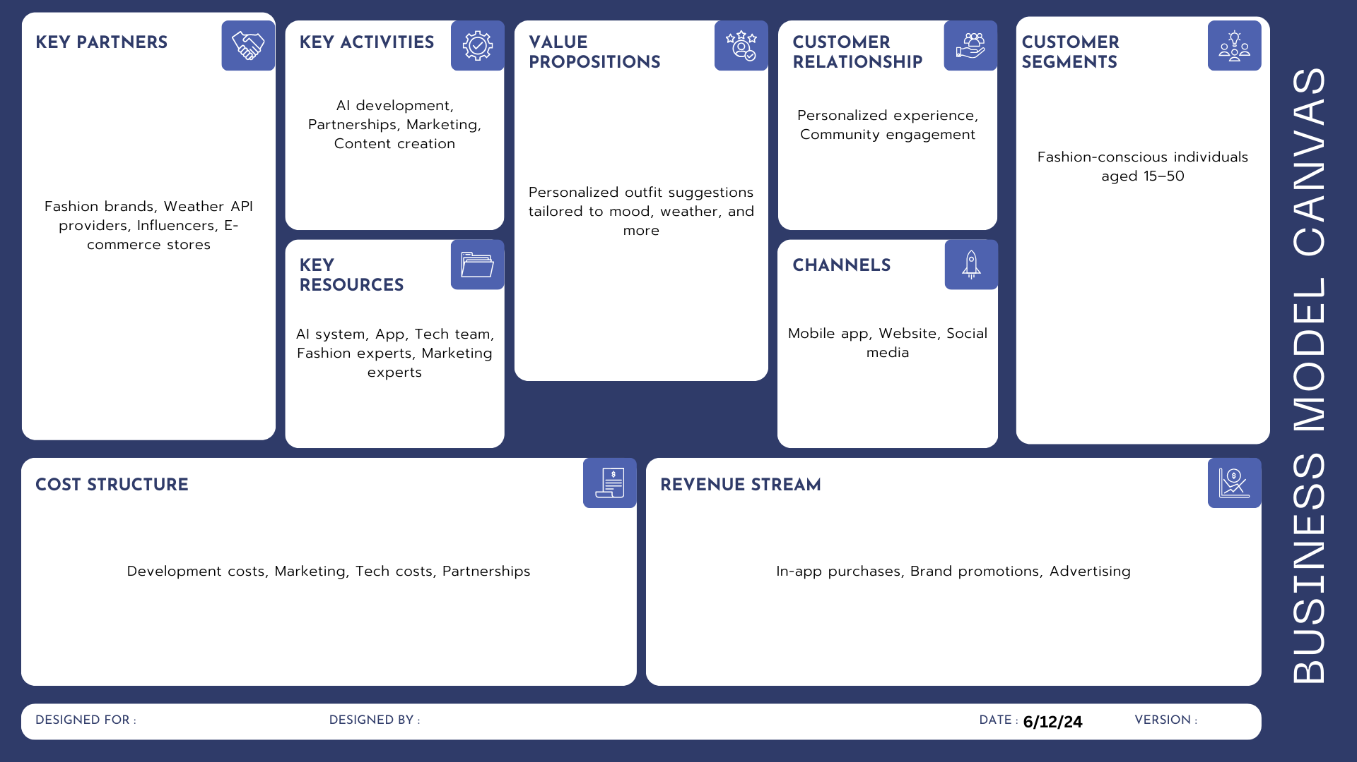
BUSINESS MODEL

Slide 10
