Slide 1

Project Title - Seasonal Agriculture performance analysis
Student Name – Yash Mohan Mahalle
College Name - Shri Shankarprasad Agnihotri College Of Engineering
AICTE STU ID : STU6918a1627733b1763221858

Slide 2

PROBLEM STATEMENT
(Agricultural activities are influenced by seasonal variations in environmental conditions, farming practices, resource availability and market conditions. As a result, agricultural performance may differ from one season to another. However, raw agricultural data does not clearly explain how agricultural performance changes across seasons or what patterns can be observed in different seasonal conditions. The problem is to analyze the given agricultural dataset and investigate seasonal differences in agricultural performance by identifying meaningful patterns, trends, relationships and variations within the available data.

Slide 3
Project Description
Analysis of agricultural performance across different seasons
Study of crop production and productivity
Comparison of yield, revenue, cost and profit
Analysis of environmental conditions
Study of fertilizer, pesticide and irrigation usage
Analysis of water consumption and water efficiency
Comparison of agricultural performance across regions
Identification of seasonal patterns and trends
Correlation analysis between agricultural variables
Statistical analysis of seasonal differences
Development of data-driven agricultural recommendations

Slide 4

WHO ARE THE END USERS?
Farmers
Agricultural planners
Government agricultural departments
Agricultural researchers
Agribusiness organizations
Farm management organizations
Data analysts
Students and educational institutions

Slide 5

Technology Used
Python
Google Colab
Jupyter Notebook
Pandas
NumPy
Matplotlib
SciPy
CSV Dataset
Exploratory Data Analysis (EDA)
Statistical Analysis
Data Visualization

Slide 6
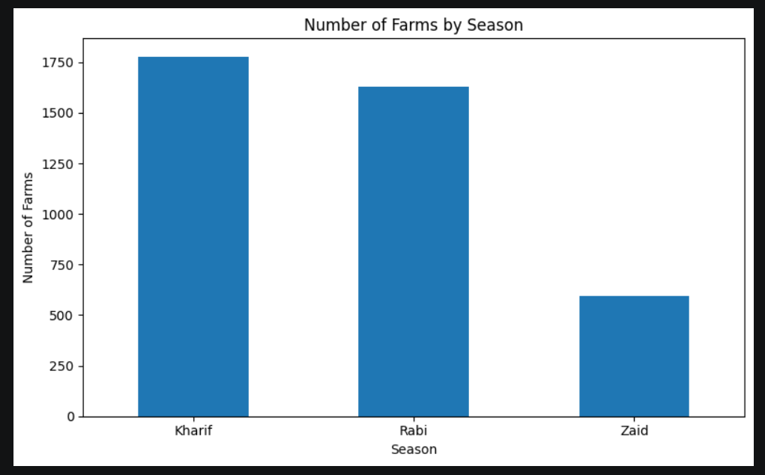
RESULTS
The graph shows the distribution of farms across Kharif, Rabi and Zaid seasons.
Kharif has the highest number of farms.
Rabi has the second-highest number of farms.
Zaid has considerably fewer farms compared with Kharif and Rabi.
This indicates that the dataset has greater representation of agricultural activities during Kharif and Rabi seasons.
The difference in the number of farms should be considered when comparing seasonal results.

Slide 7
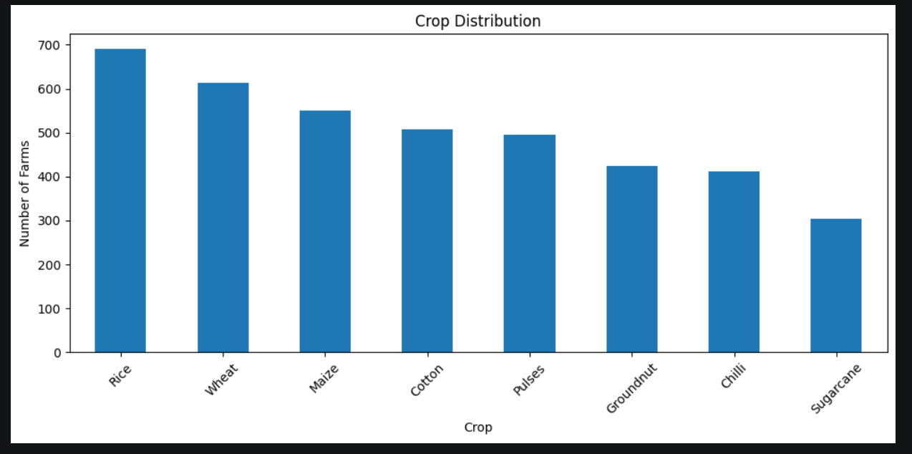
RESULTS
The graph presents the number of farms growing different crops.
Rice has the highest representation in the dataset.
Wheat is the second most represented crop.
Maize also has a significant number of farms.
Cotton and Pulses have moderate representation.
Groundnut, Chilli and Sugarcane have comparatively fewer farms.
The distribution helps identify which crops are more commonly represented in the dataset.

Slide 8
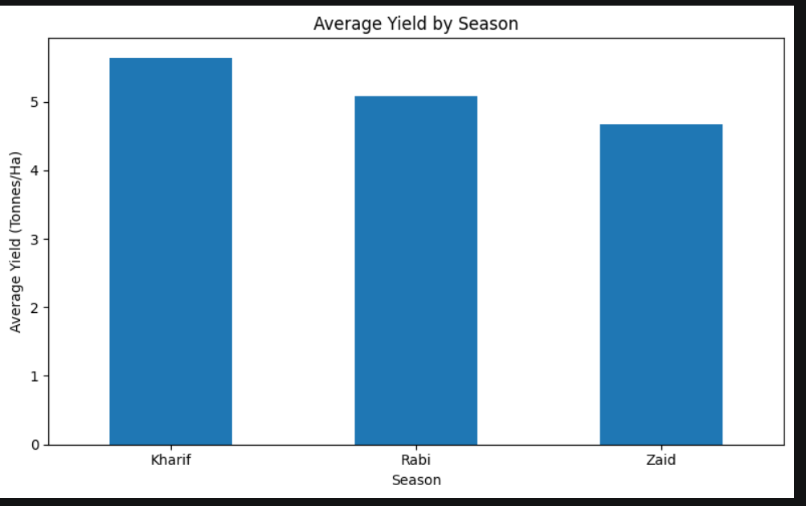
RESULTS
The graph compares the average agricultural yield across the three seasons.
Kharif records the highest average yield, approximately 5.6 tonnes/ha.
Rabi has an average yield of approximately 5.1 tonnes/ha.
Zaid has the lowest average yield, approximately 4.7 tonnes/ha.
Therefore, Kharif shows the strongest average productivity in the dataset.
The results indicate that seasonal conditions may influence agricultural yield.

Slide 9
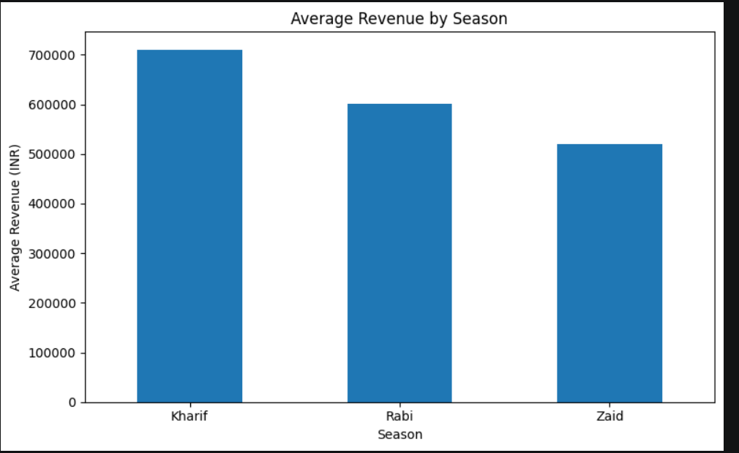
RESULTS
The graph compares average agricultural revenue across different seasons.
Kharif generates the highest average revenue, around ₹7.1 lakh.
Rabi generates approximately ₹6.0 lakh.
Zaid generates approximately ₹5.2 lakh.
Kharif therefore shows the strongest average economic performance in terms of revenue.
Revenue differences may be influenced by yield, crop type, production and market-related factors.

Slide 10
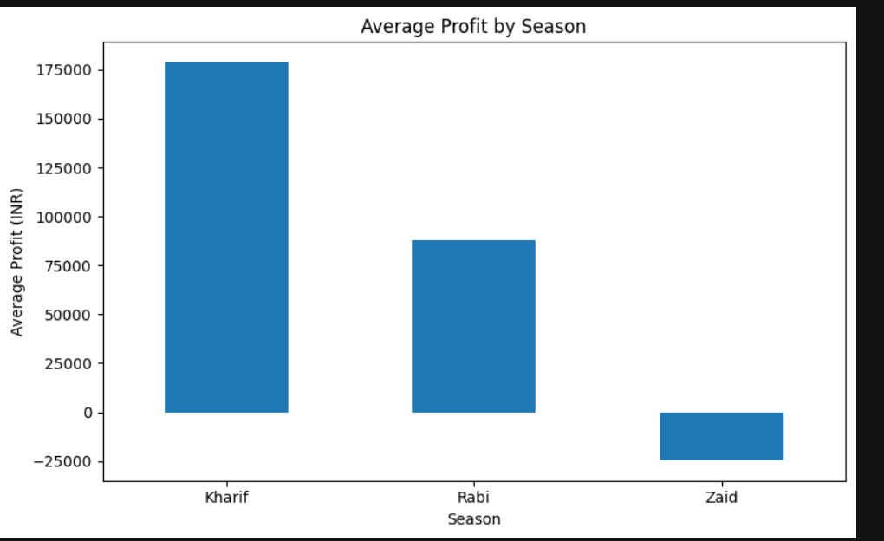
RESULTS
The graph compares average profit across Kharif, Rabi and Zaid seasons.
Kharif has the highest average profit, approximately ₹1.8 lakh.
Rabi has a lower but positive average profit of approximately ₹0.9 lakh.
Zaid shows a negative average profit, approximately ₹−0.25 lakh.
This indicates that profitability varies substantially between seasons.
The negative average profit for Zaid suggests that costs may exceed revenue for the average observation in this season.
Further investigation of crop choice, resource usage and production costs could help explain this difference.

Slide 11
Future scope
Machine-learning based yield prediction
Seasonal crop-performance forecasting
Weather-data integrationMarket-price integration
Interactive agricultural dashboard
Crop recommendation system
Disease and pest prediction
Smart irrigation recommendations
Resource optimization
Region-specific agricultural planning

Slide 12
GitHub Link
https://github.com/yash-mahalle/Seasonal-Agriculture-performance-analysis.git

Slide 13
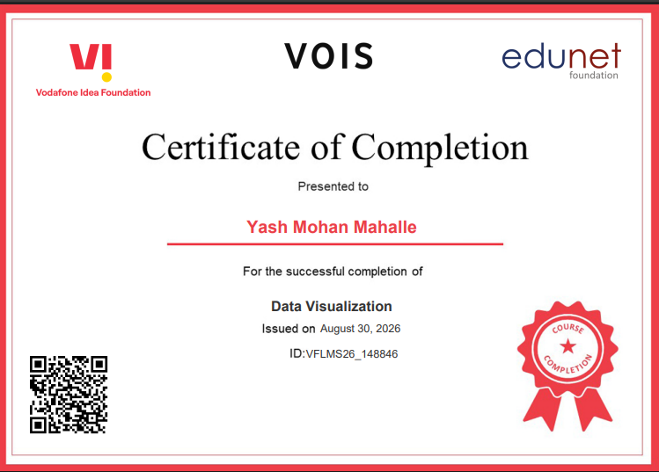
VOIS Course completion certificate - Course name- Data Visualization

Slide 14
Thank you
.
.

