Slide 1


Medlife Pharmacy
Group: Project_0502_01
Presented by:
Parika Rawat, Shweta Salelkar, Vidit Vaywala, Yash Makadia
Date: 7th December 2022

Slide 2
Agenda
Background
Introduction
ER Diagram
Database Design
Business Transactions
Presentation Title

Slide 3
Background
There are three main sources of data that are being managed in this system at Medlife Pharmacy:
The data coming from different Pharmaceutical companies that manufacture drugs.
The Employees who work at Medlife
The customers who purchase drugs from our stores
As a Company that sources its products from different locations and sells it at different locations, Medlife Pharmacy needs to keep track of it’s inventory purchases and sales. At a smaller scale, it is easy but Medlife has stores all over the country and thus needs to ensure that the data is tabulated and managed in an appropriate manner.

Slide 4

Introduction
Medlife Pharmacy is a system that stores data related to medication use processes
within pharmacies in an orderly and systematic manner.
Mission Statement
The main aim of this project is to develop the system such that the pharmaceutical
store can effectively manage its behemoth data and stay ahead of the curve.
Mission Objective
To develop a system that deals with the day to day requirement of any pharmacy.
To ensure safety, accuracy, and efficiency within the pharmaceutical store.
To provide competitive advantage to the pharmacy.

Slide 5
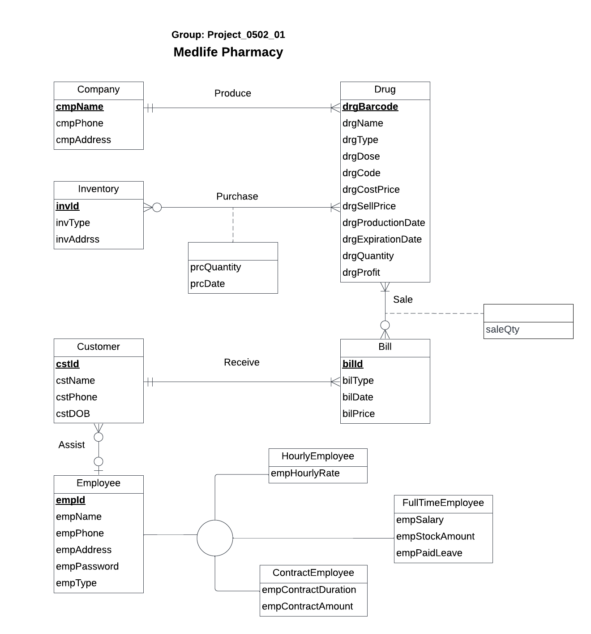
Conceptual Database Design

Slide 6
Logical Database Design
Company (cmpName, cmpPhone, cmpAddress)
Drug (drgBarcode ,drgName, drgType, drgDose, drgCode, drgCostPrice, drgSellPrice, drgProductionDate, drgExpirationDate, drgQuantity, drgProfit, cmpName)
Inventory(invId, invType, invAddress)
Employee (empId, empName, empPhone, empAddress, empPassword, empType)
HourlyEmployee (empId, empHourlyRate)
FullTimeEmployee (empId, empSalary, empStockAmount, empPaidLeave)
ContractEmployee (empId, empContractDuration, empContractAmount)
Customer (cstId, cstName, cstPhone, cstDOB, empId)
Bill (bilId , bilType, bilPrice, bilDate, cstId)
Purchase (invId, drgBarcode , prcQuantity, prcDate)
Sale (drgBarcode, bilId , saleQty)

Slide 7
Physical Database Design
CREATE TABLE Company (
cmpName VARCHAR (30) NOT NULL,
cmpPhone CHAR(10),
cmpAddress VARCHAR(50),
CONSTRAINT pk_Company_cmpName PRIMARY KEY (cmpName))
CREATE TABLE Drug (
drgBarcode CHAR (10) NOT NULL,
drgName VARCHAR(30),
drgType VARCHAR(20),
drgDose INTEGER,
drgCode VARCHAR(10),
drgCostPrice DECIMAL(6,2),
drgSellPrice DECIMAL(6,2),
drgProductionDate DATE,
drgExpirationDate DATE,
drgQuantity INTEGER,
drgProfit DECIMAL(6,2),
cmpName VARCHAR (30) NOT NULL,
CONSTRAINT pk_Drug_drgBarcode PRIMARY KEY (drgBarcode),
CONSTRAINT fk_Drug_cmpName FOREIGN KEY (cmpName )
REFERENCES Company (cmpName )
ON DELETE NO ACTION ON UPDATE CASCADE)

Slide 8
Physical Database Design
3. CREATE TABLE Inventory (
invId CHAR(10) NOT NULL,
invType VARCHAR(20),
invAddress VARCHAR (50),
CONSTRAINT pk_Inventory_invId PRIMARY KEY (invId))
4. CREATE TABLE Employee (
empId VARCHAR (10) NOT NULL,
empName VARCHAR (20),
empPhone CHAR (12),
empAddress VARCHAR (50),
empPassword VARCHAR (20),
emp_type VARCHAR(20),
CONSTRAINT pk_Employee_empId PRIMARY KEY (empId) )

Slide 9
Physical Database Design
5. CREATE TABLE Customer (
cstId VARCHAR (10) NOT NULL,
cstName VARCHAR (20),
cstPhone CHAR (10),
cstDOB DATE,
empId VARCHAR (10) NOT NULL,
CONSTRAINT pk_Customer_cstId PRIMARY KEY (cstId),
CONSTRAINT fk_Customer_cmpName FOREIGN KEY (empId)
REFERENCES Employee (empId)
ON DELETE NO ACTION ON UPDATE CASCADE)

Slide 10
Physical Database Design
6. CREATE TABLE Bill (
bilId CHAR (10) NOT NULL,
bilType VARCHAR (20),
bilDate DATE,
bilPrice DECIMAL (8,2),
cstId VARCHAR (10) NOT NULL,
CONSTRAINT pk_Bill_bilId PRIMARY KEY (bilId),
CONSTRAINT fk_Bill_cstId FOREIGN KEY (cstId)
REFERENCES Customer (cstId)
ON DELETE NO ACTION ON UPDATE CASCADE )

Slide 11
Physical Database Design
7. CREATE TABLE HourlyEmployee(
empId VARCHAR (10) NOT NULL,
empHourlyRate DECIMAL (6,2),
CONSTRAINT pk_HourlyEmployee_empId PRIMARY KEY (empId),
CONSTRAINT fk_HourlyEmployee_cmpName FOREIGN KEY (empId)
REFERENCES Employee (empId)
ON DELETE CASCADE ON UPDATE CASCADE)
8. CREATE TABLE FullTimeEmployee (
empId VARCHAR (10) NOT NULL,
empSalary DECIMAL (10,2),
empStockAmount DECIMAL (9,2),
empPaidLeave INTEGER,
CONSTRAINT pk_FullTimeEmployee_empId PRIMARY KEY (empId),
CONSTRAINT fk_FullTimeEmployee_cmpName FOREIGN KEY (empId)
REFERENCES Employee (empId)
ON DELETE CASCADE ON UPDATE CASCADE)

Slide 12
Physical Database Design
9. CREATE TABLE ContractEmployee (
empId VARCHAR (10) NOT NULL,
empContractDurationMonths INTEGER,
empContractAmount DECIMAL (9,2),
CONSTRAINT pk_ContractEmployee_empId PRIMARY KEY (empId),
CONSTRAINT fk_ContractEmployee_cmpName FOREIGN KEY (empId)
REFERENCES Employee (empId)
ON DELETE CASCADE ON UPDATE CASCADE)

Slide 13
Physical Database Design
10. CREATE TABLE Purchase (
invId CHAR (10) NOT NULL,
drgBarcode CHAR (10) NOT NULL,
prcQuantity INTEGER,
prcDate DATE,
CONSTRAINT pk_Purchase_invId_drgBarcode PRIMARY KEY (invId, drgBarcode),
CONSTRAINT fk_Purchase_invId FOREIGN KEY (invId)
REFERENCES Inventory (invId)
ON DELETE NO ACTION ON UPDATE CASCADE,
CONSTRAINT fk_Purchase_drgBarcode FOREIGN KEY (drgBarcode)
REFERENCES Drug (drgBarcode)
ON DELETE CASCADE ON UPDATE CASCADE)

Slide 14
Physical Database Design
11. CREATE TABLE Sale (
drgBarcode CHAR (10) NOT NULL,
bilId CHAR (10) NOT NULL,
saleQty INTEGER,
CONSTRAINT pk_Sale_drgBarcode_bilId PRIMARY KEY (drgBarcode, bilId),
CONSTRAINT fk_Sale_drgBarcode FOREIGN KEY (drgBarcode)
REFERENCES Drug (drgBarcode)
ON DELETE NO ACTION ON UPDATE CASCADE,
CONSTRAINT fk_Sale_bilId FOREIGN KEY (bilId)
REFERENCES Bill (bilId)
ON DELETE CASCADE ON UPDATE CASCADE)

Slide 15
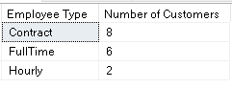
Business Transactions
1. As part of our customer experience, we would like to know how our employees are doing with customer assistance.
Are customers who purchase from our pharmacy, helped by Full-time employees or part-time (Hourly)?
SELECT e.empType AS 'Employee Type' , COUNT(e.empId) AS 'Number of Customers'
FROM Employee e where empId IN ( SELECT c.empId FROM Customer c, Bill b WHERE c.cstId = b.cstId)
GROUP BY e.empType
ORDER BY COUNT(e.empId) DESC;

Slide 16
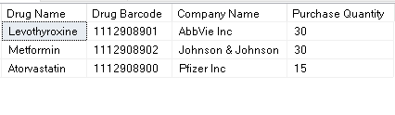
Business Transactions
2. For the purpose of efficient Inventory management, the manager wants to know the purchase quantity of drugs for any particlar month and year. This will help the manager in determining which drugs to buy in bulk and also determine the kind of contracts he/she wants to make with drug selling companies.
SELECT d.drgName AS 'Drug Name', p.drgBarcode AS 'Drug Barcode', d.cmpName AS 'Company Name', SUM(p.prcQuantity) AS 'Purchase Quantity'
FROM Purchase p, Drug d
WHERE YEAR(p.prcDate) = '2021' AND MONTH(p.prcDate) = '09' AND p.drgBarcode = d.drgBarcode
GROUP BY p.drgBarcode, d.drgName, d.cmpName
ORDER BY SUM(p.prcQuantity) DESC;

Slide 17
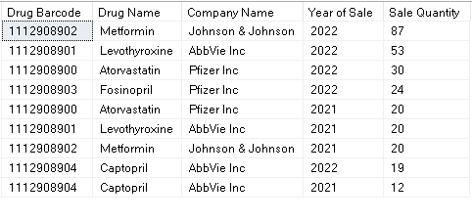
Business Transactions
3. The consumption pattern of drugs changes yearly. With the rise in variety of diseases and global outbreaks, the most-selling drugs are different for every year. The Sales manager wants to see the most-selling drugs every year to analyze the trends and patterns and for forecasting purposes.
SELECT s.drgBarcode AS 'Drug Barcode', d.drgName AS 'Drug Name', d.cmpName AS
'Company Name', YEAR(b.bilDate) AS 'Year of Sale', SUM(s.saleQty) AS 'Sale Quantity'
FROM Drug d, Sale s, Bill b
WHERE (Year(b.bilDate) IN (SELECT Year(b.bilDate) FROM Bill b GROUP BY YEAR(b.bilDate) )
AND (s.drgBarcode = d.drgBarcode AND s.bilId = b.bilId))
GROUP BY s.drgBarcode, d.drgName, d.cmpName, YEAR(b.bilDate)
ORDER BY SUM(s.saleQty) DESC, d.drgName;

Slide 18
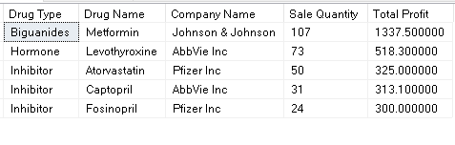
Business Transactions
4. Profitabilty is an important part of any business. Medlife wants to estimate which drugs are the most profitable for them.
This will help the Sales manager and the Relationship manager to enter into long-term contracts for companies whose drugs are sold in highest number by Medlife.
SELECT d.drgType AS 'Drug Type', d.drgName AS 'Drug Name', d.cmpName AS 'Company
Name', SUM(s.saleQty) AS 'Sale Quantity',
((SUM(d.drgProfit)*SUM(s.saleQty))/COUNT(s.drgBarcode)) AS 'Total Profit'
FROM Drug d, Sale s
WHERE d.drgBarcode = s.drgBarcode
GROUP BY d.drgType, d.cmpName, d.drgName
ORDER BY d.drgType ASC , SUM(s.saleQty) DESC;

Slide 19
Thank You

