Slide 1

P393- Resume Classification
PRESENTED BY G-3:
MR. YASH KUMAR ROY
Ms. Vaishali Ravi Mukharjee

Slide 2
CONTENTS
Business Objective
Introductions
Project Architecture
Data Details
Visualization and EDA
Model Building
Evaluation
Deployment

Slide 3
ACKNOWLEDGEMENT
We would like to express our deepest gratitude to Mr. Iftekar Patel for their invaluable patience and feedback. Thank you for entrusting us with this opportunity. We could not have undertaken this journey without your guidance and expertise.

Slide 4
BUSINESS OBJECTIVE
The Document classification solution significantly reduce the manual human effort in the HR management.
It should achieve a higher level of accuracy and automation with minimal human intervention

Slide 5
PROJECT ARCHITECTURE/ PROJECT FLOW
Business Understanding
Model Deployment
Data Collection
Model Evolution
Data Preparation
Visualization
Exploratory Data Analysis

Slide 6
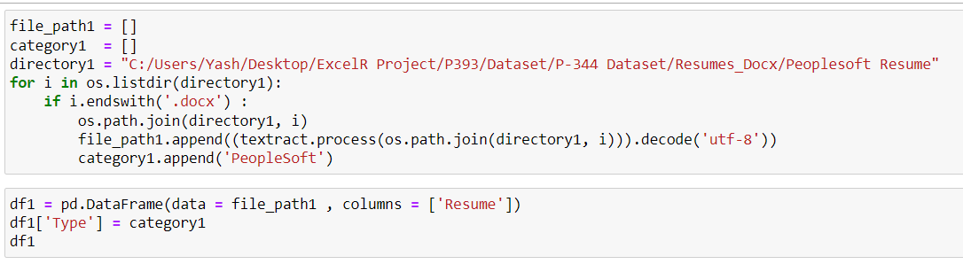
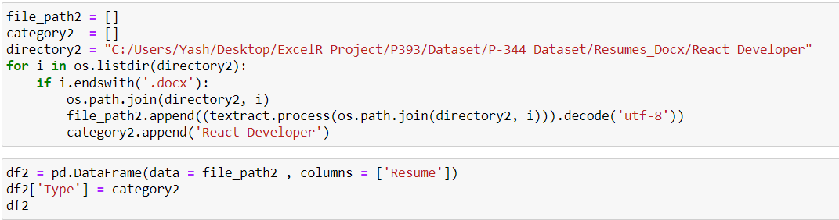
Merging resume to dataframe

Slide 7
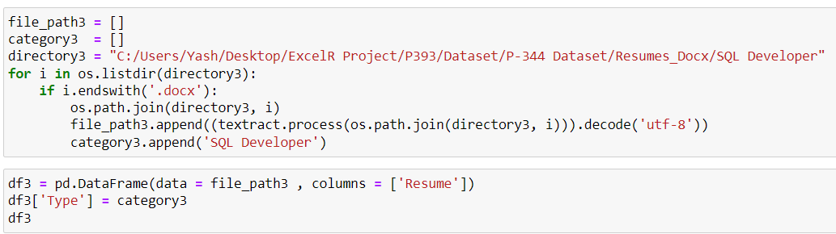
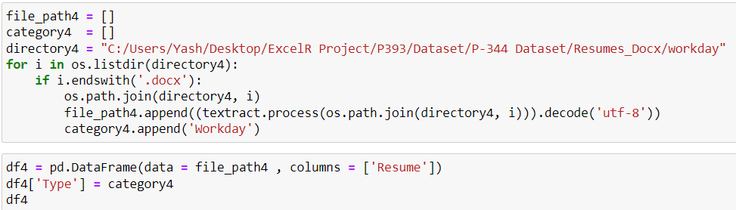


Slide 8
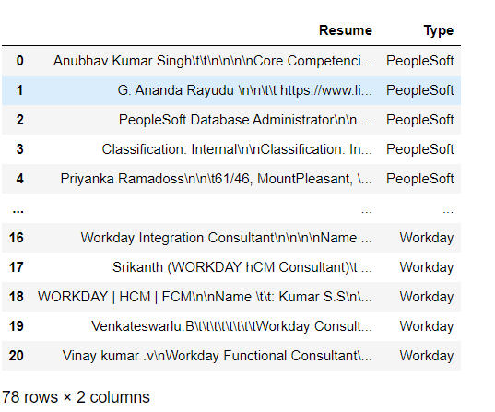
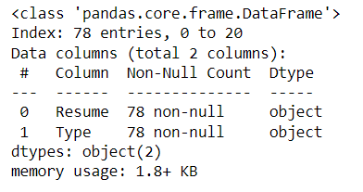
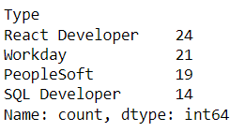
Dataset Details
Observation:-
After Extracting and modifying the dataset we have 78 number of total resume and we have 4 categories of resume

Slide 9
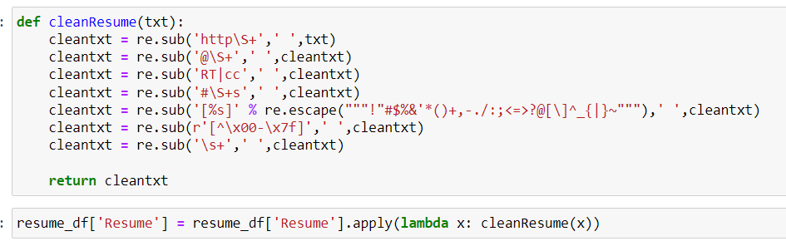
Removing all unwanted characters
Note:-
We have remove all unwanted characters using Regex.

Slide 10
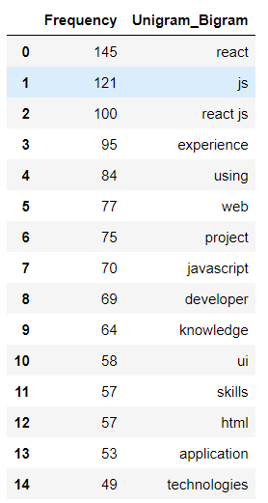
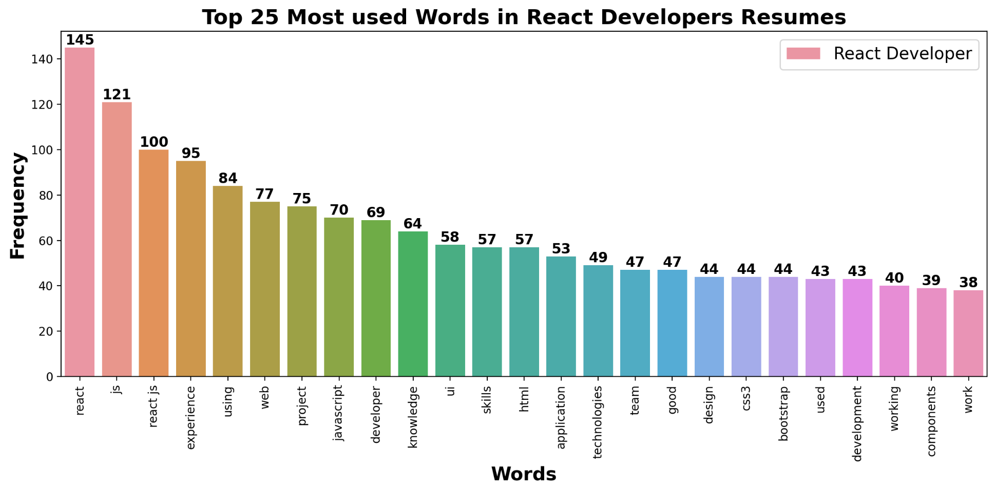
React Developer
Most occurring words:-
The average experience for React Developer is: 2.57 Years

Slide 11
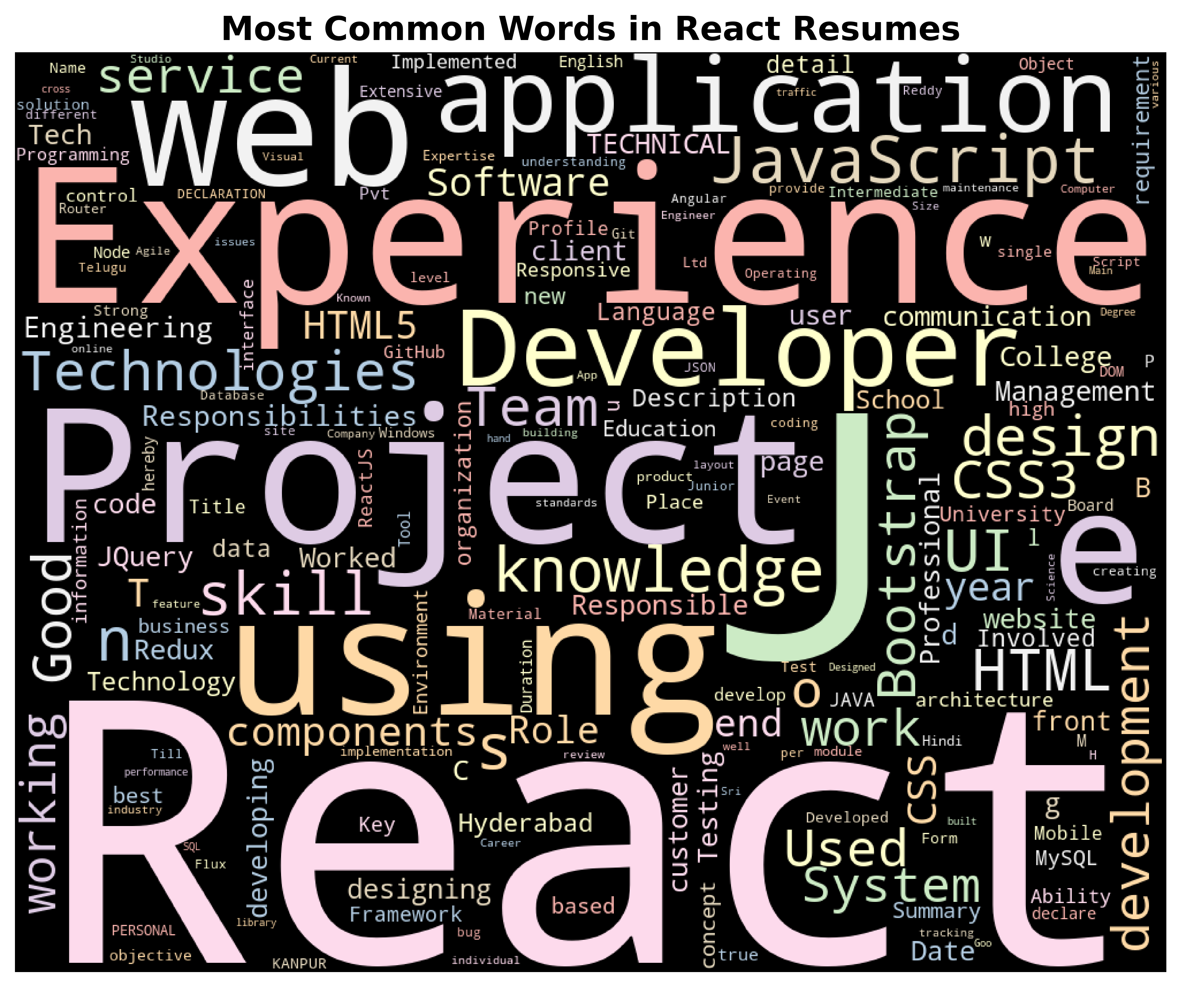
Word cloud:-

Slide 12
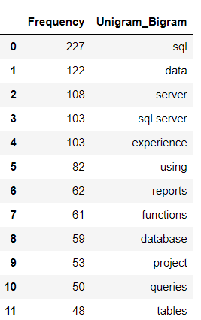
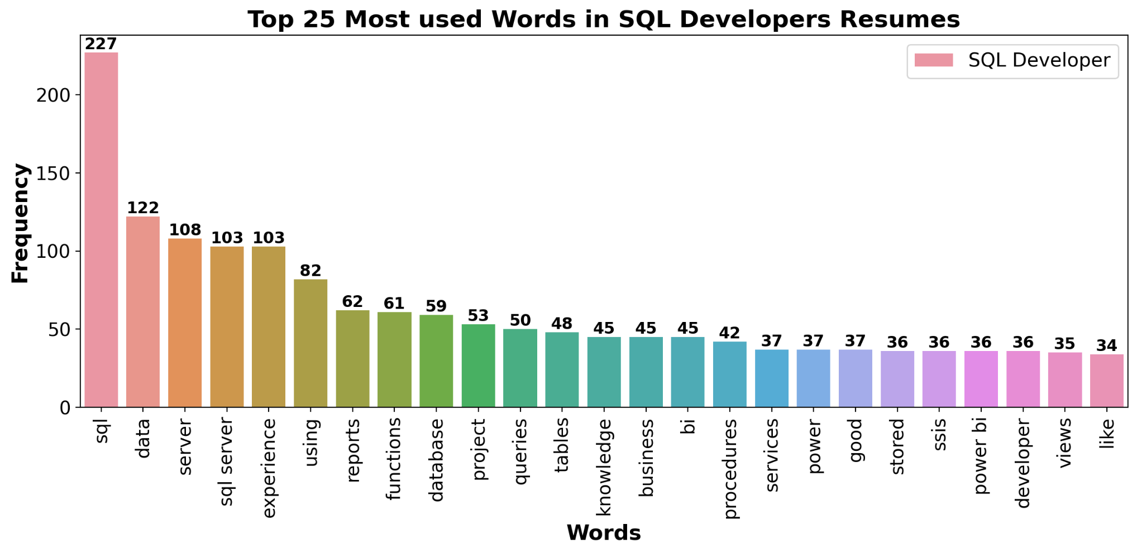
SQL Developer
Most occurring words:-
The average experience for SQL Developer is: 4.86 Years

Slide 13
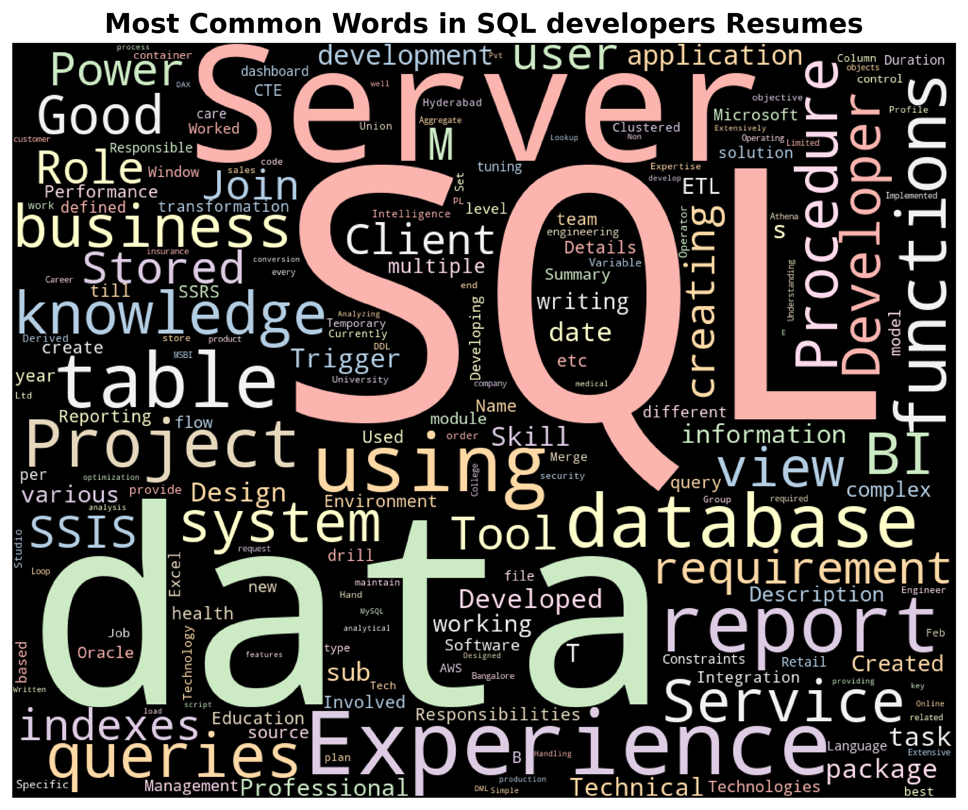
Word cloud:-

Slide 14
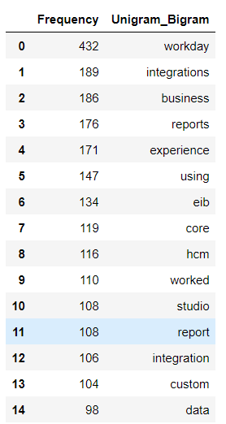
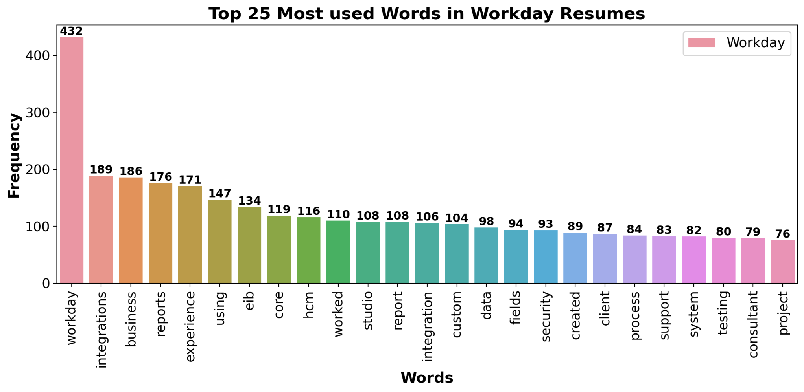
Workday
Most occurring words:-
The average experience for Workday is: 6.2 Years

Slide 15
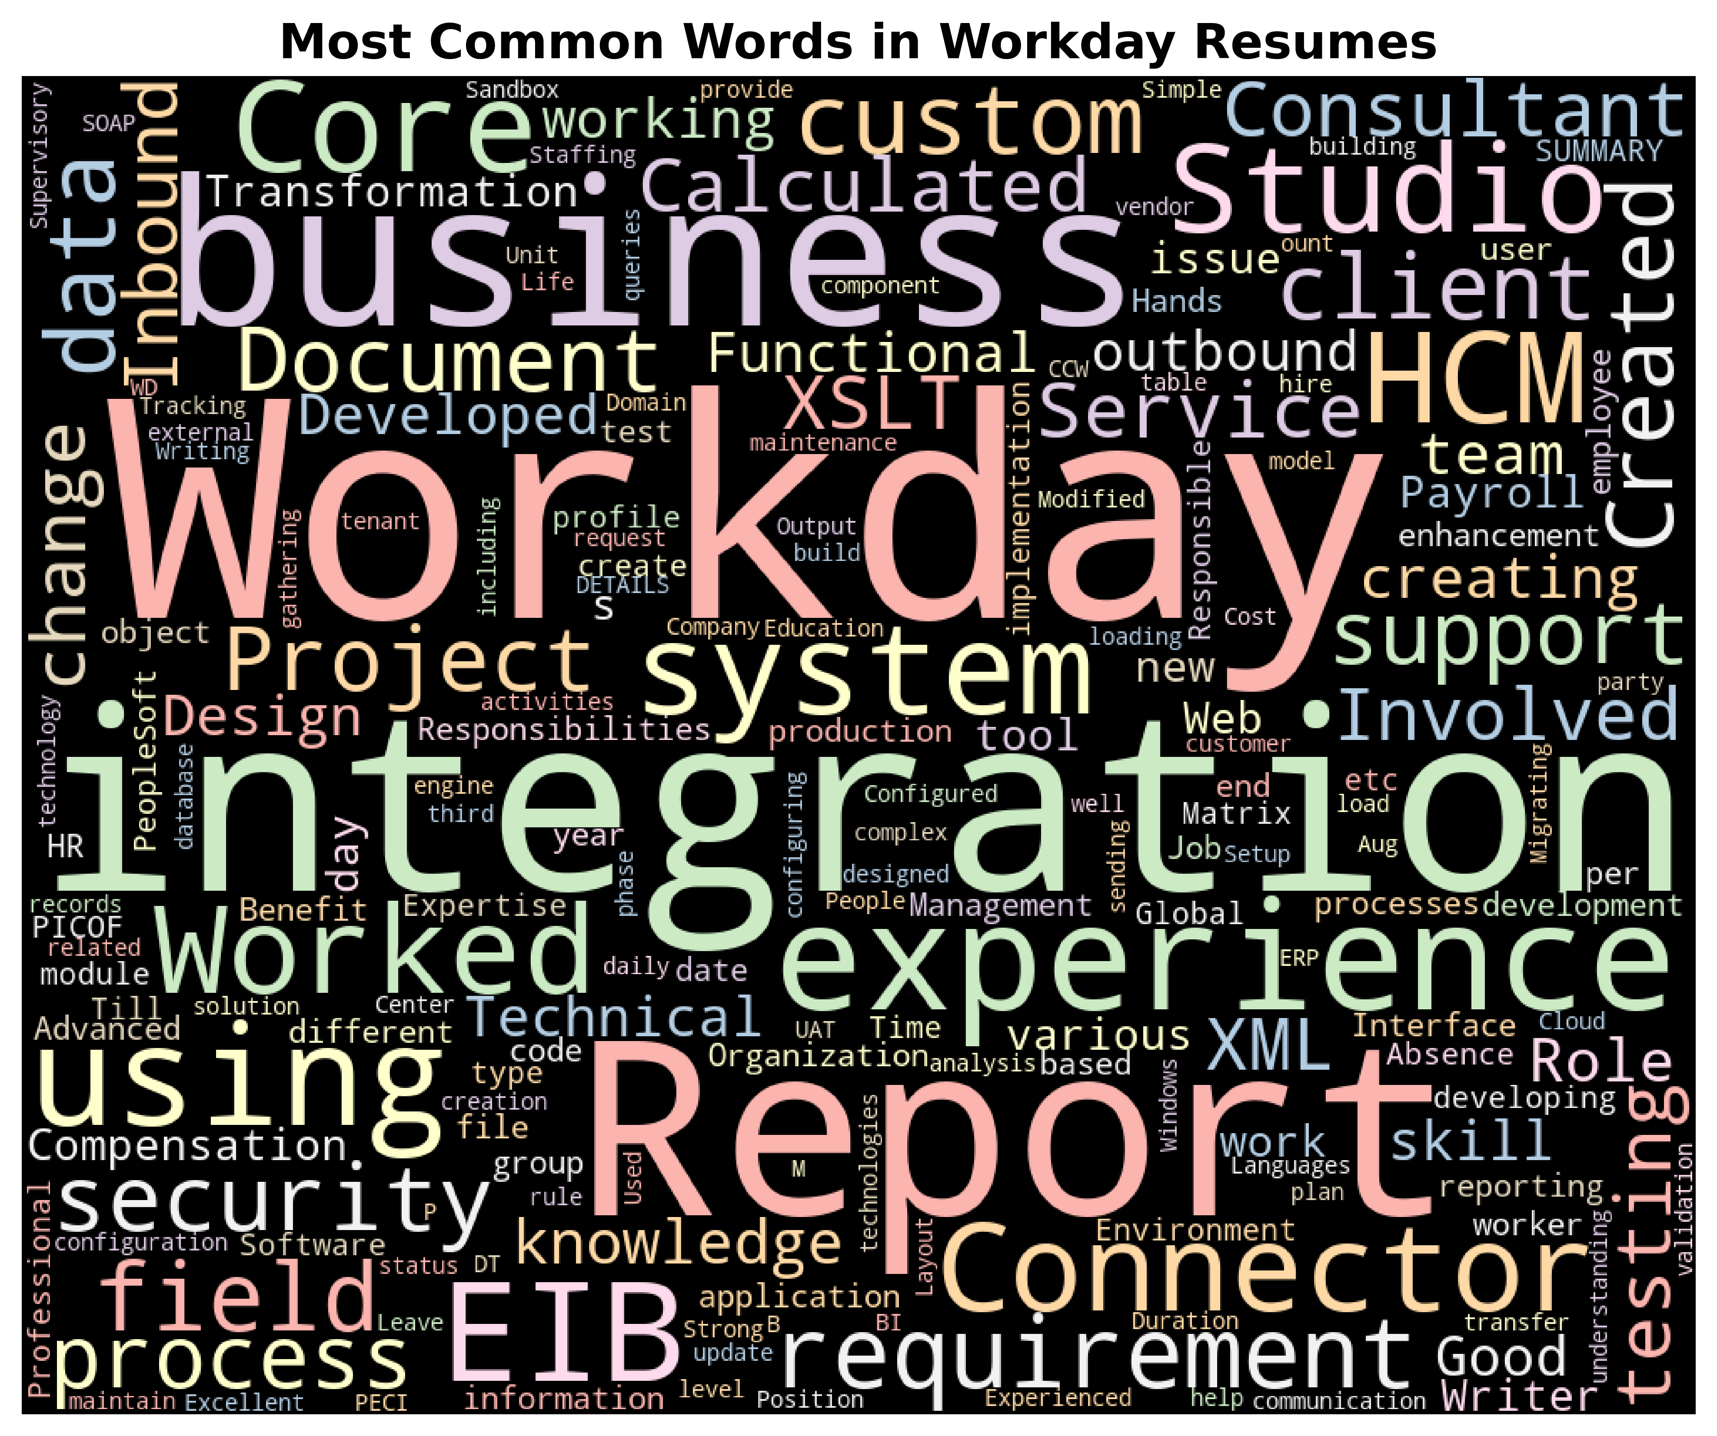
Word cloud:-

Slide 16
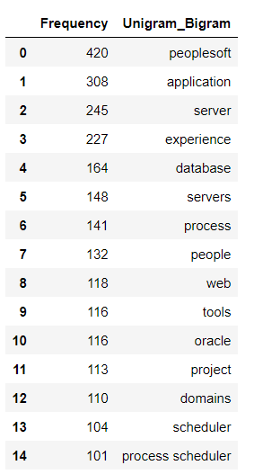
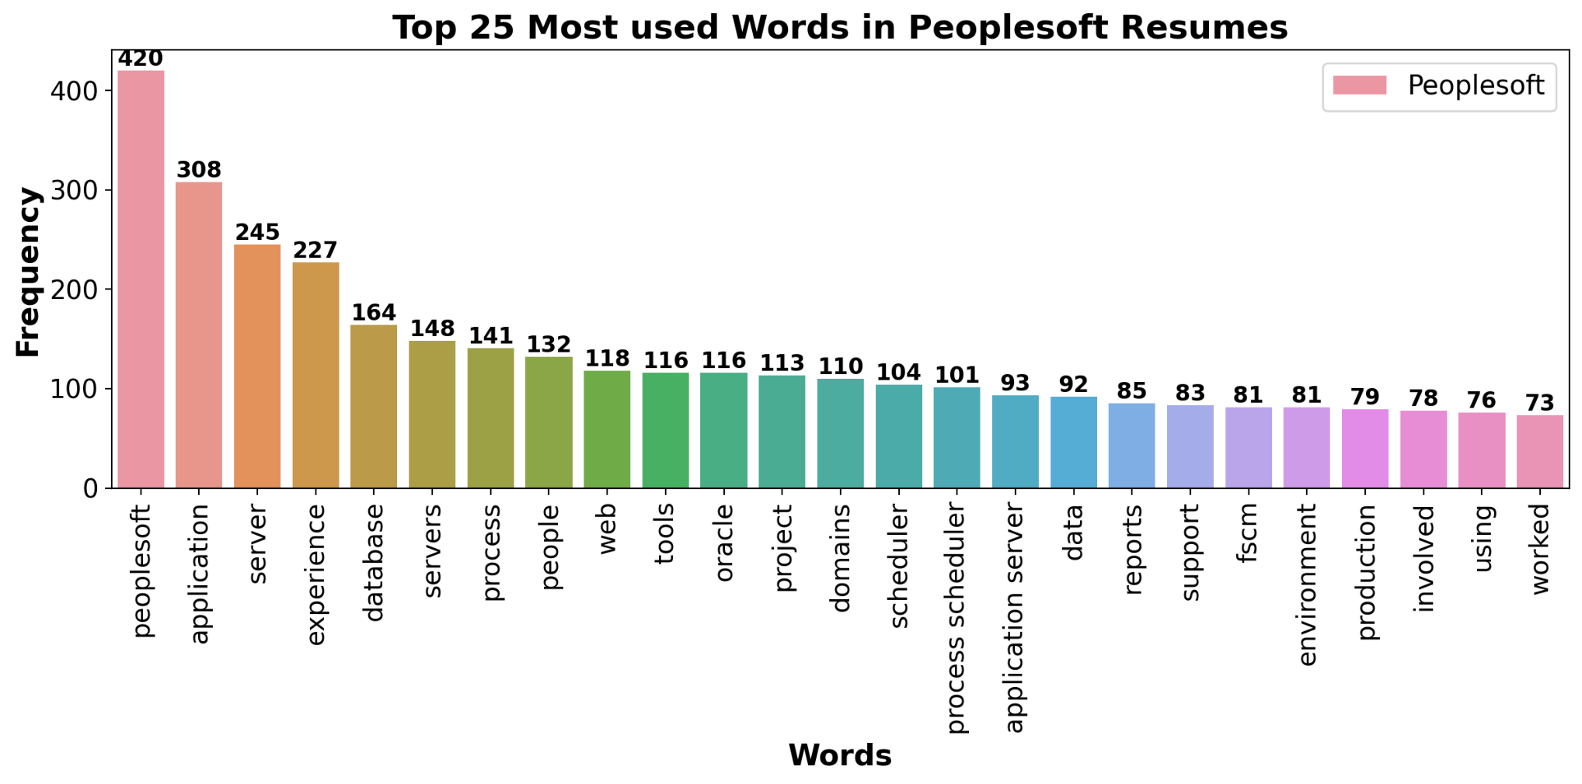
Peoplesoft
Most occurring words:-
The average experience for Peoplesoft is: 5.26 Years

Slide 17
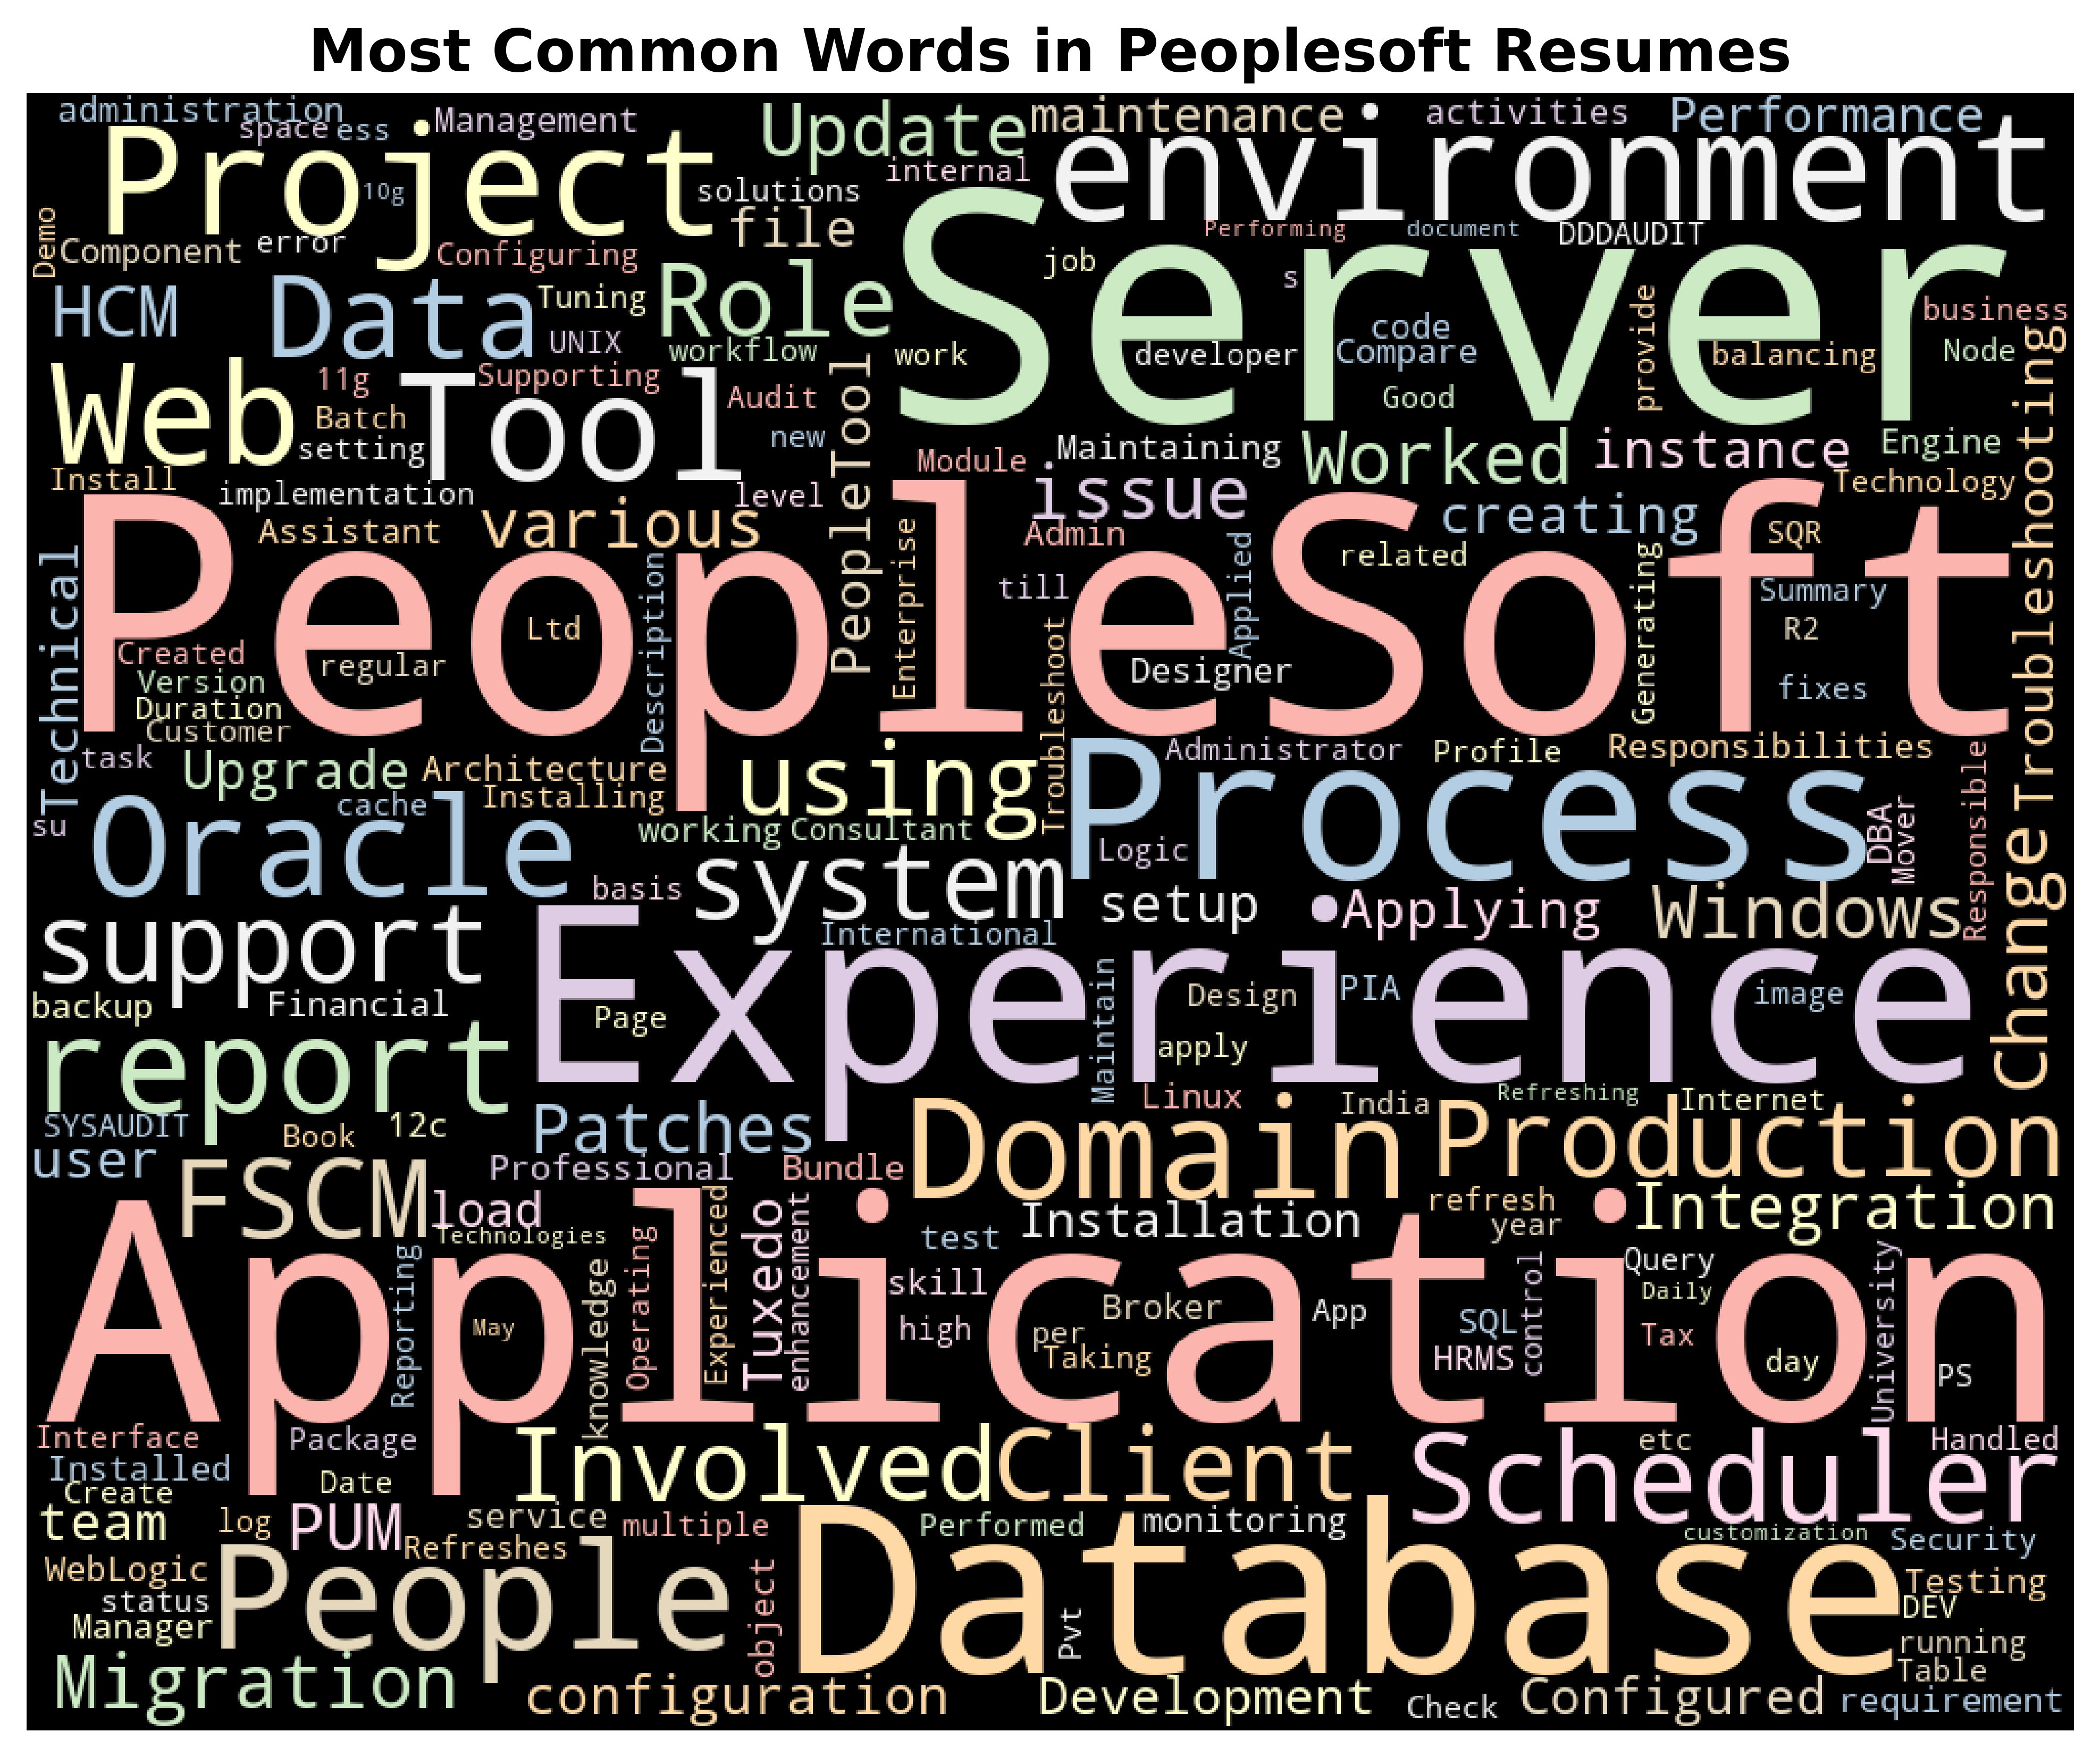
Word cloud:-

Slide 18
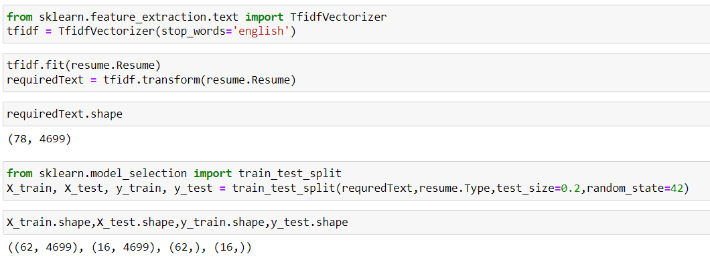
Modeling
TfidfVectorizer:-
Splitting dataset into train test set:-
Algorithm | Accuracy
KNN | 100
Logistic Regression | 93.75
Decision Tree | 100

Slide 19
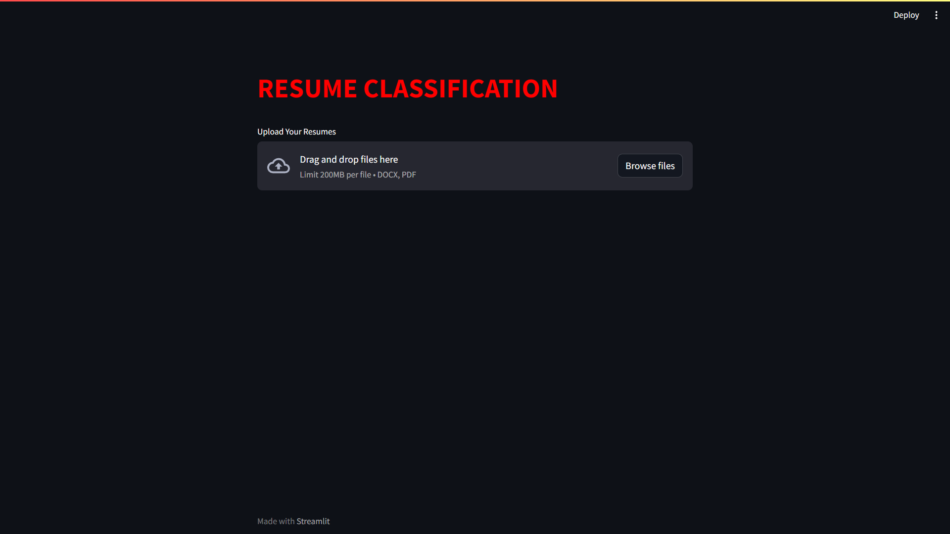
Deployment

Slide 20
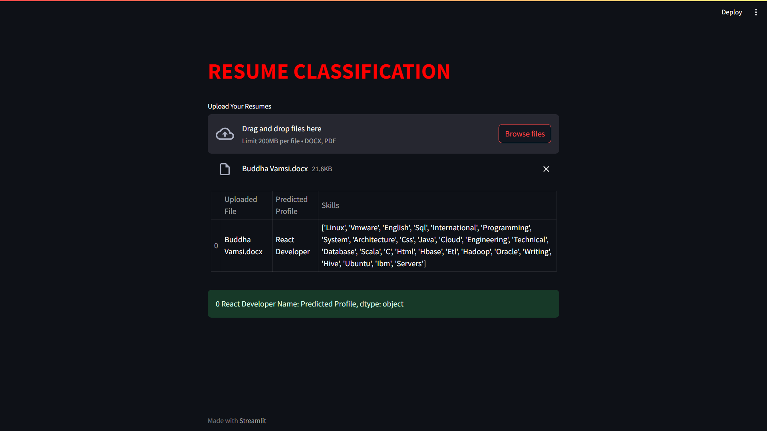

Slide 21
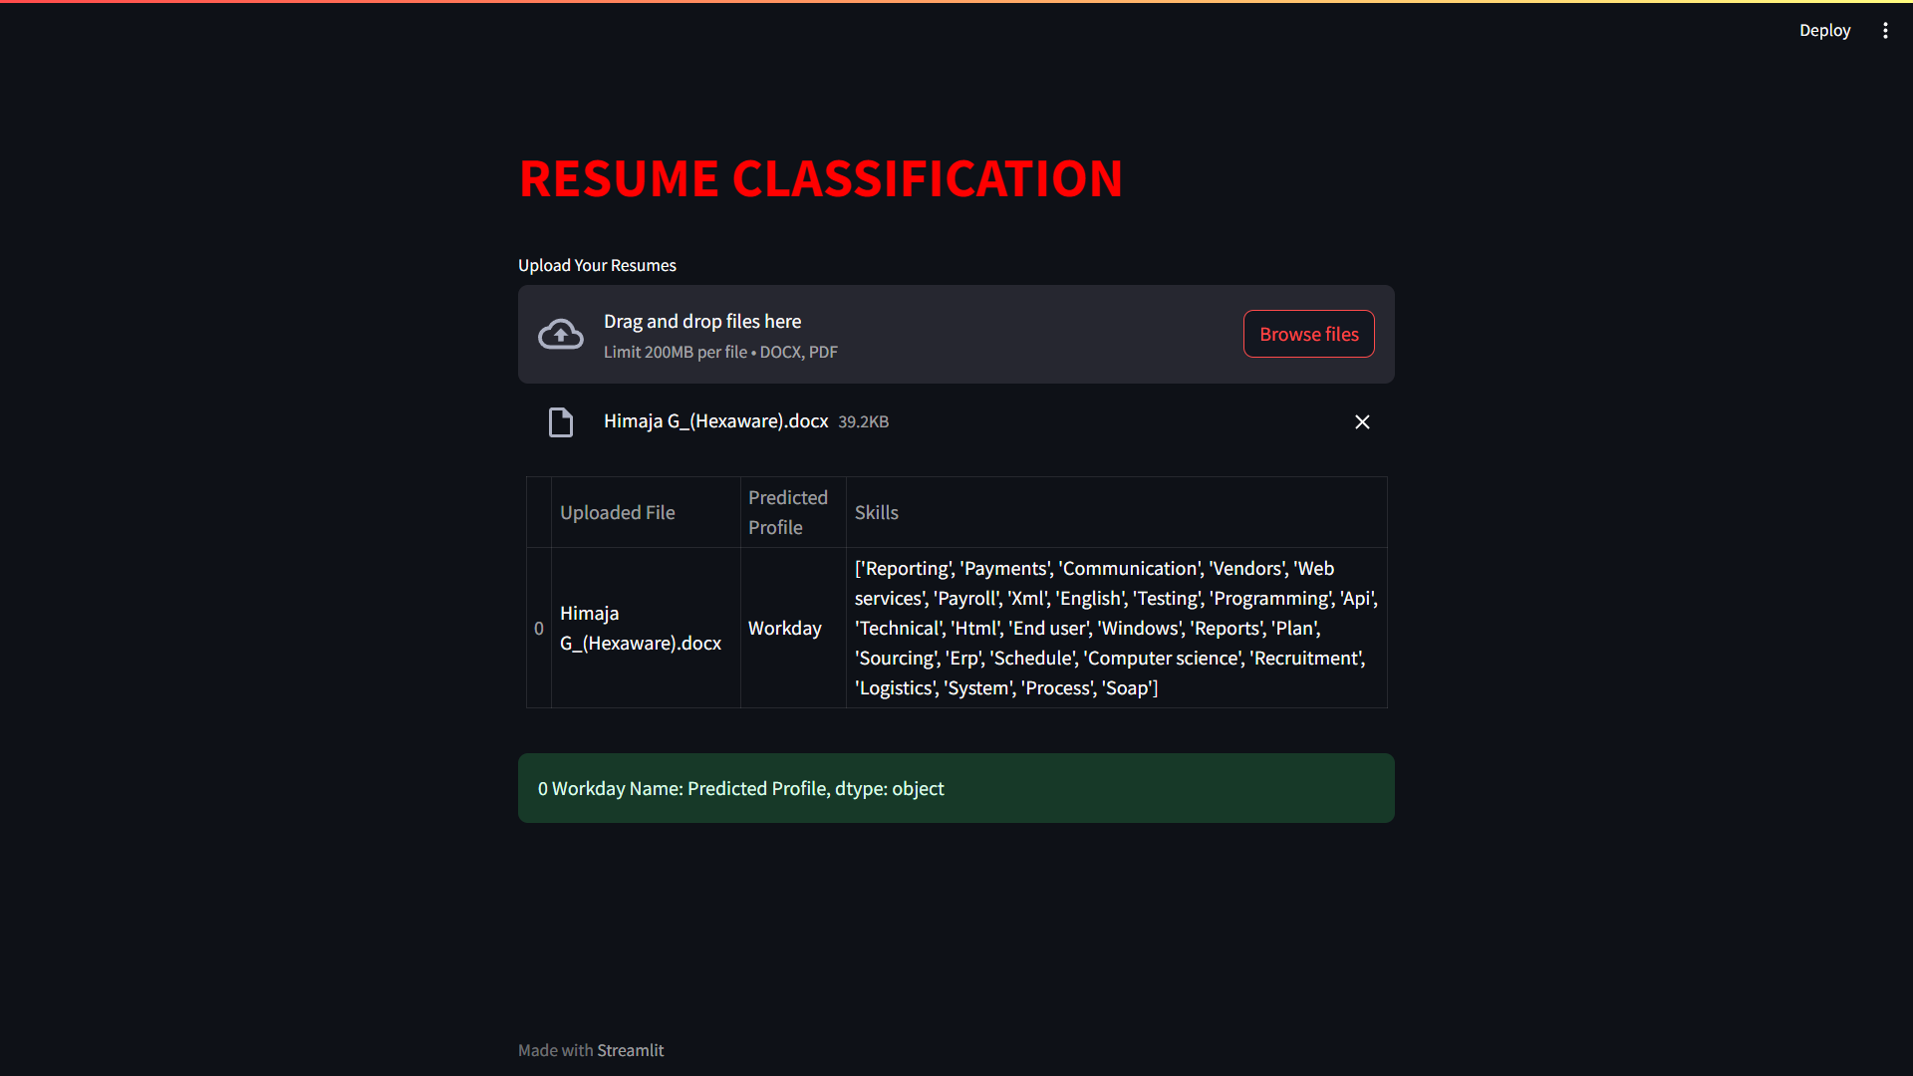

Slide 22
Thank You

