Slide 1

Axon Healthcare
Analysis Report
Data-Driven Insights • 2023–2025 | 10,000 Patients • 1,000 Doctors • 10,000 Visits
Excel
Power BI
Tableau
SQL / MySQL
Presented by: Axon Analytics Team

Slide 2
Table of Contents
01
Project Overview
05
Tableau Dashboard
Objectives, Scope & Tools Used
Visual Analytics & Deep Dive
02
KPI Summary
06
SQL Queries & Logic
Core Metrics at a Glance
Data Extraction Methodology
03
Excel Dashboard
07
Key Findings
Interactive Analysis in Excel
Insights from the Data
04
Power BI Dashboard
08
Conclusion
Business Intelligence View
Recommendations & Next Steps

Slide 3





01 • Project Overview
Project Objective
Data Source
Tools Used
Build a full-scale healthcare analytics system using real-world patient data
MySQL Database
healthcare_db
SQL • Excel • Power BI
Tableau • MySQL
Track key clinical & financial KPIs across 10,000 patients and 1,000 doctors
Analyse diagnosis trends, lab test results, and treatment costs
Dataset Size
Time Period
Deliver interactive dashboards in Excel, Power BI, and Tableau
10K Patients | 1K Doctors
10K Visits | 10K Lab Tests
March 2023 — March 2025
(25 Months of Data)
Enable data-driven decision-making for hospital management

Slide 4





02 • KPI Summary
Core metrics powering clinical and financial decisions
10,000
1,000
10,000
10,000
Total Patients
Total Doctors
Total Visits
Lab Tests
5.25M
$524.75
49
49.84%
Total Revenue ($)
Avg Cost / Visit
Avg Patient Age
Follow-Up Rate

Slide 5
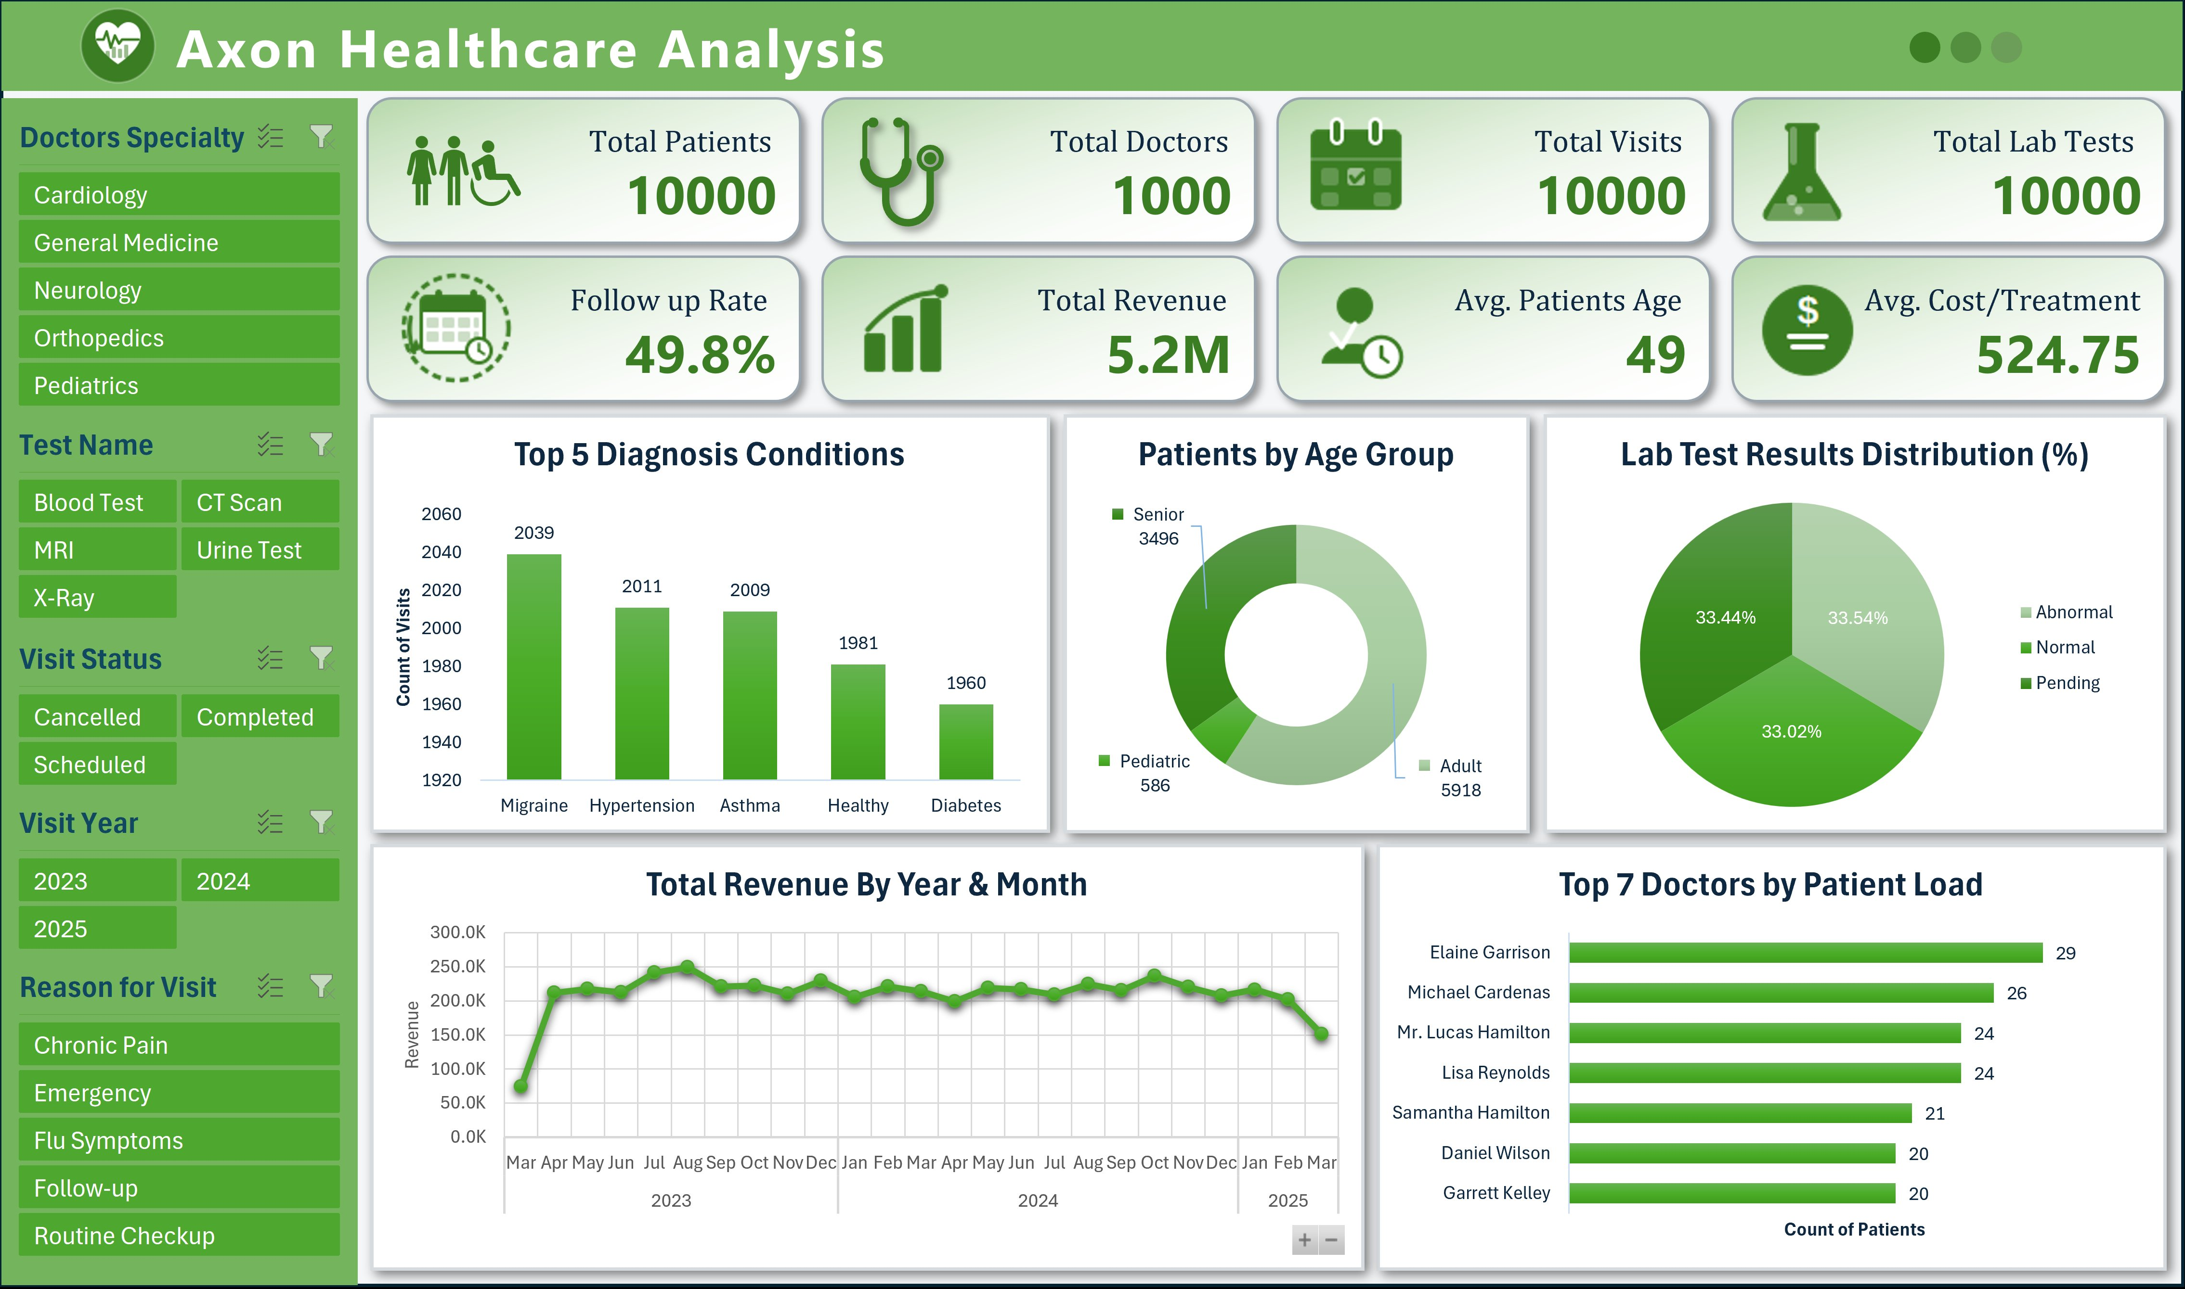
03 • Excel Dashboard
Highlights
8 KPI cards with icons
Top 5 Diagnosis bar chart
Age Group donut chart
Lab Results distribution
Revenue trend line (2023–25)
Top 7 Doctors by workload
5 interactive filter slicers

Slide 6
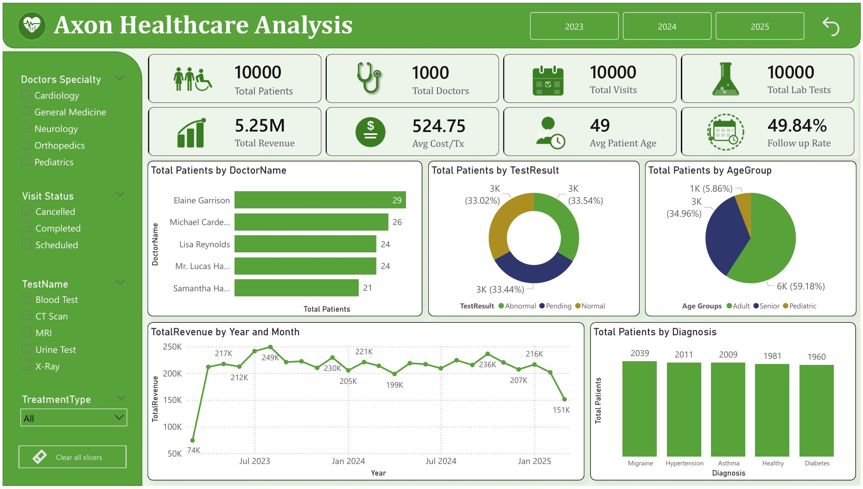
04 • Power BI Dashboard
Highlights
Year filter: 2023 / 2024 / 2025
Doctor workload bar chart
Lab result donut (3 segments)
Age group pie chart
Revenue by Year & Month line
Diagnosis bar chart
Specialty & status slicers

Slide 7
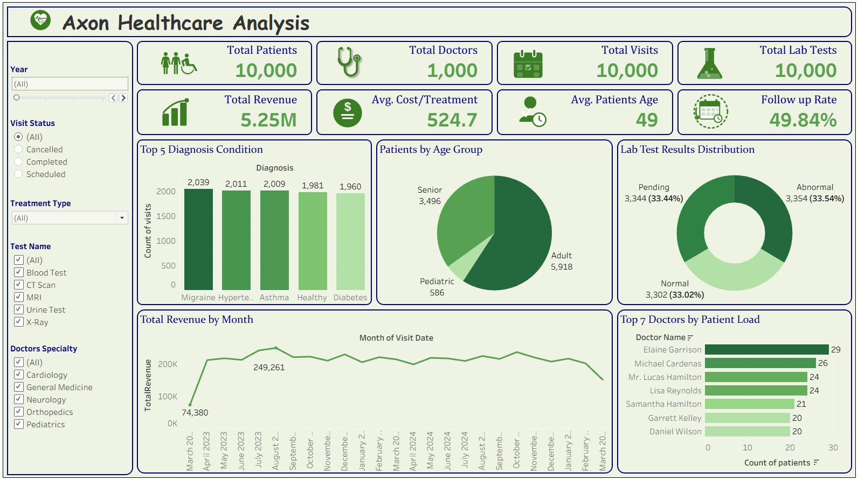
05 • Tableau Dashboard
Highlights
Year, Visit Status & Treatment filters
Test Name & Specialty slicers
Top 5 Diagnosis bar chart
Patients by Age Group donut
Lab Test Results distribution
Monthly revenue trend line
Top 7 Doctors by patient load

Slide 8
06 • SQL Queries & Logic
Core KPI Queries
Diagnosis & Visit Analysis
Revenue Trend (Year & Month)
SELECT COUNT(PatientID) AS total_patients FROM patients;
SELECT COUNT(DoctorID) AS total_doctors FROM doctors;
SELECT ROUND(SUM(TreatmentCost),2) AS total_revenue FROM treatments;
SELECT ROUND(AVG(Age)) AS avg_patient_age FROM patients;
SELECT Diagnosis, COUNT(VisitID) AS total_patients
FROM visits GROUP BY Diagnosis
ORDER BY total_patients DESC LIMIT 5;
SELECT ROUND(SUM(FollowUpFlag)/COUNT(VisitID)*100,2) AS followup_rate FROM visits;
SELECT YEAR(v.VisitDate) AS year,
MONTHNAME(MIN(v.VisitDate)) AS month,
ROUND(SUM(t.TreatmentCost),2) AS monthly_revenue
FROM treatments t JOIN visits v ON t.VisitID=v.VisitID
Additional queries: Lab test distribution, Age group segmentation, Doctor workload, Patient full-profile view (vw_PatientFullProfile)

Slide 9
07 • Key Findings

Slide 10
07 • Key Findings (continued)

Slide 11
08 • Conclusion & Recommendations
Top Diagnosis
Patient Profile
Lab Results
Migraine leads with 2,039 cases, followed closely by Hypertension (2,011) and Asthma (2,009)
59% Adults • 35% Seniors • 6% Pediatric. Average age is 49 — focus on chronic disease management
One-third abnormal results (33.54%) demand urgent diagnostic review and follow-up protocols
Financial Health
Follow-Up Gap
Doctor Workload
$5.25M total revenue over 25 months with avg cost of $524.75 per visit. Revenue dipped in 2025
Only 49.84% follow-up rate means half of patients are not returning — patient retention needs improvement
Elaine Garrison leads with 29 patients. Workload is relatively balanced across top doctors

Slide 12
Thank You
Axon Healthcare Analysis • 2023 – 2025
Built with SQL • Excel • Power BI • Tableau
Data speaks. Decisions follow.

