Slide 1
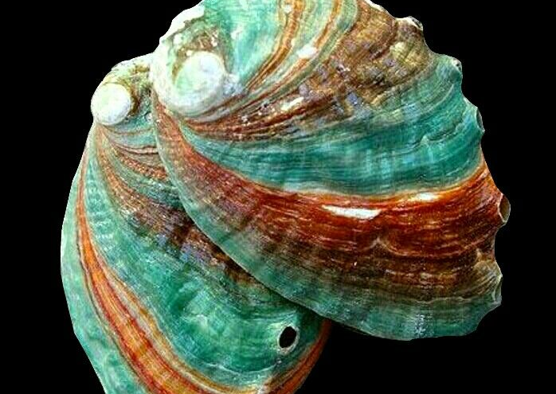
ABALONE DATASET
Data Analysis & Cleaning
Introduction To Machine Learning
PRESENTED BY:
YASH PAWAR (1332240242)
Gaurika Ghosh (1332240386)

Slide 2
About the Dataset
This dataset contains physical measurements of abalone, a marine organism.
The goal is to analyze how different measurements relate to each other.
The dataset includes 8 numerical features plus Rings, which is a count of rings on the shell.
Commonly used for data analysis, pattern identification, and machine learning tasks.

Slide 3
Column Descriptions
Length: Longest measurement of the shell
Diameter: Width measured across the shell
Height: Height including shell
Whole Weight: Weight of the entire abalone
Shucked Weight: Weight of the meat
Viscera Weight: Weight of the internal organs
Shell Weight: Weight of the dried shell
Rings: Count of visible rings on the shell

Slide 4
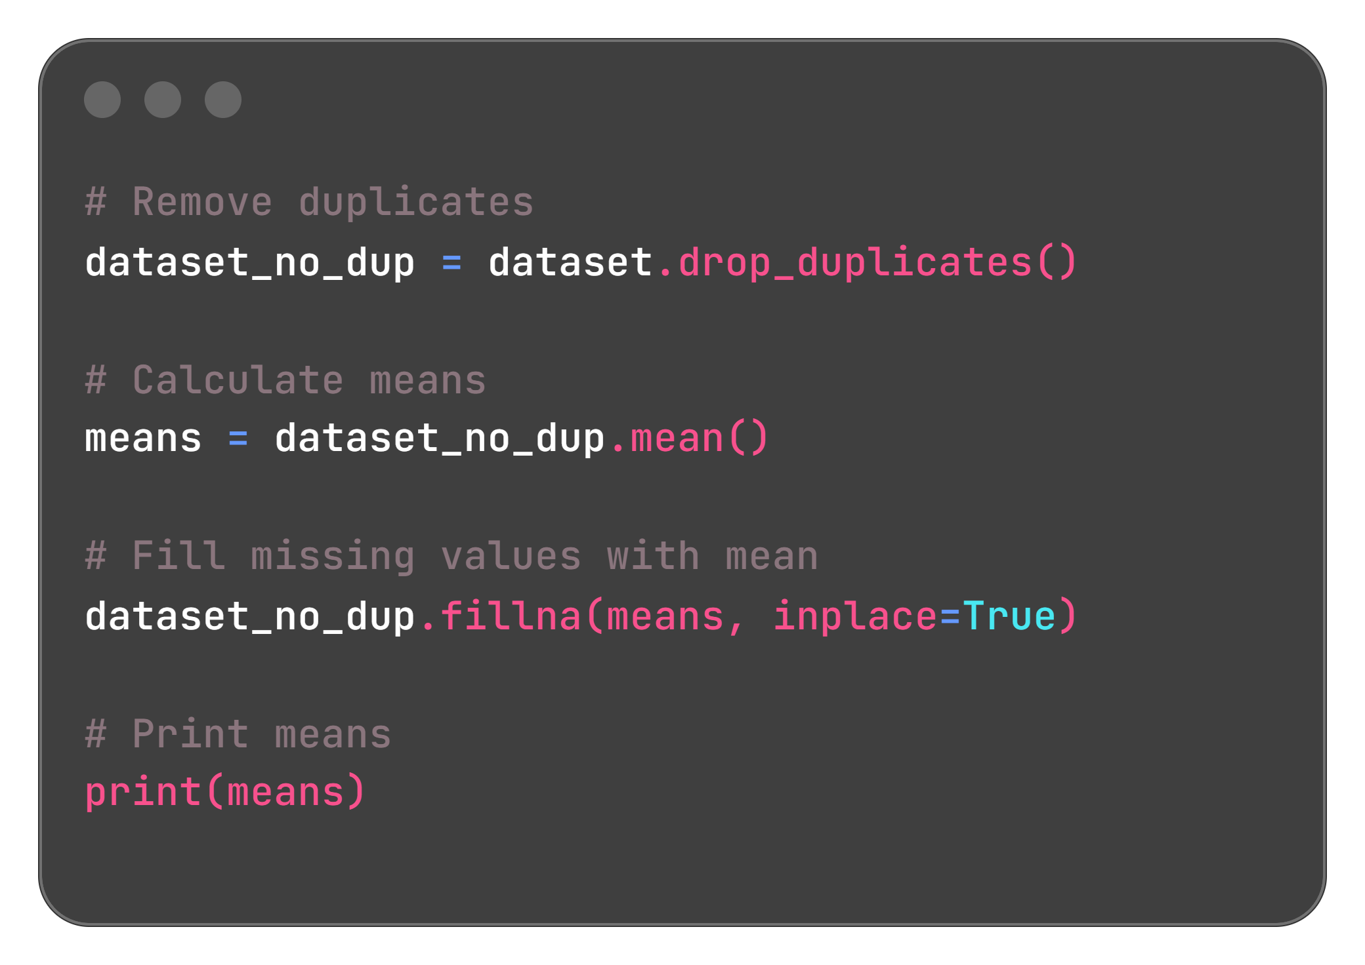
CODE:
The code removes duplicate rows, calculates column means, fills missing values with those means, and prints the averages.

Slide 5
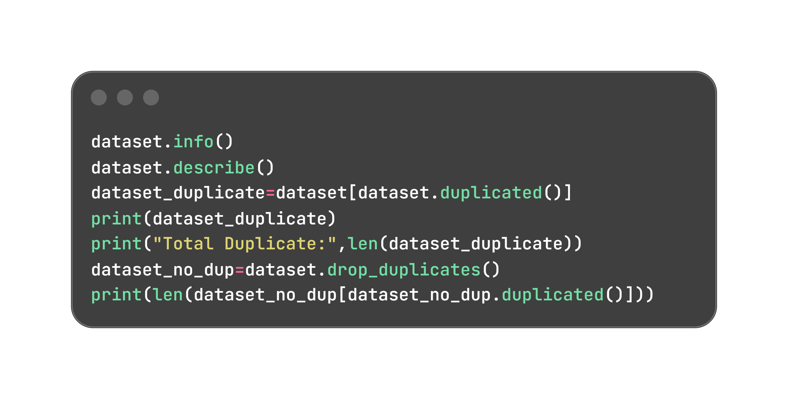
Functions Used in Data Cleaning
df.Fillna(df.Mean()) – Fill Missing Numeric Values With Mean
df.Drop_duplicates() – Remove Duplicate Rows
df.Describe() – View Summary Statistics
df.Info() – Quick Summary Of A Dataframe.

Slide 6
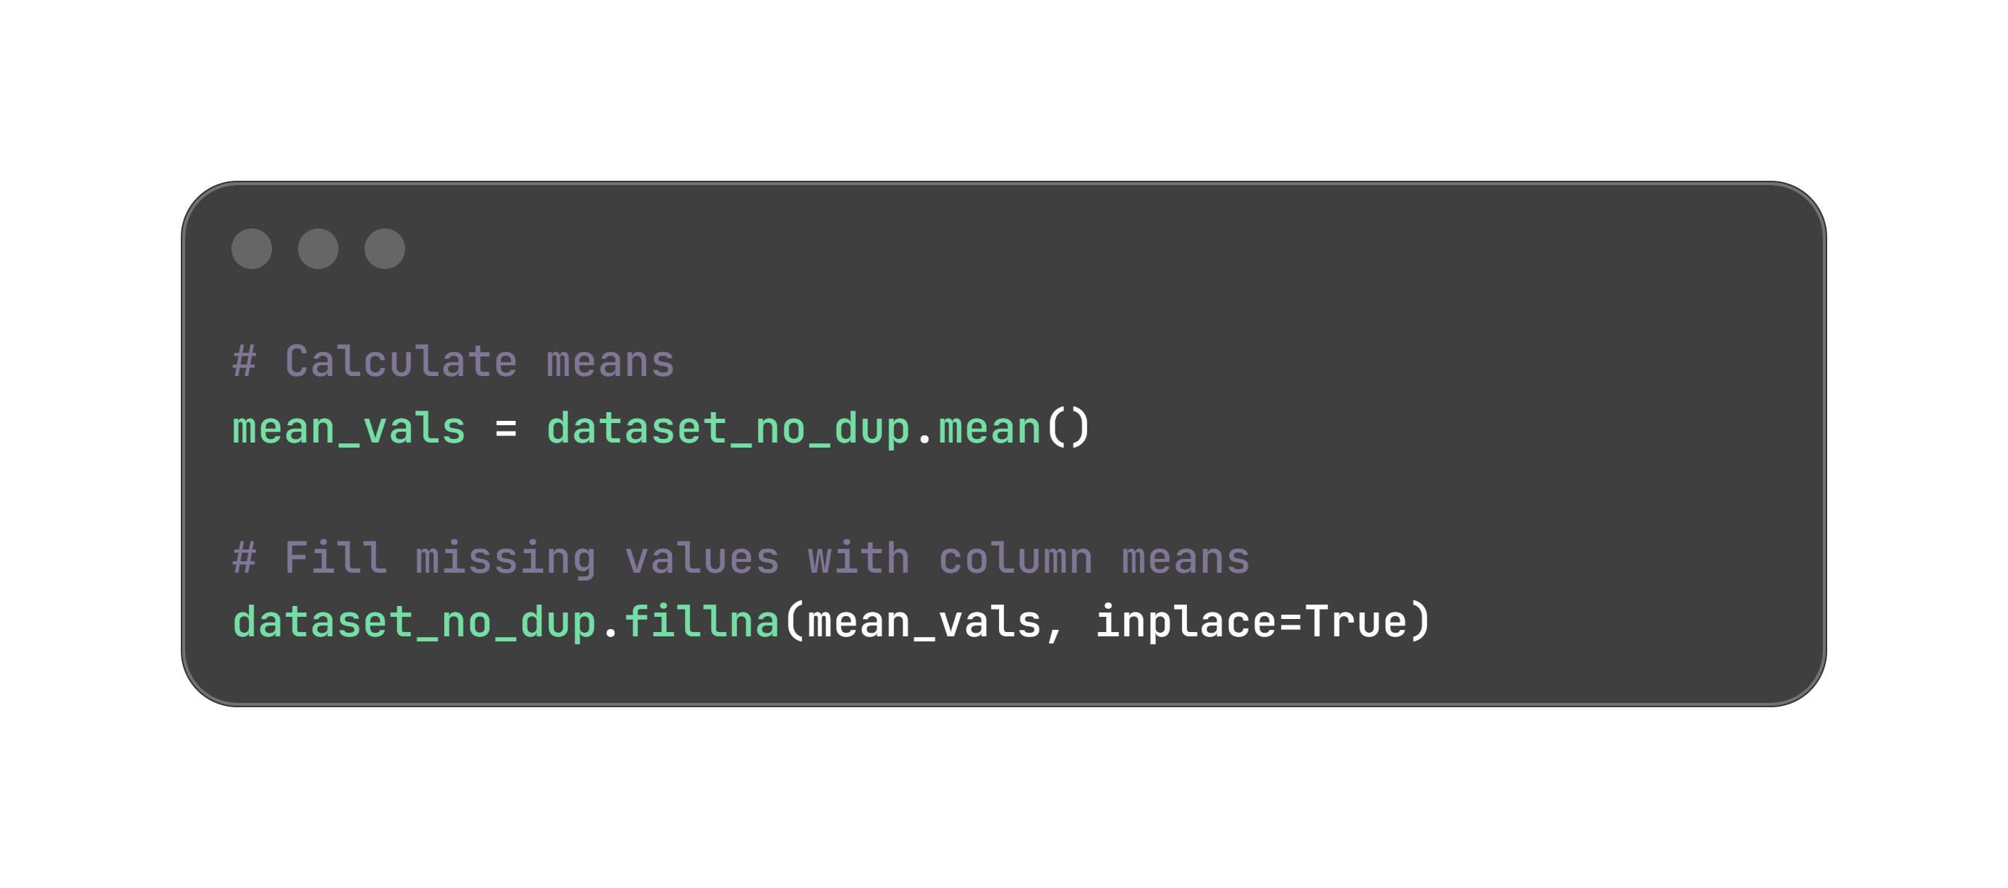
Handling Missing Values
Missing values can affect accuracy
Models may fail or give wrong results
Data must be clean before analysis

Slide 7
Before Vs After Cleaning
Column | With Duplicate | Without Duplicate | After
ID | 4182 non-null | 4177 non-null | 4177 non-null
Length | 4163 non-null | 4158 non-null | 4177 non-null
Diameter | 4159 non-null | 4155 non-null | 4177 non-null
Height | 4158 non-null | 4153 non-null | 4177 non-null
Whole weight | 4153 non-null | 4148 non-null | 4177 non-null
Shucked weight | 4152 non-null | 4147 non-null | 4177 non-null
Viscera weight | 4153 non-null | 4148 non-null | 4177 non-null
Shell weight | 4160 non-null | 4155 non-null | 4177 non-null
Rings | 4181 non-null | 4176 non-null | 4177 non-null

Slide 8
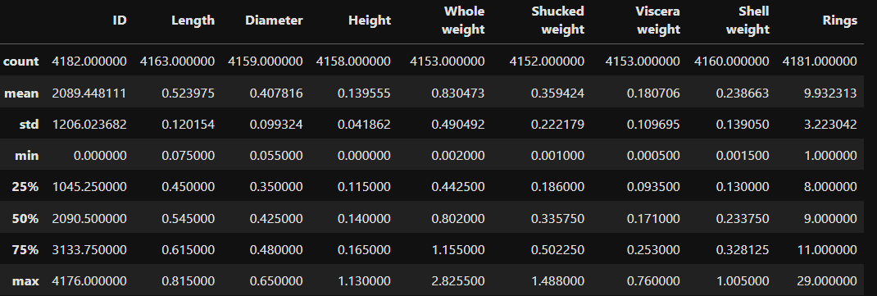
Summary Statistics
The dataset has 4182 entries with different size and weight measurements.
Length, diameter, and height show moderate variation.
Weight features show larger variation due to differences in body mass.
Rings mostly fall between 8 and 11.
Minimum and maximum values show the smallest and largest specimens in the dataset.
After cleaning change in only Count that become 4177 values in each Column.

Slide 9
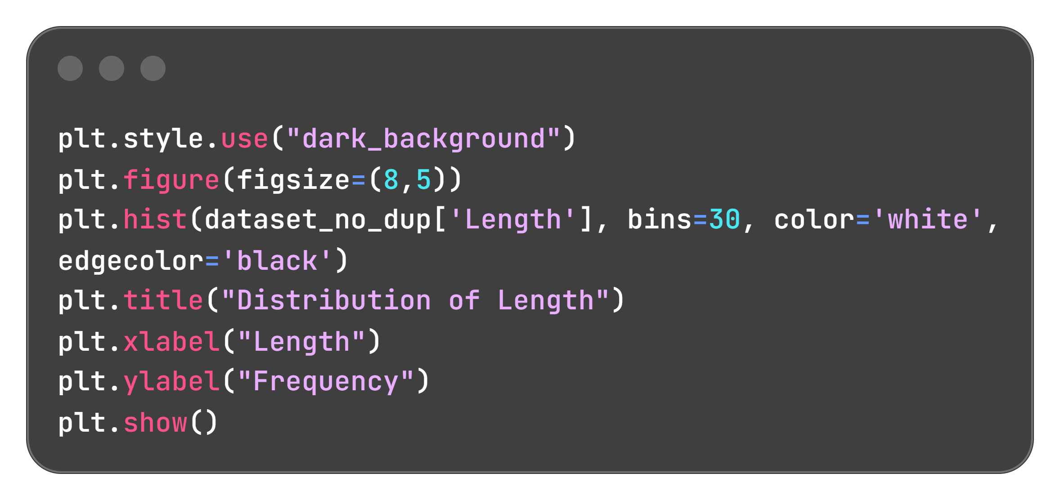
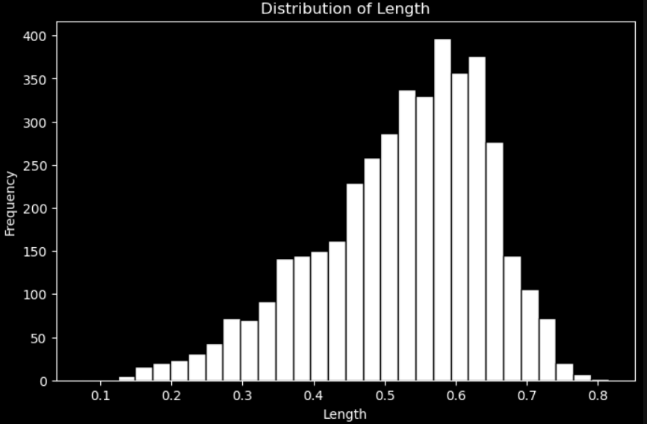
Distribution of Length
The shell length data mostly ranges from 0.45 to 0.65, with fewer extreme values. It shows the overall size pattern and is slightly right-skewed.

Slide 10
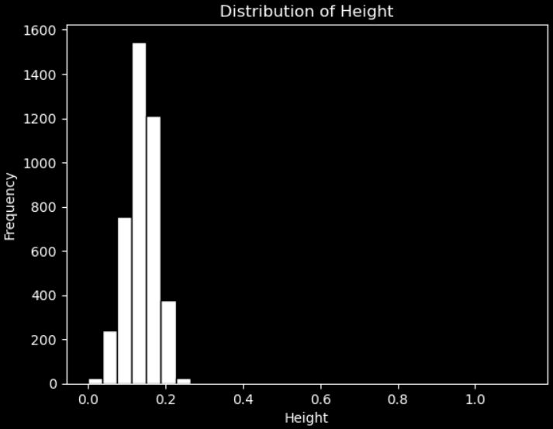
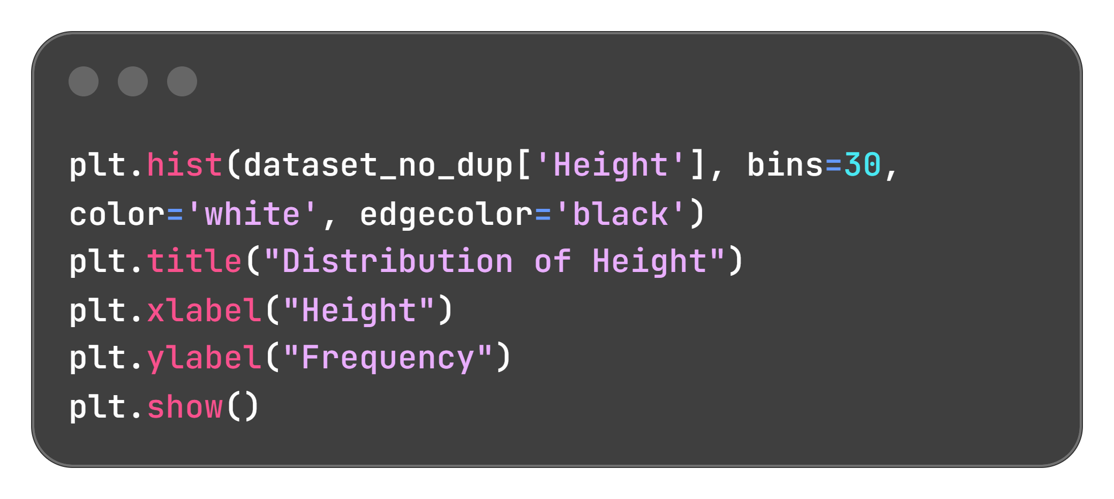
Distribution of Height
Most height values are between 0.10 and 0.20, with little variation and few extremes, showing the general thickness pattern of abalones.

Slide 11
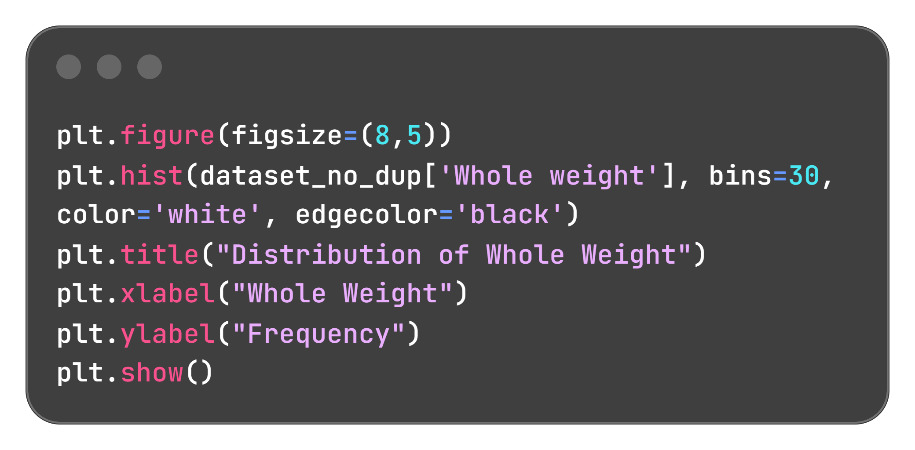
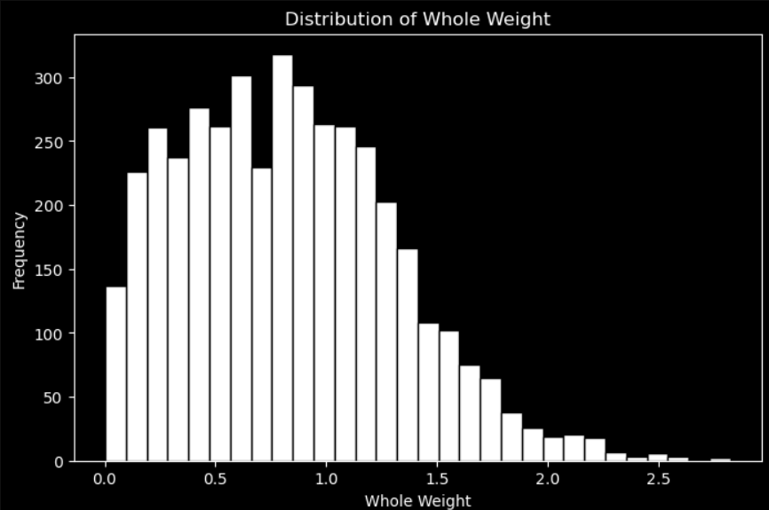
Distribution of Whole Weight
Whole-weight values mostly fall between 0.3 and 1.2, with fewer extremes. The distribution decreases at higher weights, showing overall size and mass variation in abalones.

Slide 12
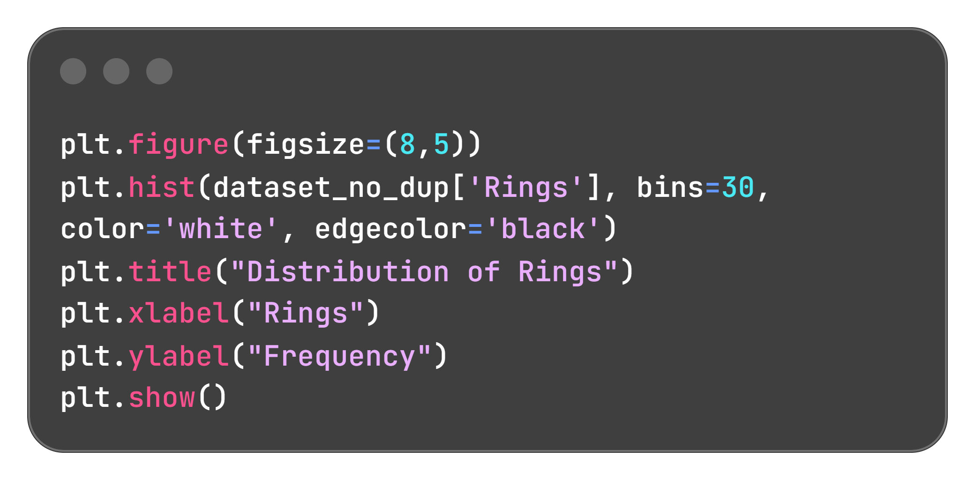
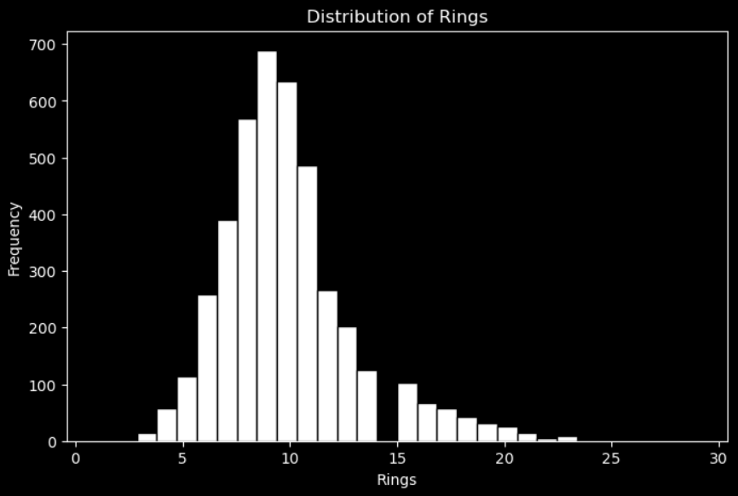
Distribution of Rings
Most abalones have 7 to 12 rings, while very low and very high counts are rare. The distribution is slightly right-skewed, helping show the overall pattern of ring variation.

Slide 13
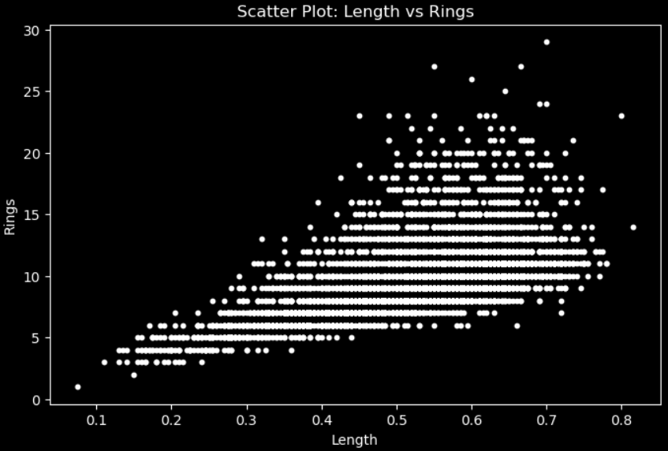
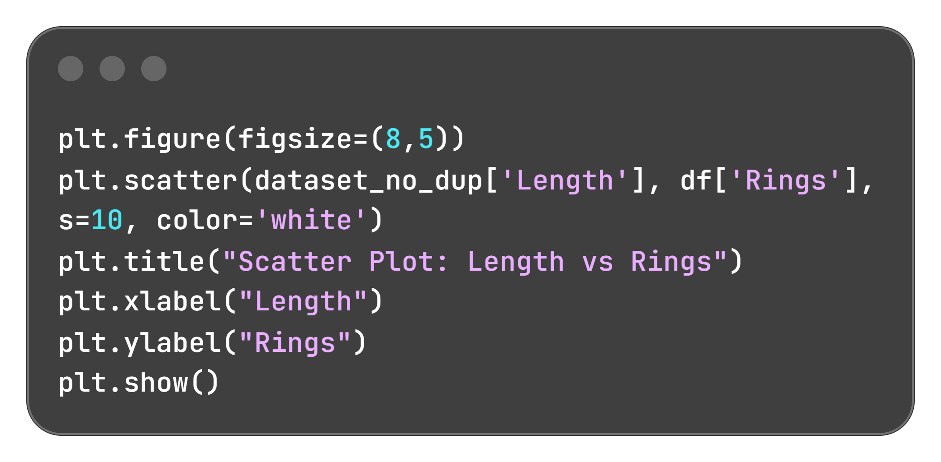
Scatter Plot: Length Vs Rings
The plot shows a positive link between length and rings—longer abalones usually have more rings, helping reveal growth trends.

Slide 14
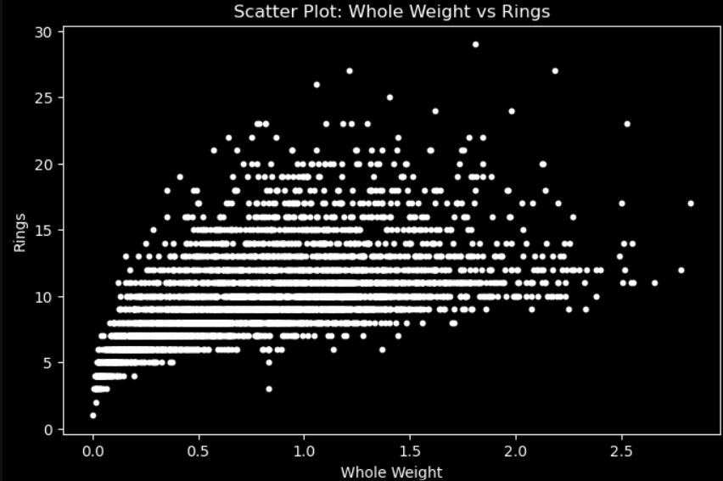
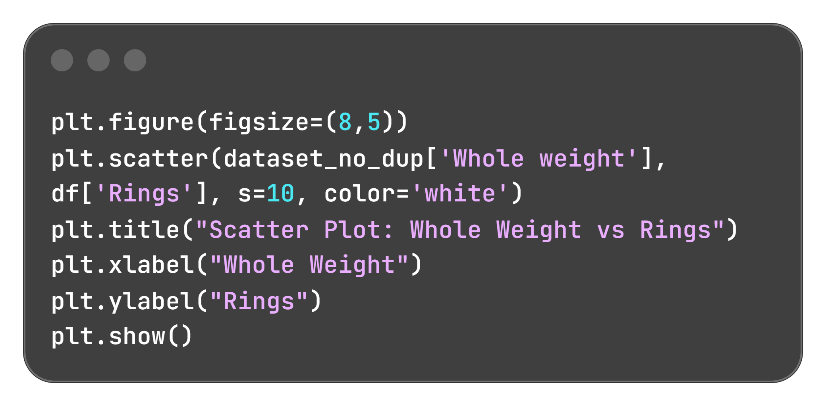
Scatter Plot: Whole Weight Vs Rings
The plot shows a clear positive trend: heavier abalones tend to have more rings, with most samples clustered in the mid-weight range.

Slide 15
Key Insights
Length, Height, and Whole Weight show clear distribution patterns, with most values in a central range.
Rings distribution shows most samples fall between mid-range ring counts.
Scatter plots reveal strong positive patterns — as length and whole weight increase, ring counts also increase.
Weight-based features show greater variation than size features.
All graphs together show consistent relationships among measurements.
These trends make the dataset suitable for pattern analysis, feature exploration, and predictive modeling.

Slide 16
THANK YOU

